Slide 1
U.S. Army Offensive Cyber Operations
1LT Daniel Lim
780th MI BDE

Slide 2



What is “Cyber?”

Slide 3

What is “Cyber?”

Slide 4
What is “Cyber?”
Cyberspace Operations
Defensive Cyberspace Operations
(DCO)
Offensive Cyberspace Operations
(OCO)
Defense
Response
Espionage
Attack
DODIN Ops (Network Maintenance)

Slide 5



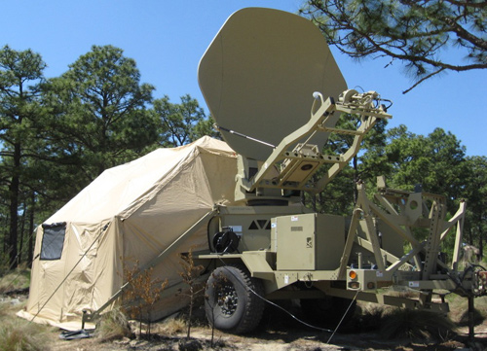

Army Cyber

Slide 6


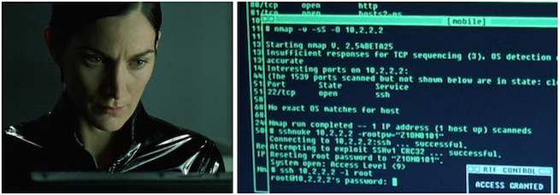
Offensive Cyber

Slide 7
Network / Host based OCO
Recon
Intrusion
Achieve Effects
Cleanup
Identify the target system / network
Find vulnerabilities
Exploit vulnerabilities
Gain access to the target system / network
Gather intel
Disrupt / destroy opposition capabilities, infrastructure, etc.
Erase evidence
Undermine opposition’s ability to trace

Slide 8
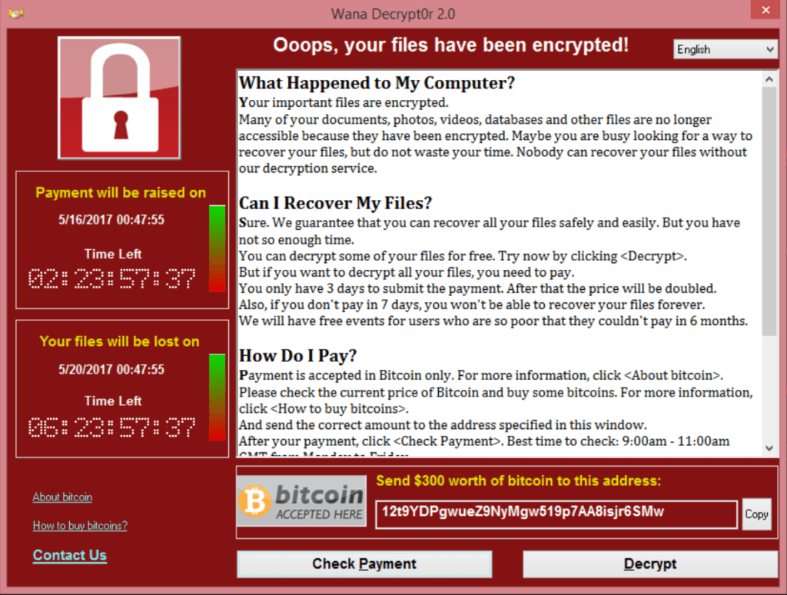
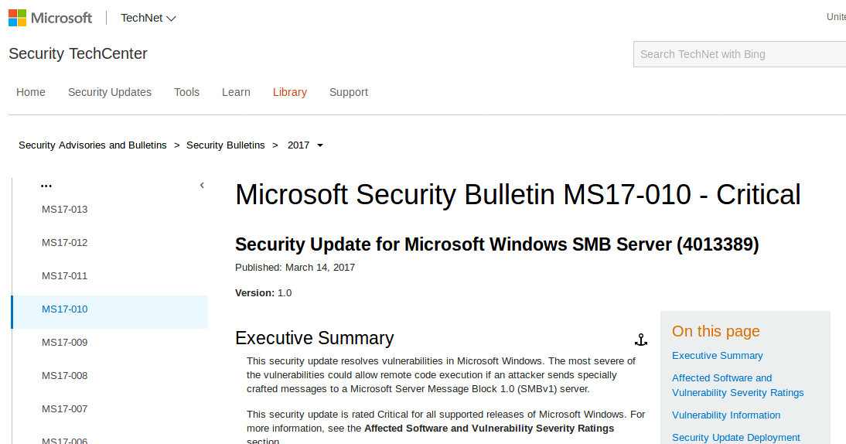
MS17-010

Slide 9
Offensive Cyber Demonstration
Exploiting a Target with MS17-010

