Slide 1
An Intro to Cyber Security & Army Cyber
1LT Daniel Lim
ARCYBER HQ
2LT Ken McGaffey
CTB
R00tz 2018 // DEFCON 26

Slide 2

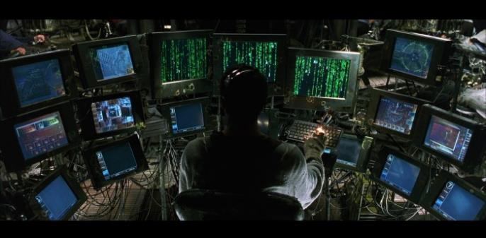

What is “Cyber?”

Slide 3

What is “Cyber?”

Slide 4
What is “Cyber?”
Cyberspace Operations
Defensive Cyberspace Operations
(DCO)
Offensive Cyberspace Operations
(OCO)
Defense
Response
Espionage
Attack
DODIN Ops (Network Maintenance)

Slide 5

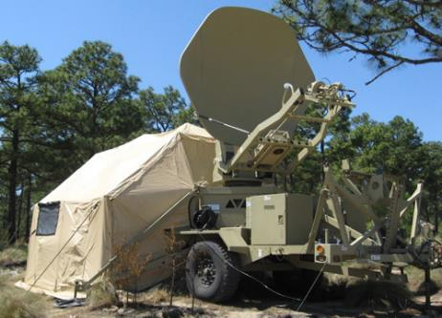
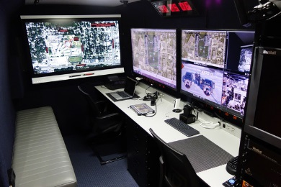
Army Cyber

Slide 6
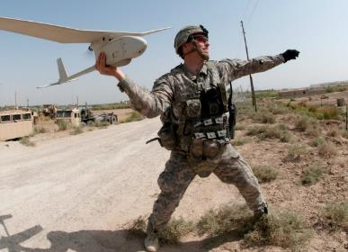
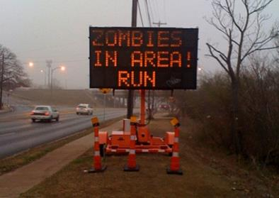
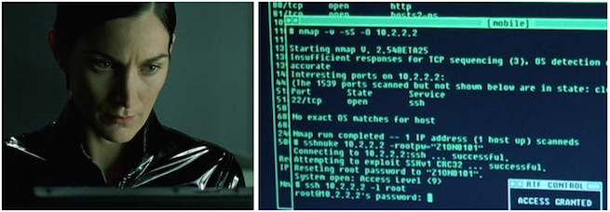
Examples of Cyber

Slide 7
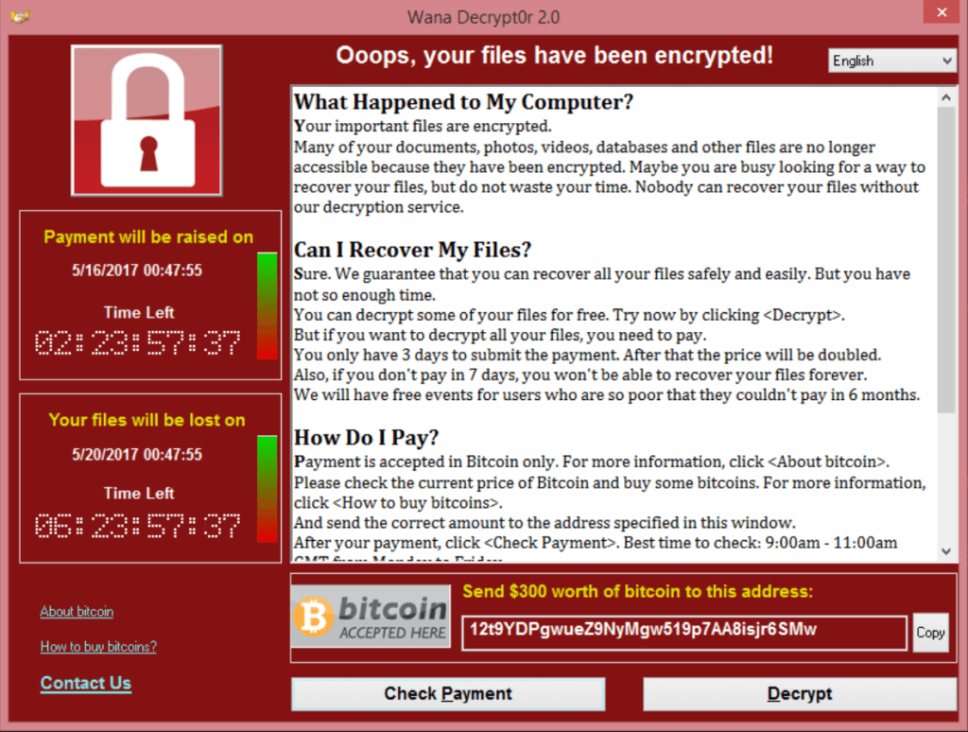
Offensive Cyber
Reconnaissance
Exploitation
Effects
Cleanup
Exploit vulnerabilities
Gain access to the target system / network
Gather intel
Disrupt / destroy opposition capabilities, infrastructure, etc.
Identify the target system / network
Find vulnerabilities
Erase evidence
Undermine opposition’s ability to trace

Slide 8

How to Defend?
“Defense in Depth”
Valuables hidden deep inside keep
Guards watch from towers
Guards patrol inside & catch intruders
Gate allows authorized entrants
Inner walls hinder intruders who get in
Moat & outer wall keep intruders out

Slide 9
Defensive Cyber
Protect
Detect
Respond
Keep an eye on potential threats and weak points
Know when an actual threat gets in
Neutralize a threat when it becomes reality
Protect friendly forces and critical infrastructure
Keep threats outside
Let friendlies in

Slide 10
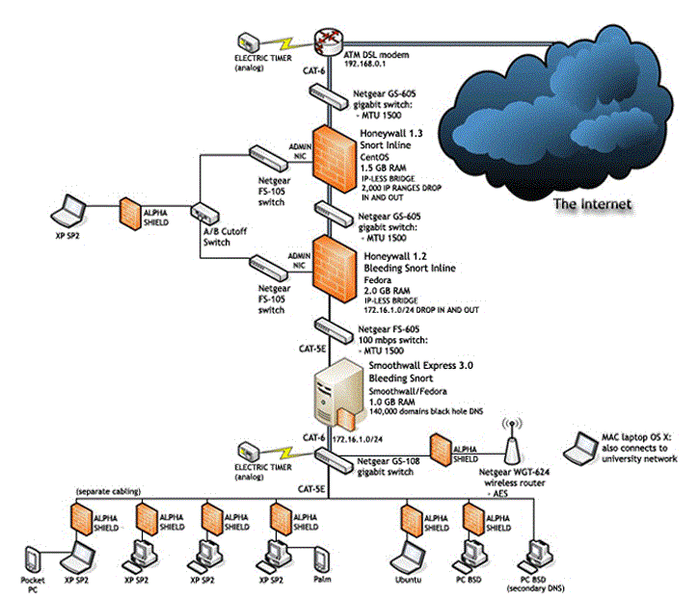
How to Defend?
OOB station for threat response
OOB Timers to shut off Internet
IPS to surveil & automate response
Multiple Firewalls
Encryption on WiFi

Slide 11

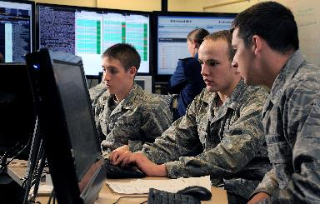
Practical Exercises

Slide 12
Lab Time!
Let’s put these concepts into practice:
https://danielklim.github.io/r00tz2018/

