Slide 1
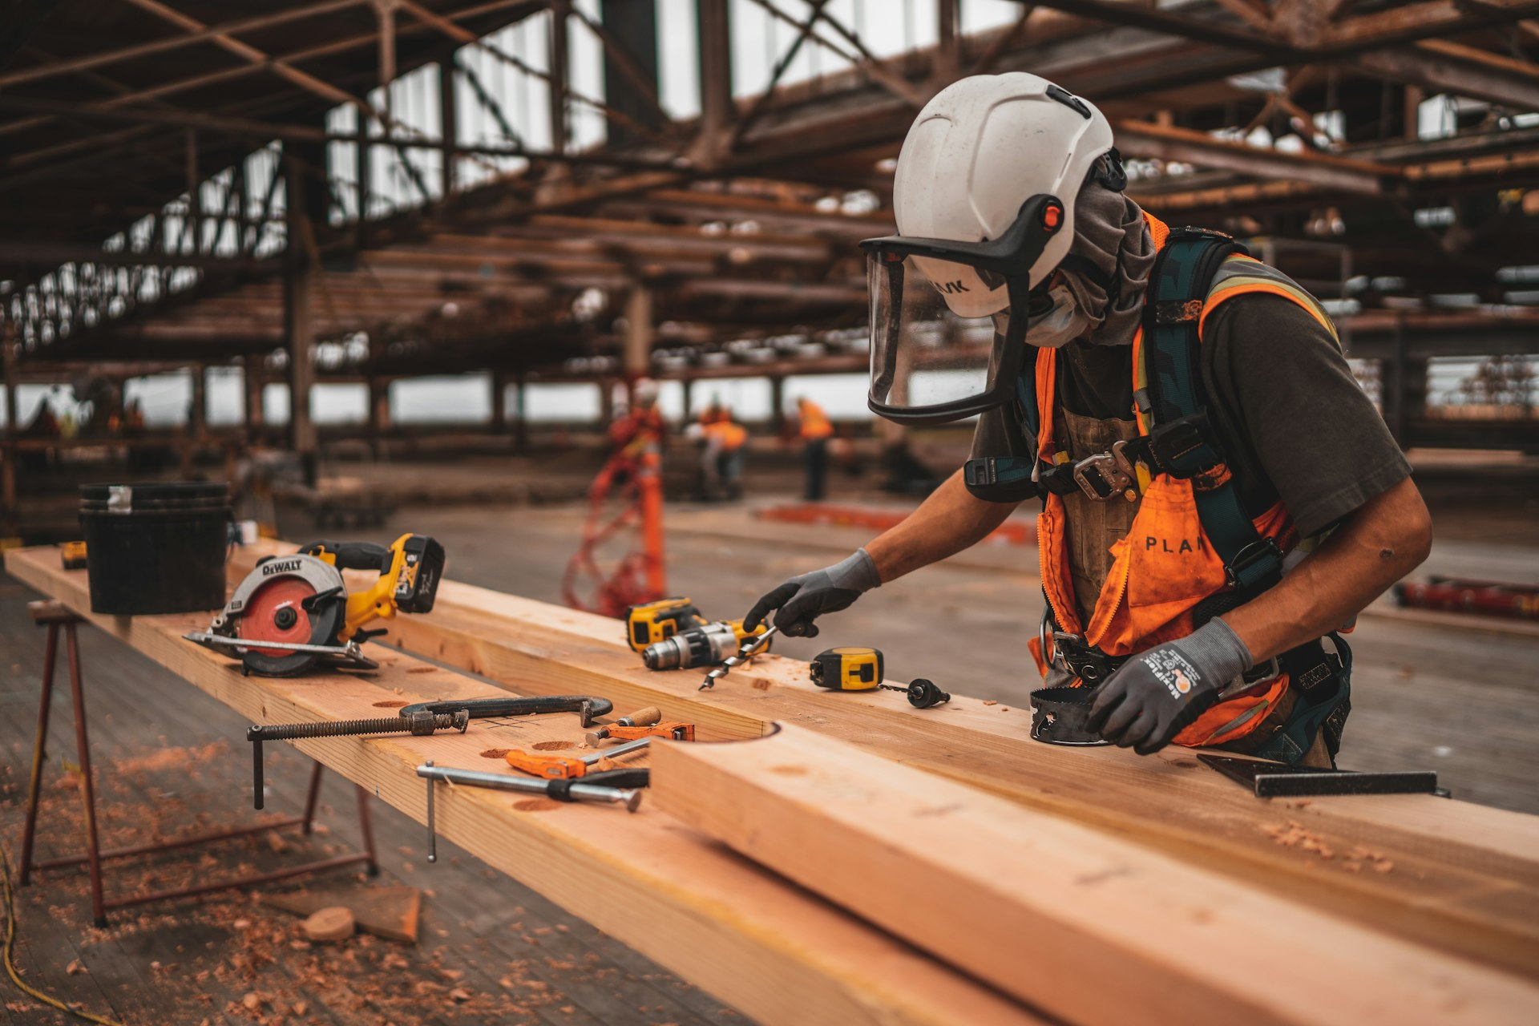


GROWTH & DIGITAL STRATEGY
A Partnership Proposal
Presented by
Notes:
Appreciate you taking the time today. I'll walk you through what we see, what's currently missing, and exactly how we can help you scale this.

Slide 2
Here's something most masonry businesses share:
"Most masonry companies grow through referrals... but that limits how much they can scale."
Meanwhile, people are actively searching for your services every single day.
Notes:
Most masonry companies grow through referrals and word of mouth — which works, but it puts a ceiling on how much you can scale.

Slide 3
Customers Are Already Searching
Real searches happening in Ontario — every single day
🔍 masonry contractor near me
🔍 brick installation Ontario
HIGH VOLUME
HIGH VOLUME
🔍 stone wall builders Toronto
🔍 masonry company commercial
MED VOLUME
MED VOLUME
97%
78%
681%
consumers search online for local services
mobile searches lead to a purchase within 24hrs
avg ROI for construction cos. using digital marketing
Notes:
97% of consumers search online for local services. 78% of mobile searches lead to a purchase within 24 hours. The demand is there — it just needs to be captured.

Slide 4
EST. 1994
You're in a High-Ticket Business
Project-based. High value. Every lead matters.
$15K–100K+
typical project value
1 deal
can change the month
Est. 1994
A High-Ticket Business
decades of expertise
Notes:
You're in a high-ticket business. One project can be $15–100K+. Growth comes from consistent, high-quality leads — not volume.

Slide 5
GAP 01
Website
Presence Without Performance
A website that exists but doesn't convert is a missed opportunity every single day.
🌐 No clear call to action
Visitors land and don't know what to do next. No quote forms, no lead capture, no next step.
🔍 No structured service pages
Each service needs its own SEO-optimised page to rank on Google and convert intent into enquiries.
📊 No lead capture system
No enquiry forms, no quote requests, no follow-up — visitors leave without a way to reach you.
Notes:
Right now, the website exists — but it's not working as a system to bring in leads consistently.

Slide 6
GAP 02
No Predictable Lead Pipeline
Referrals are great. But they're not scalable, predictable, or targetable.
TODAY
WITH A SYSTEM
✗ Growth relies entirely on referrals ✗ No consistent way to attract new clients ✗ High-value clients are unreachable online ✗ Revenue is unpredictable month to month ✗ Growth plateaus — limited by word of mouth
✓ Predictable flow of qualified leads monthly ✓ Targeting builders, developers & commercial clients ✓ Online presence works 24/7 even when you're not ✓ Revenue compounds — not dependent on luck ✓ Scalable growth with a system behind it
Notes:
The growth right now depends on referrals — not predictable or scalable. A system changes that.

Slide 7
So what's the real issue?
Not a demand problem. A system problem.
People are searching. The demand is real. The system to capture it just doesn't exist yet.
Notes:
This isn't a demand problem — it's simply that there's no system in place to capture that demand.

Slide 8
The Opportunity — In Plain Numbers
What even a conservative improvement in lead flow looks like for MMG
+2–3
+$50K
+$600K
extra projects per month (conservative)
additional monthly revenue (avg project $25K)
additional revenue in year one alone
If we bring you even 2–3 additional qualified projects per month, at an average value of $25,000, that's an extra $50,000/month — or over $600,000 in additional revenue in year one.
And that's the conservative estimate.
Notes:
Conservative: 2–3 extra projects at $25K = $50K/month = $600K+ in year one. Strong scenario: nearly $2M additional annually.

Slide 9
What the Growth Curve Looks Like
Projected monthly revenue: Referral-only vs. With Stenth's system
+$111K
additional monthly revenue by Month 12
+148%
revenue growth over 12 months with system
681%
avg ROI for construction cos. (SEO)
Notes:
On referrals alone: flat. With Stenth: $198K by Month 12. That's $111K additional per month. And it only grows from there.

Slide 10
Who We Are
Two founders. One focus — growth systems that drive real revenue.
👥
⚙️
Aakash Lakhataria
Ansh
Co-Founder & Growth Lead
Co-Founder & Technical Lead
Drives client strategy, marketing systems, and pre-client relationships. Leads growth initiatives for Stenth's clients across Canada and Australia.
Oversees all technical delivery — from website builds to digital infrastructure and performance systems. Ensures every system we build actually converts.
Specialises in building scalable systems that turn unknown businesses into recognised brands.
Specialises in web development, conversion architecture, and analytics.
Notes:
Two founders, completely focused on growth systems. Aakash handles strategy and client relationships. Ansh handles the technical build and delivery.

Slide 11
INTRODUCING
STENTH
stenth.com
Strategy. Marketing. Growth.
We don't just build websites.\nWe build systems that consistently bring in qualified leads.
Notes:
At Stenth, we don't just build websites or run ads — we build complete growth systems that bring in qualified leads consistently.

Slide 12
MMG'S STORY — TOLD ONLINE
▶
[VIDEO PLAYS HERE]
This is how we want to portray Modern Masonry Group online — telling its story visually, with precision and prestige.
Notes:
AAKASH: Play the video/brand demo here. This is exactly how we want to present MMG's story online — its craftsmanship, its legacy since 1994 — told visually.

Slide 13
01
Foundation
First, we fix what's underneath everything else.
🌐 High-converting website
Not just beautiful — built to turn visitors into enquiries. Clear structure, fast load, mobile-first design.
🎯 Clear brand messaging
Every visitor should immediately know who MMG is, what you offer, and why they should call — within 5 seconds.
🏢 Strong portfolio showcase
Your past work is your best sales tool. Presented to build instant trust with high-value clients.
Notes:
Step 1: Fix the foundation. A website that converts, clear messaging, strong portfolio. Everything built to work.

Slide 14
02
Traffic
Bring the right people to the right place — consistently.
🔍 Google SEO
Dominate local search. When someone searches masonry in Ontario, MMG appears first.
📣 Google Ads
Instant visibility for high-intent searches. Target people ready to hire — not just browse.
🌐 Local visibility
Google Business optimisation, local citations, map rankings — own your local market completely.
Notes:
Step 2: Drive traffic. SEO builds long-term visibility. Ads bring instant leads. Local visibility makes MMG the obvious choice.

Slide 15
03
Conversion
Traffic means nothing if visitors don't become clients.
💰 Lead funnels
Guided paths that take a visitor from "interested" to "I want a quote" — without friction.
🎯 Quote forms
Smart, fast enquiry forms designed to capture quality leads with the right information upfront.
📊 Follow-up systems
Automated follow-ups so no lead falls through the cracks. Every enquiry gets a timely response.
Notes:
Step 3: Convert. Lead funnels, quote forms, follow-up systems — so every interested visitor becomes a real enquiry.

Slide 16
Your Dedicated In-House Marketing Team
Every serious, growing company has a dedicated marketing team.
THE TRADITIONAL WAY
THE STENTH WAY
Hire internal staff. High cost. Slow to hire. Hard to manage.
We become that team. Integrated. Accountable. Focused on growth.
Notes:
Instead of hiring and managing internally, we become that team. We coordinate with your people, learn your business, and operate as a genuine extension of MMG.

Slide 17
Not an Expense. An Investment.
"Just like this office and showroom — the investment you made to build it — you did that because it creates an impression, builds trust, and brings in more business. Your online presence should do exactly the same thing. But at scale."
A great office & showroom
→
Builds trust in person
A great online presence
→
Builds trust at scale — 24/7
Stenth as your partner
→
Turns that presence into revenue
Notes:
This isn't a cost. Just like this office builds trust and brings in clients — your online presence should do the same. At scale.

Slide 18
Now...
Ready for the exciting part?
Because everything we've talked about... it already exists.
Notes:
AAKASH: Pause here. Build anticipation. Everything we've talked about — it's not a concept. It already exists. Let me show you.

Slide 19
THE NEW
Modern Masonry Group
modern-masonry-group.vercel.app
Notes:
AAKASH: Open the browser. Navigate to modern-masonry-group.vercel.app — walk them through it. Let the work speak.

Slide 20
If this makes sense...
Let's map out what this looks like for MMG.
The next step is simple: we sit down together and map out a strategy specifically tailored to Modern Masonry Group — the right system, the right timeline, and what results look like in month 1, 3, and 6.
Notes:
If this makes sense, the next step is simple: sit down together and map out a strategy tailored entirely to MMG — the right system, the right timeline, what results look like in month 1, 3, and 6.

