Slide 1
Page 01
Parkinson's Classification
Stefano Colella
865075

Slide 2
Page 02
Introduction
I present a binary classification pipeline to distinguish
Parkinson's disease (PD) patients (1)
from healthy subjects (0)
using the PaHaW Handwriting Dataset.
Our goal is to extract reliable indicators of PD from time-series tablet data.

Slide 3
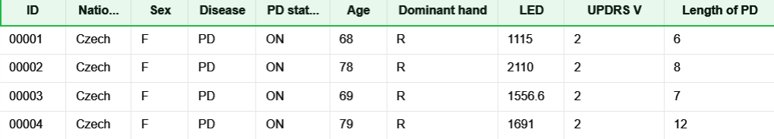
Page 03
The dataset contains time-series handwriting samples:
X/Y coordinates
pen pressure
Altitude
Azimuth
from 72 subjects (37 with Parkinson Diagnosis and 38 without).
STATE OF THE ART
Subjects 00061, 00080, and 00089 were excluded due to incomplete data.

Slide 4
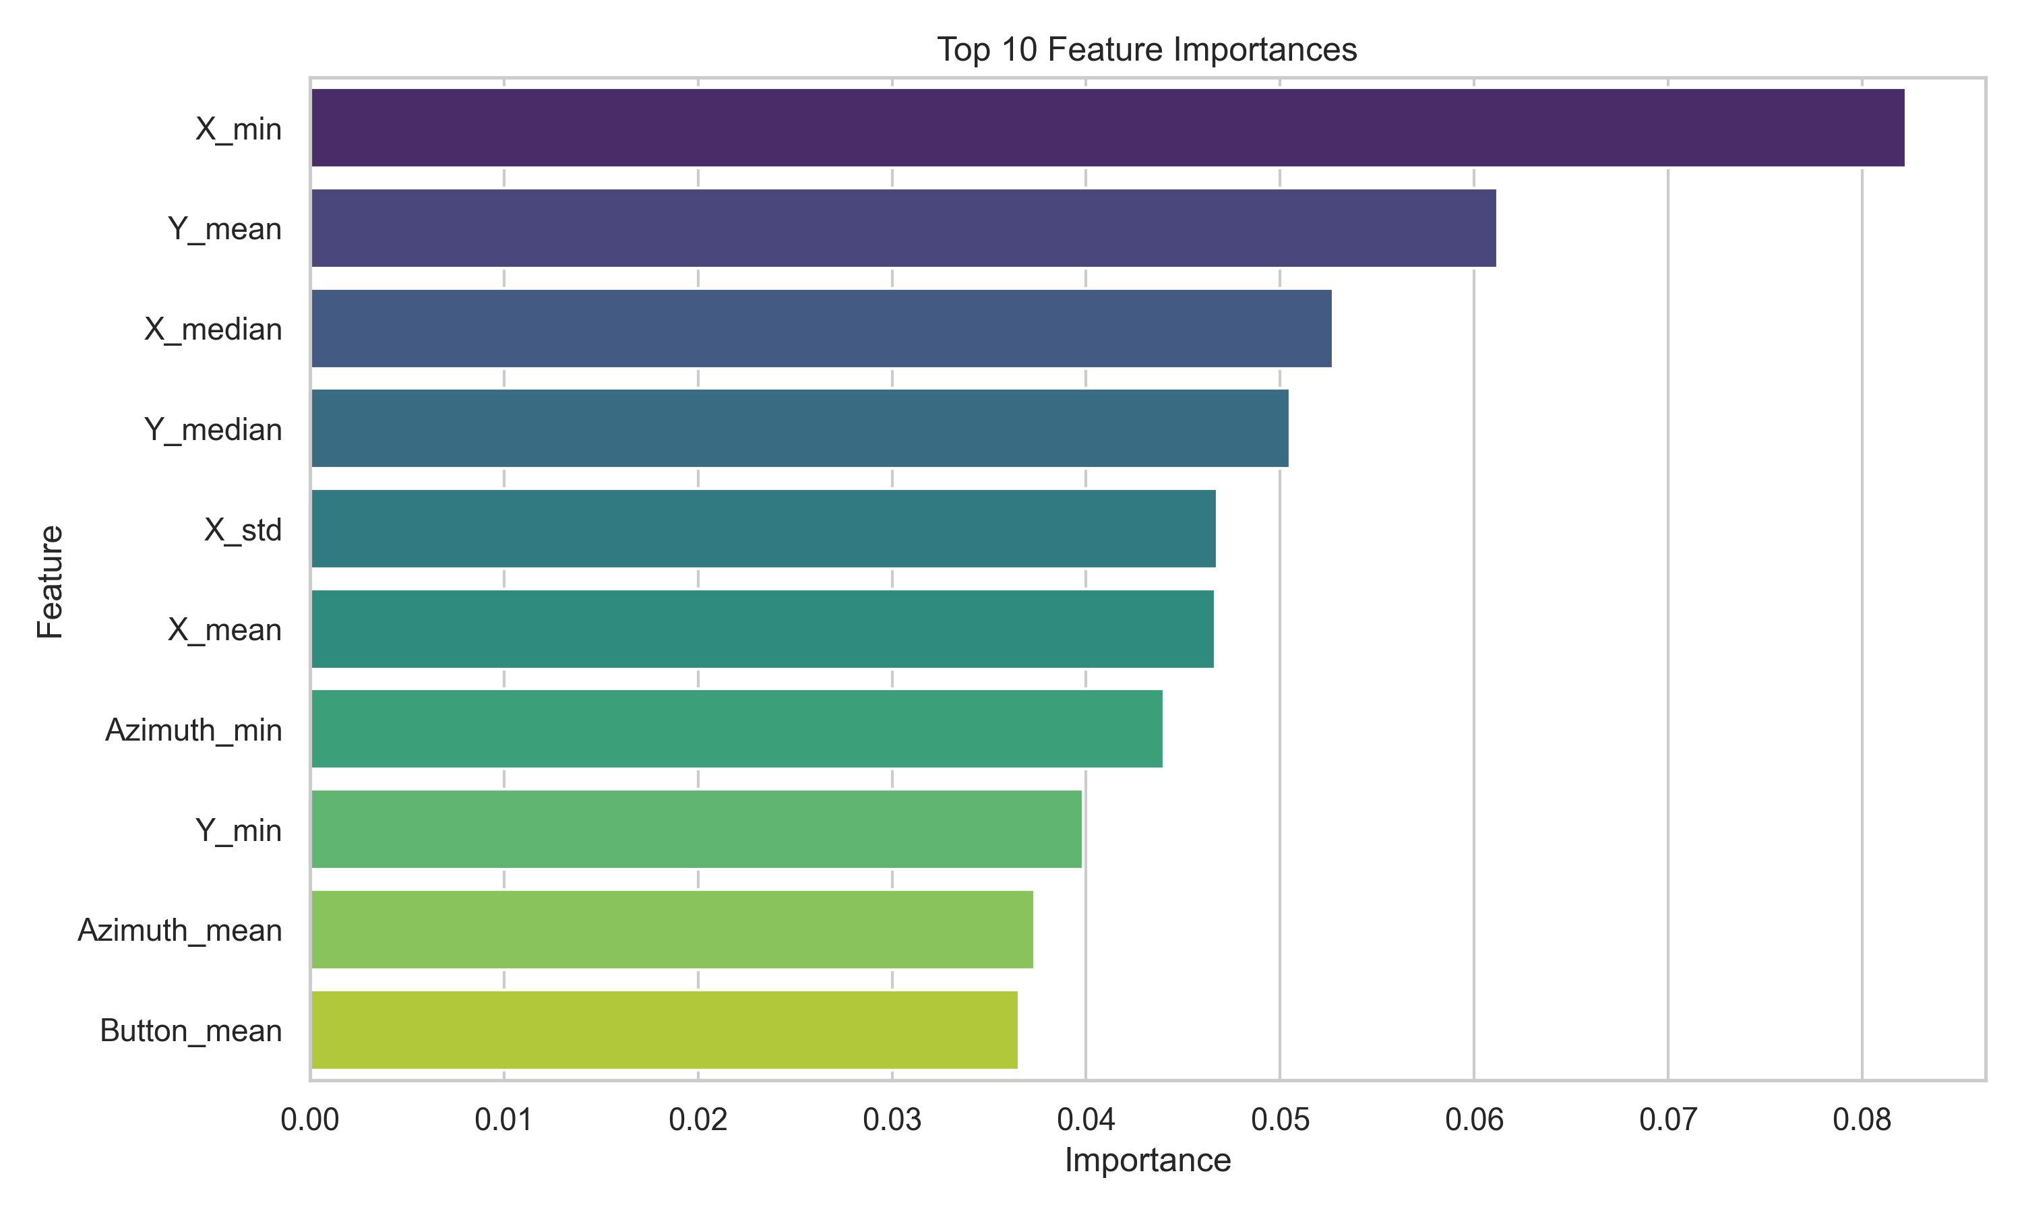
Page 04
Materials & Dataset
Raw time-series files (.svc) were processed to extract static and dynamic features.
We calculated continuous velocity from spatial displacements and time deltas. We computed the mean, std, max, min, and median for all physical properties.

Slide 5
Page 05
We deployed a Random Forest Classifier. To prevent overfitting on small data, hyperparameters were optimized:
n_estimators=200
max_depth=7
min_samples_split=5
min_samples_leaf=2
max_features='sqrt’
class_weight='balanced'
Model Training & features engineering

Slide 6
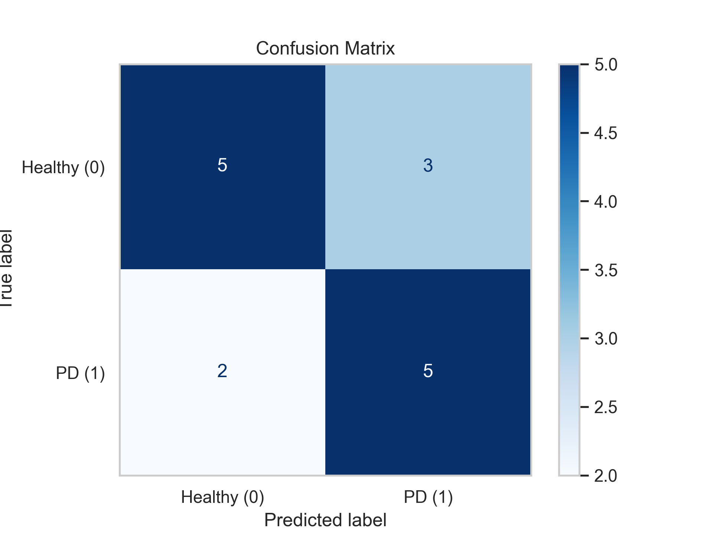
Page 05
Future improvements could involve employing Convolutional Neural Networks on Spectrogram representations of the time series to capture more intricate temporal dependencies.
EVALUATION METRICS

Slide 7
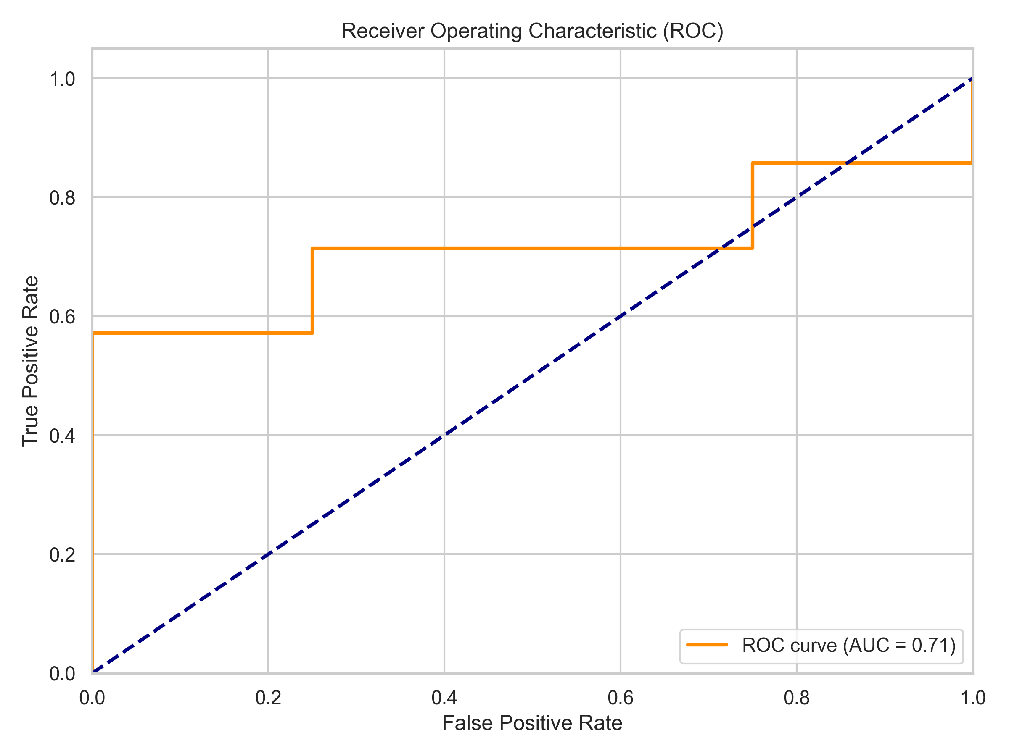
Page 05
Conclusion
The model demonstrates a strong capability to identify PD patients
The Random Forest naturally resisted overfitting, establishing a highly competitive baseline.
Precision: 0.625
Specificity: 0.625
F1-Score: 0.6667
Accuracy: 0.6667
Recall: 0.7143
AUC: 0.7143
_________________________________
_________________________________
_____________________________________
_____________________________________
__________________________________________
__________________________________________

Slide 8
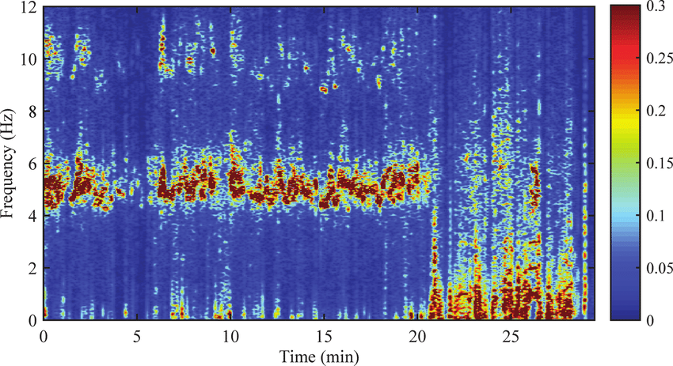
Page 05
Future improvements could involve employing Convolutional Neural Networks on Spectrogram representations of the time series to capture more intricate temporal dependencies.
Future Work

