Slide 1
GitHub project
Плахотин Степан Юрьевич

Slide 2

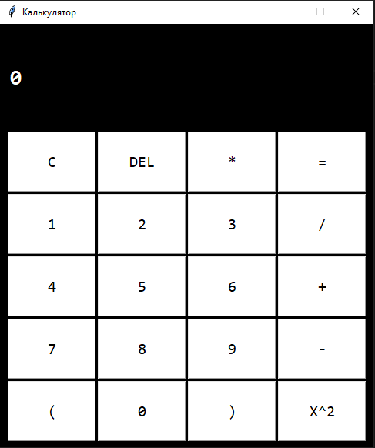
Пример моей работы:

Slide 3
Шаг 1
from tkinter import *
from functools import partial
primer = '' # '3 + (2 * 2) ** 2'
sw = True

Slide 4
Шаг 2
def click(nameB):
global primer
if nameB == '=':
primer = str(eval(primer))
label.config(text = primer)
elif nameB=='X^2':
primer += '**2'
label.config(text = primer)
elif nameB=='C':
primer = ''
label.config(text = '0')
elif nameB=='DEL':
primer = primer[:-1]
label.config(text = primer)
else:
primer += nameB
label.config(text = primer)

Slide 5
Шаг 3
root = Tk()
root.config(bg = "black")
root.geometry("485x550")
root.title("Калькулятор")
root.resizable(False, False)
label = Label(text='0', font=("Consolas", 21, "bold"), bg="black", foreground="white")
label.place(x = 10, y = 50)

Slide 6
Шаг 4
buttonNames = [
"C", "DEL", "*", "=",
"1", "2", "3", "/",
"4", "5", "6", "+",
"7", "8", "9", "-",
"(", "0", ")", "X^2"
]
x = 10
y = 14

Slide 7
Шаг 5
for i in buttonNames:
Button(
text = i,
bg="white",
font=("Consolas", 15),
command = partial(click, i)
).place(
x = x,
y = y,
width = 115,
height = 79)
x += 117
if x > 400:
x = 10
y += 81
root.mainloop()

