Slide 1
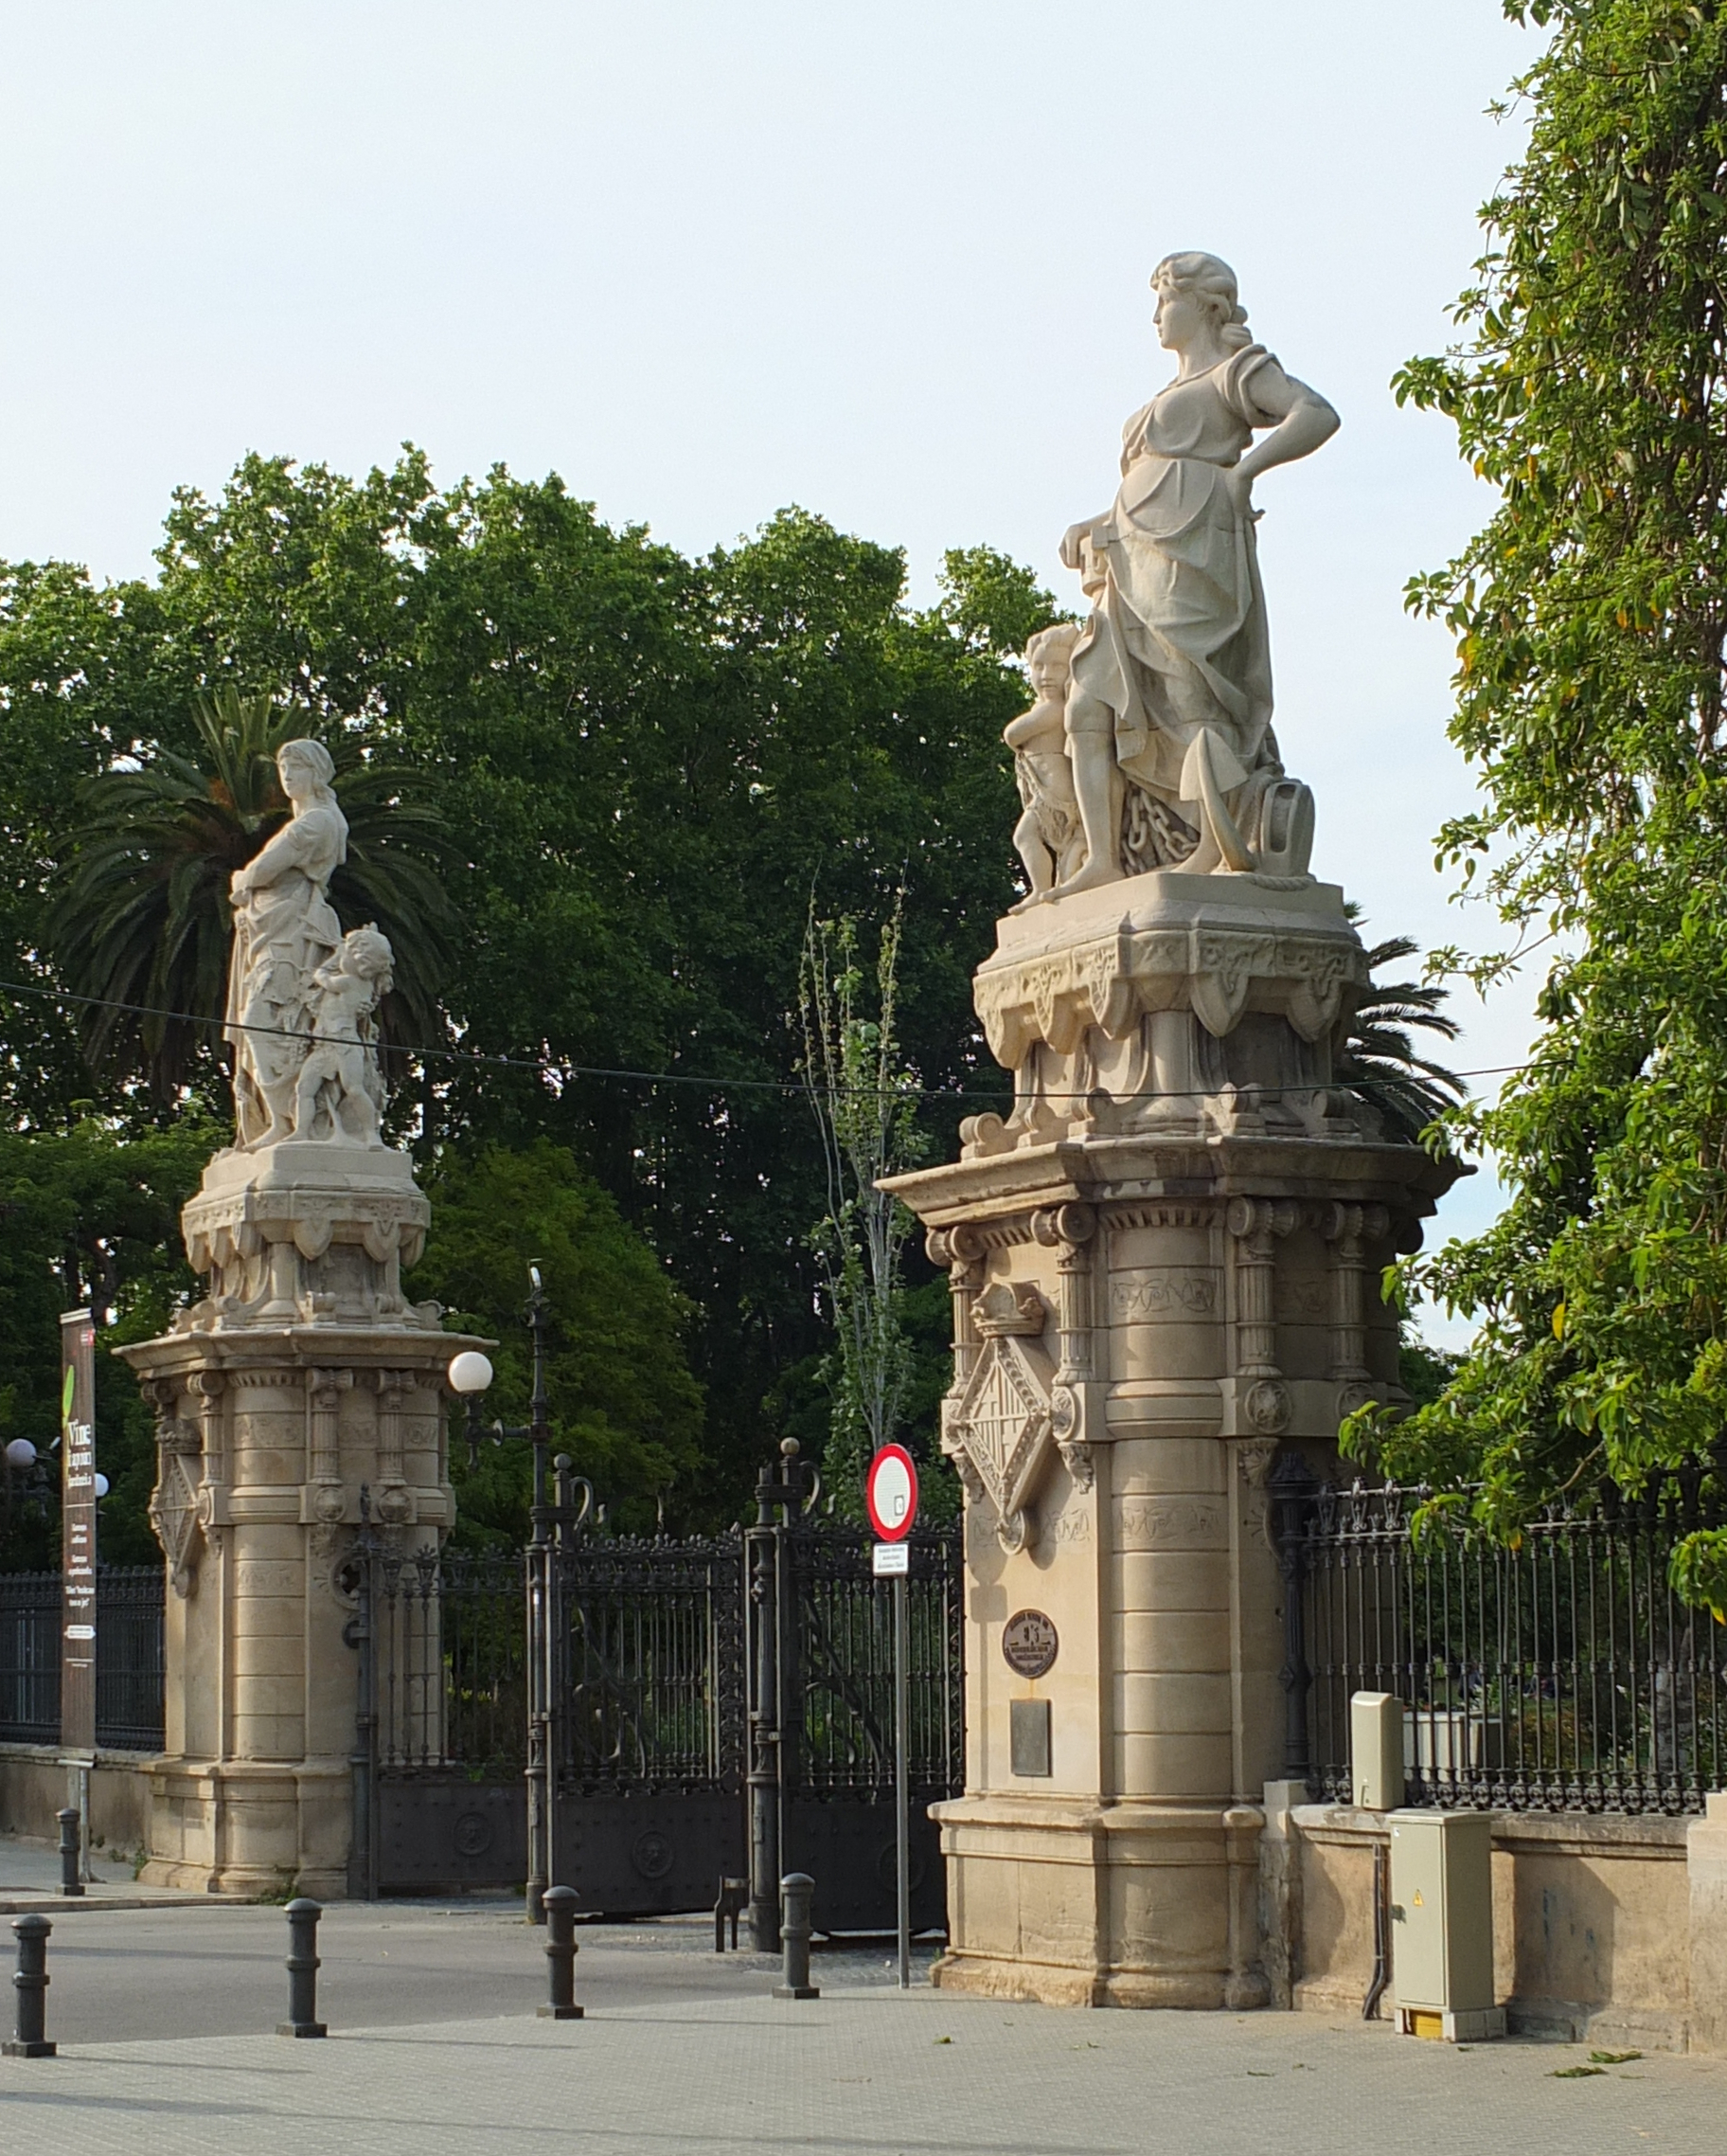
Barcelona
Pre-schematic research
A worked example of location, climate and regional vegetation research
Parc de la Ciutadella surroundings
Public study example · September 2026
Context photograph: Ad Meskens / Wikimedia Commons, CC BY-SA 4.0. Taken in 2016.
Notes:
Public tutorial example, not a commissioned site proposal. Study area: Parc de la Ciutadella surroundings. No property boundary or building program was supplied. Photo: Ad Meskens, 24 May 2016, CC BY-SA 4.0, unmodified, fitted to frame. https://commons.wikimedia.org/wiki/File:Barcelona_Parc_de_la_Ciutadella.jpg License: https://creativecommons.org/licenses/by-sa/4.0/

Slide 2
Study area and climate station
N
Study area
Barcelona
Ciutadella surroundings
Study point
41.385447° N, 2.186136° E
Airport climate station
41.292778° N, 2.070000° E
Airport station
E
Locator diagram. No site boundary supplied. Airport measurements do not describe the site microclimate.
Notes:
Study point is the camera coordinate from the context photograph: 41.385447 N, 2.186136 E. https://commons.wikimedia.org/wiki/File:Barcelona_Parc_de_la_Ciutadella.jpg
AEMET airport station 0076: 41.2927777778 N, 2.07 E, altitude 4 m. https://www.aemet.es/es/serviciosclimaticos/datosclimatologicos/valoresclimatologicos?k=cat&l=0076
Locator diagram uses a local equirectangular coordinate projection. It is not a cadastral map, a current vegetation survey or a depiction of the site boundary.

Slide 3
Climate baseline
Mean temperature · °C
Monthly precipitation · mm
Warm summers and a dry July in this historical station record
Source: AEMET, Barcelona Aeropuerto, 1981–2010. Historical station baseline; not a site forecast.
Notes:
AEMET Barcelona Aeropuerto station 0076, monthly normals 1981–2010. https://www.aemet.es/es/serviciosclimaticos/datosclimatologicos/valoresclimatologicos?k=cat&l=0076
T is mean monthly temperature in degrees C. R is mean monthly precipitation in mm. Values are reproduced as published. This is a historical baseline, not current weather or the latest normals. The published annual rainfall is 588 mm; rounded monthly values sum to 579 mm, so no annual total is inferred here.

Slide 4
Design questions from the evidence
Summer heat
Where can shade reduce exposure?
Seasonal rainfall
Where could water collect or infiltrate?
Regional vegetation
Which species fit the actual soil and space?
Conceptual diagram. Sun/shadow analysis, wind measurements and a site survey remain separate inputs.
Notes:
This diagram is a proposed research-to-design interpretation, not a simulation or a verified design recommendation. The climate observations refer to https://www.aemet.es/es/serviciosclimaticos/datosclimatologicos/valoresclimatologicos?k=cat&l=0076. Each design question needs a supplied site boundary, project brief and appropriate analysis before design decisions.

Slide 5
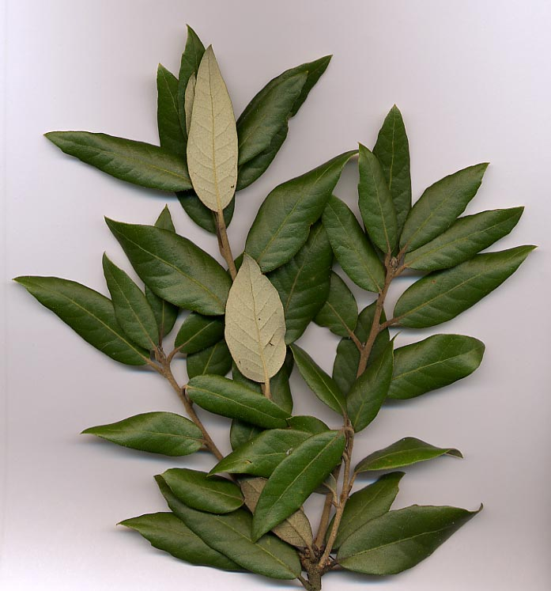
Regional plant references
Quercus ilex
Holm oak; characteristic of regional oak woodland.
Pinus halepensis
Aleppo pine; common in mixed Collserola woodland.
Pinus pinea
Stone pine; also present in regional pine formations.
Regional habitat sources: Parc Natural de Collserola. Species photo: MPF, CC BY-SA 3.0; not a site photograph.
Notes:
Collserola park authority describes holm oak Quercus ilex, Aleppo pine Pinus halepensis and stone pine Pinus pinea in regional habitats. https://parcnaturalcollserola.cat/habitats/alzinars/
https://parcnaturalcollserola.cat/habitats/pinedes/
These are regional references, not a site inventory or planting prescription. Photo of Quercus ilex foliage: MPF, Wikimedia Commons, CC BY-SA 3.0; unmodified and fitted to frame. https://commons.wikimedia.org/wiki/File:HolmOak.jpg License: https://creativecommons.org/licenses/by-sa/3.0/

Slide 6
Information needed before design
Site geometry
Boundary, levels, existing buildings and access
Environmental conditions
On-site shade, wind, noise and drainage observations
Planting conditions
Soil, available rooting volume and maintenance needs
Project requirements
Program, users, area targets and planning constraints
The research pack supports a first discussion. Site verification and design decisions remain with the project team.
Notes:
These are outstanding inputs for the public example, not findings about the real site. No cadastral, zoning, flood, soil, tree-inventory or engineering assessment was performed.

Slide 7
Sources and image credits
Climate
AEMET · Barcelona Aeropuerto station 0076
Monthly normals, 1981–2010
Regional plants
Parc Natural de Collserola
Alzinars and Pinedes habitat descriptions
Photographs
Park entrance: Ad Meskens · CC BY-SA 4.0
Holm oak foliage: MPF · CC BY-SA 3.0
Images remain under their original licenses.
Full source and license links are in the slide notes and accompanying source register.
Notes:
All URLs accessed during this research on 2026-09-14.
https://www.aemet.es/es/serviciosclimaticos/datosclimatologicos/valoresclimatologicos?k=cat&l=0076
https://parcnaturalcollserola.cat/habitats/alzinars/
https://parcnaturalcollserola.cat/habitats/pinedes/
https://commons.wikimedia.org/wiki/File:Barcelona_Parc_de_la_Ciutadella.jpg
https://commons.wikimedia.org/wiki/File:HolmOak.jpg

