Slide 1
K-Nearest Neighbor(KNN)
ADA AI/ML April, 2023

Slide 2
Introduction
K-Nearest Neighbour (KNN or K-NN) is one of the simplest Machine Learning algorithms used for Supervised Learning.
K-NN algorithm assumes the similarity between the new case/data and available cases and put the new case into the category that is most similar to the available categories.
Similarity is sometimes called distance, proximity, or closeness.

Slide 3
Introduction
K-NN algorithm can be used for Regression as well as for Classification but mostly it is used for the Classification problems.
K-NN is a non-parametric algorithm, which means it does not make any assumption on underlying data.
It is also called a lazy learner algorithm because it does not learn from the training set immediately instead it stores the dataset and at the time of classification, it performs an action on the dataset.

Slide 4
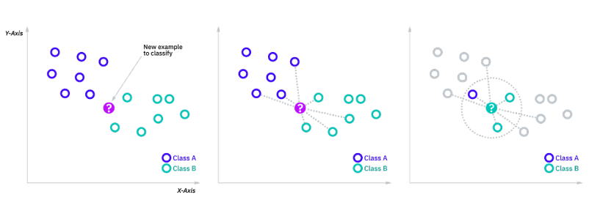
KNN - basic idea

Slide 5
KNN - distance metrics
The goal of the k-nearest neighbor algorithm is to identify the nearest neighbors of a given query point, so that it can assign a class label to that point.
To this end, different distance metrics can be used such as:
Euclidean distance (p=2): This is the most commonly used distance measure
Manhattan distance (p=1)
Minkowski distance

Slide 6
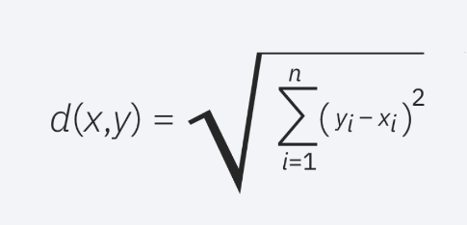
KNN - distance metrics
Euclidean distance (p=2): This is the most commonly used distance measure, and it is limited to real-valued vectors. Using the below formula, it measures a straight line between the query point and the other point being measured.

Slide 7
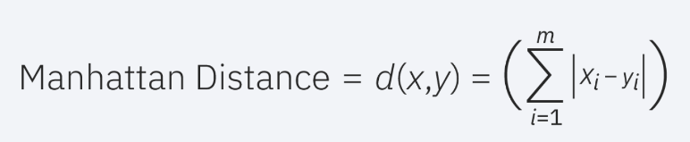
KNN - distance metrics
Manhattan distance (p=1): This is also another popular distance metric, which measures the absolute value between two points. It is also referred to as taxicab distance or city block distance as it is commonly visualized with a grid, illustrating how one might navigate from one address to another via city streets.

Slide 8
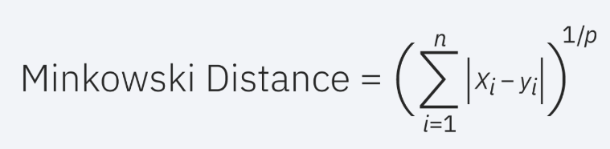
KNN - distance metrics
Minkowski distance: This distance measure is the generalized form of Euclidean and Manhattan distance metrics. The parameter, p, in the formula below, allows for the creation of other distance metrics. Euclidean distance is represented by this formula when p is equal to two, and Manhattan distance is denoted with p equal to one.

Slide 9
KNN - Defining K
The k value in the KNN algorithm defines how many neighbors will be checked to determine the classification of a specific query point. For example, if k=1, the instance will be assigned to the same class as its single nearest neighbor.
Defining k can be a balancing act as different values can lead to overfitting or underfitting. Lower values of k can have high variance, but low bias, and larger values of k may lead to high bias and lower variance.
The choice of k will largely depend on the input data as data with more outliers or noise will likely perform better with higher values of k.
Overall, it is recommended to have an odd number for k to avoid ties in classification, and cross-validation tactics can help you choose the optimal k for your dataset.

Slide 10
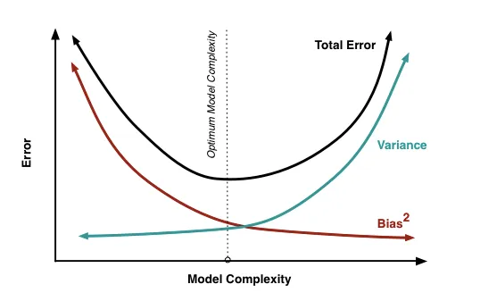
KNN - Defining K

Slide 11
Steps in KNN algorithm
Step 1: . Calculate the distance between a new observation (the one for which a prediction is to be made) and each observation from the training set,
Step 2: For the new observation, find k closest observations in the training set (= k nearest neighbors),
Step 3: In case of classification, assign label (class) to the new observation based on the majority class of its nearest neighbors; in case of regression, compute the predicted outcome value as the average value of the outcome variable of the nearest neighbors.

Slide 12
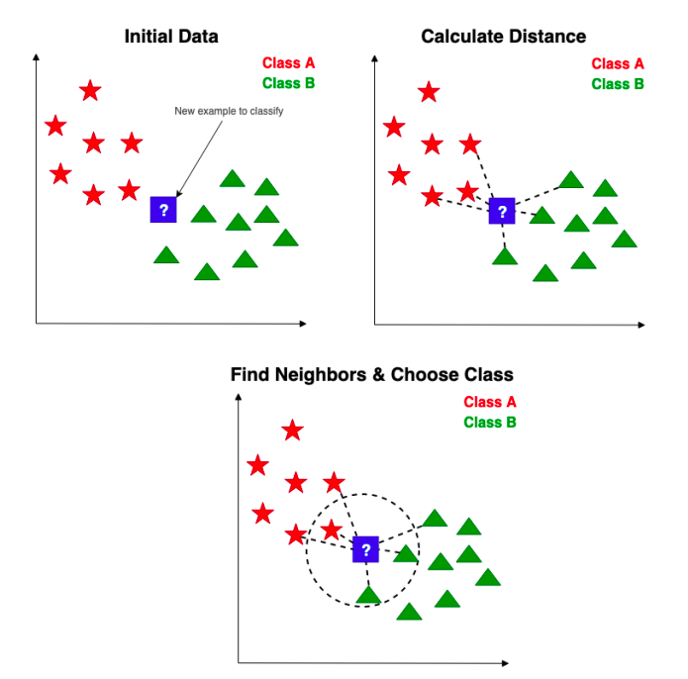
Steps in KNN algorithm

Slide 13
Pros & Cons
Cons:
Does not scale well: Since KNN is a lazy algorithm, it takes up more memory and data storage compared to other classifiers.
Curse of dimensionality: The KNN algorithm tends to fall victim to the curse of dimensionality, which means that it doesn’t perform well with high-dimensional data inputs.
Prone to overfitting: Due to the “curse of dimensionality”, KNN is also more prone to overfitting.
Pros:
Easy to implement: Given the algorithm’s simplicity and accuracy, it is one of the first classifiers that a new data scientist will learn.
Adapts easily: As new training samples are added, the algorithm adjusts to account for any new data since all training data is stored into memory.
Few hyperparameters: KNN only requires a k value and a distance metric, which is low when compared to other machine learning algorithms.

