Slide 1
RNAseq introduction
12.03.2024, LIB Museum Koenig, Bonn
Eckart Stolle, Lars Podsiadlowski, Katja Nowick, Thomas Joseph Colgan

Slide 2
https://github.com/LIB-insect-comparative-genomics/RNAseq-workshop2023/tree/main
ssh -X -p 6022 user@131.220.238.3
/scratch/rnaseq2023

Slide 3
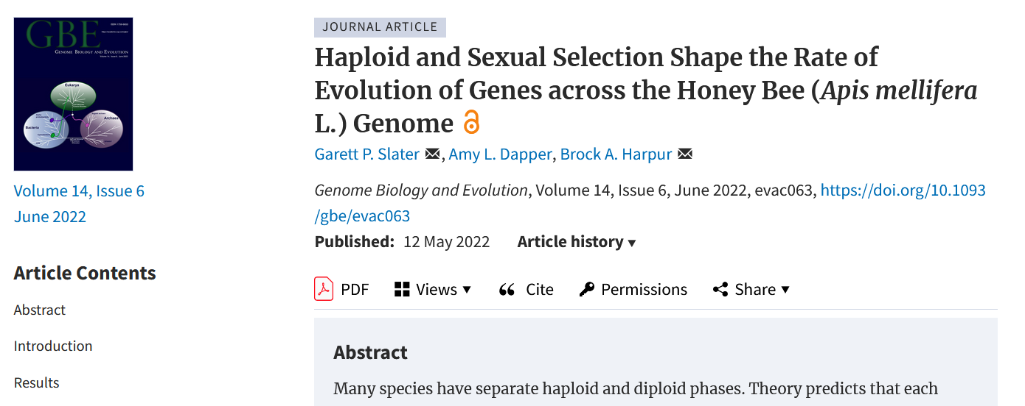
Slater et al. 2022: Haploid and Sexual Selection Shape the Rate of Evolution of Genes across the Honey Bee (Apis mellifera L.) Genome - GBE

Slide 4
how haploid selection and expression contribute to genome-wide levels of genetic diversity
large fraction of the honey bee genome is expressed in the haploid state (drones)
genes have a unique pattern of genetic diversity and divergence relative to other genes in the genome.
Test haploid selection hypotheses
evolution of social insects more broadly
haploid state has an important role in the evolution of arrhenotokous genomes

Slide 5
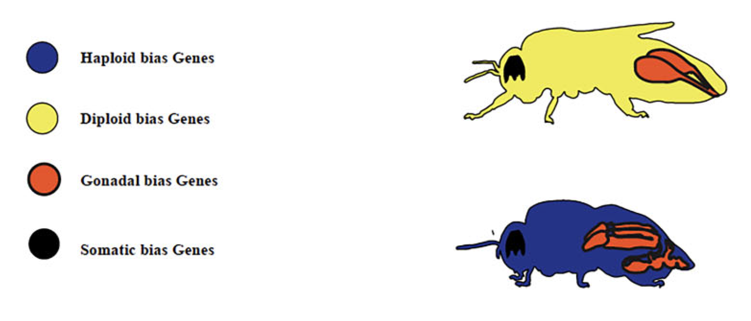

Slide 6
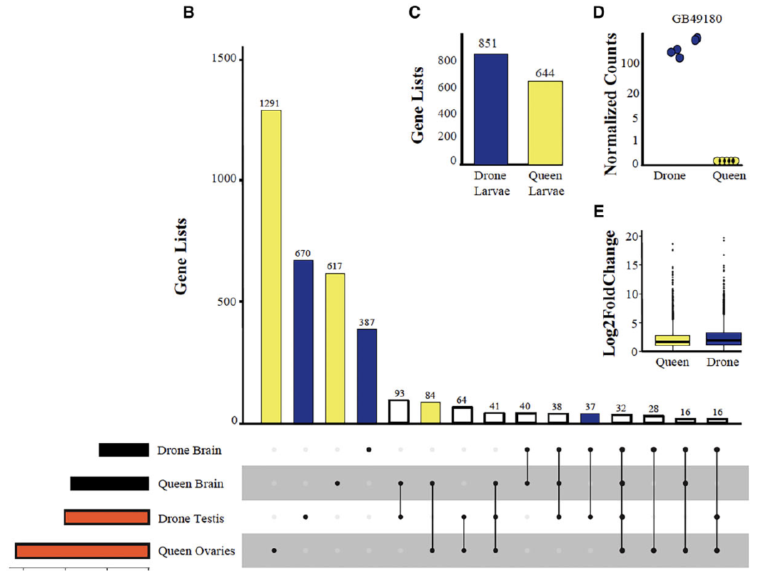

Slide 7
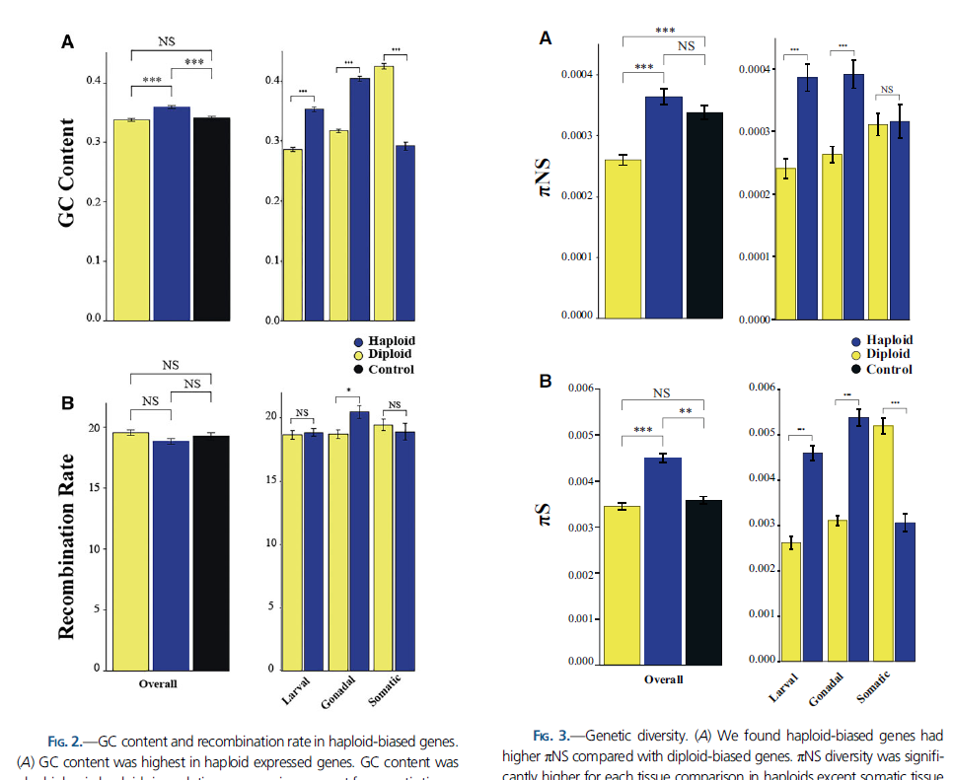

Slide 8
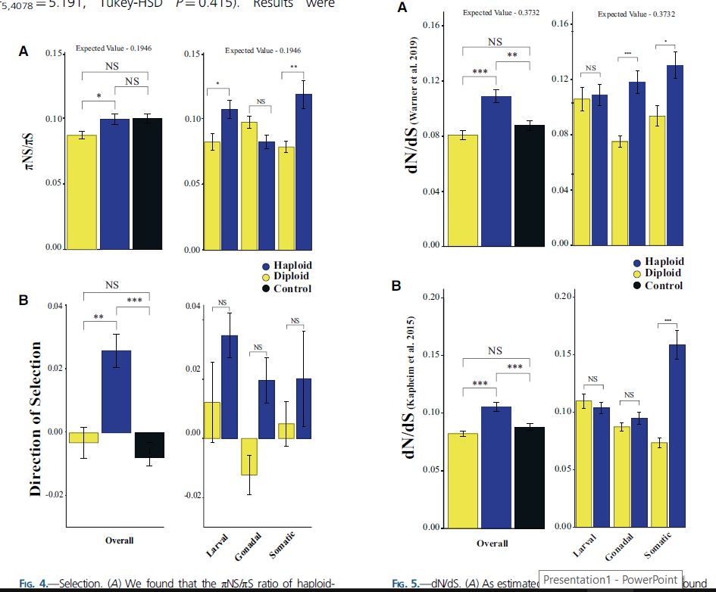

Slide 9
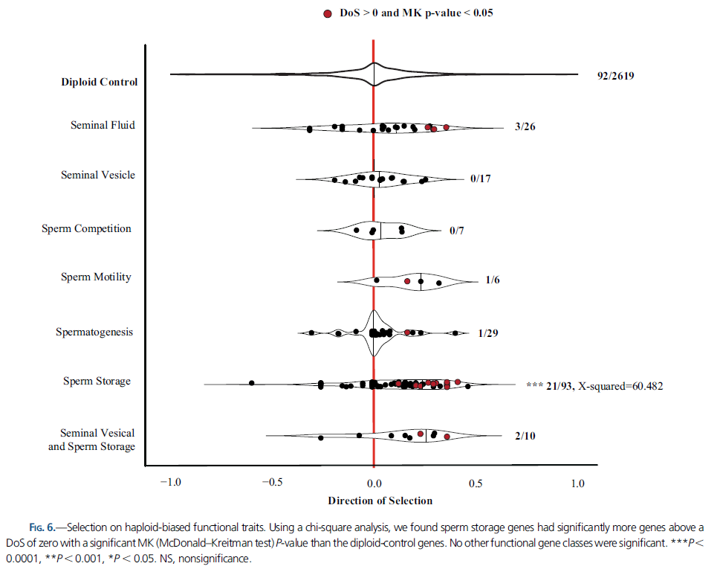

Slide 10
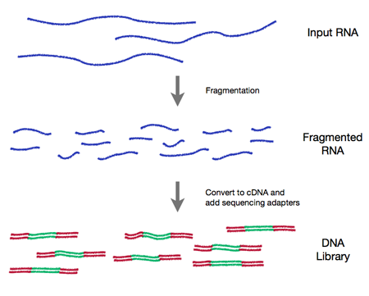
RNAseq
→ sequencing, PE100-150

Slide 11
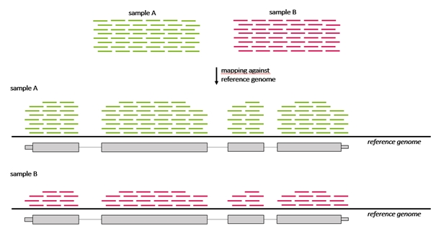
„read counting“ and finding differences
Level of expression
Length of genes
Mapping vs alignment free

Slide 12
How many / which reads do I need?
Depends on your goal:
Gene expression profiling / quick snapshot of highly expressed genes may only need 5–25 million reads per sample (source: Illumina).
Experiments looking for a more global view of gene expression, and some information on alternative splicing, typically require 30–60 million reads per sample, for an in-depth view even 100–200 million reads
miRNA-Seq or small RNA Analysis experiments may require fewer reads than whole transcriptome sequencing
Transcriptome assembly (>50M reads recommended): Trinity performs well (see: Martin Hölzer, Manja Marz (2019): De novo transcriptome assembly: A comprehensive cross-species comparison of short-read RNA-Seq assemblers. GigaScience, Volume 8, Issue 5, May 2019, giz039, https://doi.org/10.1093/gigascience/giz039)
Single end and shorter read length (e.g. 50, 75 or 100 bp) may suffice to obtain read counts, at the disadvantage of reliable mapping (especially important with very similar paralogs), hence the general recommendation: paired end, 150 bp read. (exception: small RNAs: a single 50bp read typically covers the entire sequence).

Slide 13
Depth vs Replicates?
7 replicates or more give good power to detect differential expression
10M reads may be insufficient except when aiming at highly expressed genes or larger expression differences. Otherwise 20M or more is recommended.
Consider these:
Scotty: A Web Tool For Designing RNA-Seq Experiments to Measure Differential Gene Expression. M.A. Busby; C. Stewart; C. Miller; K. Grzeda; G. Marth Bioinformatics 2013; doi: 10.1093/bioinformatics/btt015 http://scotty.genetics.utah.edu/help.html

Slide 14
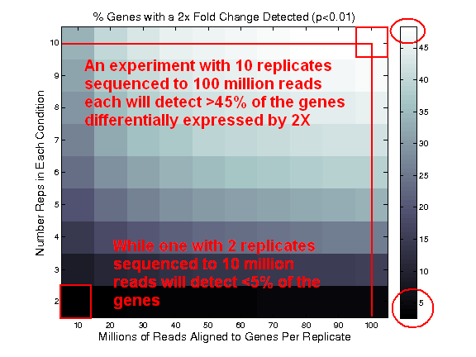
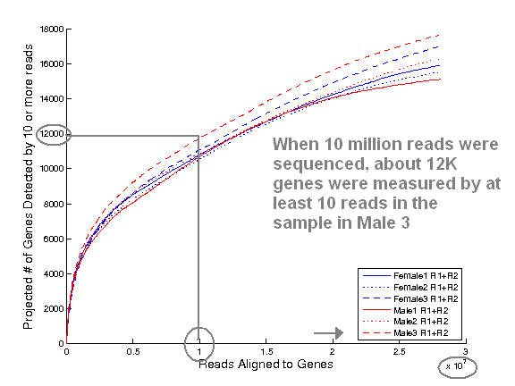

Slide 15
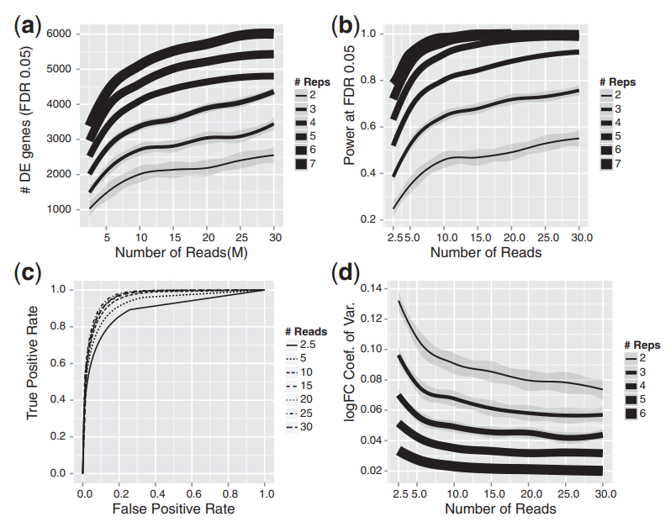
Schurch et al. (2016): How many biological replicates are needed in an RNA-seq experiment and which differential expression tool should you use? RNA. 2016 Jun; 22(6): 839–851. doi: 10.1261/rna.053959.115 https://www.ncbi.nlm.nih.gov/pmc/articles/PMC4878611
Baccarella et al. (2018): Empirical assessment of the impact of sample number and read depth on RNA-Seq analysis workflow performance. BMC Bioinformatics volume 19, Article number: 423. https://bmcbioinformatics.biomedcentral.com/articles/10.1186/s12859-018-2445-2
Lui et al. (2014): RNA-seq differential expression studies: more sequence or more replication? Bioinformatics, Volume 30, Issue 3, 1 February 2014, Pages 301–304, https://doi.org/10.1093/bioinformatics/btt688 https://academic.oup.com/bioinformatics/article/30/3/301/228651

Slide 16
polyA enrichment vs ribo-depletion?
polyA enrichment (mRNAs) is well established/cheap, but omits non-polyA-tailed RNAs (e.g. some long non coding RNAs and many TEs)
depletion of ribosomal RNA from total RNA ideally needs species-specific probes. For some insects (e.g. bumblebees) it works well to use the Illumina RiboZero Kit for Human/Mouse/Rat. There are also homemade solutions, e.g. Kraus et al. 2019: https://www.nature.com/articles/s41598-019-48692-2 or https://journals.asm.org/doi/10.1128/mBio.00010-20 .
post-library prep depletion of rRNA and other custom / abundant RNAs: NuGen AnyDeplete https://www.nugen.com/anydeplete-rrna-depletion
Watch out for batch effects
Avoid Pseudoreplication
Remove Optical Duplicates

Slide 17
RNAseq Workshop 2023/24
Day 1: introduction into RNAseq and differential gene expression
Eckart Stolle, Lars Podsiadlowski, Joe Colgan
~10-16
https://github.com/LIB-insect-comparative-genomics/RNAseq-workshop2023/tree/main
ssh -X -p 6022 user@131.220.238.3
/scratch/rnaseq2023
Day 2: coexpression networks, differential splicing
Katja Nowick, Joe Colgan
9-12, 14-16

