Slide 1
Abreviations.md

Slide 2
Vocab
DSP (Digital Signal Processing): extra maching instructions for the CPU to do heavy math tasks
FPU (Floating Point Unit): hw block to do floating point operation directly => 1 cicle for add/mul
Cortex-M4: 32-bit RISC core optimized for real-time control.
ADC (Analog to Digital Converter)
FOC (Field-Oriented Control): technique to control a BLDC motor to behave like a perfectly linear DC motor (smooth torque, high efficiency, precise speed and pos control). The key idea is to transform the messy 3 phase driving (ESC, …) to 2 DC like currents to control
  Measure motor currents
  Transform them mathematically to separate Id (current aligned with the motor magnetic field -> control flux) and Iq (current perpendicular to the rotor -> control torque)
  Control Id and Iq separately using PI controllers
  Reconstruct the 3-phases voltage using an inverse transform
BOM: Bill of Materials
IC: Integrated circuit
OP-amp (AOP in French): Operational Amplificator
LDO (Low Dropout Regulator): take a higher voltage to convert it in a lower voltage. Low dropout => works even if the difference is small
OCP (Over-Current Protection)
UVLO (Under Voltage Lockout): For a mosfet driver => if gate tension drop under specified voltage, gate is shut => this ensure that the MOSFET do not stay in an half open state, where a lot of heat is produced
NTC-Thermistor (Negative Temperature Coefficient Thermistor): Thermal sensor using a resistance that decreases with temperature
Planes (= power lines)
Bypass capacitor: Used to smooth Vcc : https://www.youtube.com/watch?v=d-j0onzzuNQ and (https://www.ti.com/lit/an/scba007a/scba007a.pdf?ts=1755839806265#:~:text=A%20bypass%20capacitor%20stores%20an,switching%20outputs%20of%20the%20device.)
https://www.youtube.com/watch?v=d-j0onzzuNQ
Back-EMF (Electro Magnetic Force): Tension generated by an inductance/coil when charging. For a BLDC, it become null when stator and rotor are aligned.
Schottky diode + simple Altium designer tuto: diode with minimal voltage drop (less resistance)
KCF: Kirchhoff Curent Law
HSE / LSE: High-Speed External Oscillator / Low-Speed
BSP (Board Support Packages)
HPB: Handle to Push Button
HAL: Hardware Abstraction Layer

Slide 3
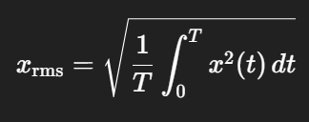
Vocab
IRQn: Interrupt ReQuest Number
Boostrap capacitor : used to ensure self-starting of the High Side mosfet on a GD. It is important as the HS mosfet does not have a grounded drain but a floating one.
RMS (Root Mean Square): compute the effective value of a varying signal
RTC: Real-Time Clock
SDK: Software Development KitCMRR: Common-Mode Rejection Ratio, is used for a differential amplifier to quantify the ability to reject common-mode signals, i.e. those that appear simultaneously and in-phase on both inputs. Higher means better. Needed when high EMI.
CSA: Current-Sense Amplifier
SWD: Serial Wire Debug, standard compact debuging interface with 2 wires – STM proprietary
JTAG: Joint Test Action Group (4 wires), worse than SWD
THD: Total Harmonic Distorsion
ZC: Zero Crossing
DMA: Direct Memory Access
ISR: Interrupt Service Routine
SMC: Sliding Mode Control
NVIC: nested vectored interrupt controller
SCB: system control block
SysTick: System Timer
MPU: Memory Protection Unit
FPU: Floating Point Unit
EOC: End Of Conversion / JEOC: Injected End Of Conversion
EOS: End Of Sequence / JEOS: Injected End Of Sequence
CMSIS: Cortex Microcontroller Software Interface Standard
GPIO: Generql Purpose Input Output

Slide 4
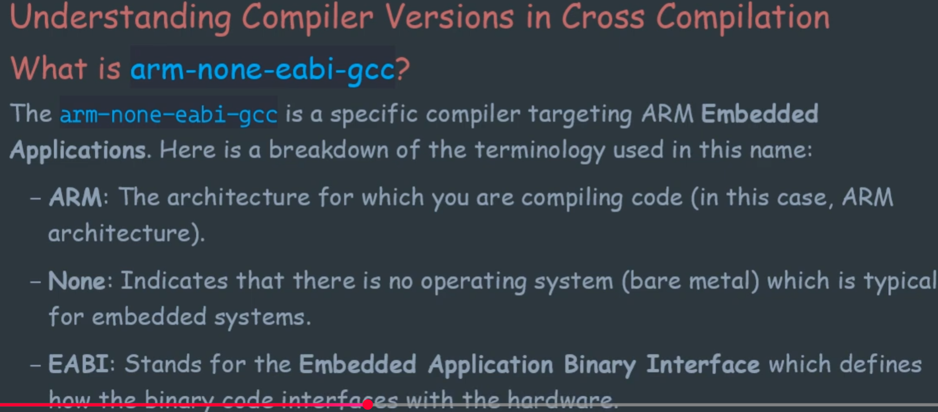
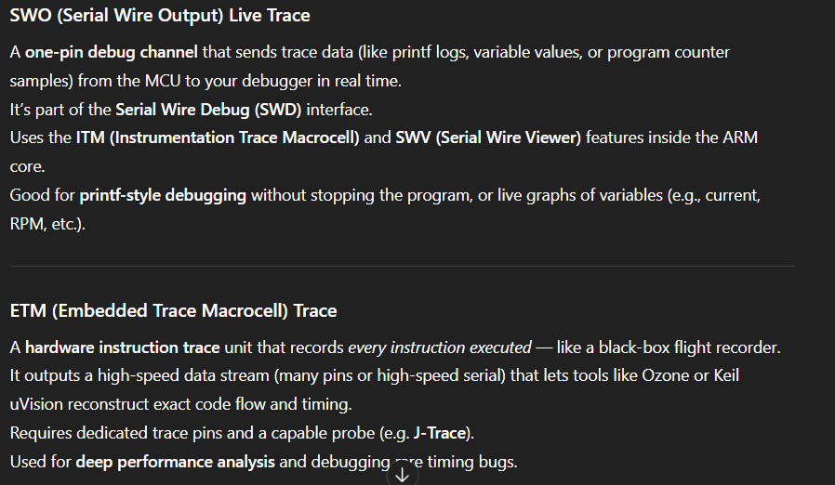
Vocab
EABI: Embedded Application Binary Interface
EEPROM: Electrically Erasable Programmable Read-Only Memory
EPROM: Erasable Programmable Read-Only Memory (erase using uv rays)
PROM: Programmable Read-Only Memory (one time programming)
ROM: Read-Only Memory (only programmed in factory)
FGMOS: Floating Gate Mostfet
ITM: Instrumentation Trace Macrocell https://orbcode.org/orbuculum/single-wire-output/
ETM: Embedded Trace Macrocell (full instruction-level trace recorder) https://orbcode.org/orbuculum/single-wire-output/
SWO: Single Wire Output (one-pin debug channel that sends trace data) part of SWD and relies on ITM
SWD: Serial Wire Viewer
OpenOCD: Open On-Chip Debugger
GDB: Gnu DeBuger (connect to the MCU throught GDB server - e.g., ST-Link GDB server, J-Link GDB server,
or OpenOCD)
DWT: Data Watchpoint & Trace
TPIU: Trace Port Interface Unit https://orbcode.org/orbuculum/single-wire-output/
APB: ARM Peripheral Bus
TLA: Three Layer Acronyms
NRZ: Non-Return to Zero
RZ: Return to Zero
ELF: Executable and Linkable Format (.out, .o, .elf)
LMA: Load Memory Adress https://embeddedartistry.com/fieldmanual-terms/load-memory-address/
VMA: Virtual Memory Adress https://embeddedartistry.com/fieldmanual-terms/load-memory-address/
ld: loader -> Linker script for GNU (.ld)
POSIX: Portable Operating System Interface
LLVM: Not an acronym but the full name
cc: C Compiler
as: ASsembler
nm: NaMes
ar: Archiver
.s: assembly file

Slide 5
Vocab
.o: Object file (etymology is lost to time), is assembled from .s assembly files by the assembler
IR (e.g., GCC IR, LLVM IR): Intermediate Representation, between .c and assembly
CTR: C RunTime objects
PHDR: Program HeaDeR
Export/import of symbols: dynamic linking of shared libraries (.dll on windows, .so on linux) to find and use each other variables at loadtime or runtime. It include a specific section (.dynsym in ELF) that serves as a public registery of available symbols. Offer an API which removes the need to recompile the calling program. The import is asked by the importing program to the dynamic linker (run by the OS) on start. Static libraries cannot do it, no resolution at runtime. On MCU, it is rarely implemented as it requires a lot of ressources
CAN: Controller Area Network, a message-based communication protocol
VCS: Version control system
LTO: Link Time Optimization
Soft Float ABI: floating point operation are handled by software using library calls rather than by using HW such as with a FPU, used for compatibility issues
ABI: Application Binary Interface
MPU: Memory Protection Unit
Semihosting: mechanism that allows code running on a embedded system to use the graphic facilities of a host computer via the debugger
Stack overflow
ITM: IBM Tivoli Monitoring
DFU: Device Firmware Update
NVIC: Nested Vector Interrupt Controller
WFI: Wait For Interrupt, low power mode waker
CCM: Core Coupled Memory
SRAM: Static Random Acces Memory
MTE: Memory Tagging Extension
PMU: Performance Monitoring Unit
Dump Stack: stack traceback which is printed on crashes
SMP: Symetric MultiProcessing,
NTP: Network Time Protocol server synch the clock on a device with a network clock
IRQ chain: IRQ linked to numerous devices ask these device is they produce the interrupt so we know which is responsile7
IRQ wqueue: Working queue
ISR: Interrupt Service Routine

Slide 6
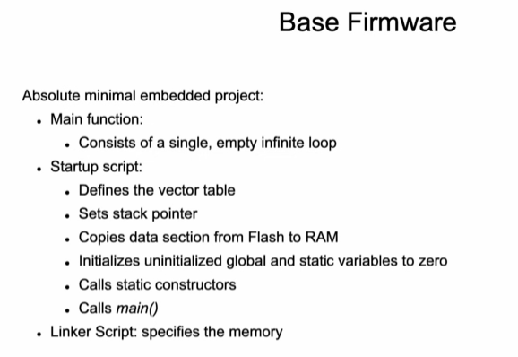
Vocab
IRQ stack: dedicated memory region to handle interrupts and exceptions
Main thread stack size: size of the memory allocated to the first thread/ process that start afet board init
Sporadic scheduling: scheduling algo that handle aperidic task in a system that mostly rely on periodic scheduling
PC: Program Counter
Literal pool: region of memory (often places immediately after the function/code that use it) that store constant data (literals) that CPU instruction cannot encode directly. In ARM, it is used to load large constant as immediate values are limited to 8 or 12bits (and instruction to 16 or 32bits)
Immediate value: constant number that is encoded directly in the instruction
rx: Read-only and eXecutable
LMA: Load Memory Adress
NMI: Non-Maskable Interrupt
RTC: Real Time Clock
MCO: Microcontroller Clock Output
UB: Undefined Behavior
EPI: External Peripheral Interface
Dynamic Polymorphism:
  Interfaces
  Realisations
RTTI: Run-Time Type Information, increase the binary size as information on each objects have to be explicated
  -fno-rtti, gcc tag to disable it
Constexpr
Consteval
Mangled named: Names after linking and compiling
ABI: Application Binary Interface
Atomic: means the operation completes in one indivisible step - it cannot be interrupted or partially completed.
BSSR: Bit Set/Reset Register
ODR: Output Data Register
IWDG: Independent WatchDOG, reset MCU if not periodically refreshed, runs on independent clock and survives to Sleep mode
NVIC: Nested Vectored Interrupt Controller, manage interrupts priorities and enables/disables interrupts
RCC: Reset Clock Control, configures all system clocks (HSE, HIS, PLL, …)
WWDG: Window WatchDOG,

Slide 7
Vocab
APB clock: Advance Peripheral Bus clock
HSE: High-Speed External (oscillator)
HSI: High-Speed Internal (oscillator)
PLL: Phase-Locked Loop (Generate High frequency clock from HSI or HSE) ex: 16MHz HSI -> 170MHz
  PLLM: Divider
  PLLN: Multiplier
  PLLP: For ADC, SAI
  PLLQ: Used for USB, RNG, FDCAN
  PLL
LSI: Low-Speed Internal
LSE: Low-Speed External
VCO: Voltage Controlled Oscillator
MSC: MCU Support Package
Edge Aligned PWM
Edge Aligned PWM with deadtime insertion
Center aligned PWM
RCR: Repetition counter, can be used to oversample the PWM
DPWM: Discontinous PWM
Register Preloading: Allow to prewrite register before they are write in an active (=shadow) register at a specified event. This avoid to have only a part of a register write when PWM start and the other at the end
DMA burst for 0 overhead register updates: DMA is used to store PWM value until time to write (TTW), allowing CPU to continue SW computation without having to care of when or how to write the data on the event itsellf
Synchronized ADC triggering for 0 overhead: Syncrhonise PWM and the ADC reading, allowing 0 SW trigger
Multiple Update in Center Aligned PWM: Only usefull in double PWM configuration, permit to avoid both PWM to be trigger on the same edge, which reduce noise, ripple, … also, allows to write the cycle time twice per electrical cycle to double resolution
Multi-Sample current sensing: Using the comparator associated with a trigger to get multiple reading of current/tension on ADC with no CPU overhead
Break Input Filtering: Filter the break trigger so they are not triggered by EMI
Asymmetric Dead Time: Can be used if not the same HIGH and LOW mostfets, can also update DT on the fly depending of current
Control method for MOSTFET:
  Synchronous rectification: both MOSTFET are driven, which avoid having to use the diode
  Diode freewheeling: current flows though the MOSFET, less switching loss but more conduction losses (the diode) which are often much greater. DPWM mitigate this issue by freewheeling only the non-driven phase

Slide 8
Vocab
Dithering:
CCR: Capture and Compare Register, hold the duty cycle for each channel
ARR: Auto-Reload Register, define the value at which the timer reload (aka the PWM period)
ARP: Auto Register Preloader, is used to avoid immediate write to ARR (PWM base frequency), which can result in glithc, by delaying it until the next update event. Only needed when we want to change PWM on the fly, consume no overhead so always activated.
Timer slave mode: the timer is partially controlled by another, no SW overhead
MSM: Master/Slave Mode
MOE: Main Output Enable
OC: Output Compare
OSSR:Off State Selection for Run mode, MOE=0 (output inactive) but CEN=1 (counter active)
OSSI: Off State Selection for Idle mode, MOE=0 (output inactive) but CEN=0 (counter inactive)
OIS: Output Idle State, defined disabled output level (=0 => gate dischages on ESC)
Lock Levels: prevent accitendal modification after initialisation (cannot be changed before MCU reset)
Preload: Meaning that the register is preloded and DMA does when trigger by an event. Allows 0 overhead control of when changes are applied, hence avoiding glitches.
Cache placement: refer to the method of placing tight loop at a cash-line-aligned Flash adress using the linker script
AHB: Advanced High-performance Bus

Slide 9
Vocab
------------------------------------------------ ALGO
Algo: completeness and correctness – must produce correct output for all valid input of is domain. It must handle invalid input appropriatly, including proper termination conditions.
  Full constraint specification: need to state: memory bounds, numeric precision, allowable operations, time complexity expectation.
A

Slide 10
Vocab
-------------------------------------------------------------------------------------------- OS VOCAB
Round-Robin: Cyclic distribution of quantas
POSIX: Portable Operating System Interface
IEEE: Institute of Electrical and Electronic Engineers
Semaphore: variable used to access a common resource by multiple threads
IPC: Inter-Process Communication
Message Queue: sibling of the ublisher/subscriber pattern used in message-oriented middleware
pthreads: POSIX threads, execution and parallel execution model, API
Robust mutex: mutex that automatically release the thread when terminated
Standard default signal action: terminate the process (e.g. SIGINT, SIGTERM), terminate the process and generate a core dump (e.g. SIGQUIT), ignore the signal (e.g. SIGCHLD), or stop/continue the process (e.g. SIGSTOP, SIGCONT)
BSD: Berkley socket
Race condition
Preemptive scheduler https://en.wikipedia.org/wiki/Preemption_(computing)
VxWorks: Proprietary RTOS
LKM: Loadable Kernel Modules, kernel binaries that can be loaded and unloaded without rebuilding the image
MPU: Memory Protection Unit
MMU: Memory Managment Unit
  Flat Embedded Build
  Protected Build with Memory Protection Unit (MPU)
  Kernel Build with Memory Management Unit (MMU)
NUMA: Non-Uniform Memory Access
HM: Heterogeneous Memory
A page: A fixed-length continuous block of virtual memory

Slide 11
Vocab
Memory allocators:
  Standard heap memory allocation: pool of memory for dynamic allocation at runtime (malloc, …). Program ask a certain amount of the heap, and the allocator finds it
  Granule allocator: allocator the manage 'granules': fixed size memory blocks. Used with DMA as precise alignment is required. More performant but memory waste.
  Shared memory: region that can be access by multiple processes simultaneously,
  Dynamically allocated, per processes, heap memory: Private heap memory for each process
IPC: Inter Process Communication
inheritable controlling terminal: the terminal of a child process is inherited when forker
I/O redirection: command line command to specify input and output of a process
PTY/pseudotty: pseudoterminal, A device that has the functions of a physical terminal without actually being one.
In memory, pseudo-file system: RAM based file system that create its structure on the fly, meaning that it only exist while the system is runnning.
VFS: Virtual File System, allow client applications to access different types of concrete file systems in a uniform way (window, linux, ethernet, …) in 1 file system thanks to abstraction
Mount-able volumes
SYSLOG: System Logging
FAT: File Allocation Table
NFS: Network File System
NxFFS: Nuttx Flash File System (wear balancer)
LittkeFS: Little Flash System(wear balancer) for arm embedded
ROMFS: Read-Only Memory File System
XIP capable: eXecute In Place, means a device or system can execute code directly from flash memory without first copying it into RAM
QSPI: Quad Serial Peripheral Interface
CROMFS: Compressed ROMFS
TMPFS: TeMPorary File System, file storage paradigm that is intended to appear as a mounted file system but is stored in volatile memory
RAM disk: equivalent to TMPFS but need a File System to operated on top of it, where TMPFS is the file system
UnionFS: File System which implement an union mount for other files systems
Union mount: Is a way to combine mutiples directories into one that appears to contain their combined content
FTP: File Transfert Protocol
TFTP: Trivial File Transfert Protocol

Slide 12
Vocab
HTML: HyperText Markup Language
Device Driver: Piece of software that allows the operating system to communicate with an HW device
CDI ('c'): Character-Device Interface, device driver that transfer data as a continuous array of bytes (e.g., serial port, keyboard)
BDI ('b'): Block-Device Interface, device driver that transfer data as fixed size chunk called blocks (e.g., hard disk, usb drives)
Raw I/O and Direct I/O: are mechanisms that bypass the standard operating system buffer cache for data transfer, but still use the FS. It bypass the Page Cache of the OS
IOMMU: I/O Memory Management Unit
AIO: Asynchronous I/O
INTID: Interrupt ID
SBSA: Server Based System Architecture
PPI: Private Peripheral Interrupt
WFE: Wait For Event
Watchdog Timer Driver Architecture
/dev/null
/dev/zero
/dev/random, /dev/urandom
SPI: Serial Peripheral Interface, 4 wires
  MOSI (Master Out, Slave In)
  MISO (Master In, Slave Out)
  SCLK (Serial Clock)
  CS (Chip Select)
Framebuffer driver: manage a specific region of the RAM that directly correspond to pixels on screens, exposed as a file in Linux (/dev/fb0)
RFB: Remote Frame Buffer
VNC: Virtual Network Computing
TCP: Transmission Control Protocol
IP: Internet Protocol
UDP: User Datagram Protocol
DNS: Domain Name System
MTD: Memory Technology Device
FTL: Flash Translation Layer
LBA: Logical Block Adresses

Slide 13
Vocab
Weak symbol: specially annotated symbal during the linking of ELF object file that can be overridden during linking.
RISK: Reduced Instruction Set Computer
TAR: Tape ARchive, combine multiple file in one, it preserves file metadata (permission, …) but do not compress them
Bind mount
etc/ (linux folder): ec cetera
Linux OS: access the whole FS manual using ‘man hier’ (hierarchy)
/etc/udev: subsystem that manages external devices event
USBIF: USB Implementer Forum, distribute the usd vendor ID
ID: Identification Document
VID: Vendor ID
PID: Product ID
arch: architecture
mm: memory management
NuttX FS: explanations Directory Structure — NuttX latest documentation
U-Boot loader: Universal Bootloader, open-source bootloader used in embedded
Bootloader/bootstrap loader: loads the OS in the computer memory
POST: Power-On Self-Test, test perform by the BIOS to check all hardware components are OK
IAP: In Application Programing, firmware update after the product has been deployed
OTA: Other The Air, can be said for firmware update for instance
Interrupt Vector Table
DFU: Device Firmware Update
binfmt: Binary Format Miscellaneaous
Lower half: hardware specific driver
Upper half: driver registered as driver to the OS and implement the high-level interface. It calls the lower half using callbacks
Virtual Vertical Graphics Space
Client/Server Model
Multi-User Support
SWI: SoftWare Interrupts

Slide 14
Vocab
NSH: NuttSHell
ps: Processes Status
TID: Task ID
PID: Process ID
PPID: Parent Process ID
PRI: PRIority
Kthread: Kernel Thread
hpwork: Hight Priority Work queue
NPX: Non-Preemptable Count (NuttX): ‘-’ means that preemption is enabled
Task State
  Ready, ready tu run, waiting for CPU
  Waiting: currently blocked, waiting for smth to occurs
  Running: currently using the CPU
Event, specifies what a task is waiting for
  Signal: waiting for a specific signal or interrupt
  Semaphore: waiting for a semaphore to be realesed bu another task
SIGMask: SIGnal Mask, hexa bitmask that show which signal are currently blocked from being deliver to a task
Stack usage: amount of memory has utilized in its dedicated call stack, to much stack usage led to stack overflow
Stack: reserved area of RAM used by a task to manage its execution flow. It is LIFO (Push+Pop)

Slide 15
Vocab
---------------------------------------AI
Segmentation
CNN: Convolutional Neural Network
FCN: Fully Conventional Network
Deep ConvNet: Deep Convolutional neural Network, core feature extractor (backbone)
R-CNN/Fast R-CNN: Mask Region-based CNN, deep learning model for instance segmentation, detect object and generate high quality pixel level segmentation mask for each instance. Multi-Stage, not design for RT performace, need pixel level annotated data
YOLO: You Look ONly Once, designed for real time performance
ResNet
FPN: Feature Pyramid Network
RPN: Region Proposal Network
Region Proposal
Feature Extraction
Parallel Prediction
RoI: Region of Interest
RoIAlign: Feature to extract pixel perfect contours (unlike previous models like RoIPool)
Classification branch: predict the object's class label
Bouding box regression: refine the object location with a precise bounding box
Mask branch: generate a binary mask for each object
Keypoint detection/landmark detection: locate point of interest
FC layer: Fully Connected layer
RoI Projection: mapping coord of a RoI from the real image to the lower resolution feature map
RoI polling / RoI align: extract feature
Conv feature map / activation map: primary output of DeepConvNet, smaller dimesion but much deeper channel dimension. Each unit of the new map is activated by the convolution function or not, depending of the values in the convolution filter

Slide 16
Vocab
COCO: Common Object in COntext, dataset widely used for benchmarking
ILSVRC: ImageNet Large Scale Visual Recognition Challenge, CNN competition, as stop in 2017
Fundational models/fundation model/base model: AI trained on broad unlabeled data. Unlike traditional, specialized AI models designed for a single task (e.g., just classifying dog breeds), foundational models are general-purpose and capture a wide understanding of data, allowing them to be adapted or "fine-tuned" for a wide range of specific downstream applications with less additional training data.
LLM: Large Language Models (GPT4, Claude, PaLM2 (google))
computer vision models: SAM: Segment Anything Model (Meta), CLIP (OpenAI), YOLO
Text-to-Image models: Dall-E (openAI) and Stable Diffusion
Backbone: primary part of the network responsible of producing the feature extraction, essential in CNN, feature hierarchy (layer1:line -> layer n:objects)
  ResNet: RESidual NETwork
  VGG16/VGG19: Visual Geometry Group
  GoogleNet
  MobileNet: optimised for mobile and embedded devices
  EfficientNet
  FPN: Feature Pyramid Network
Classifier: sorts input data into several predefined classes. Learns patters from labeled training data and then make prediction and categorize
  SoftMax Regressor
Transfer learning: adapting pre-trained data to a new, smaller dataset
Anchors generators: Generate a set of anchor (for instance 15), defined by the author, for each pixel in the img
Accelerator
Data loader: dataset+sampler
Sampler: define a strategy to for drawing sample from the dataset
Device: specify is CPU RAM or GPU RAM/VRAM is used
Optimizer: algorithm that adjust weights and biais based on calculated loss. Job is to fin the set of weight that minimizes the loss function.(e.g., SGD)
SGD: Stockastic Gradient Descent
Learning rate scheduler: hyperparameter of the training. Systematically adjust the learning rate to balance performance and stability (e.g., start at 0.005)
Batch: when the dataset are too large for RAM, they are split in batches
Epoch: training cycle where all the dataset single data point is passed forward and backward through the neural network.
Backward/backpropagation/calculate the gradient
mAP: Mean Average Precision
ImageNet: big database used to pre-train CNN
ReLU: Rectified Linear Unit
CUDNN: Cuda Deep NN library
Loss: cost function, error function,

Slide 17
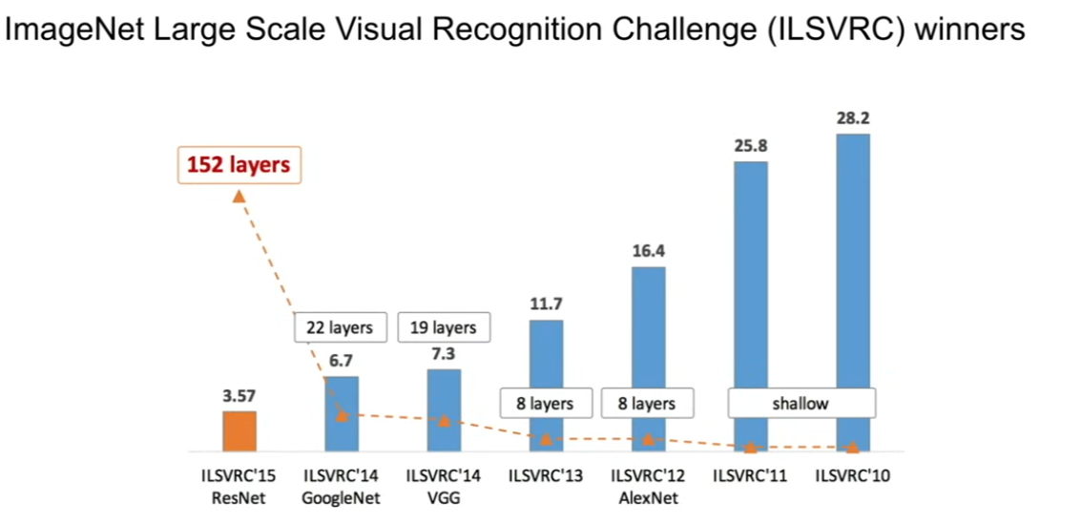
Vocab
Fixed feature extractor: a strategy in transfert learning where you freeze most of the layers of the pre-trained deep NN, which prevent weight to change during training on the new task.
FGSM: Fast Gradient Sign Method attacks
Stride: parameter that defines how many pixels the convolution filter (kernel) shift across the input image (or feature map) at a time.
ERF: Effective receptive field
Depth: Number of layer in the NN
Inception module/layer
IoU: Intersection over Union, compare the predicted box with the ground-truth box
  MAP@.5: a detection need 50% overlap to be deemed correct
  COCO AP (AP .5:.005:.95): starting from 0.50 and stepping up by 0.05 all the way to 0.95. This gives a comprehensive view of the model's performance
AOI: Automated Optical Detection
ASI: Automated Surface Inspection
Supervised training
Unsupervised training/Anomalie detection
Pooling layer: used for image feature extraction
Autoencoder NN/ self-coding NN
Pre-trqining/Transfer learning
VAE: Variational Auto Encoder
GAN: Generative Adversarial Networks
DM: Diffusion Model
Multi-models
Pattern recognizer -> feature engineering
DL: Deep Learning
ML: Machine Learning

Slide 18
Vocab
-------------------- INDUS
Global shutter: Shutter that occult the whole camera at once
IR-cut filter: mechanical shutter that blocks IR to ensure the best imaging quality during the day and the dark vision during the night
Visible wavelength: 320-760nm
IR wavelength: 780nm-1mm
NIR wavelength: 780-2500nm
NIR camera: Near-InfraRed
Black light: light that emit UV to make some substance shine
OD: Optic Density
SNR: Signal to Noise Ratio
Specular surface: surface that behave like a mirror even if irregular
Dynamic range: ratio between the maximum and minimum measurable values of a signal or quantity
Chromatic lens distortion: Distortion created by the refraction and reflection of light beams or same direction but different wavelength => reduce contrast
Exposure
Apperture/f-stop:
Focal depth/focal range
(artificial) gain
Diffusion
reflection
polarisation
Dataset from scratch
Dataset pre train => besoin de train again
  A tester sur alexnet + une question de temps de calcul => GTX 1650 ordre de la seconde
  Mais aussi faire un petit CNN -> autant de couche que de feature
    C’est la partie robustesse du CNC qui va prendre du temps
  Tester avec chatGPT
Qu base de donnee non open source
Qu quid des timing
Isaac Sim ou Blender pour le dataset

