Slide 1

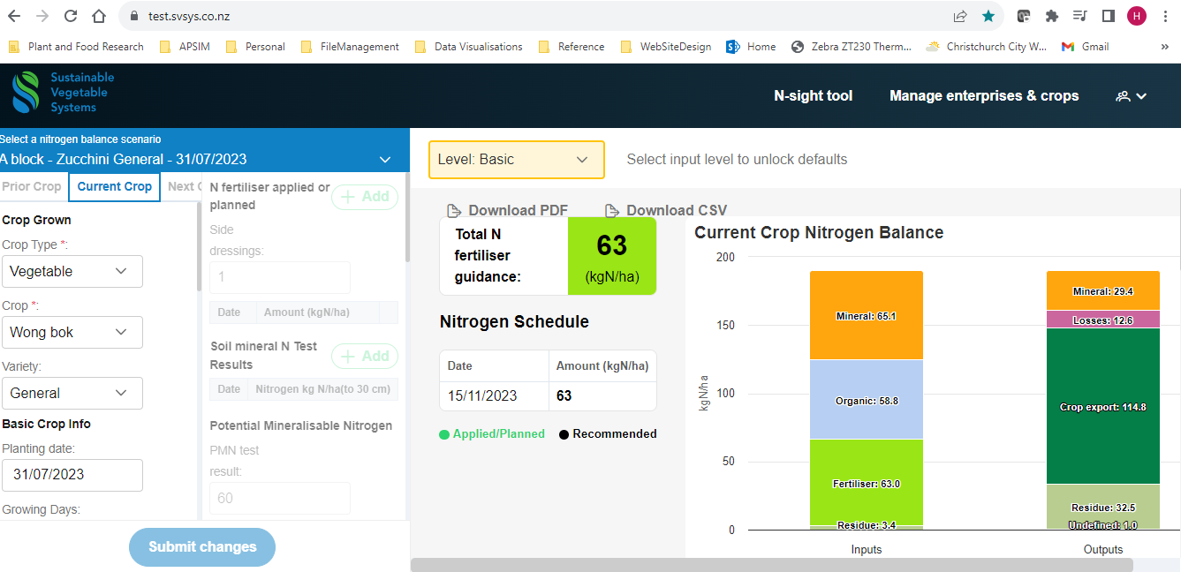
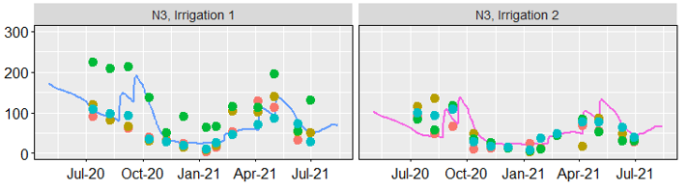
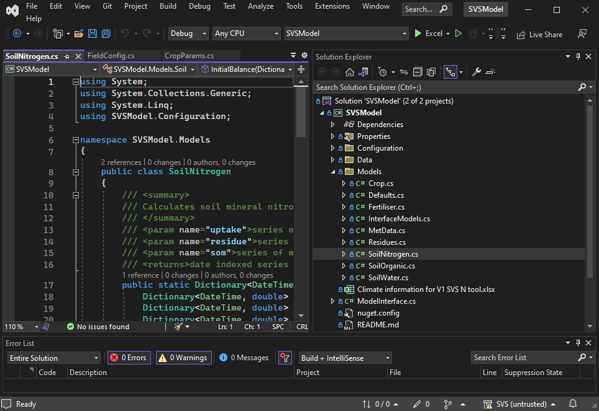
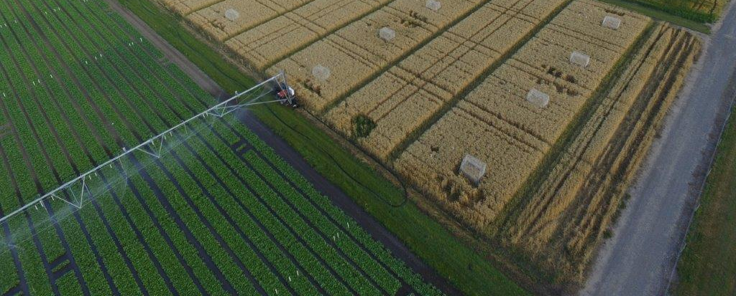
Soil test
results
Fertiliser
Requirements
Estimated
Fertiliser timing
and amount match
crop requirements
Lit review
Crop
Information
https://test.svsys.co.nz/
Model Validation
SVS nutrient
management tool
Process
abstraction
Process
model
testing
Testing System
N balance improvement
Leaching, Gaseous losses,
Residues, scheduling, coeffs
Evaluate
Nitrogen
balance
Coefficients
Pull request
Configuration
Data analysis
Model Code
WS1 & 2 field
Observations, site
and management data
API
NuGet
https://github.com/
PlantandFoodResearch/SVS

