Slide 1
Guide to GITHUB
GitHub Desktop as a bonus

Slide 2
What is a GITHUB?
It is a web-based interface that uses Git*(GitHub cannot be used without Git)
An open-source version control software that lets multiple people make separate changes to web pages at the same time. As a result, person can evaluate code prior to committing it to the source code. It makes version control easier.
Let's multiple people make separate changes to web pages at the same time. It allows for real-time collaboration.
* Git is a locally run (on your local device) version control system. It keeps track of what files are added, changed. It creates a revision history on your device to allow version rollback. Git is used via the command line interface.

Slide 3
Before start using GITHUB…
Install Git onto your local device (Git is free to download).
Create a GitHub account.
Download GitHub Desktop.
Login into GitHub Desktop with a GITHUB credentials

Slide 4
Working with local repositories
git init. This command turns a directory into an empty Git repository. This is the first step in creating a repository. After running git init, adding and committing files/directories is possible.
git add. Adds files in the to the staging area for Git.
git commit. Record the changes made to the files to a local repository
git branch. To determine what branch the local repository is on, add a new branch, or delete a branch.
git merge. Integrate branches together. git merge combines the changes from one branch to another branch.

Slide 5
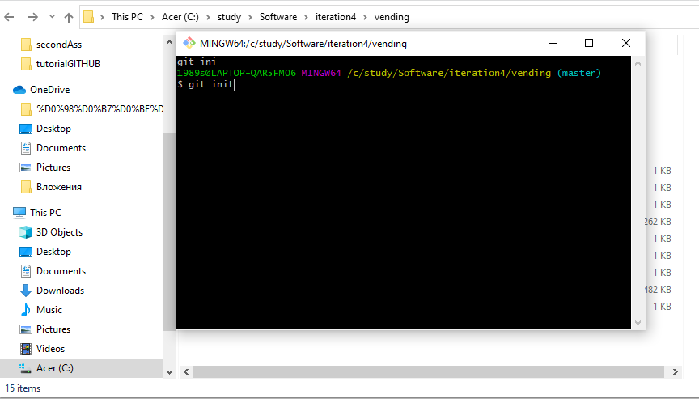
Example of “git init” command on Git Bash

Slide 6
Working with remote repositories
git remote. To connect a local repository with a remote repository.
git clone. To create a local working copy of an existing remote repository, use git clone to copy and download the repository to a computer. Cloning is the equivalent of git init when working with a remote repository.
git pull. To get the latest version of a repository run git pull. This pulls the changes from the remote repository to the local computer.
git push. Sends local commits to the remote repository. git push requires two parameters: the remote repository and the branch that the push is for

Slide 7

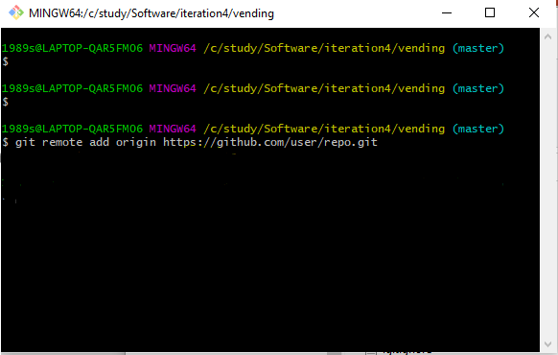
Example of “git remote” command

Slide 8
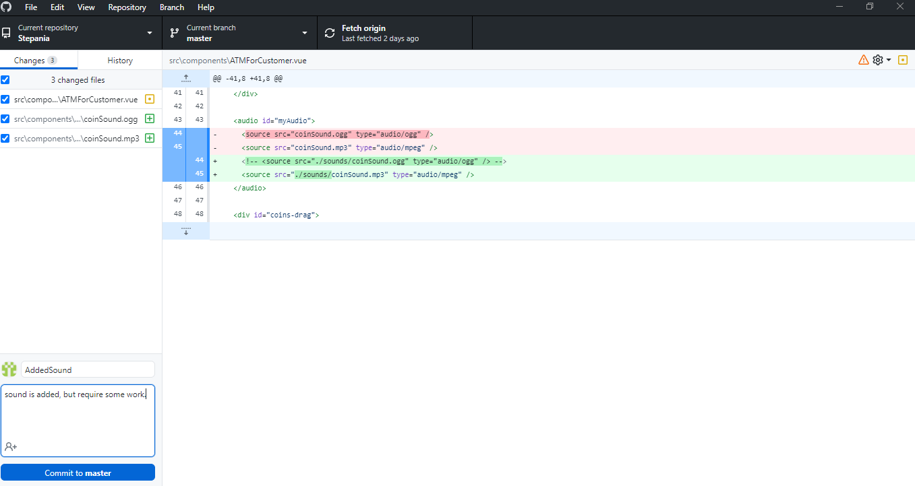

All changes from previous commit are highlighted
Example of commit by using a GitHub Desktop

Slide 9
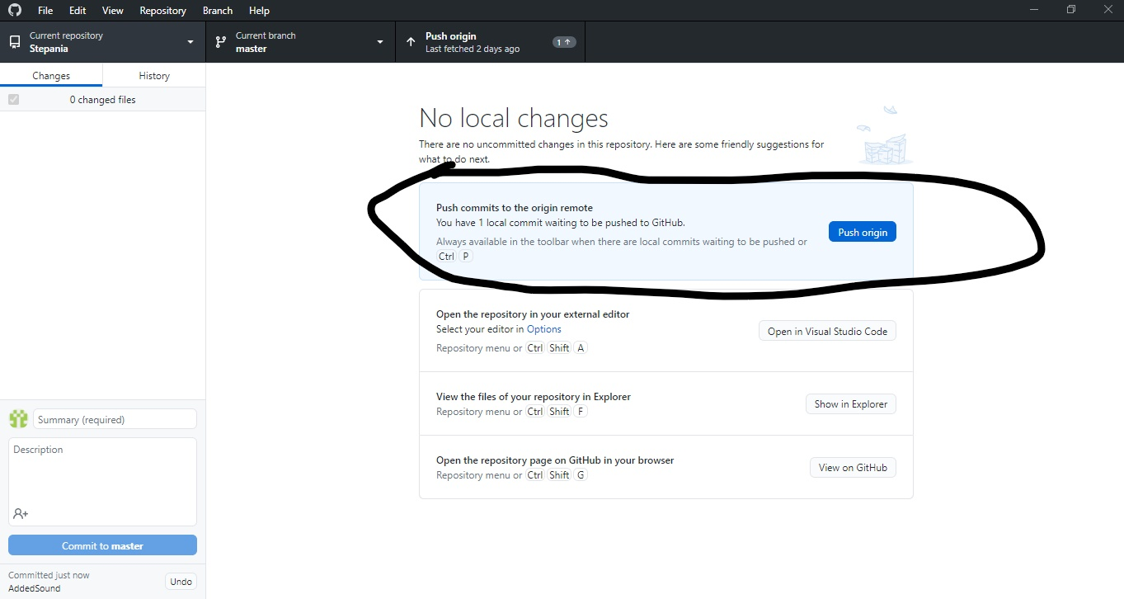
“Push” commit into repository

