Slide 1
Quick guide to git
And git hooks

Slide 2
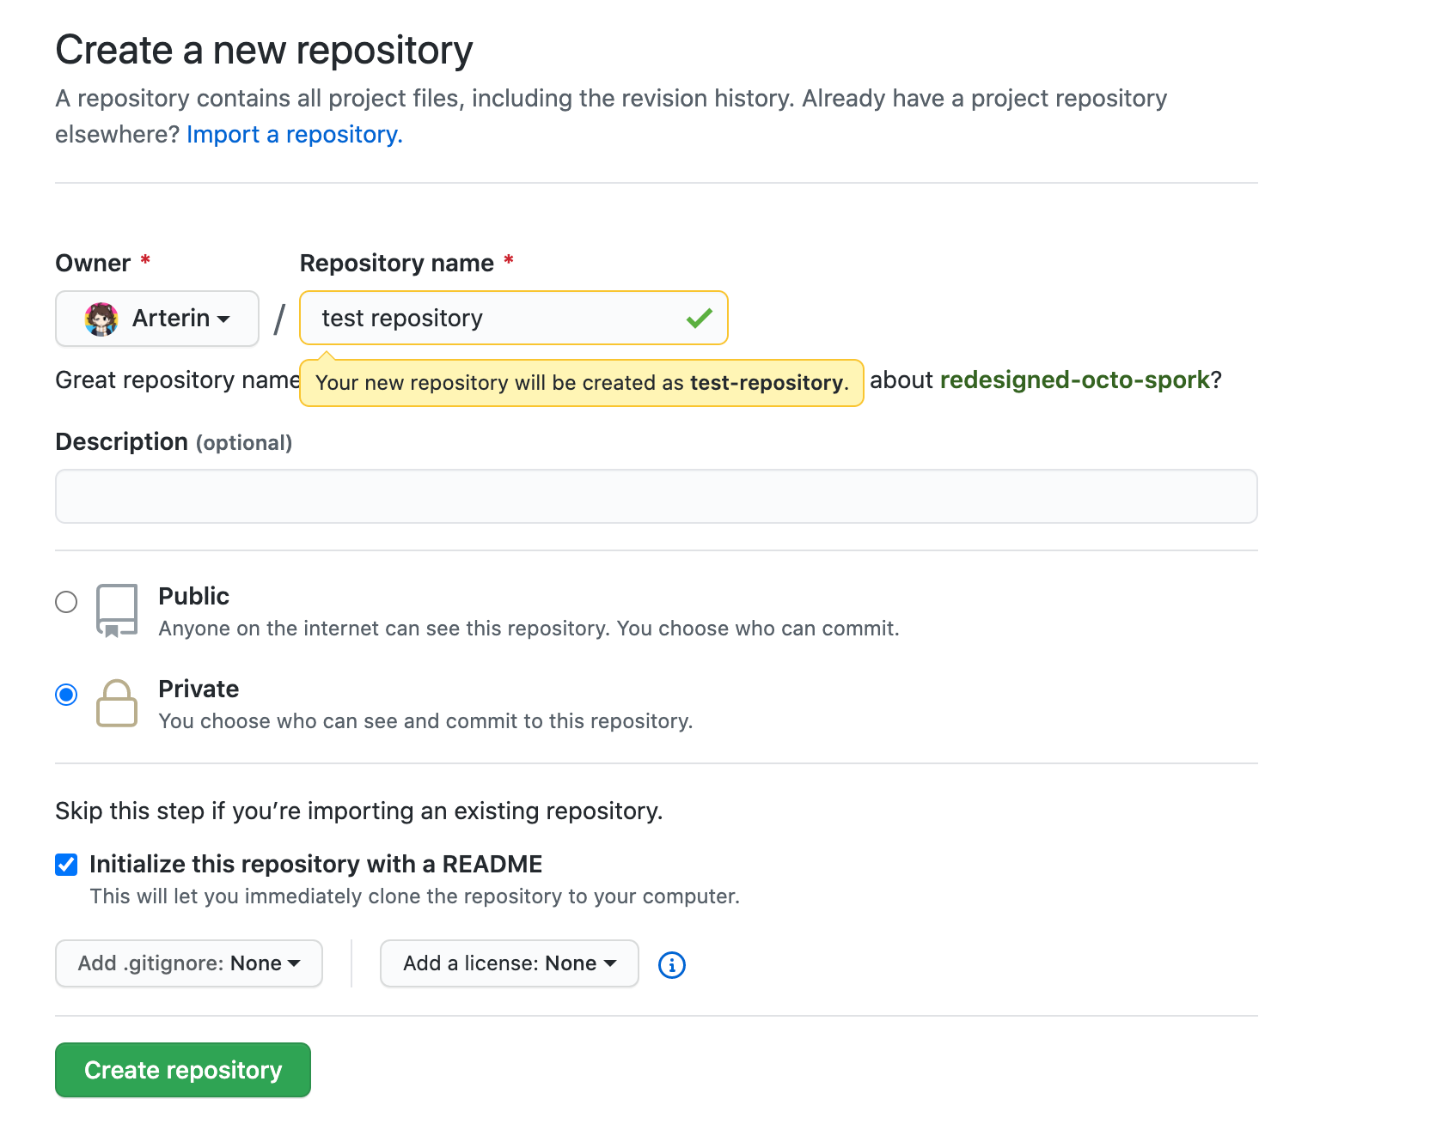
Github
To follow along you will first need to make an account at github.com and a new repository. A repository represents a project or a library of code. Select a license for your repository, this lets other people know what they can do with your work if you choose to make your repository public. this website can help you choose a license.

Slide 3
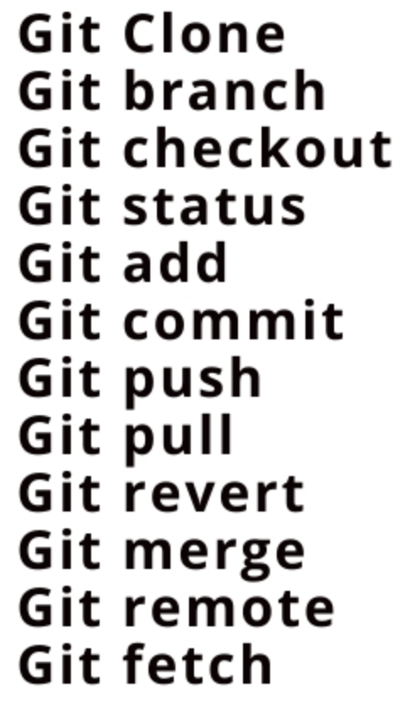
GIT
Git is software that provides version control and a connection to a remote repository. Every time you make a change to a file, git will recognize this and wait for you to ‘commit’ the file. Previous commits of the same file are saved in a hidden folder, so you can go back to them at any time and have a history of changes. When you are ready to sync with your repository that is hosted on github you can pull (sync yourself with your remote repo) and push (add your commits to the remote repo) your commits.

Slide 4
The files on your local machine are a clone of your github repository. Your github repository acts as the master copy and any commit pushed to it must also have a comment. Download git here, then add a readme.md file to your repository on github.com and clone it to your machine. Open a terminal, navigate to your cloned repository and configure git.
$ git config --global user.name "Your name here"
$ git config --global user.email your_email@example.com
$ git config --global color.ui true
$ git remote add “the url of your github repository here”

Slide 5
Now we can make a change to our local readme.md file, commit and push it to our remote repository.
Change the contents of your readme.md file on your local machine.
‘$ git status’ will tell you what files have changed and if you are up to date with your remote repo
‘$ git commit readme.md –m “we made a change to learn how to commit and push”’
The –m option is our comment.
‘$ git status’ will tell us that our readme.md file is commited and staged.
Staged changes are added to the next push, we can unstage changes with ‘$ git reset – readme.md’ if we wish.
Now let’s push our commit to the remote repo with ‘$ git push’
If you check your repository on github now you will see your commit and
the comment, and the content of readme.md has changed

Slide 6
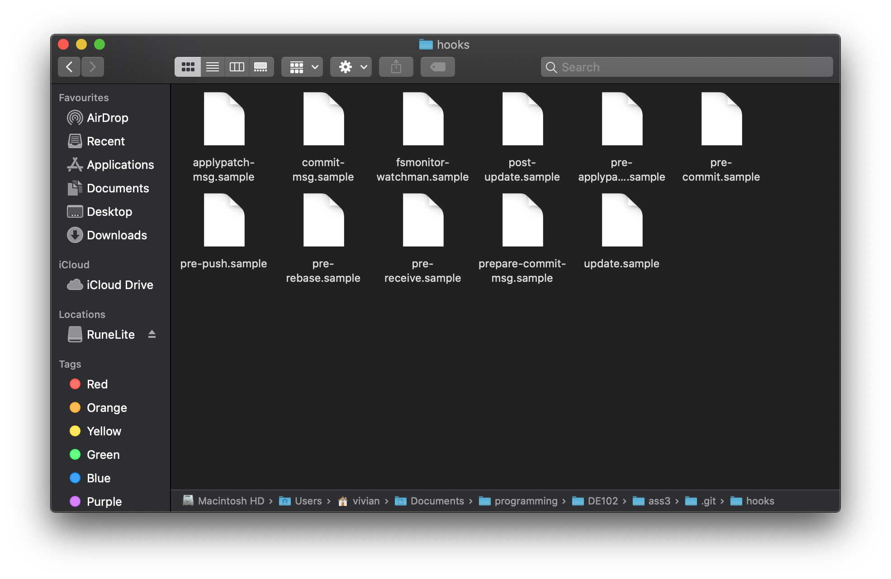
GIT HOOKS
Git hooks are scripts that run at specific times during a git process, we will look at the pre-commit hook, this hook runs before you commit. You can see your hook scripts in .git/hooks in your local repository (git is a hidden folder) in order to activate a hook script you have to rename it to remove the .sample

Slide 7
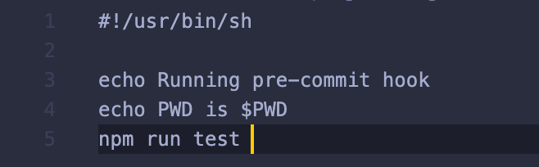
Pre-commit hook
We are going to make a very simple pre-commit hook bash script, delete everything inside your pre-commit.sample and also rename it to just pre-commit. I use npm in this example to run my unit tests, just substitute with however you run your unit tests. This script will exit with code 0 if the tests are successful. Git hooks are very useful, and we can use them for all sorts of other useful things like linting and formatting our code on commit too.

