Slide 1
Sales Force Automation (SFA)
JARDINE

Slide 2
Current Status
On-going Development for SFA Web and Mobile
Finalization of Module Restrictions and Documentation

Slide 3
SFA Modules - Web

Slide 4
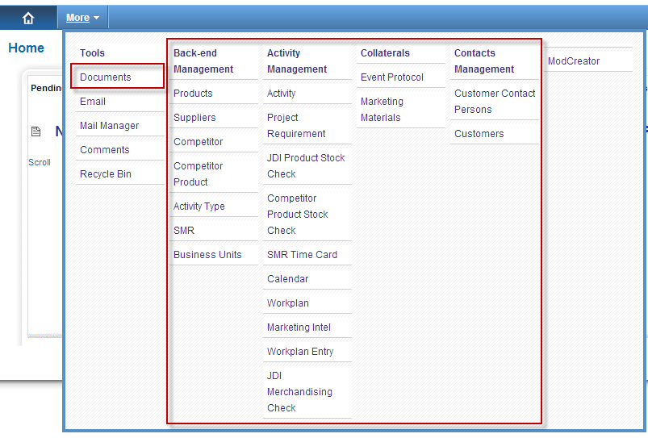
SFA Modules

Slide 5
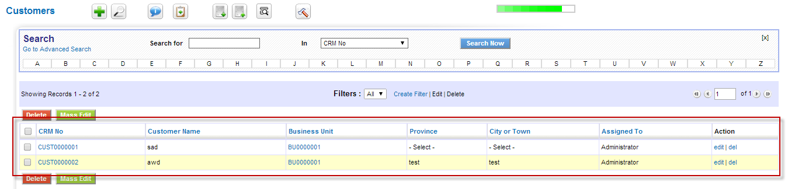
Contact Management
List View

Slide 6
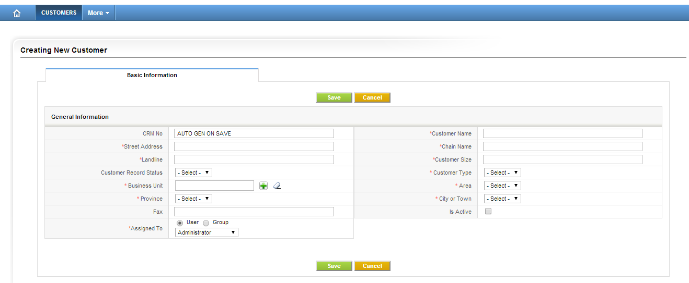
Contact Management
Create New Customer

Slide 7
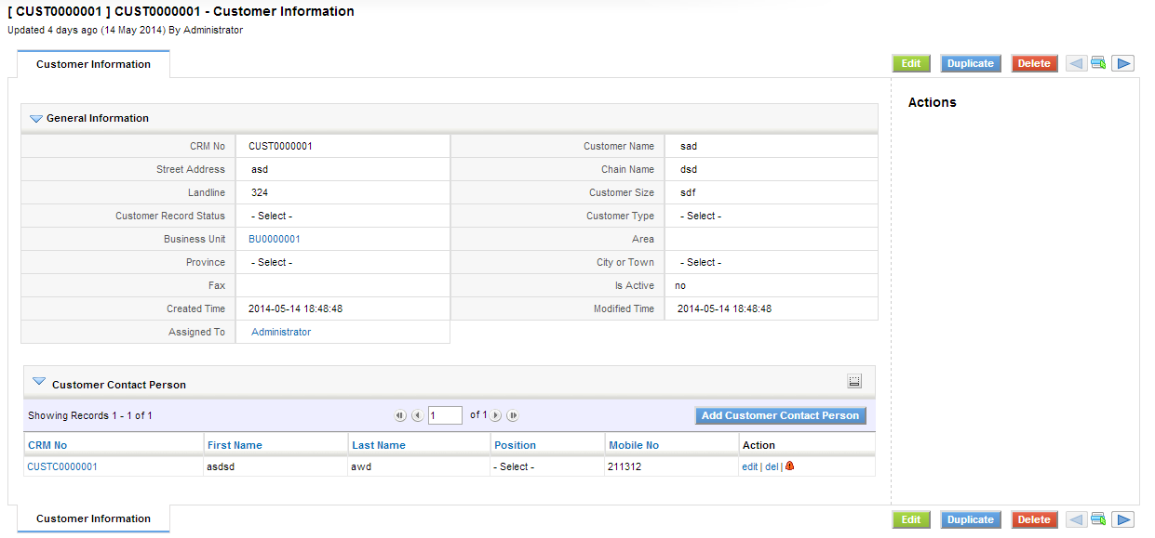
Contact Management
Detail View

Slide 8
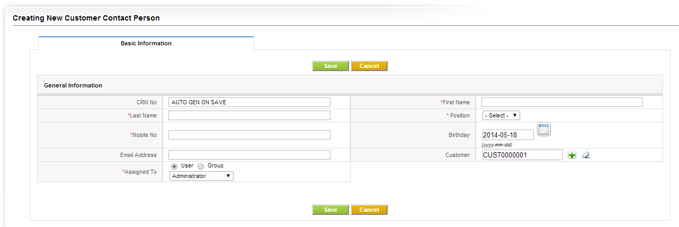
Contact Management
Adding of Customer Contact Person

Slide 9
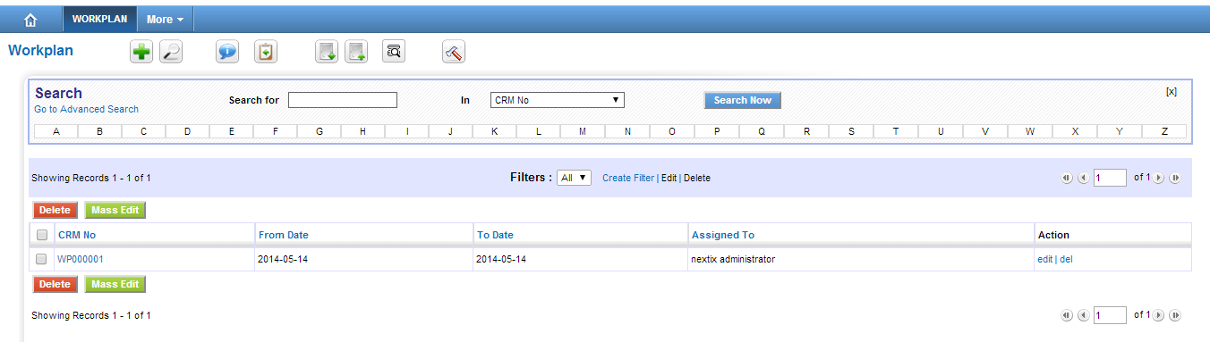
Activity Management
List View

Slide 10
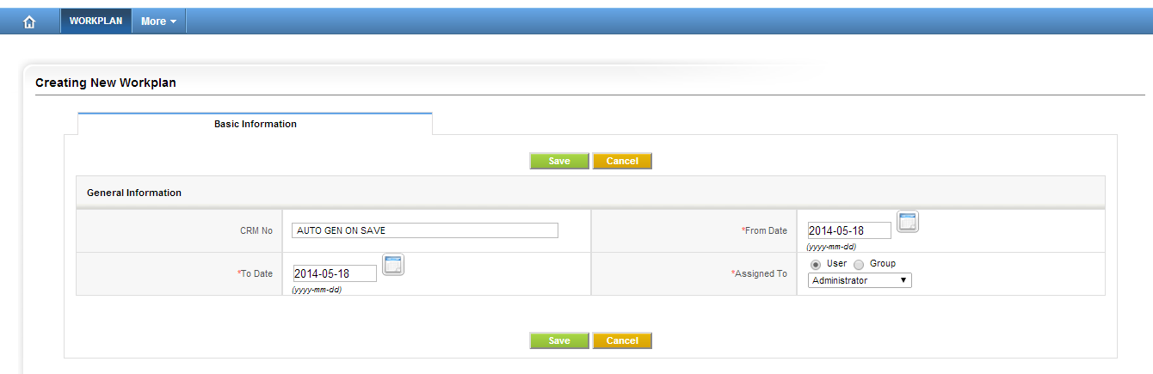
Activity Management
Create Work Plan

Slide 11
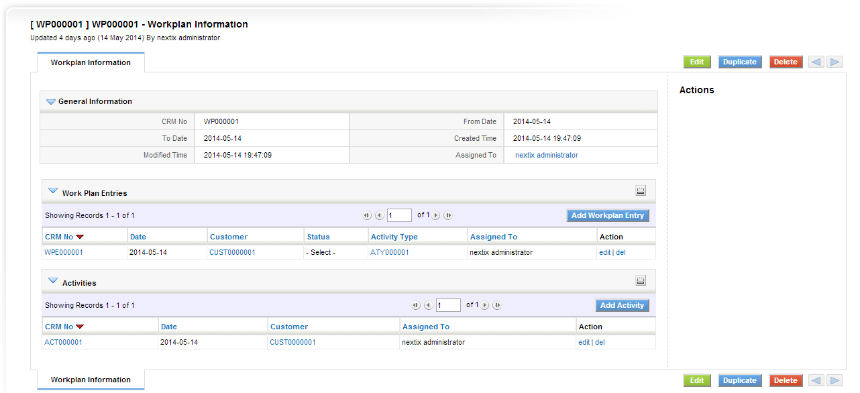
Activity Management
Detail View

Slide 12
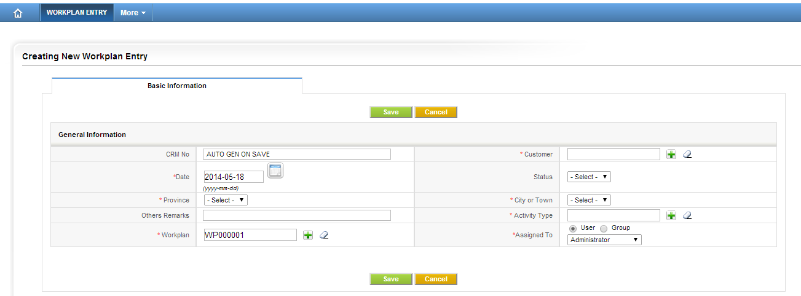
Activity Management
Adding New Work Plan Entry

Slide 13
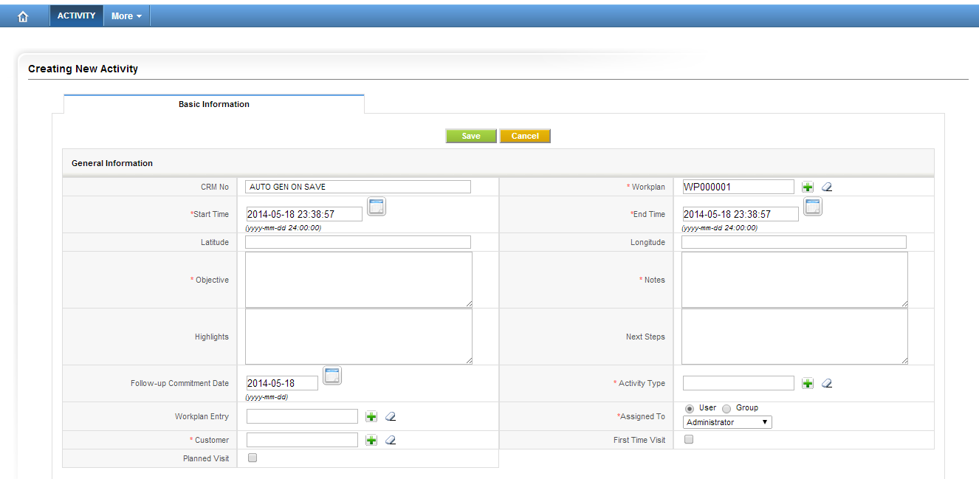
Activity Management
Adding New Work Plan Entry

Slide 14
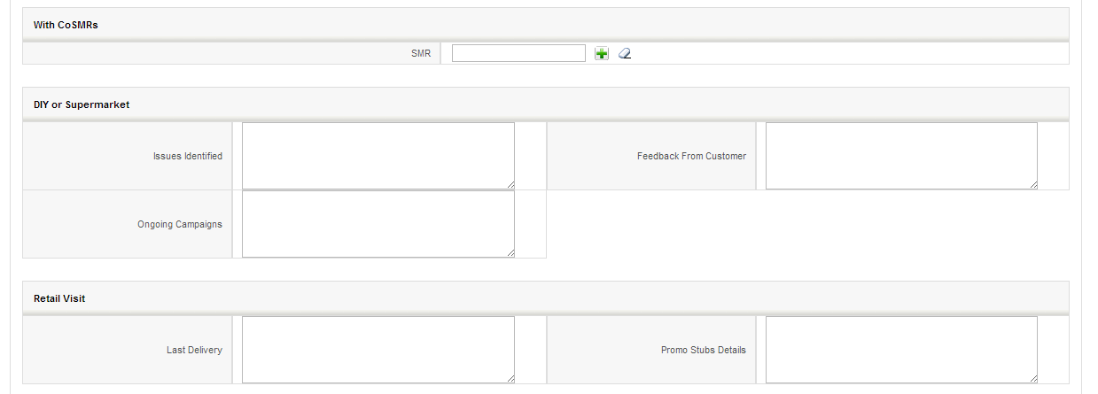
Activity Management
Adding New Work Plan Entry

Slide 15
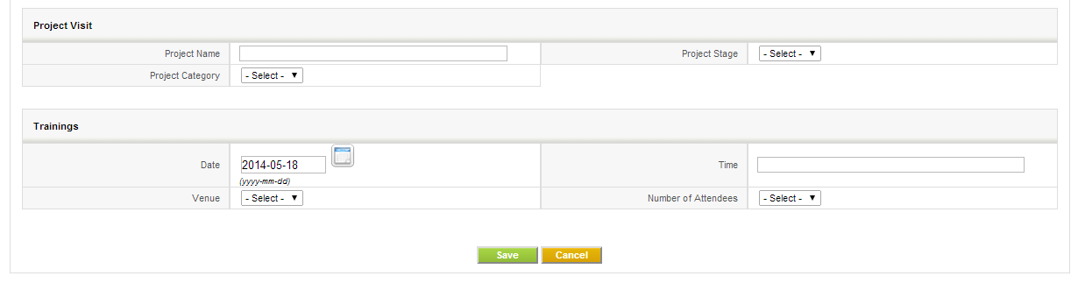
Activity Management
Adding New Work Plan Entry

Slide 16
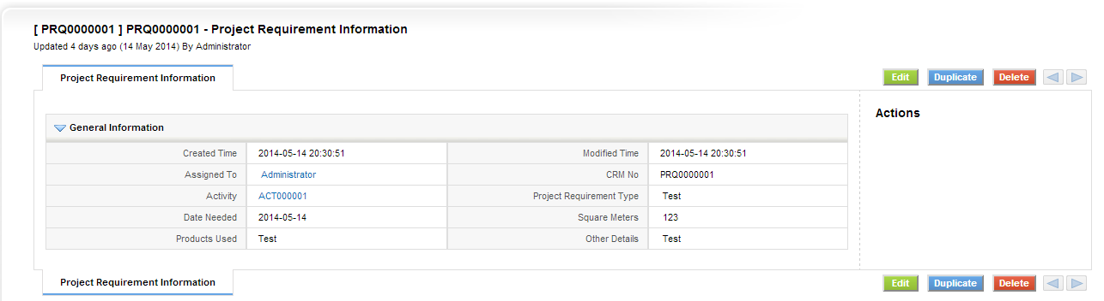
Activity Management
Project Requirement

Slide 17
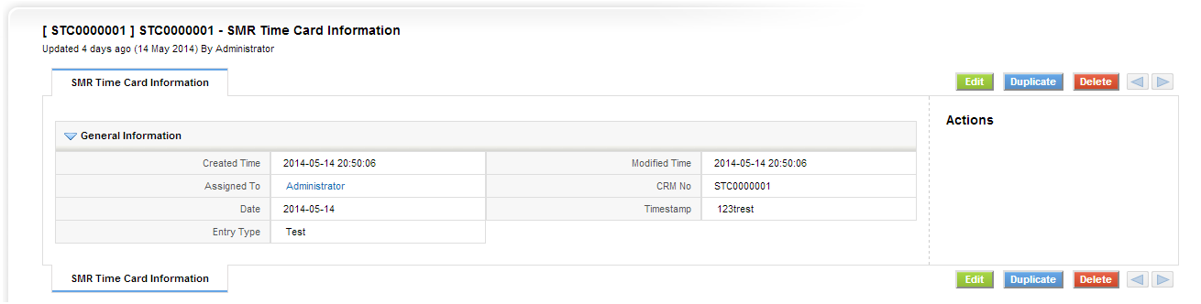
Activity Management
SMR Time Card

Slide 18
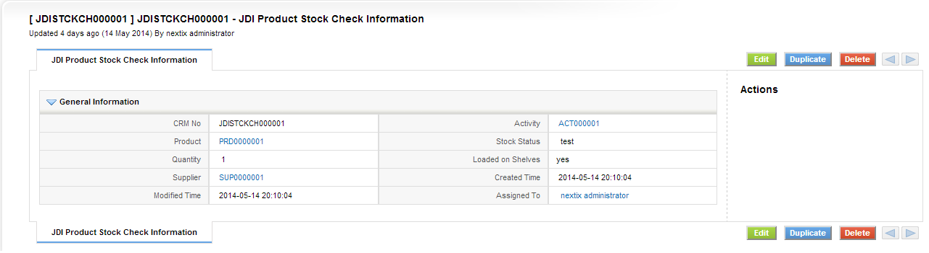
Activity Management
JDI Product Store Check

Slide 19
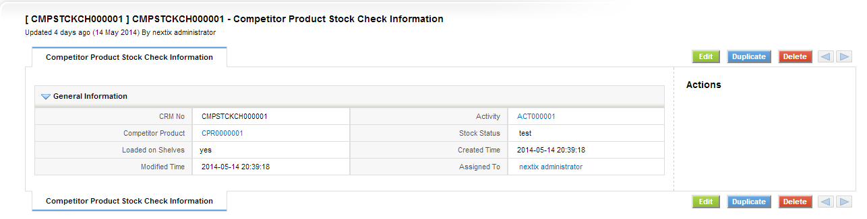
Activity Management
Competitor Product Store Check

Slide 20
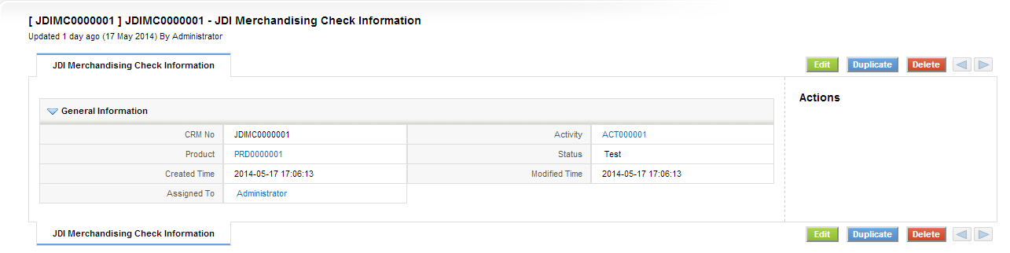
Activity Management
JDI Merchandising Check

Slide 21
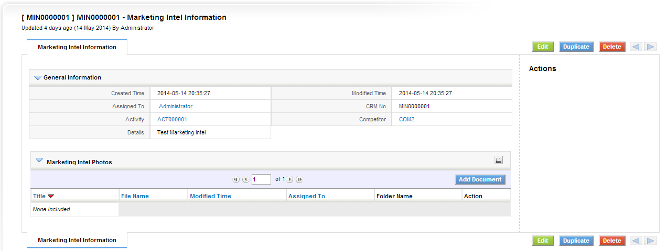
Activity Management
Marketing Intel

Slide 22
Activity Management
Marketing Intel

Slide 23
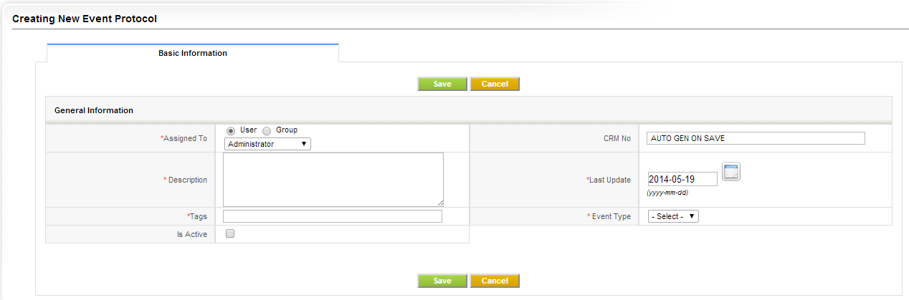
Collaterals
Event Protocol – Creating New

Slide 24
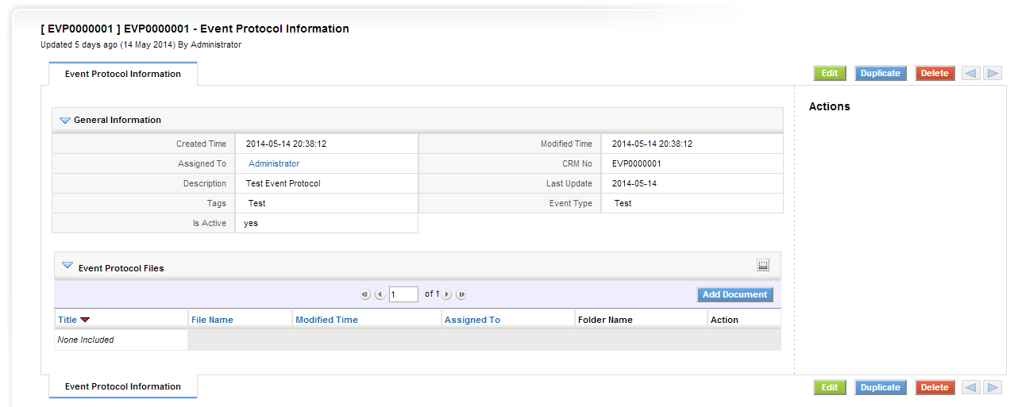
Collaterals
Event Protocol – Detail View

Slide 25
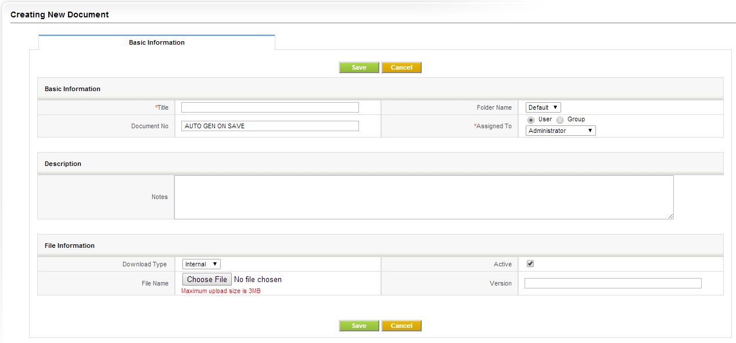
Collaterals
Event Protocol – Adding Document

Slide 26
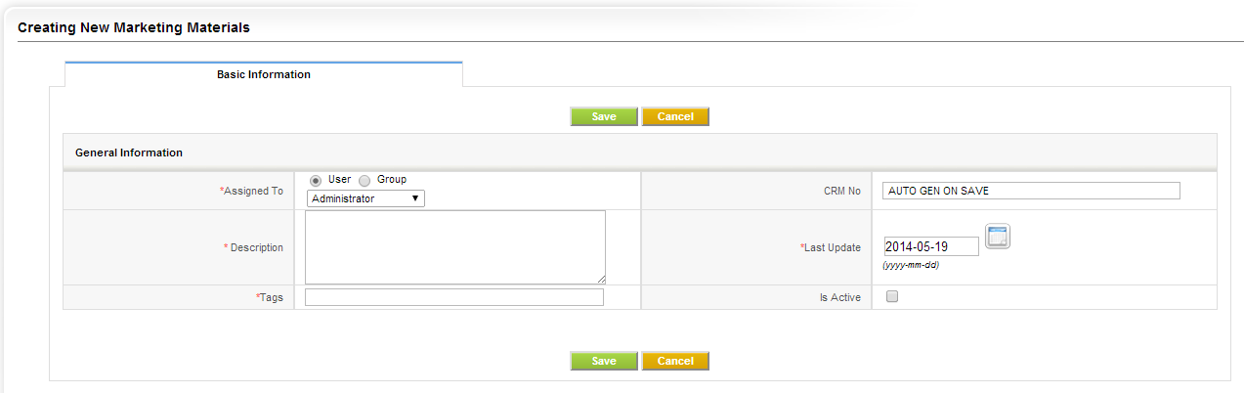
Collaterals
Marketing Material – Adding Document

Slide 27
Collaterals
Marketing Material – Adding Document

Slide 28
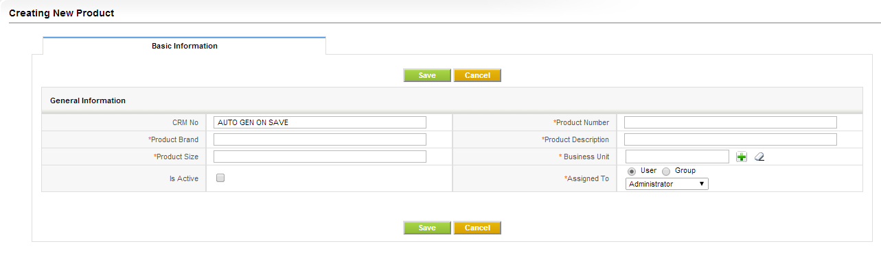
Back-end Management
Product

Slide 29
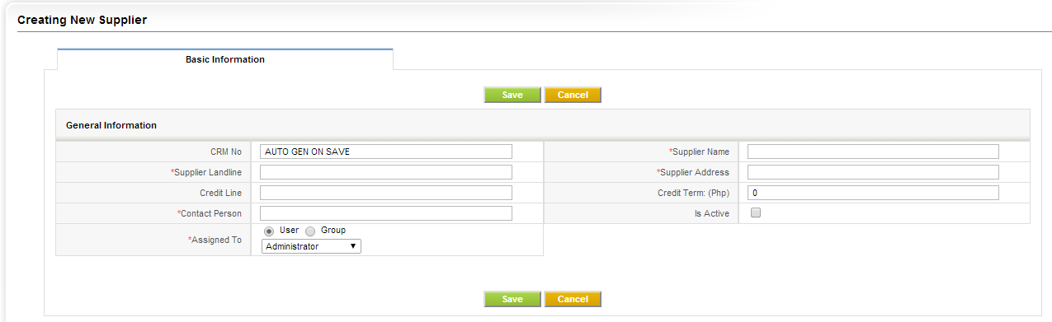
Back-end Management
Supplier

Slide 30
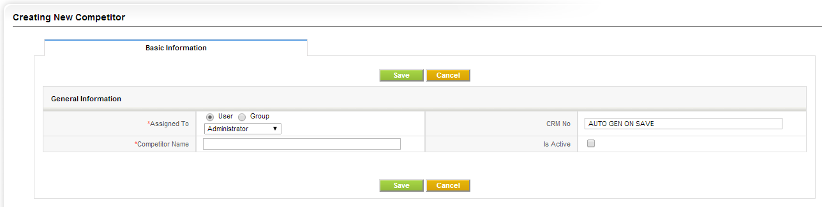
Back-end Management
Competitor

Slide 31
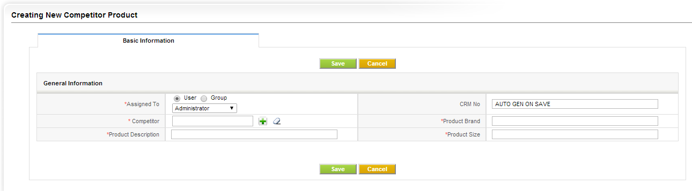
Back-end Management
Competitor Product

Slide 32
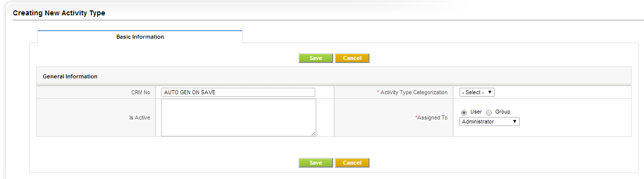
Back-end Management
Activity Type

Slide 33
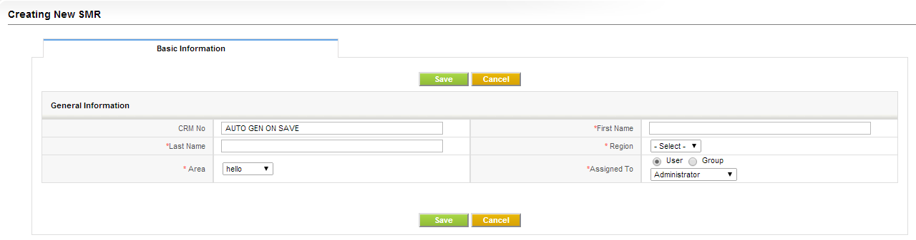
Back-end Management
SMR

Slide 34
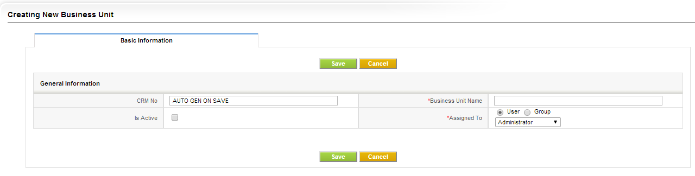
Back-end Management
Business Unit

Slide 35
The End!
Thank You

