Slide 1
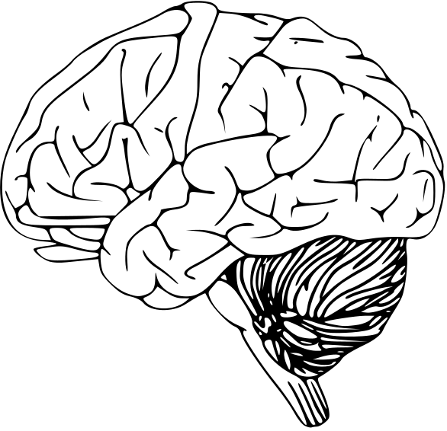
HIDS-7006 AI for Health Applications | Spring 2025
Predicting Alzheimer’s Diagnosis from Perfusion MRI
Stephanie Araki
Health Informatics & Data Science
Notes:
Hi everyone, today I'll speaking about my model which predicts alzheimers diagnosis from perfusion MRI.

Slide 2
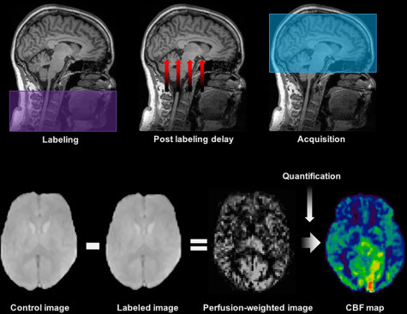
Background & Significance
Need for non-invasive methods for early detection of Alzheimer’s disease (AD)
Arterial Spin Labeling (ASL): a non-contrast MRI technique for measuring cerebral blood flow (CBF)[1]
CBF alterations could serve as a potential biomarker for disease classification[2]
GOAL:
Develop a ML model to support early-stage diagnosis using a non-invasive MRI technique
[1] Arterial Spin Labeling - an overview | ScienceDirect Topics. (n.d.). Retrieved April 23, 2025, from https://www.sciencedirect.com/topics/medicine-and-dentistry/arterial-spin-labeling
[2] Alsop, D. C., Dai, W., Grossman, M., & Detre, J. A. (2010). Arterial spin labeling blood flow MRI: Its Role in the early characterization of Alzheimer’s disease. Journal of Alzheimer’s Disease, 20(3), 871–880. https://doi.org/10.3233/JAD-2010-091699;PAGE:STRING:ARTICLE/CHAPTER
Notes:
Alzheimer’s is hard to diagnose early because symptoms overlap with normal aging. Current methods like PET scans or spinal taps are expensive and invasive. Arterial Spin Labeling or ASL offers a non-contrast MRI method to measure cerebral blood flow.
ASL works by tagging water molecules with a RF pulse in the arterial blood with a magnetic label and then tracking their movement as they flow into the brain tissue.
Research suggests that reduced CBF in specific brain regions could serve as an early biomarker for Alzheimer’s, making ASL a promising tool for classification models.
My goal was to build a machine learning model that predicts Alzheimer’s diagnosis using cerebral blood flow metrics from ASL MRI scans, alongside clinical and demographic data.
----
Cerebral hypoperfusion, or reduced blood flow to the brain, is a significant feature in Alzheimer's disease (AD), particularly in the early stages. Studies have shown that hypoperfusion can precede neurodegeneration and may contribute to the development of cognitive decline.
Arterial Spin Labeling (ASL) is a Magnetic Resonance Imaging (MRI) technique used to measure cerebral blood flow (CBF) and tissue perfusion without the need for an exogenous contrast agent. It works by tagging water molecules in the arterial blood with a magnetic label and then tracking their movement as they flow into the brain tissue.
ASL involves using radiofrequency (RF) pulses to "label" or tag the water molecules in the arterial blood, essentially making them distinguishable from the water molecules in the tissue. The tagged blood is then allowed to flow into the brain tissue, and the MRI machine detects the tagged water molecules, allowing for the measurement of CBF.

Slide 3

Methods: Dataset
Data Extraction
Data Integration &
Pre-Processing
Feature Engineering
Merged dataset
Null handling
Demographic
Age, Gender, Race, Ethnicity, Years of Education
Cleaned dataset
(n =666 )
Scaling, Imputation, One-hot encoding
Clinical
APOE allele status, Baseline diagnosis,
Visit Diagnoses
Features
Un-encoded
Classes
CN, MCI and AD
Cognitive
MMSE, CDR-SB, MOCA, ADAS11/13, LDEL, ECog
ML-Ready Features
708
ML-Ready Classes
0=CN, 1=MCI, 2=AD
Neuroimaging
ASL Perfusion CBF Statistics for 130 regions
Training
80%
Testing
20%
Notes:
I used data from the Alzheimers Disease Neuroimaging database, focusing on subjects with 3T ASL MRI scans.
I pulled four types of features:
- Demographic (like age and education),
- Clinical (like APOE status),
- Cognitive scores (MMSE, CDR-SB, etc.),
- ASL-derived perfusion values for 130 brain regions.
The final dataset included 666 individuals classified as cognitively normal, Mild Cognitively Impaired or MCI, or AD or Alzheimer’s.
To prevent data leakage, I did a group-aware split to make sure that patients with multiple MRIs were put into either the training or the testing set.
During feature engineering, I imputed null values, scaled numerical features and did one hot encoding for categorical features.

Slide 4
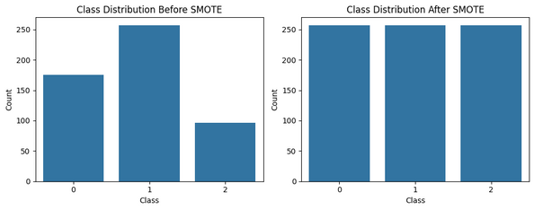
Methods: Model
Initial Training
Oversampling & Hyperparameter Tuning
Evaluation & Interpretability
Group Cross Validation, k=5
Logistic Regression
max_iter=1000, class_weight=balanced
SMOTE
Oversampling of CN and AD Class
Evaluation
Precision, Recall, F1-score, Accuracy
Random Forest
n_est=100, class_weight=balanced
CV Accuracy
SVM
kernel=rbf, class_weight=balanced
Random Search
Gradient Boosting
Feature Importance
Visualize features used in prediction
KNN
n_neighbors=5
SHAP
Visualize feature impact on prediction
XGBoost
eval=mlogloss
Notes:
I then trained six different models using group cross validation and I moved forward with only the top 3 models, Random Forest, Gradient Boosting and XGBoost.
After the initial training, I saw that performance was lower for the AD class, potentially because of the the underrepresentation of this class in the training set. I used SMOTE to oversample the minority classes and thenused random search to optimize hyperparameters.
During the evaluation on the test set, I also generated learning curves to visualize the model performance as it saw more training data and look for overfitting or underfitting. Then I did feature importance and SHAP analysis to understand my model predictions.

Slide 5
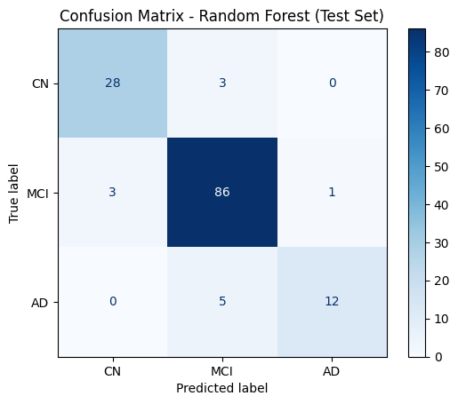
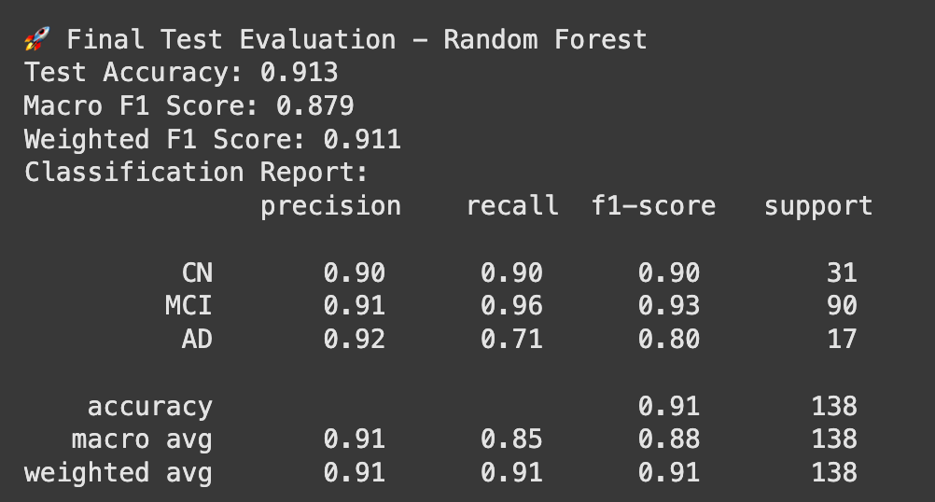
Results
Random Forest top performing model
{'model__n_estimators': 100, 'model__min_samples_split': 5, 'model__min_samples_leaf': 1, 'model__max_depth': 20}
Notes:
After hyperparameter tuning, my top performing model was Random Forest. While F1 scores for the normal and MCI classes were higher in the other two models, I chose Random Forest because it had the highest F1 score for the AD class while still maintaining good metrics for the other two classes.
Looking at the confusion matrix, it seems like the model had some dififculty distinguishing between MCI and AD - this may be because diagnosis of a patient is based on cognitive function and ability to care for themselves (ADL)
- boundary between MCI and AD is not clear because can be more subjective
---
model__n_estimators: 100
→ The number of trees in the forest. More trees generally improve performance up to a point.
model__min_samples_split: 5
→ The minimum number of samples required to split an internal node. Setting this higher can help reduce overfitting by making the tree more conservative.
model__min_samples_leaf: 1
→ The minimum number of samples required to be at a leaf node. A value of 1 means that a leaf node can represent a single sample, which can lead to very fine splits.
model__max_depth: 20
→ The maximum depth of the tree. This limits how deep each individual tree can grow, helping to control overfitting.

Slide 6
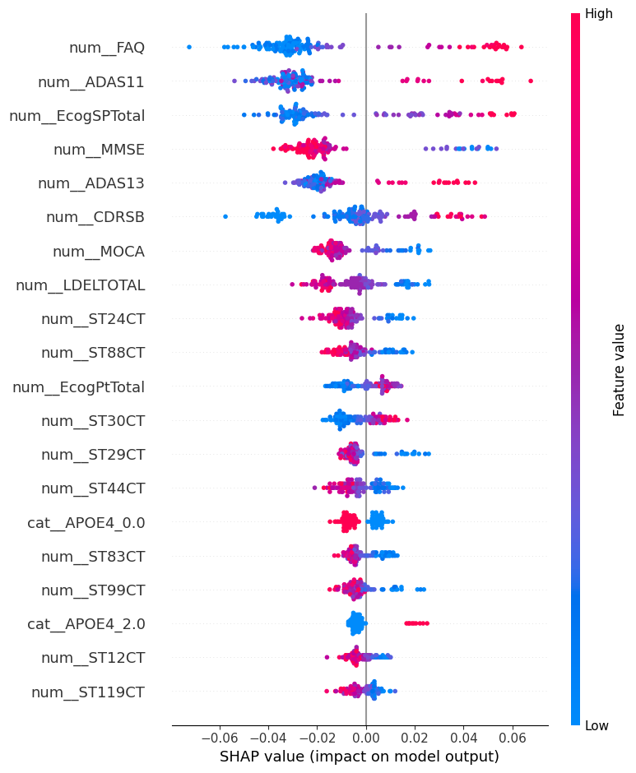
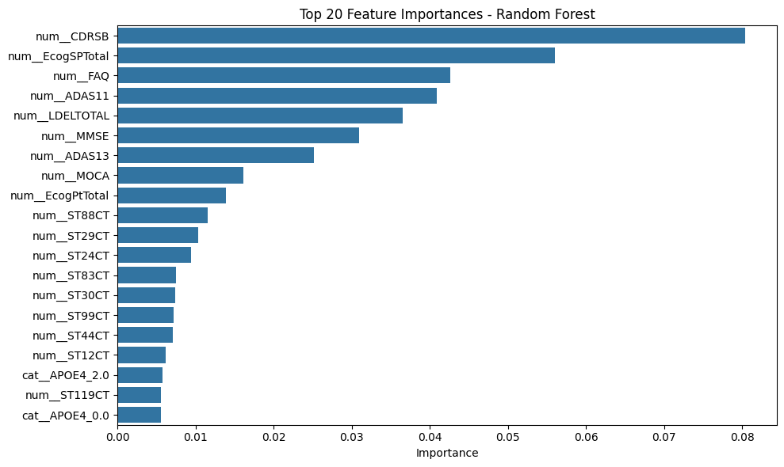
Results
Random Forest feature interpretation
Cognitive features
ASL CBF Features
Notes:
Looking at feature importance and the SHAP analysis, cognitive scores—especially CDRSB, FAQ, MMSE, and ADAS11—were top predictors. Importantly, several ASL perfusion features also ranked in the top 20, particularly in regions linked to memory and temporal processing.
This suggests that cerebral blood flow patterns hold diagnostic value, complementing traditional cognitive assessments.
------
FAQ = functional activities questionnaire
ADAS = alzheimer's disease assessment scale
Ecog = everyday cognition
MMSE = mini mental state exam
CDRSB = clinical dementia rating
MOCA = montreal cognitive assessment
LDEL = logical memory delayed

Slide 7
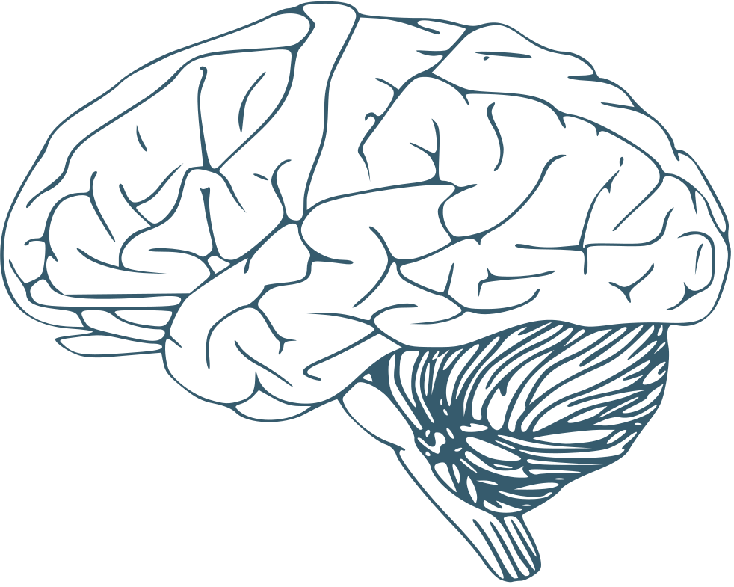
Discussion & Future Work
Interpretability
Top predictive features are cognitive scores(CDRSB, FAQ, MMSE, ADAS11)
ASL perfusion features also ranked in top 20 - CBF patterns in regions linked to memory and temporal processing carry predictive value
Limitations & Next steps
Lower recall for AD class - increase representation of AD class in training
No voxel-level information - use CBF maps in CNN
Thank you for your attention!
Applications
Identify regional perfusion patterns
Assist in triaging patients for further imaging/evaluation
Interpretable model – more confidence in clinical decision support
Notes:
To summarize, the top predictive features were mostly cognitive scores, although perfusion metrics also ranked in the top 20 and suggest that CBF patterns in regions around the hippocampus carry predictive value.
One limitation was lower recall for the AD class—likely due to class imbalance. Future work could explore larger datasets. Another approach I'd like to explore is a voxel-wise CNN to capture more spatial information.
Clinically, this model highlights the importance of looking at regional perfusion patters and could be used to triage patients and determine which need further evaluation that could be more costly or invasive. The model's interpretability also supports its potential use in decision-support systems and would give clinicians more insight into how predictions are made.

