Slide 1
Predicting Patients’ Attrition in Clinical Trials
Team 3a: Stephanie Araki, Pari Shah, Samantha Zocher
HIDS-6001 Fall 2024

Slide 2
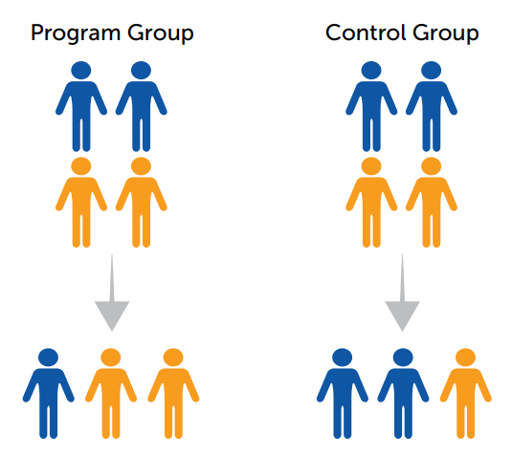
Introduction
Clinical trials are necessary to develop new therapeutic methods
Attrition rate: % of patients that drop out of a clinical trial
High attrition rates can introduce bias even in randomized trials
Understanding what influences attrition rates can inform future trials
Reference: What Isn't There Matters: Attrition and Randomized Controlled Trials

Slide 3
Primary Aims
Develop a machine learning model to predict low or high attrition rate for a clinical trial.
Create a heat map of clinical trial facilities based on actual attrition rate.

Slide 4
Workflow
Data Extraction
Data Integration & Pre-processing
Feature Engineering
Model Training &
Evaluation
Attrition Dataset
NCT ID Attrition Rate
Encoded Features
(n = 1325)
Training
(80%)
Aim 1
Encoded Outcome
(n = 1325)
Evaluation
(20%)
Clinical Trial Dataset
(n = 1325)
NCT ID
Features (un-encoded)
Attrition Rate
ClinicalTrial.gov API
Feature Data
Geocoding
Attrition Mapping
Low Attrition Dataset
(n = 495)
Low Attrition Map
RUCA Dataset
Geo Categories
Aim 2
High Attrition Dataset
(n = 285)
High Attrition Map

Slide 5
Data Extraction, Integration & Pre-Processing

Slide 6
Clinical Trials Dataset
Using ClinicalTrials.gov API:
Category | Features
Study Identifiers | Title (brief and official), Organization (name and class)
Study Status & Type | Overall Status, Study Type, Phase, Primary Purpose, Condition
Study Timeline | Start Date, End Date, Duration
Study Enrollment | Actual Enrollment
Eligibility Criteria | Minimum Age Eligible, Maximum Age Eligible, Gender Eligible
Adverse Events | Adverse Event Count
Geographic | Locations (full address, zip code), Location Count, RUCA Binary Value (urban vs non urban)

Slide 7
Clinical Trials Dataset
Attrition Dataset
NCT ID
Attrition Rate Percentage
Clinical Trials Dataset
NCT ID
Study Identifiers
Study Status & Type
Study Timeline
Study Enrollment
Eligibility Criteria
Adverse Events
Geographic
Attrition Rate Percentage
RUCA Dataset
Zip Code
State
Zip Type
RUCA1
RUCA2

Slide 8
Feature Engineering & Model Development

Slide 9
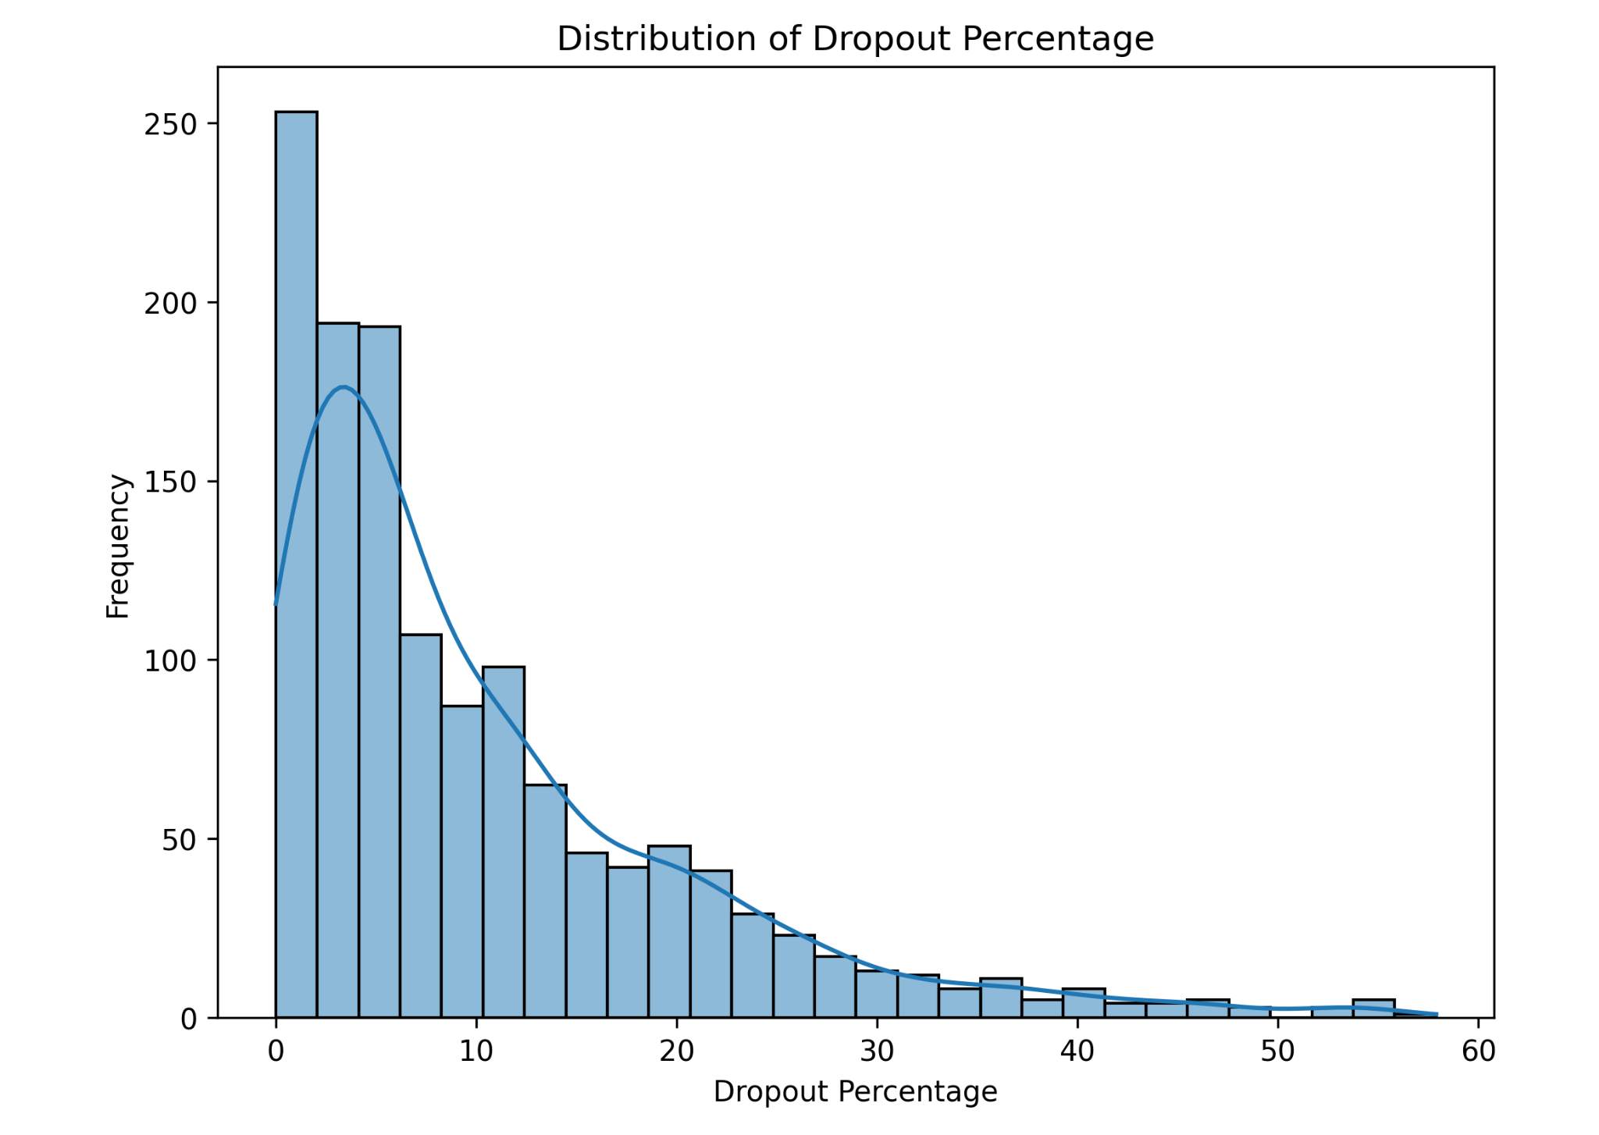
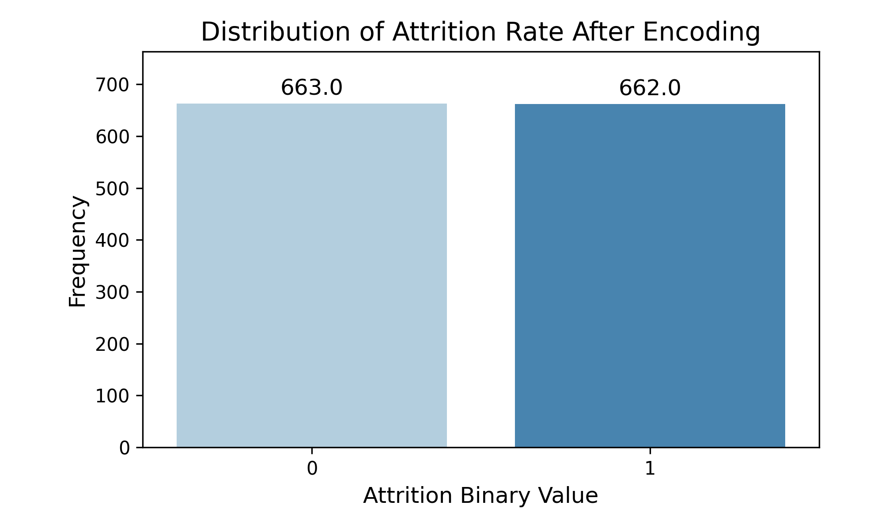
Feature Encoding
Dropout percentage was encoded into a binary variable:
High attrition (1): Dropout percentage > median
Low attrition (0): Dropout percentage ≤ median
After encoding, low and high attrition are evenly distributed
Median = 6.56%

Slide 10
Excluded Features in ML Modeling
Titles and Organization Name
Too much variability and uncategorizable.
Overall Status, Study Type, Gender Eligibility
Uniform values across trials, offering no predictive value for ML models.

Slide 11
Features Used in ML Modeling
Already Numeric
Duration (years)
Actual enrollment
Location count
Adverse event count
One-Hot Encoded (Categorical)
Organization class
Primary purpose
Condition
RUCA Binary (Most Common)
Ordinal Encoded (Natural Order)
Phase
Transformed Non-Numeric to Numeric
Days since start
Minimum eligible age
Maximum eligible age

Slide 12
3 ML Classifiers Used
Model | Strengths | Limitations | Use Cases
Logistic Regression | Simple, interpretable, fast to train | Assumes linear relationships, limited flexibility | Binary classification (e.g. spam detection)
Random Forest | Handles complex relationships, robust to overfitting | Less interpretable, more computationally intensive | Classification and regression tasks (e.g. customer segmentation)
SVM | Effective for high dimensional data, good at finding decision boundaries | Computationally expensive, less interpretable | Text classification, image recognition

Slide 13
Model Performance Metrics
Random Forest performs best with highest accuracy, precision, F1 and AUC-ROC
Model | Accuracy | Recall | Precision | F1 Score | AUC-ROC
Logistic Regression | 0.630 | 0.592 | 0.631 | 0.611 | 0.691
Random Forest | 0.694 | 0.685 | 0.690 | 0.687 | 0.768
SVM | 0.540 | 0.800 | 0.520 | 0.630 | 0.634

Slide 14
Feature Importance Summary (XGBoost Results)
Top Contributing Features:
Actual Enrollment: 574.0
Attrition dynamics vary depending on participant pool
Days Since Start: 451.0
Longer trials may result in higher dropout rates
Locations Count: 449.0
The number of trial locations may improve accessibility and improve retention
Adverse Event Count: 185.0
More adverse events may indicate participant dissatisfaction or discomfort
Minimum Age Eligible: 157.0
Older participants may have more time to participate, or experience more health issues
Notes:
Enrollment, days since start, and locations count drive the model's predictive power

Slide 15
Future Work
Explore additional decision tree-based models for prediction, focusing on optimizing performance since random forest yielded the best results.
Leverage the most important features identified through XGBoost to guide feature selection for future model development.

Slide 16
Mapping by Attrition Rate

Slide 17
Heat Map: Low attrition rate
Locations included have an actual enrollment of > 2,000
Each NCT ID has a maximum # of 10 locations included
Low attrition rate: < 10%
This map contains 495 locations from 58 unique studies
Minimum attrition rate: 0.116%
Maximum attrition rate: 9.80%
Notes:
Limitations: there were over 66,000 locations so could not map all of them

Slide 18
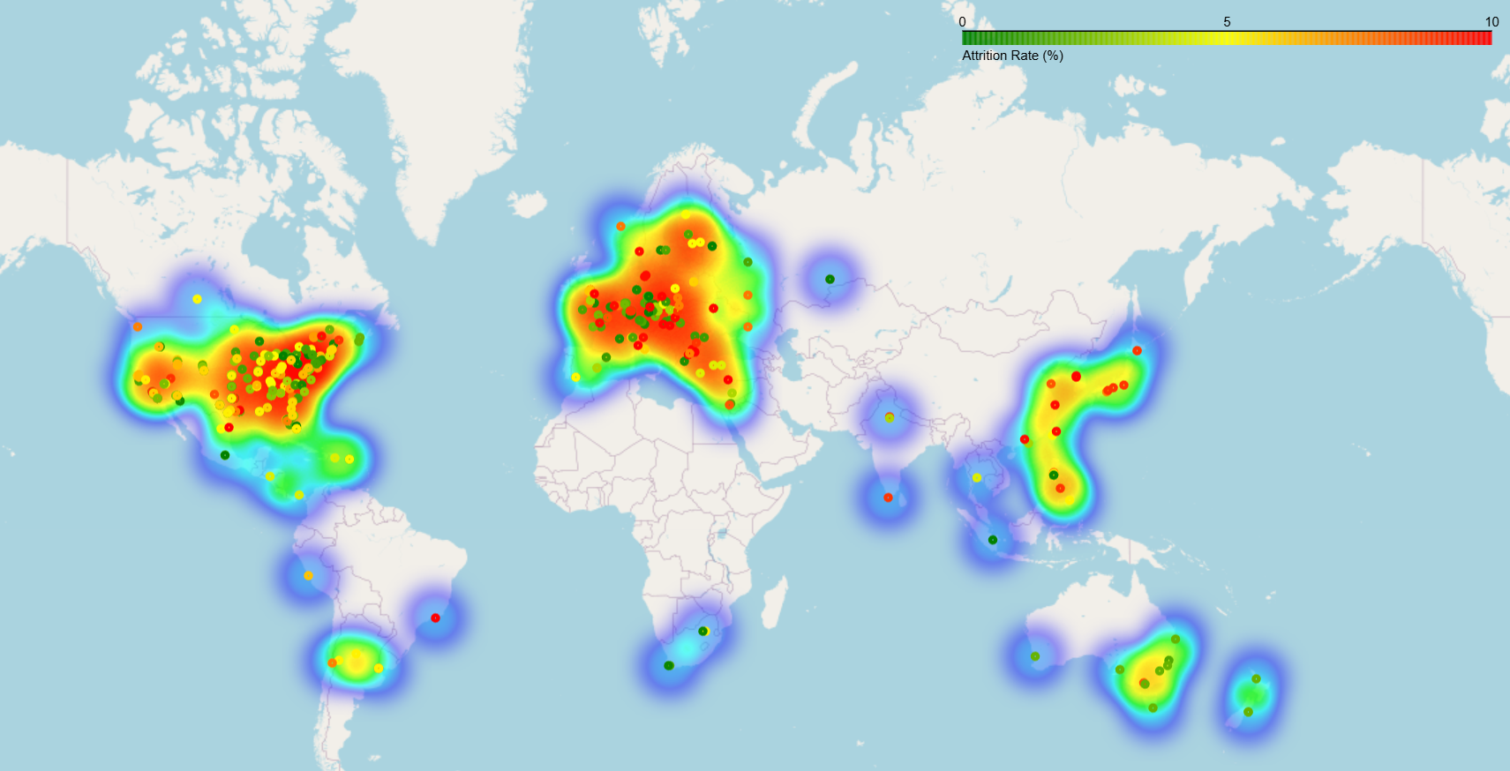
Low attrition map

Slide 19
Heat Map: High attrition rate
Locations included have an actual enrollment of > 2,000
Each NCT ID has a maximum # of 10 locations included
High attrition rate: >= 10%
This map contains 285 locations from 30 unique studies
Minimum attrition rate: 10.08%
Maximum attrition rate: 35.84%

Slide 20
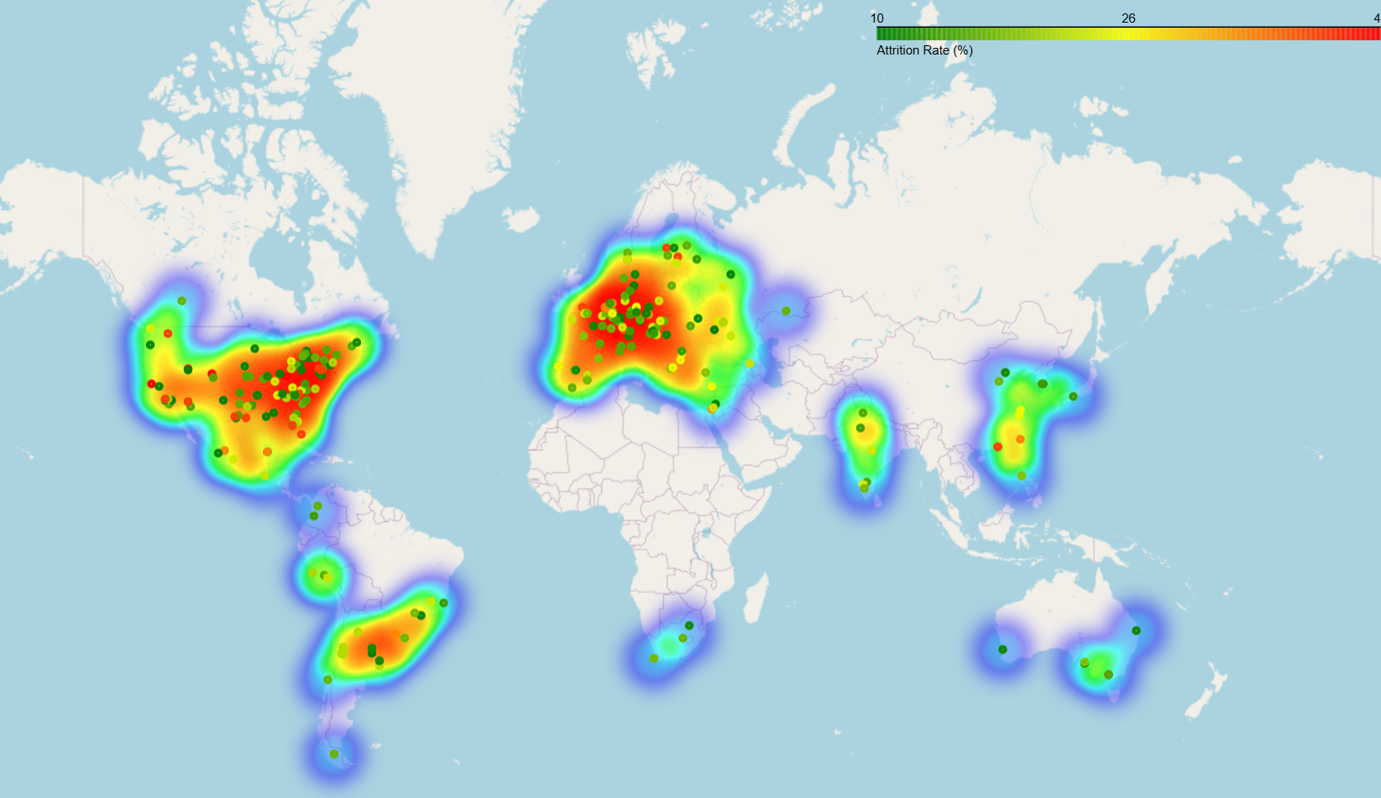
High attrition map

Slide 21
Thank you!
Stephanie – extracted data using the API and integrated the datasets.
Pari – handled data preprocessing and developed machine-learning models.
Sam – created the heatmaps.
All – contributed to feature and outcome selection, writing the report, and creating the presentation.

Slide 22
References
1. Attrition and randomized controlled trials. August 2014. Accessed December 14, 2024. https://homvee.acf.hhs.gov/sites/default/files/2019-08/HomVEE_brief_2014-49.pdf.

Slide 23
Model Evaluation
Metric | Definition | Use
Accuracy | The overall proportion of correct predictions (both true positives and true negatives) out of all predictions. | How well does the classifier predict both true positives and true negatives?
Precision | The proportion of true positives among all positive predictions. | How well does the classifier avoid false positives?
Recall | The proportion of true positives among all actual positives. | How well does the classifier identify all true positives?
F1 Score | The harmonic mean of precision and recall. | How well does the classifier perform in terms of both Precision and Recall?
AUC-ROC | The area under the receiver operating characteristic curve. | How well does the classifier distinguish between positive and negative classes?

Slide 24
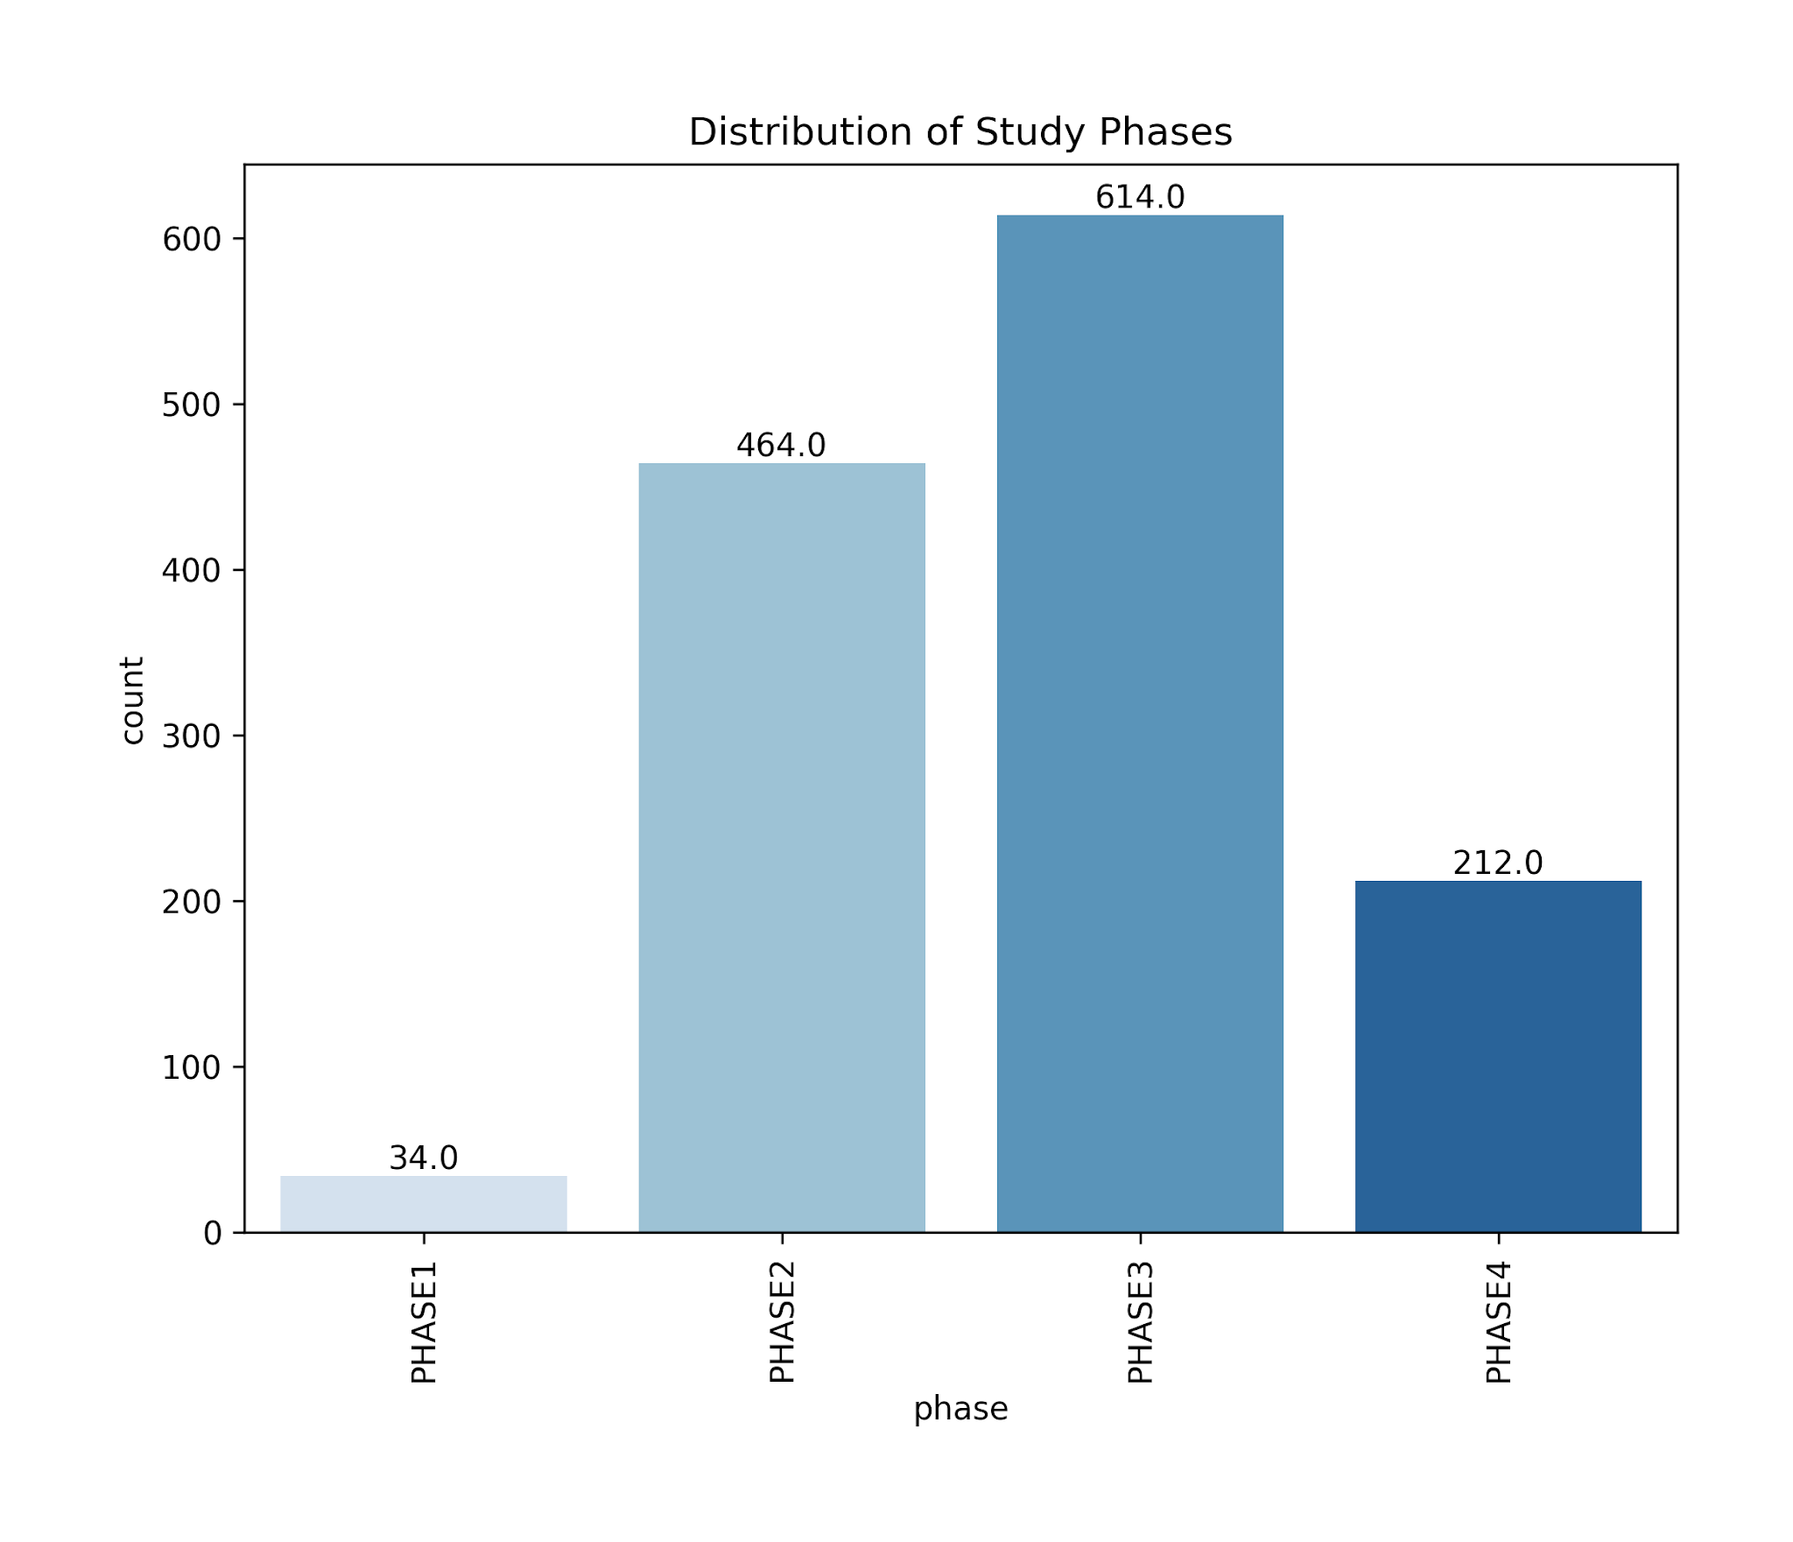
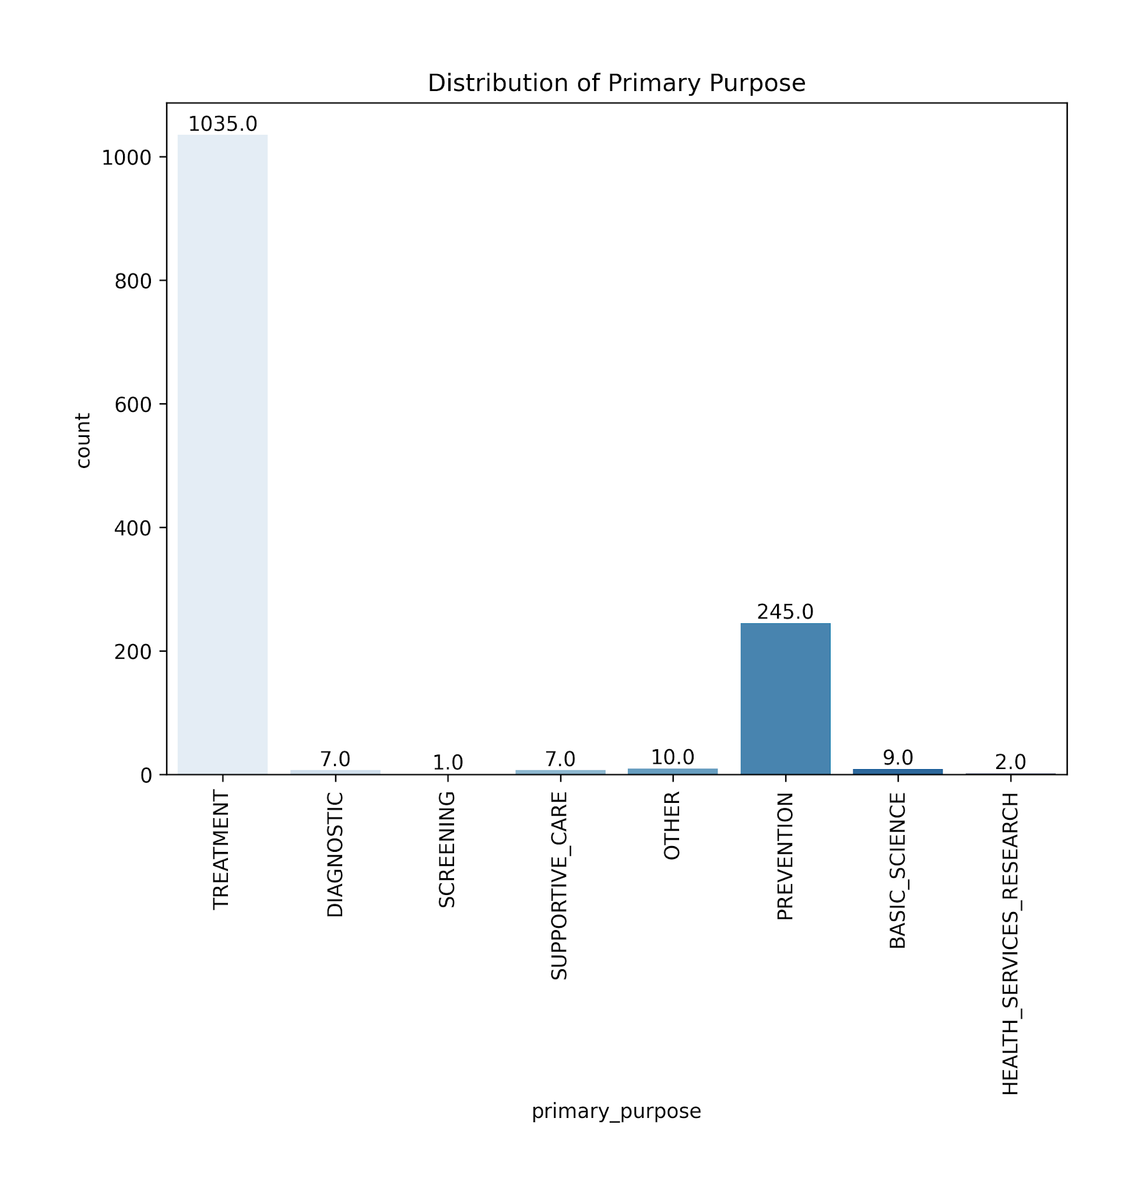
Encoded Feature Data - Phase and Purpose

Slide 25
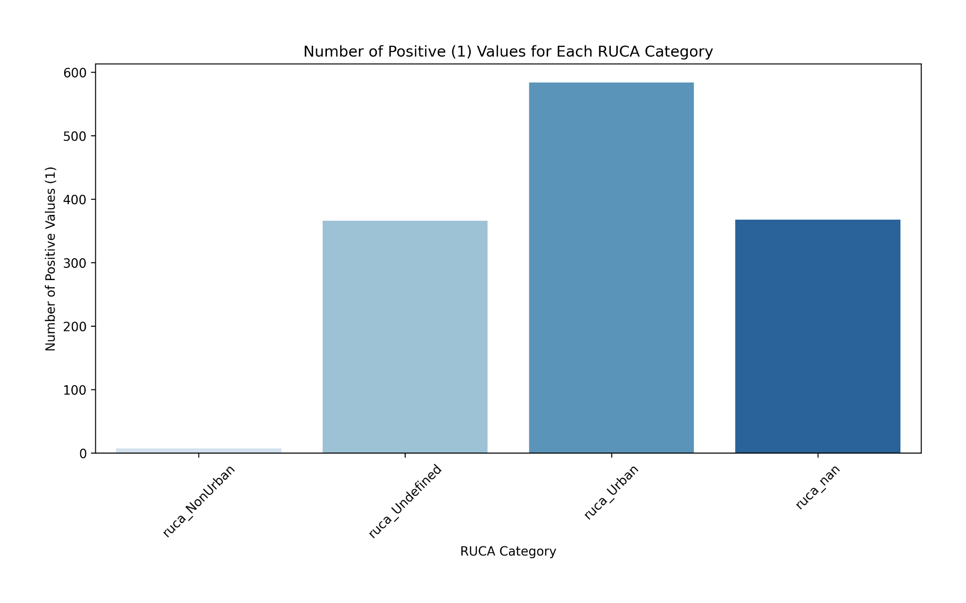
Encoded Feature Data - RUCA

Slide 26
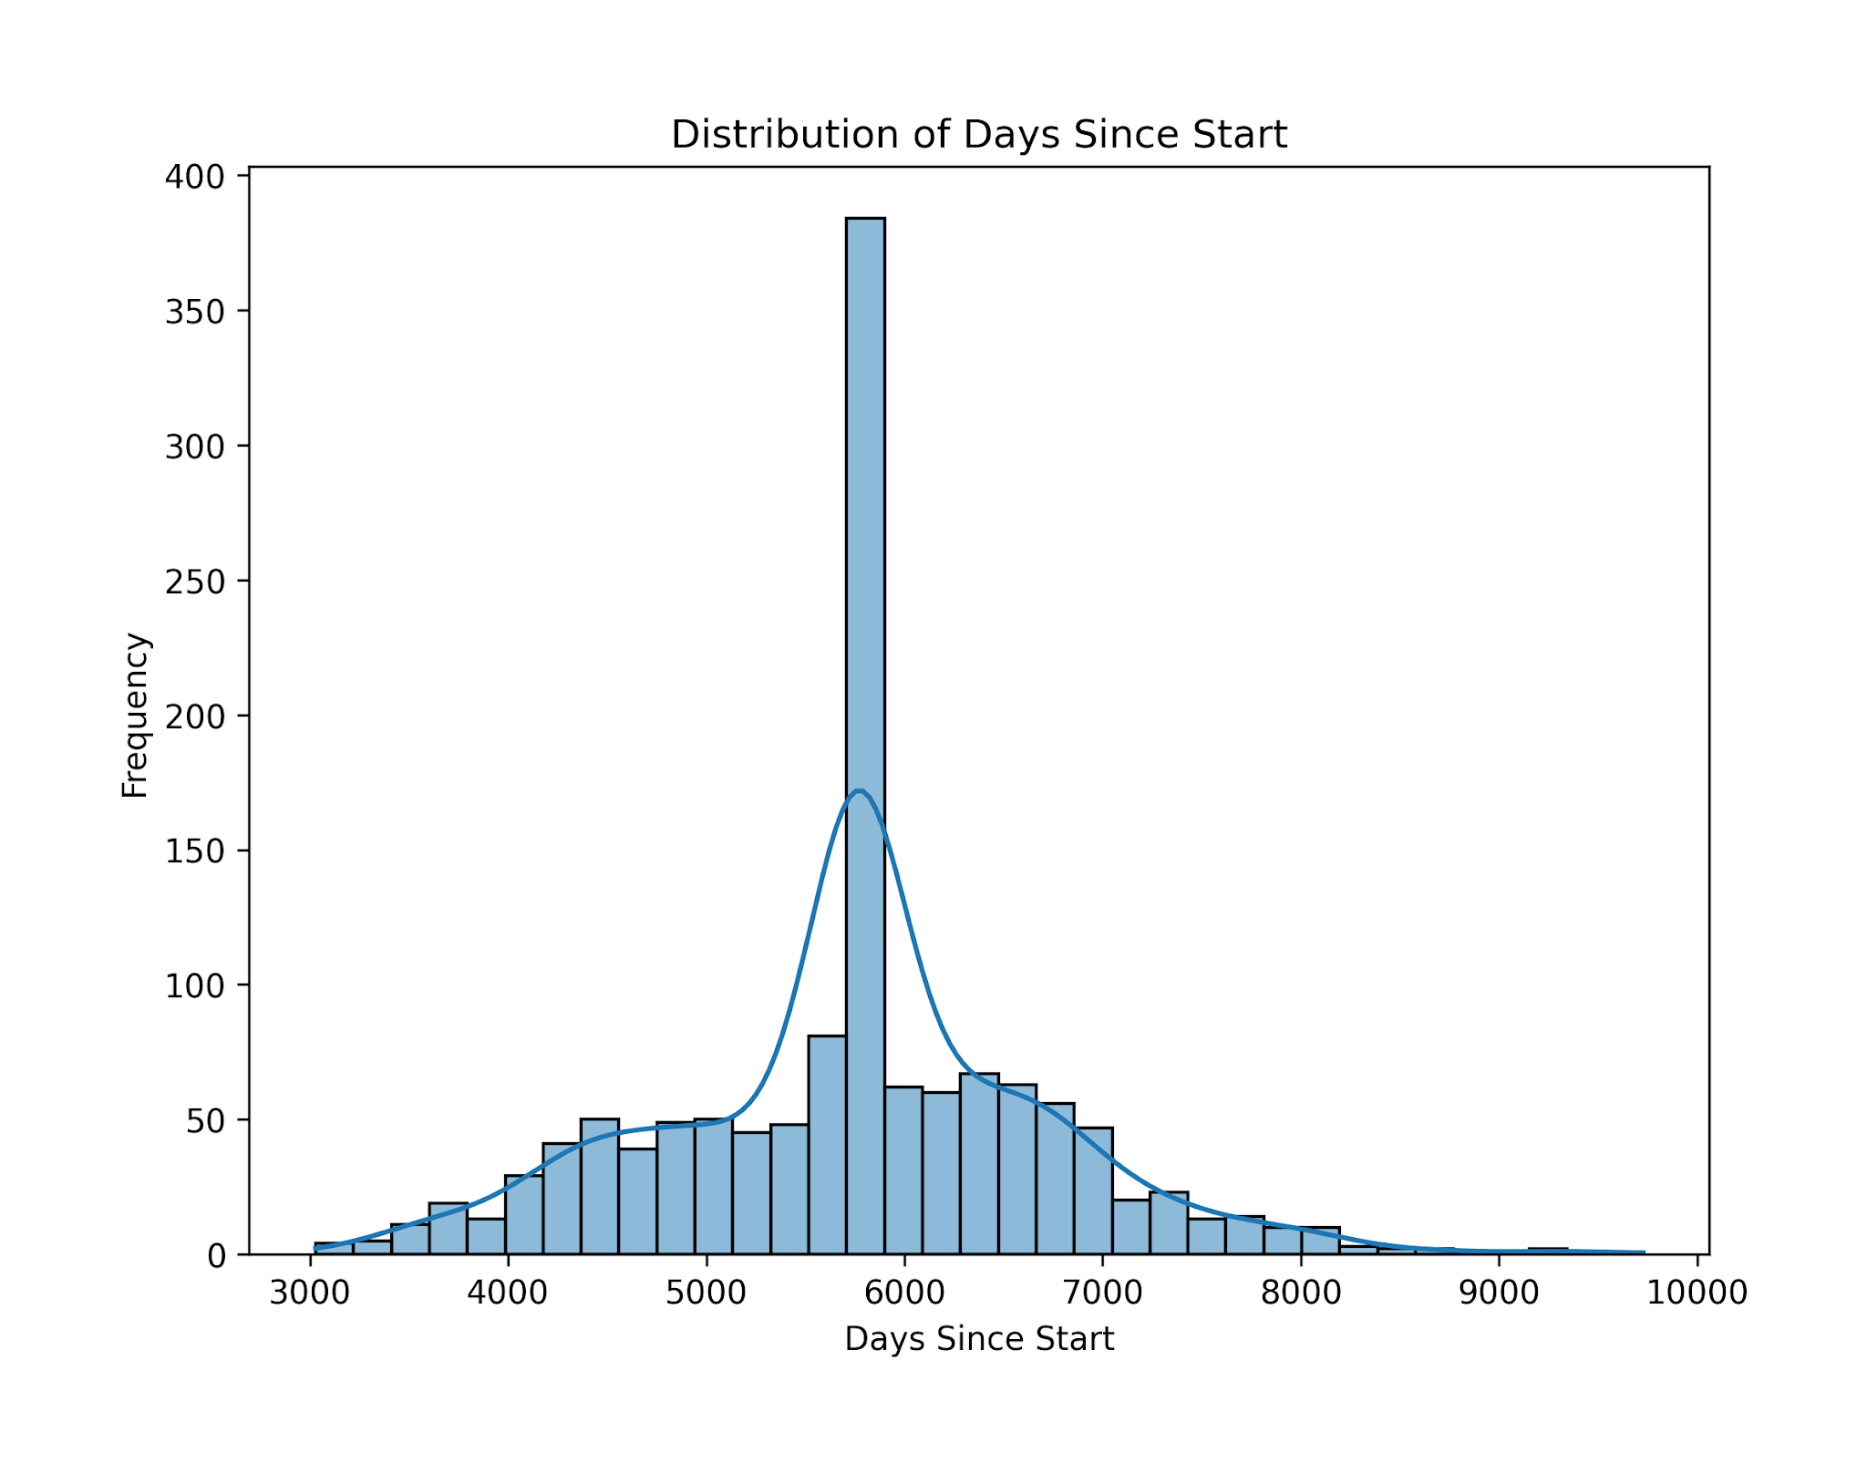
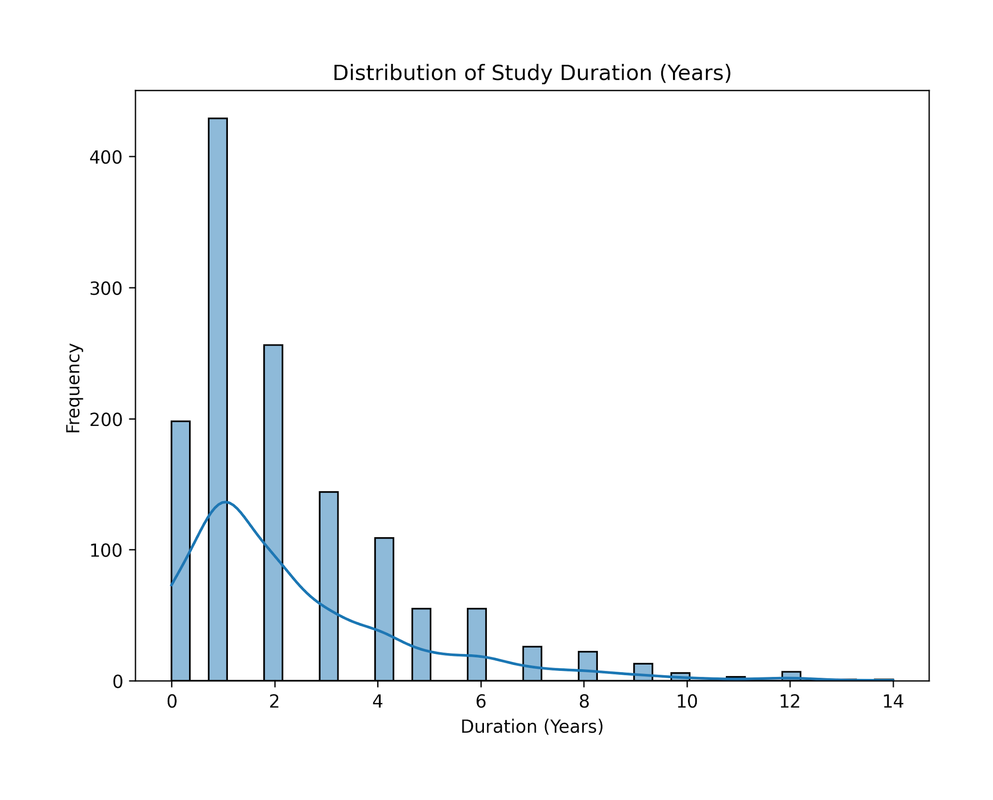
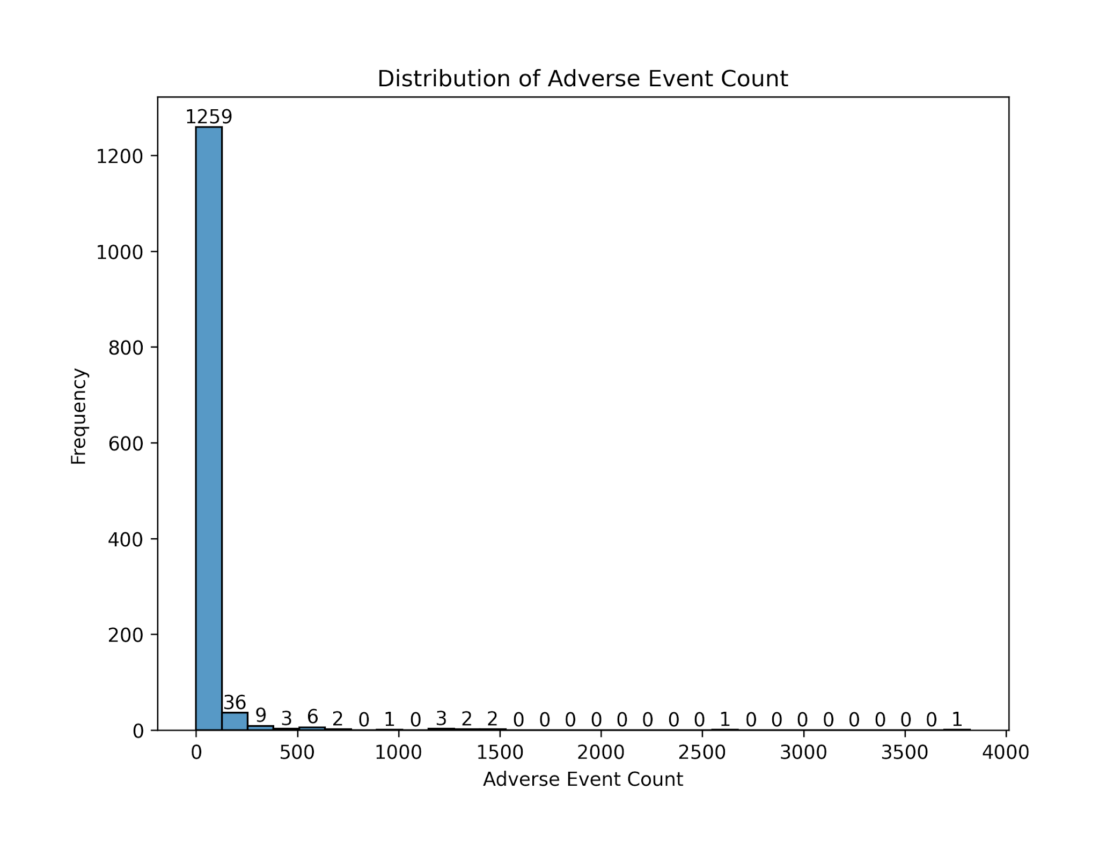
Encoded Feature Data - Days since start, Duration, Adverse Event Count

Slide 27
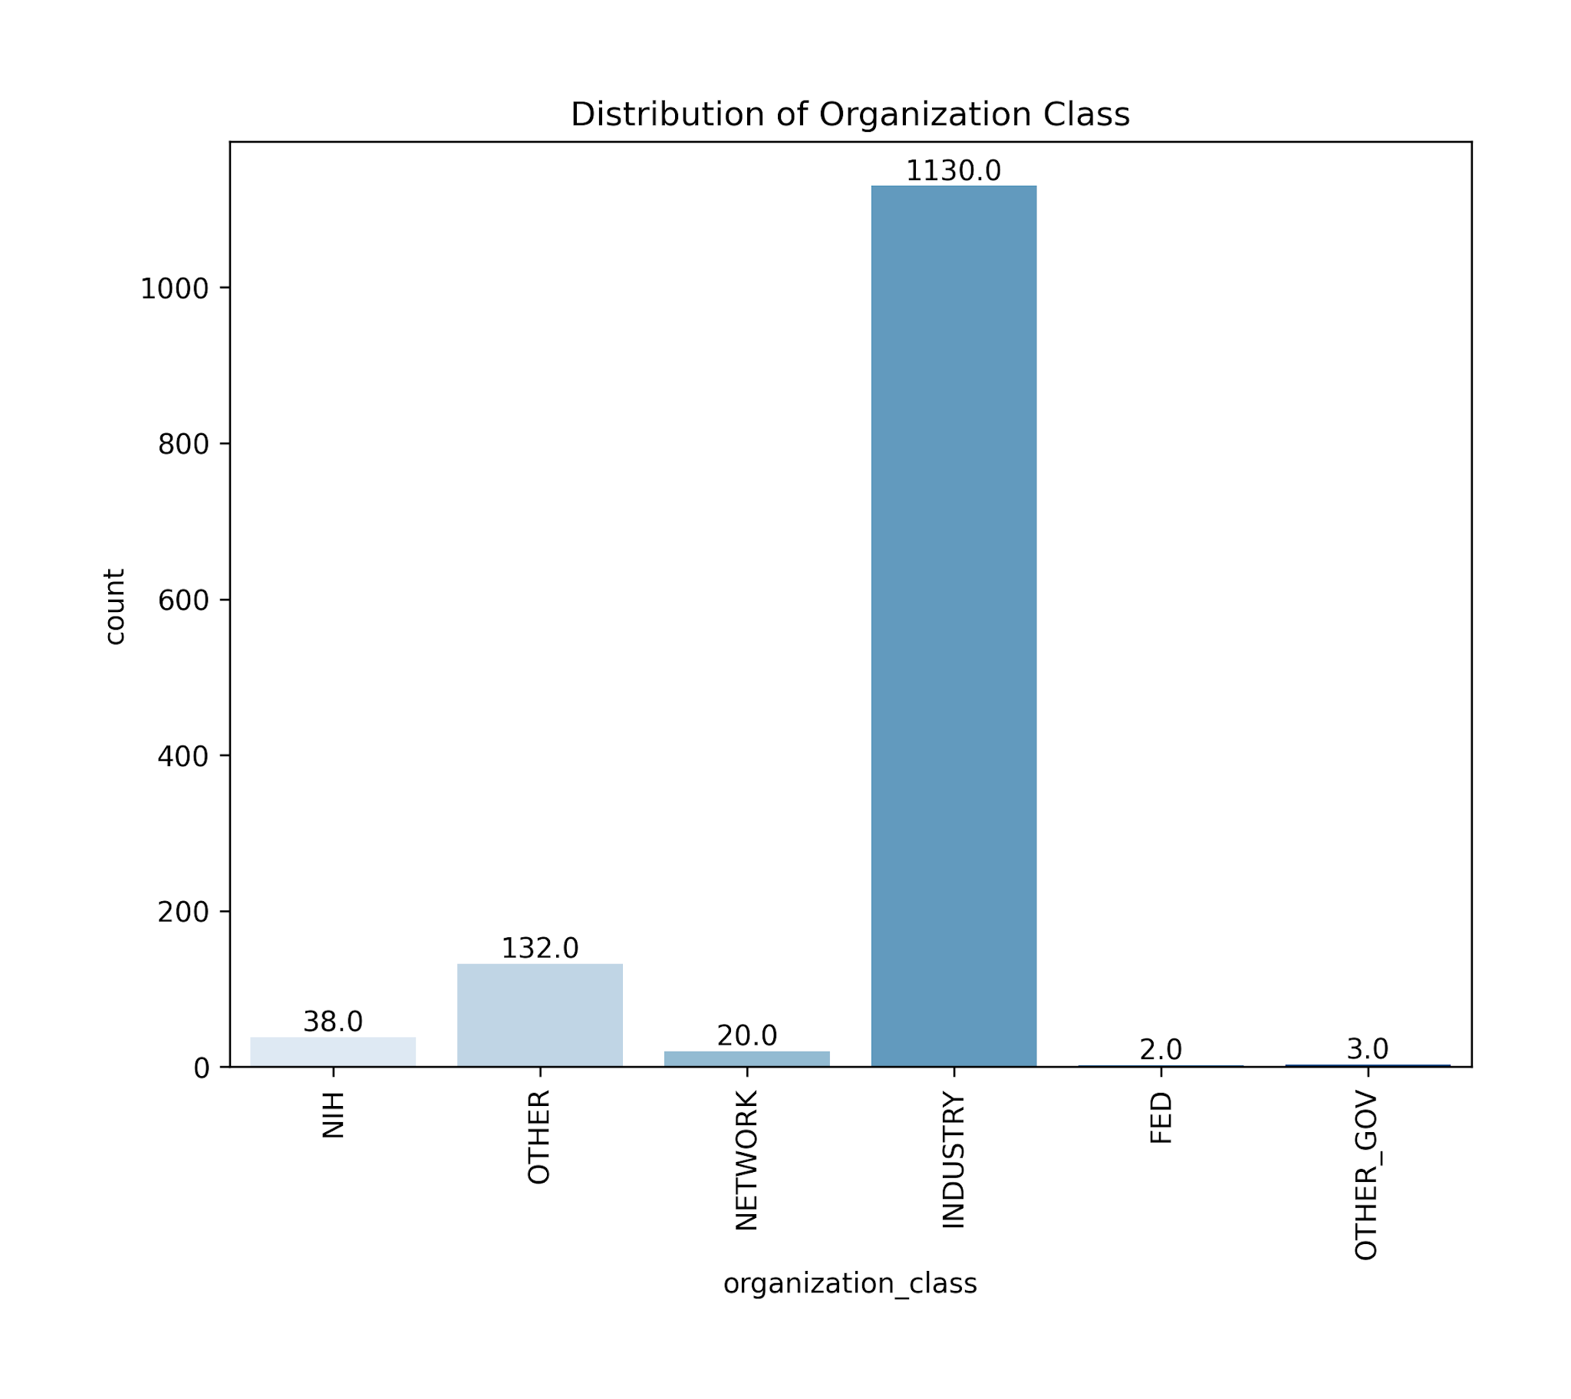
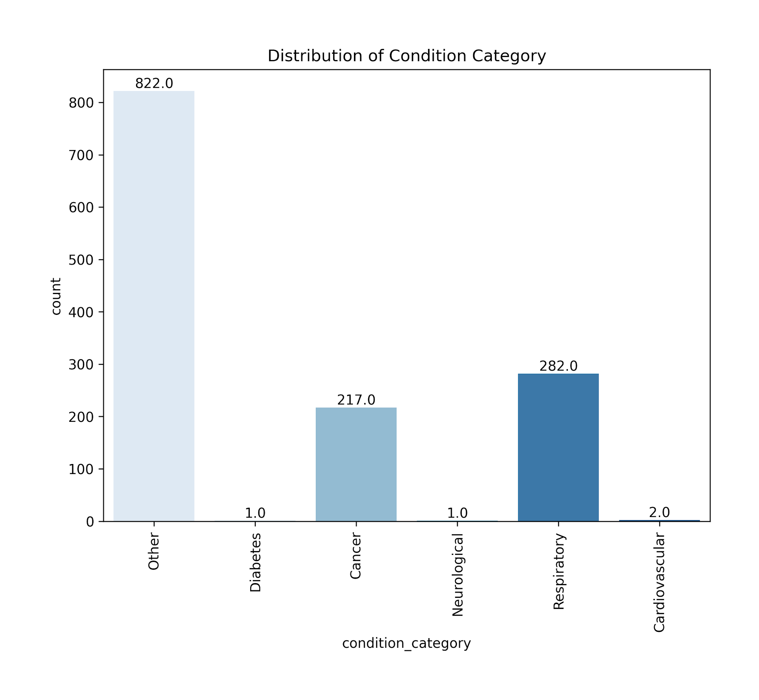
Encoded Feature Data - Organization Class, Condition Category

