Slide 1
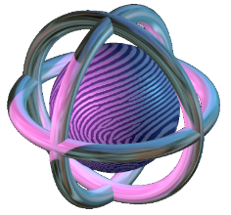

Biometric System Laboratory University of Bologna - ITALY
Raffaele Cappelli
raffaele.cappelli@unibo.it
Hands on
Fingerprint Recognition with OpenCV and Python

Slide 2
Why a Hands-on Lecture?
In past editions of biometric schools, we gave a more classical lecture on fingerprint recognition
You can download a PDF from: https://biolab.csr.unibo.it/samples/fr/FingLecture2020Cappelli.pdf
The new “hands on” format is aimed at:
Demonstrating (in practice) the basic building-blocks of fingerprint recognition
Showing that classical algorithms remain an important background in biometrics
NOTE: even if modern machine learning techniques can improve several fingerprint processing and recognition tasks (especially on latent fingerprints), fingerprint recognition was not drastically reshaped by deep learning as other biometric modalities, and classical minutiae-based approaches are still the state-of-the-art.

Slide 3
Links to the code
These slides accompany a practical example on a Jupyter notebook, which can be run locally or on Google Colab.
How to run the notebook locally (recommended):
Download https://tinyurl.com/hands-on-fr
Required: a Jupyter installation with OpenCV, ipywidgets, matplotlib
In Anaconda: "conda install -y opencv notebook ipywidgets matplotlib"
How to run the notebook on Colab:
Open https://colab.research.google.com/drive/1u5X8Vg9nXWPEDFFtUwbkdbQxBh4hba_M

Slide 4
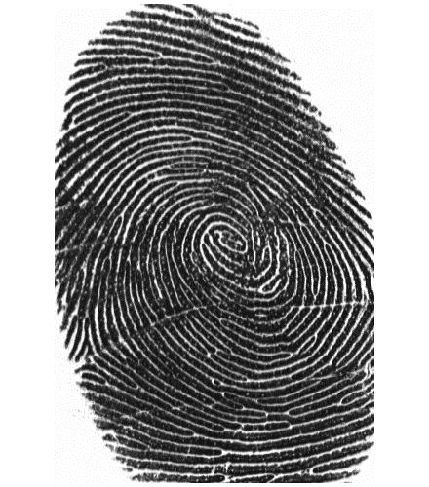
Fingerprint anatomy
A fingerprint is composed of a set of lines (ridge lines), which mainly flow parallel, making a pattern (ridge pattern).
Ridges
Valleys

Slide 5


Minutiae
Minutiae are determined by the termination or the bifurcation of the ridge lines; they are usually represented by the coordinates $\left(x,y\right)$, the angle $$ between the minutia tangent and the horizontal axis, and the type (termination/bifurcation).
termination
x
x
bifurcation
θ
θ
y
y
ridge line
termination
bifurcation

Slide 6
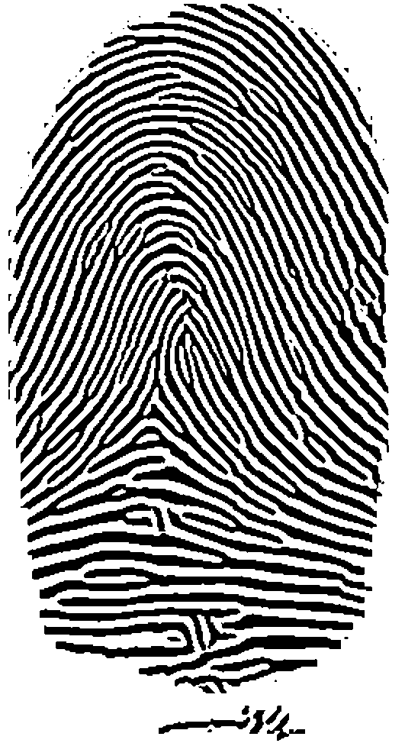
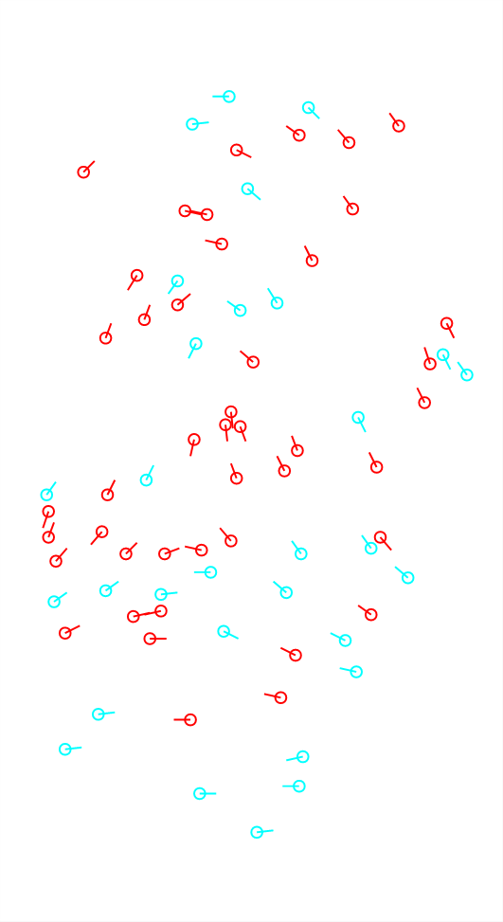
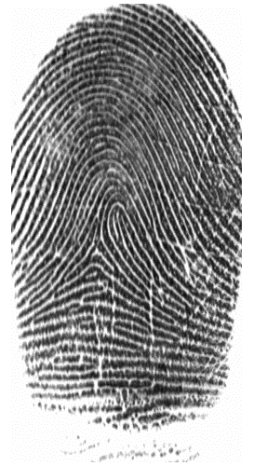

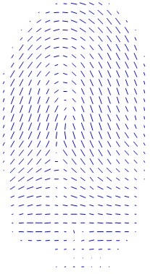
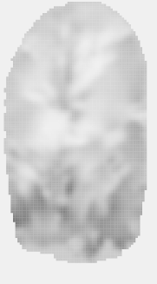
Feature extraction: main steps
Fingerprint image
Orientation image
Fingerprint foreground
Frequency image
Ridge pattern
Minutiae

Slide 7
Segmentation
The segmentation stage is aimed at separating the fingerprint area (foreground) from the background.
The foreground is characterized by the presence of a striped and oriented pattern; background presents a uniform pattern.

Slide 8
Local ridge orientation
The local ridge orientation at $[i,j]$ is the angle $θ_{ij}∈[0,180°[$ that the fingerprint ridges form with the horizontal axis in an arbitrary small neighborhood centered at $[i,j]$.
{
θ_{i,j}
i
i
r_{i,j}
j
j
The simplest approach to extract local ridge orientations is based on computation of gradient phase angles.

Slide 9
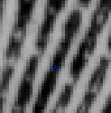
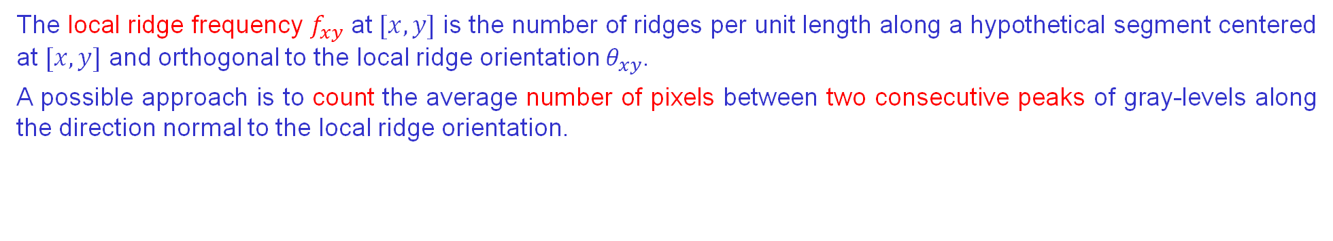





Local ridge frequency
The local ridge frequency $f_{xy}$ at $[x,y]$ is the number of ridges per unit length along a hypothetical segment centered at $[x,y]$ and orthogonal to the local ridge orientation $θ_{xy}$.
A possible approach is to count the average number of pixels between two consecutive peaks of gray-levels along the direction normal to the local ridge orientation.
oriented window
$$\left[x_{i},y_{i}\right]$$
$$s_{1}$$
$$s_{2}$$
$$s_{3}$$
$$s_{4}$$

Slide 10
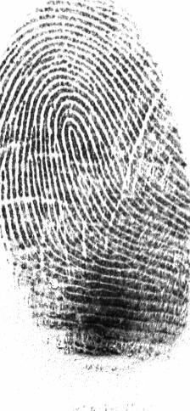
Enhancement (1)
The performance of feature extraction and comparison algorithms are strictly related to the image quality.
The objective of enhancement techniques is to improve the fingerprint image quality.
a
Typical degradations:
ridge lines are not continuous;
cuts, creases and bruises on the finger;
parallel ridges are not well separated.
The most widely used technique for fingerprint enhancement is based on contextual filters.
In contextual filtering, the characteristics of the filter used change according to the local context.
b
c

Slide 11
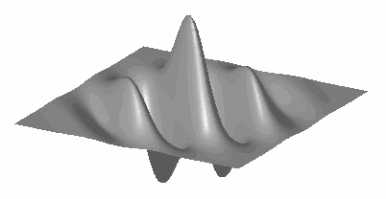
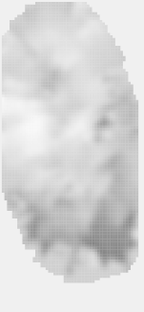
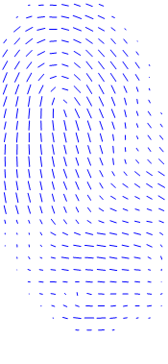
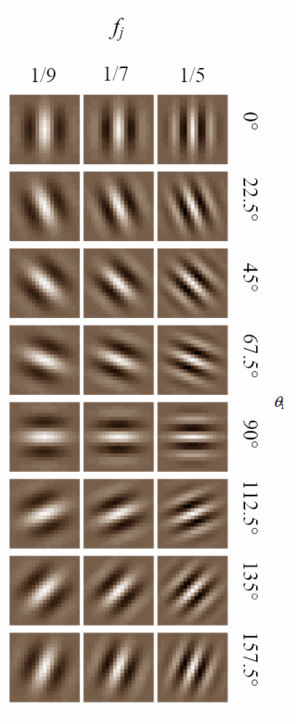
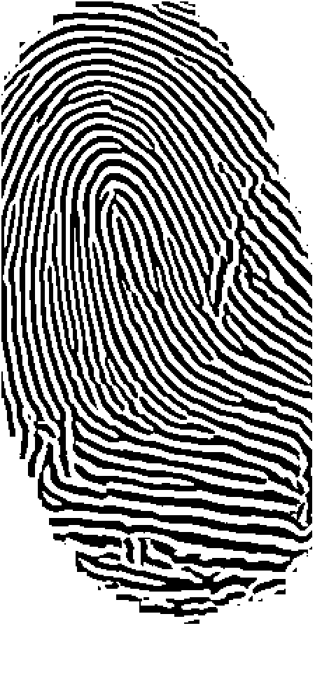
Enhancement (2)
The local context of a fingerprint is represented by the ridge orientation and frequency.
Gabor filter: sinusoidal plane wave tapered by a Gaussian.

Slide 12

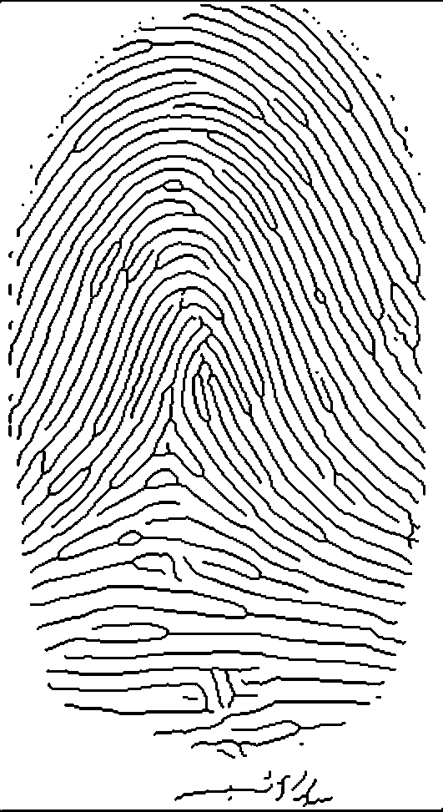
Minutiae detection (1)
Traditional approach:
Enhancement/Binarization: conversion into a binary image;
Thinning: the binary image is thinned to reduce the ridge thickness to one pixel;
Detection: an image scan then allows to detect minutiae.
a
b
c

Slide 13
Minutiae detection (2)
Minutiae detection is based on the computation of the crossing number (cn):
It is simple to note that a pixel p is:
an intermediate ridge point if cn(p)=2;
a termination if cn(p)=1;
a bifurcation if cn(p)=3;
part of a more complex minutia if cn(p)> 3.
cn(p) = 2
cn(p) = 1
cn(p) = 3
Intermediate ridge point
termination
bifurcation

Slide 14
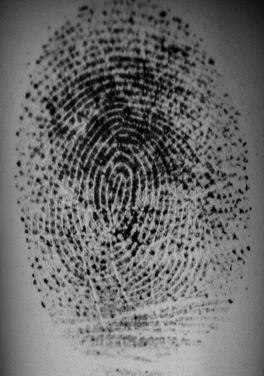
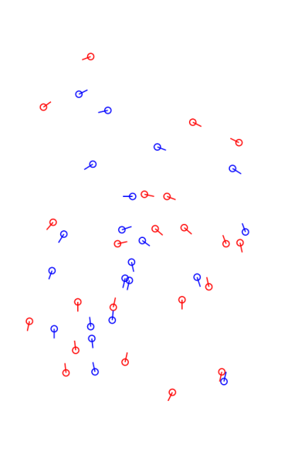
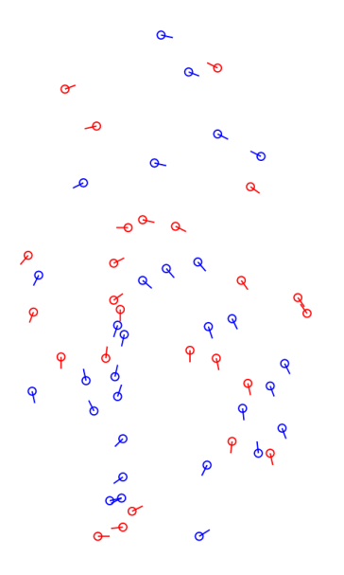
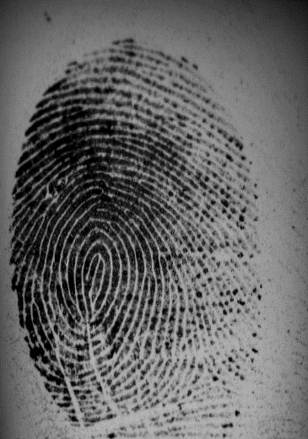
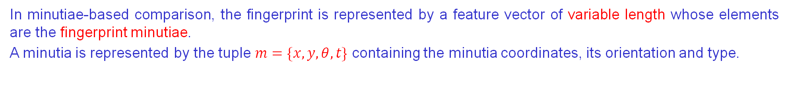

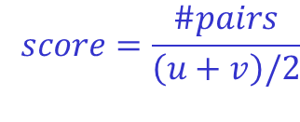

Minutiae-based fingerprint comparison
In minutiae-based comparison, the fingerprint is represented by a feature vector of variable length whose elements are the fingerprint minutiae.
A minutia is represented by the tuple $m=\{x,y,θ,t\}$ containing the minutia coordinates, its orientation and type.
$$T_{1}=\{m_{1},m_{2},…,m_{u}\}$$
$$T_{2}=\{{m′}_{1},{m′}_{2},…,{m′}_{v}\}$$
$$score=\frac{\#pairs}{\left(u+v\right)/2}$$

Slide 15
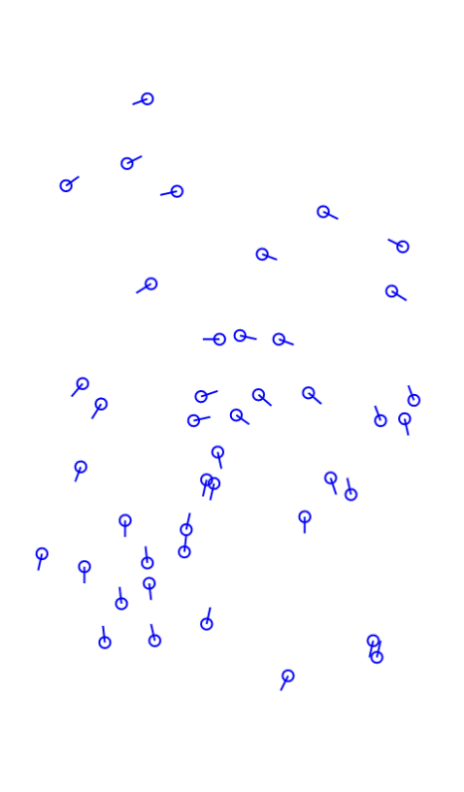
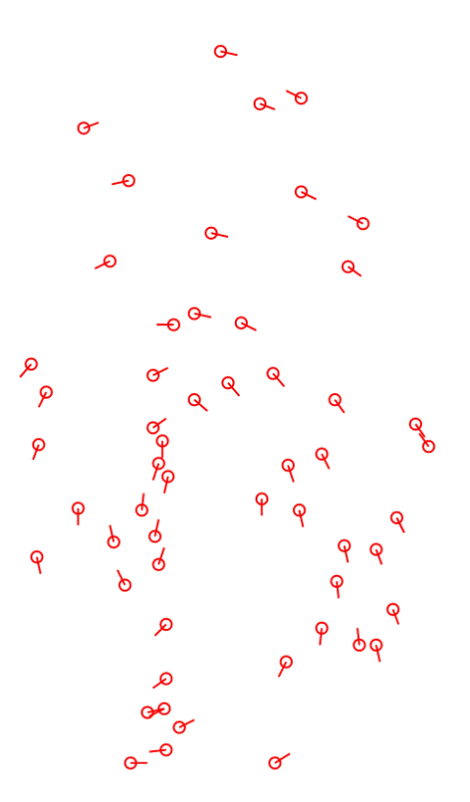
Global minutiae-based approaches
The objective of global minutiae-based approaches is to apply a global transformation that allows to maximize the number of resulting paired minutiae.
Typically use Hough transform or Ransac implementations to find the best rigid transformation to align two minutiae sets.

Slide 16
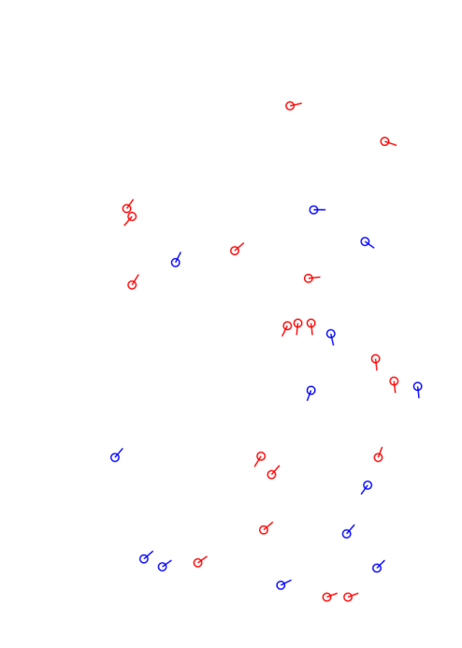
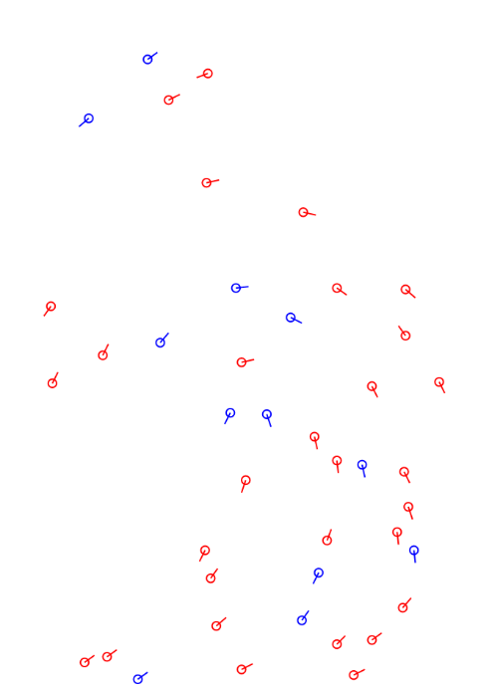
Local minutiae-based approaches
The objective of local minutiae-based approaches is to pair minutiae using local minutiae features invariant to global transformations without a pre-alignment step. Usually, they are based on the following steps:
for each minutia local features are computed from local minutiae neighborhoods.
the minutiae are paired according to local features (fast, robust to distortion but less distinctive).
a consolidation step is performed to verify if local matches hold at global level.

Slide 17
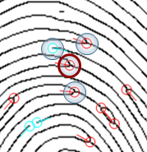
Nearest-neighbor-based local structures
The neighbors of the central minutia are formed by its K closest minutiae.
Advantages
fixed-length descriptors that can be compared very efficiently.
Drawbacks
possibility of exchanging nearest neighbor minutiae due to missing or false minutiae.
missing
false

Slide 18
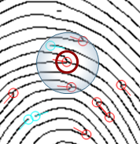
Fixed-radius-based local structures
The neighbors are defined as all the minutiae that are closer than a given radius R from the central minutia.
Advantages
missing and false minutiae are better tolerated.
Drawbacks
the descriptor length is variable and depends on the local minutiae density leading to a more complex comparison.
minutiae close to the border can be mismatched because of different local distortion or location inaccuracy.

Slide 19
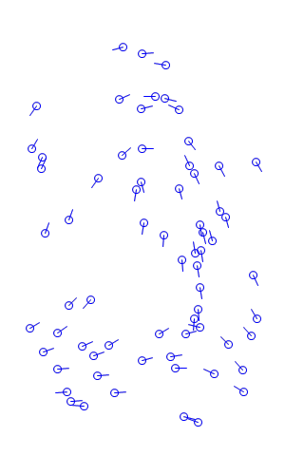
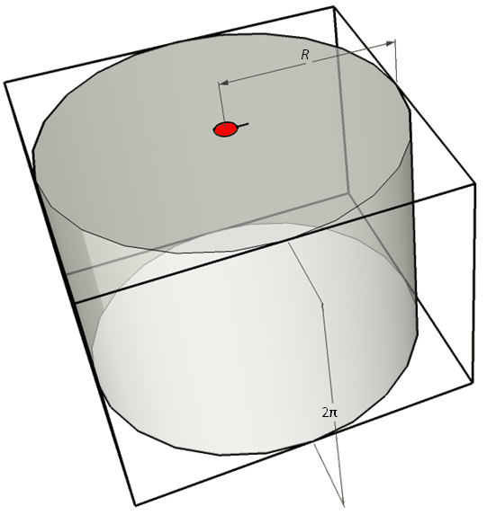
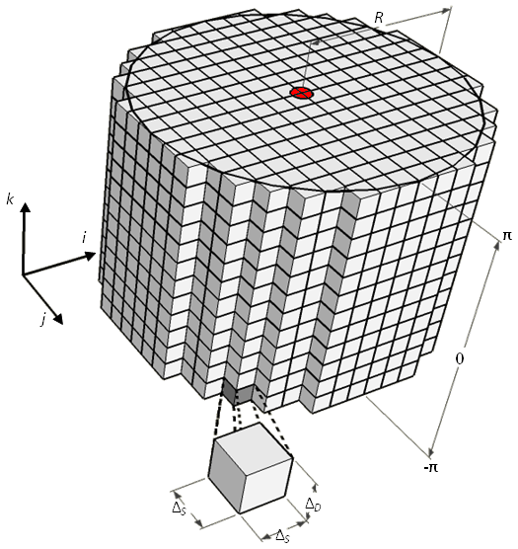
Minutia Cylinder-Code (MCC) (1)
R. Cappelli, M. Ferrara and D. Maltoni, "Minutia Cylinder-Code: a new representation and matching technique for fingerprint recognition", IEEE tPAMI 2010.
Main advantages:
fixed radius structure;
fixed-length descriptors;
tolerates local distortion and small feature extraction errors;
bit-oriented coding;
fast and simple local structure comparison phase;

Slide 20
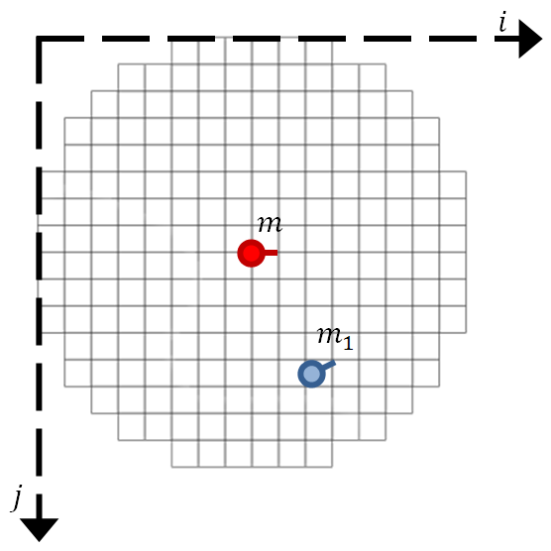


Minutia Cylinder-Code (MCC) (2)
The spatial contribution of the neighbor minutia is spread over cells near its position.

Slide 21



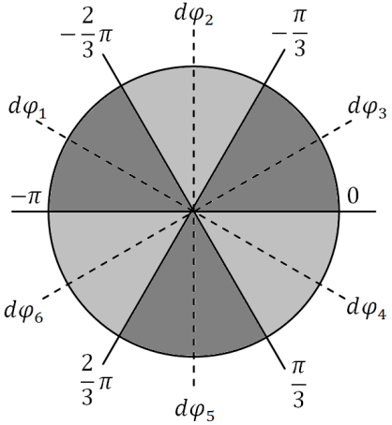


Minutia Cylinder-Code (MCC) (3)
The directional contribution depends on the angle differences.

Slide 22
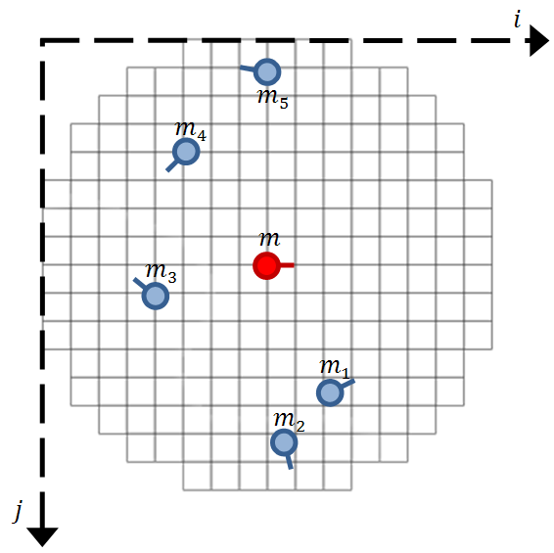
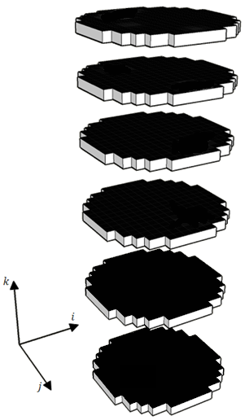
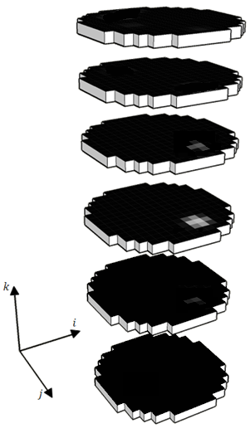
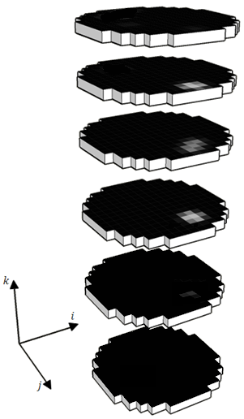
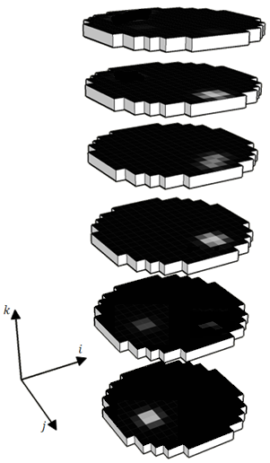
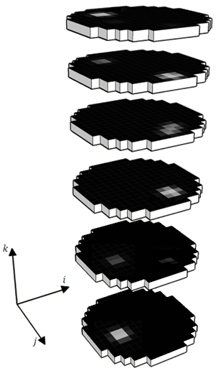
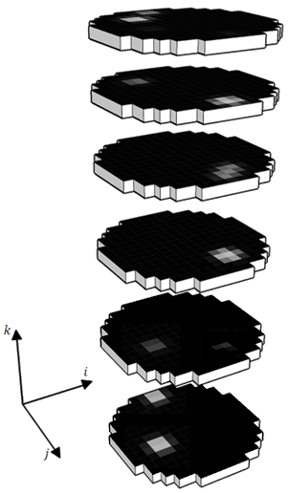

Minutia Cylinder-Code (MCC) (4)
k=6
k=5
$$C_{m}$$
k=4
k=3
d_{θ}(m,m₃)
k=2
d_{θ}(m,m₅)
d_{θ}(m,m₁)
k=1
d_{θ}(m,m₄)
d_{θ}(m,m₂)

Slide 23












Minutia Cylinder-Code (MCC) (5)
The cylinders can be conveniently converted into bit vectors by applying a unit step function.
Unit step function
1
0
Notes:
To reduce the template size but, more important, to perform a very fast comparison, the cylinders are transformed into bit vectors by applying a unit step function

Slide 24
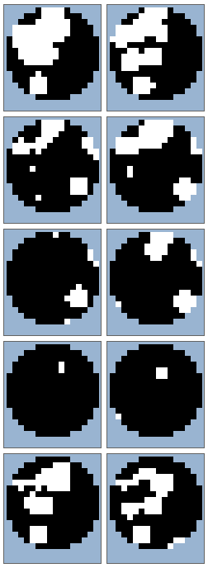
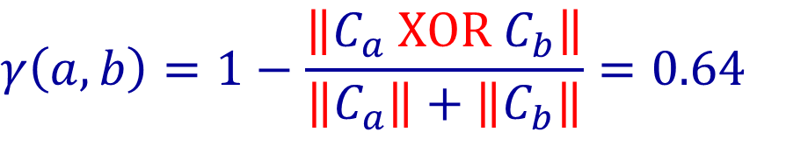


Minutia Cylinder-Code (MCC) (6)
$$C_{a}$$
$$C_{b}$$
$$γ\left(a,b\right)=1−\frac{\left\|C_{a} XOR C_{b}\right\|}{\left\|C_{a}\right\|+\left\|C_{b}\right\|}=0.64$$
Notes:
Given two bit cylinders from two different templates, their local similarity is computed very efficiently by applying simple bit-wise operations.

Slide 25
Minutia Cylinder-Code (MCC) (7)
MCC speed performance
Test: 100 identification queries on a 1M database
Version | System configuration | Comparisons per second
MCC SDK Single core, no SSE optimizations Download: http://biolab.csr.unibo.it/mccsdk.html | Intel CPU E5-2650 @ 2GHz, 64 bit O.S. | 18,000
SSE4 Optimized for CPU | Intel CPU E5-2650 @ 2GHz, 64 bit O.S. 2 processors, 32 cores | 7 Millions
GPU (CUDA) and CPU Optimized | Intel CPU E5-2650 @ 2GHz, 64 bit O.S. 2 processors, 32 cores 4 Nvidia Tesla C2075 GPUs | 42 Millions
GPU (CUDA) and CPU Optimized | Intel CPU Xeon E5-1660 @ 3.2GHz, 64 bit O.S. 1 processor, 8 cores 1 Nvidia Titan RTX GPU | 117 Millions
Notes:
This is the reason why MCC is a very efficient algorithm able to perform about 42M comparisons per second on a single PC with 4 GPUs

Slide 26
Some references
D. Maltoni, D. Maio, A.K. Jain and S. Prabhakar, “Handbook of Fingerprint Recognition,” Springer, 2022.
A.M. Bazen and S.H. Gerez, "Systematic methods for the computation of the directional fields and singular points of fingerprints," in IEEE Transactions on Pattern Analysis and Machine Intelligence, July 2002.
L. Hong, Y. Wan, A.K. Jain, “Fingerprint Image Enhancement Algorithms and Performance Evaluation”, IEEE Transactions on Pattern Analysis and Machine Intelligence, vol. 20, no. 8, pp. 777-789, 1998.
R. Cappelli, M. Ferrara and D. Maltoni, "Minutia Cylinder-Code: a new representation and matching technique for fingerprint recognition", IEEE Transactions on Pattern Analysis Machine Intelligence, vol.32, no.12, pp.2128-2141, December 2010.

