Slide 1


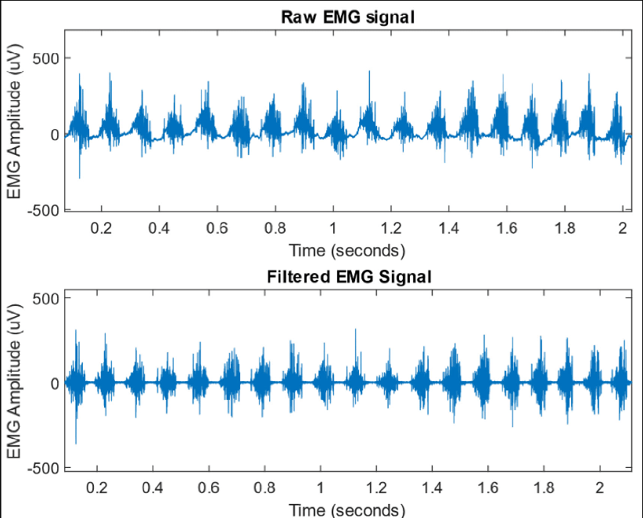

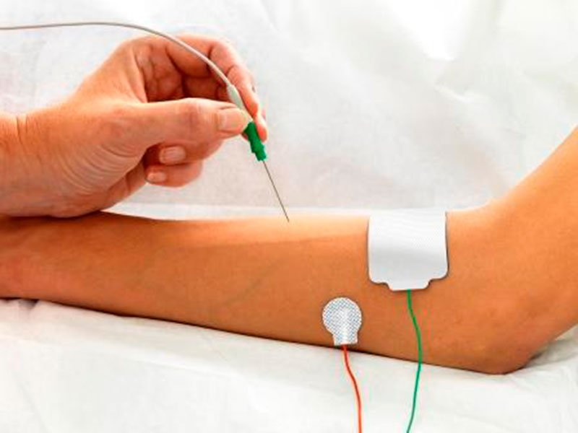
MEDICAL DEVICE (Electromyogram)
Presented by: Stephanie C. Okosa
Date: 15.06.22

Slide 2
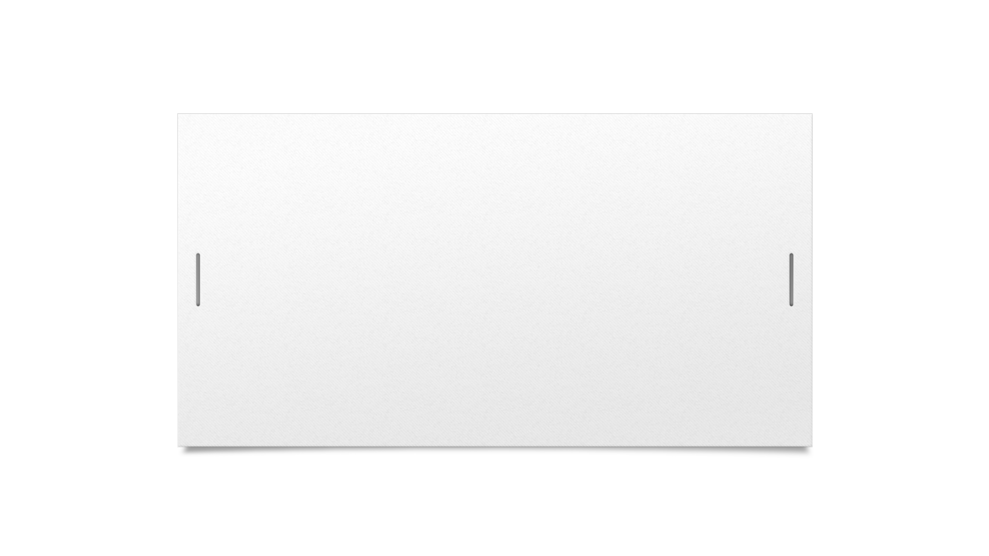
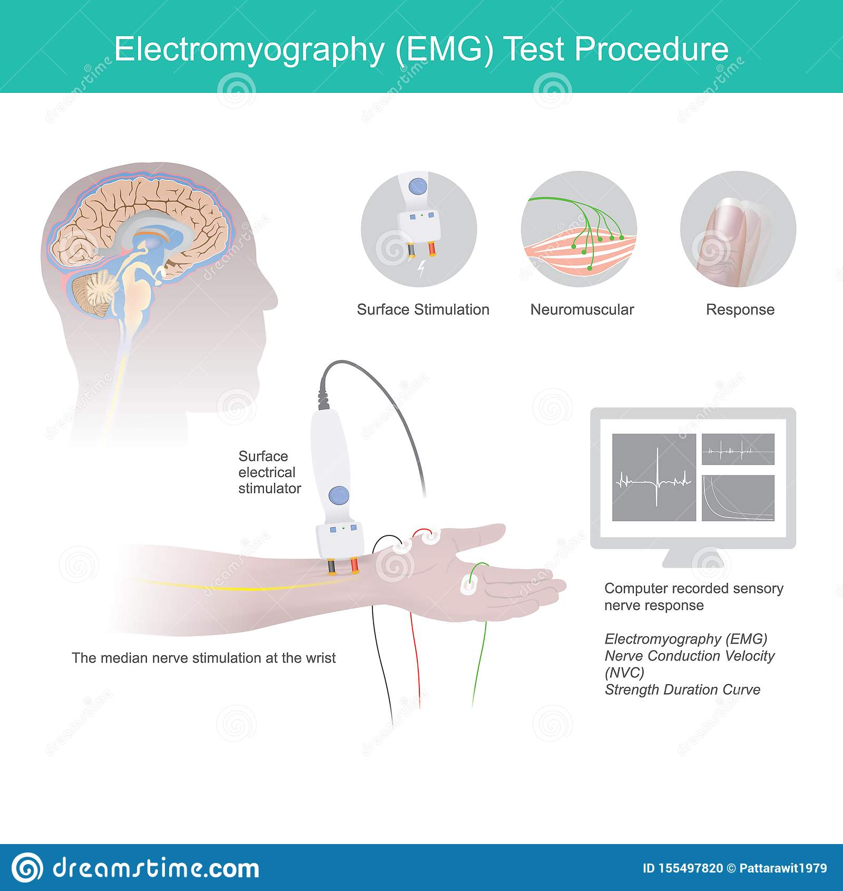

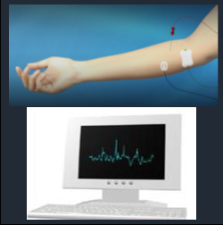
WHAT IS AN EMG
Fig. 1. Surface electrodes
USERS
Patients
Doctors or hospital technicians
Specialists
Fig. 2. Needle electrodes

Slide 3
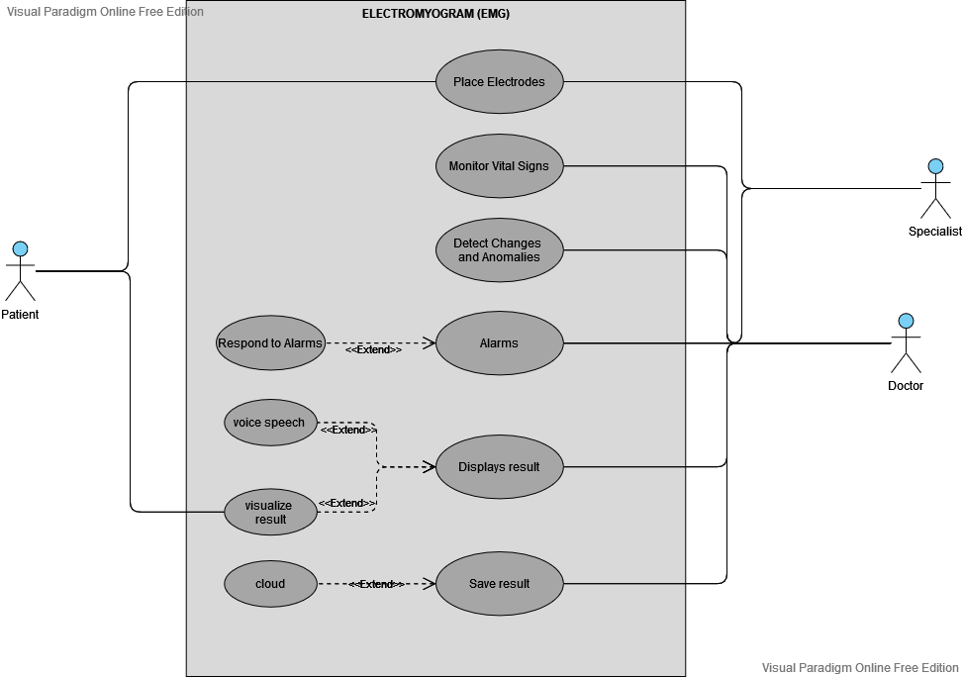
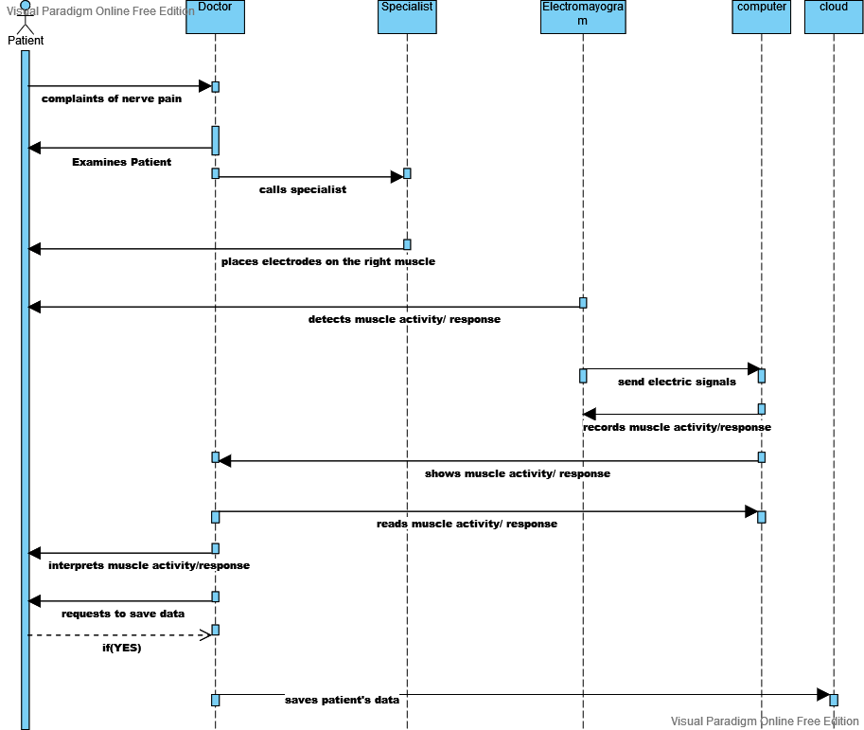
FUNCTIONS OF EMG
Fig. 3. Use case
Fig. 4. Sequence Diagram

Slide 4

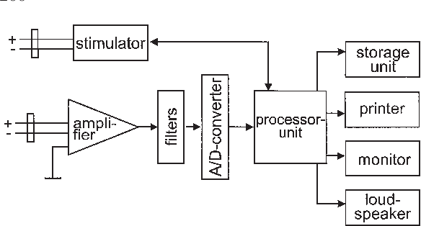
HARDWARE COMPONONENTS
Sensors
Simulators
Microcontroller
Amplifier
Microprocessor
Loudsp
Fig. 3. Block Diagram EMG

Slide 5
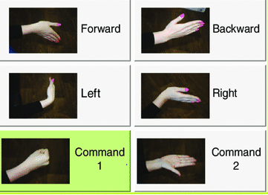


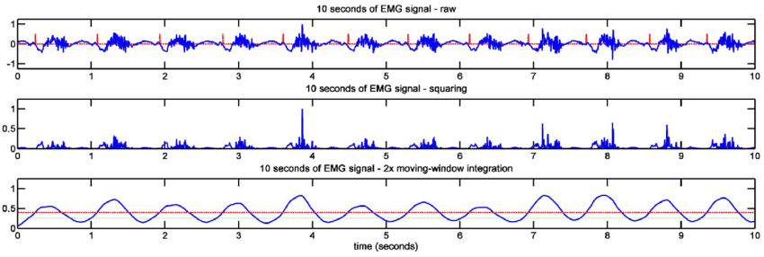



USER INTERFACE

Slide 6
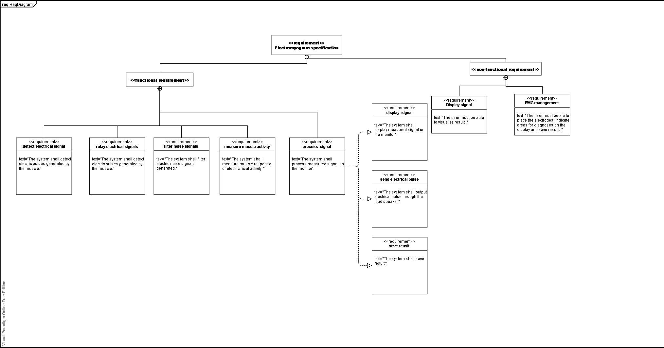
EMG REQUIREMENTS

Slide 7
CONCLUSION
Summary
Future Direction
Two types of electrodes
Surface electrodes
Needle electrodes
Advancement in signal detection.
Advanced algorithm to solve pattern recognition
Ways to reduce electrical signal noise.
THANKS FOR LISTENING

