Slide 1

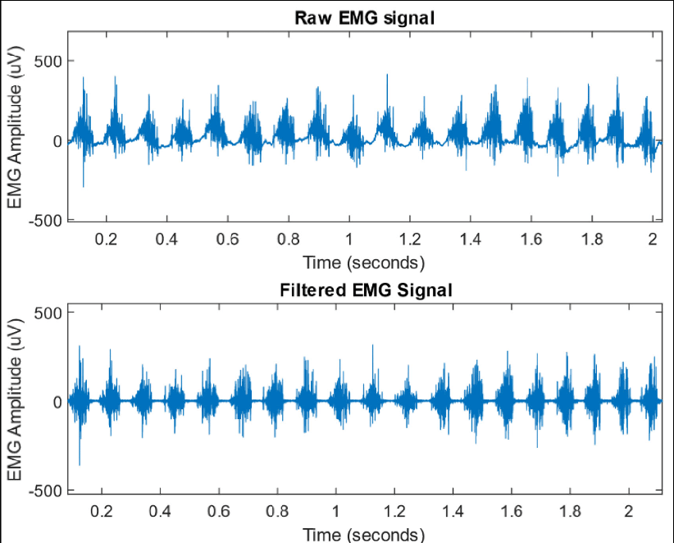

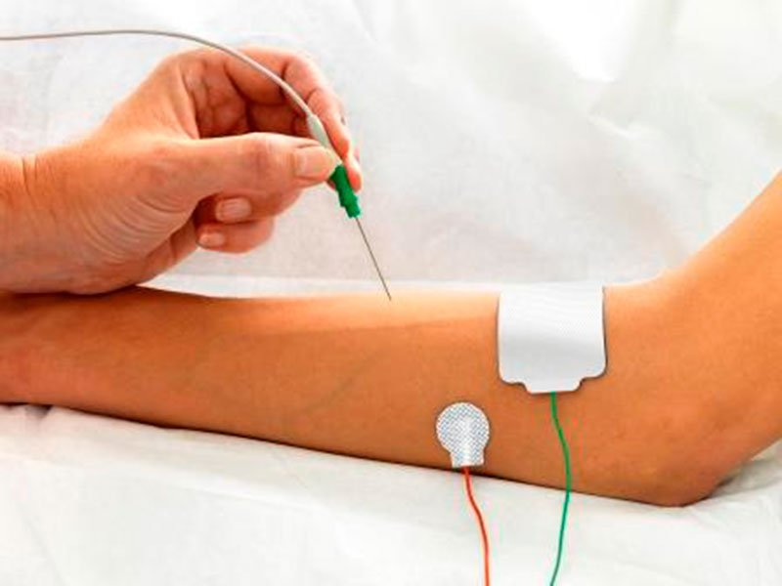
MEDICAL DEVICE (Electromyogram)
[5]
Presented by: Stephanie C. Okosa
Date: 15.06.22
[4]

Slide 2
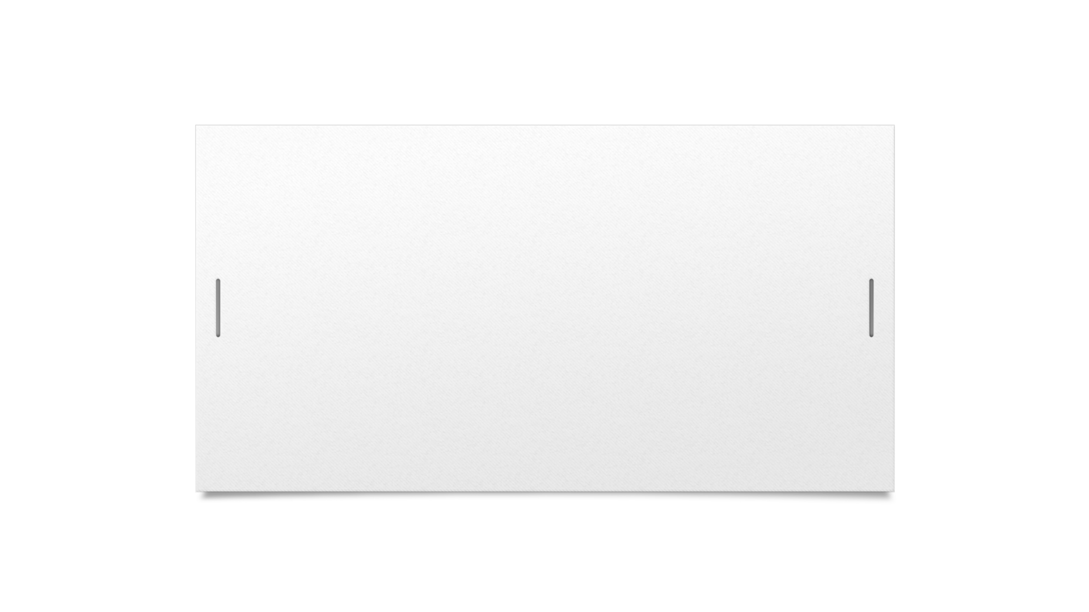
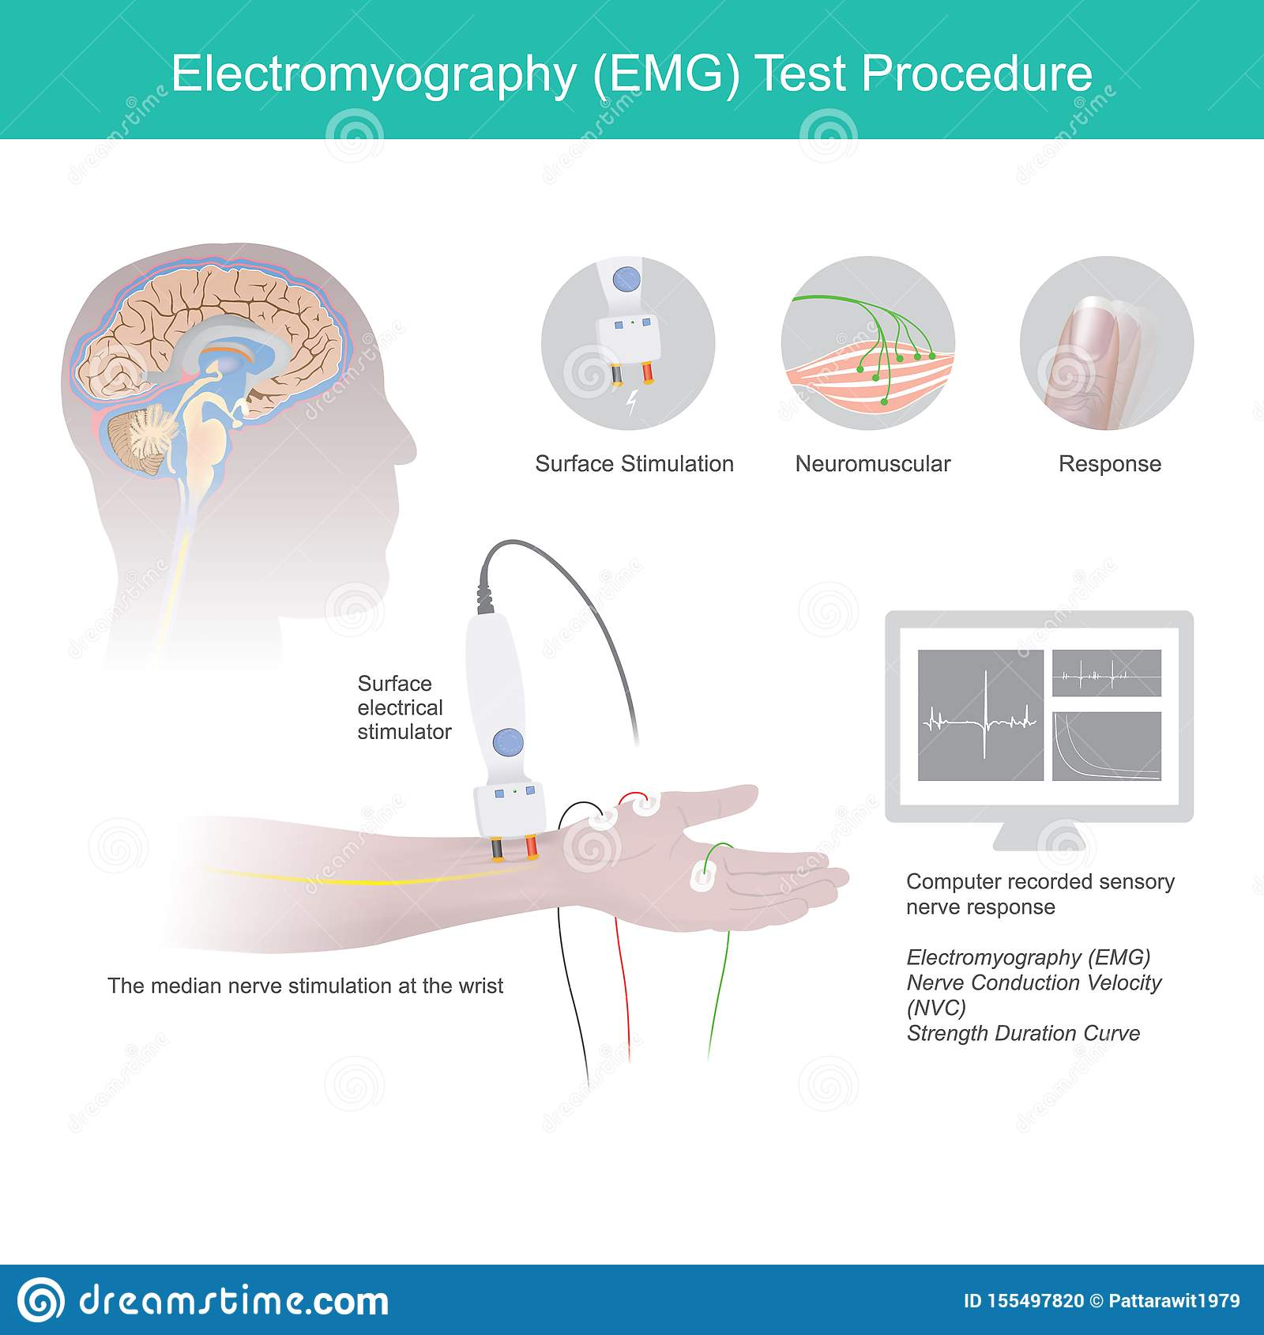

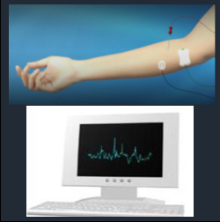
WHAT IS AN EMG
Fig. 1. Surface electrodes [3]
USERS
Patients
Doctors or hospital technicians
Specialists
Fig. 2. Needle electrodes [2]

Slide 3
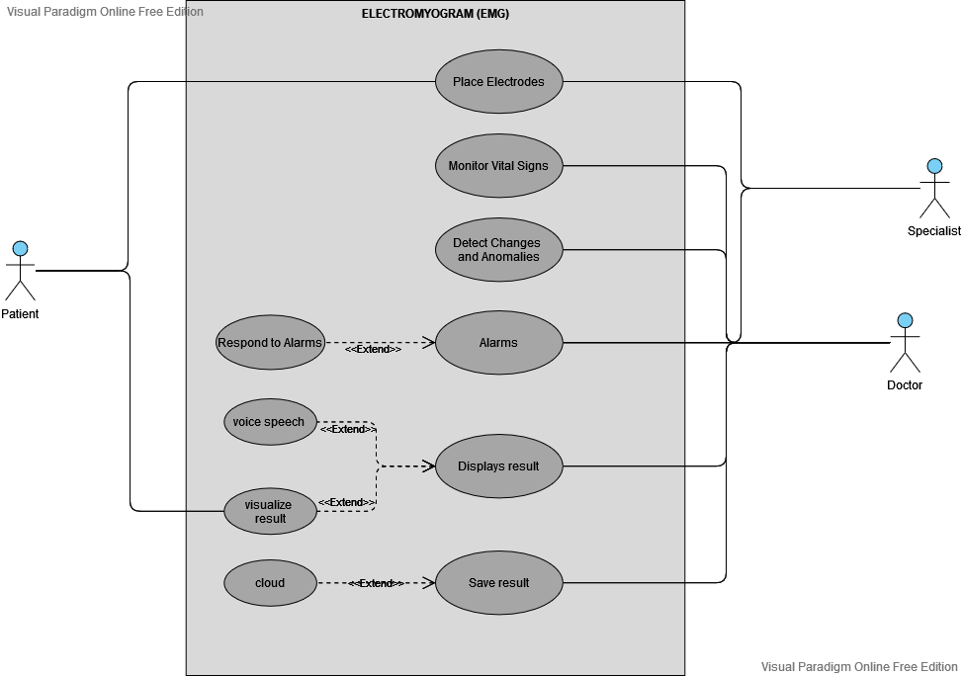
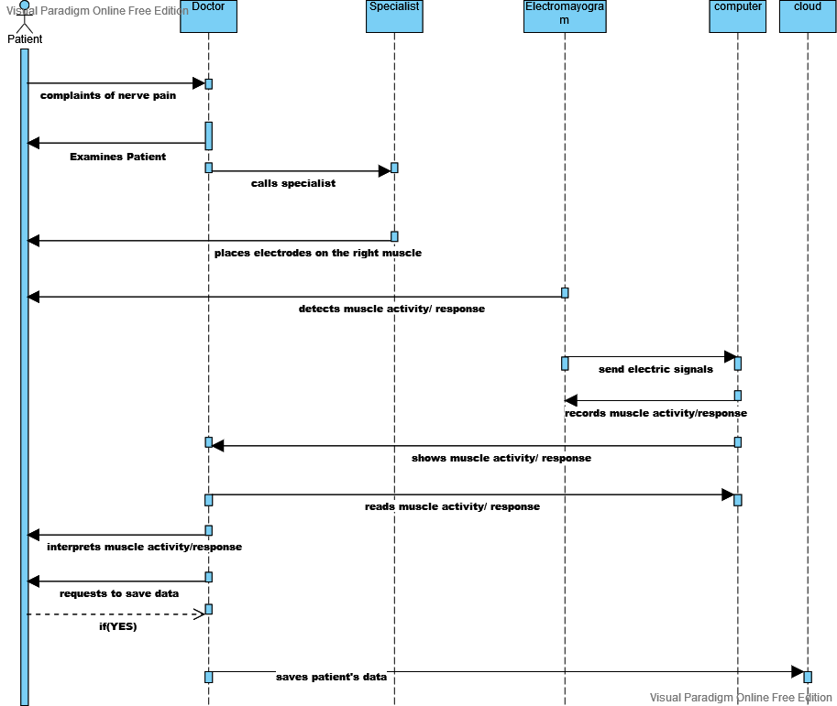
FUNCTIONS OF EMG
Fig. 3. Use case
Fig. 4. Sequence Diagram

Slide 4
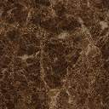
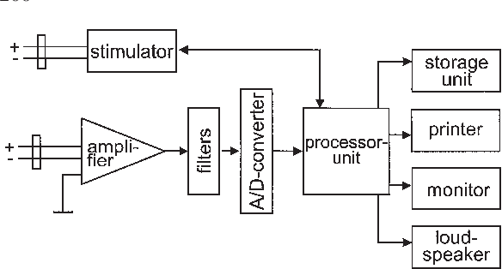
HARDWARE COMPONONENTS
EMG detector
Simulators
Microcontroller(Arduino UNO)
Amplifier
Raspberry Pi 4
Loudspeaker
Screen
Storage Unit.
Fig. 5. Block Diagram EMG [1]

Slide 5
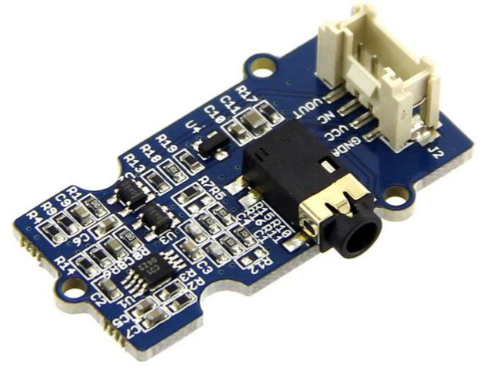
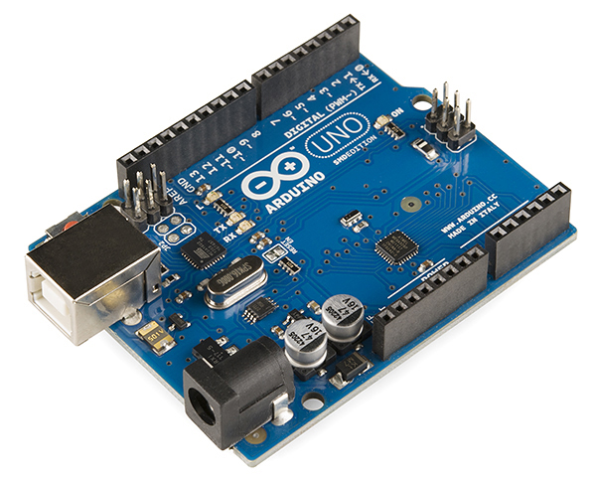
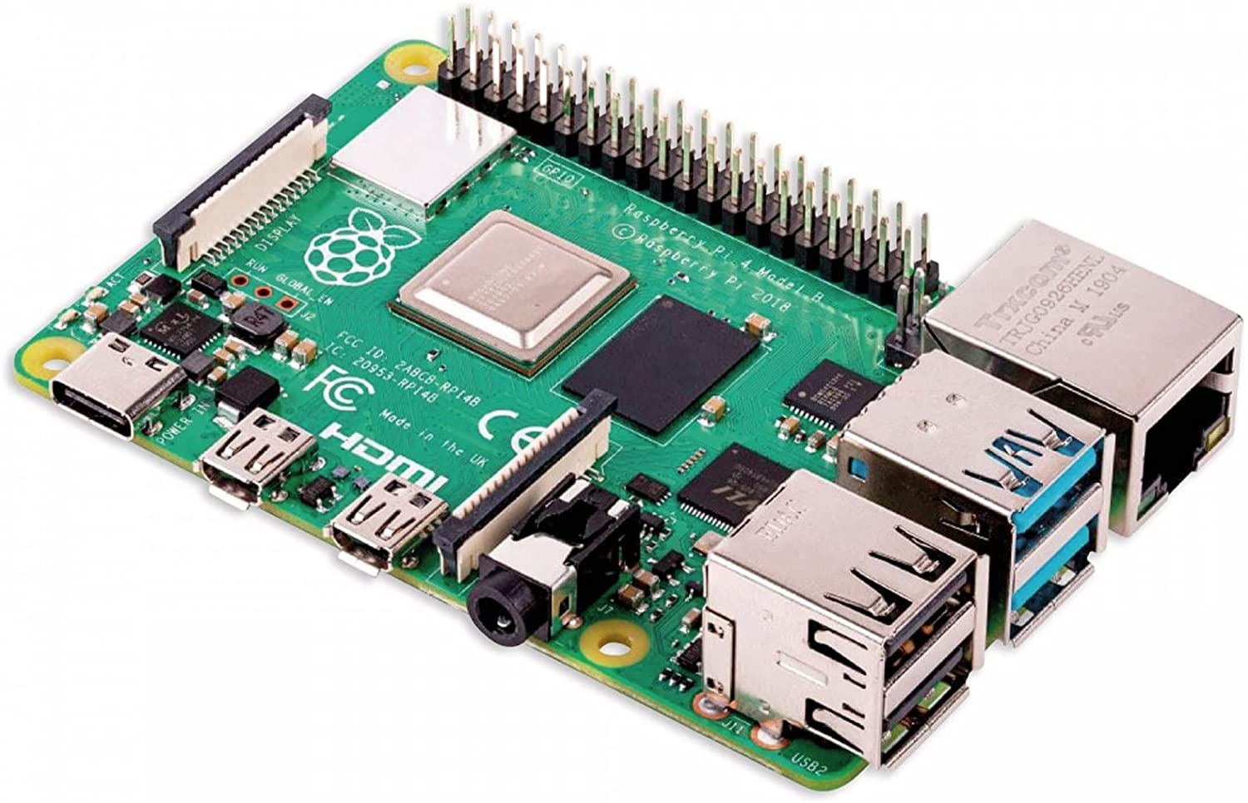
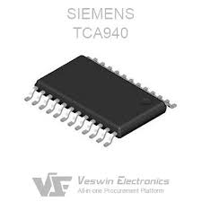
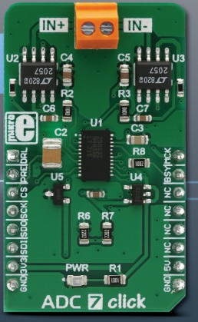
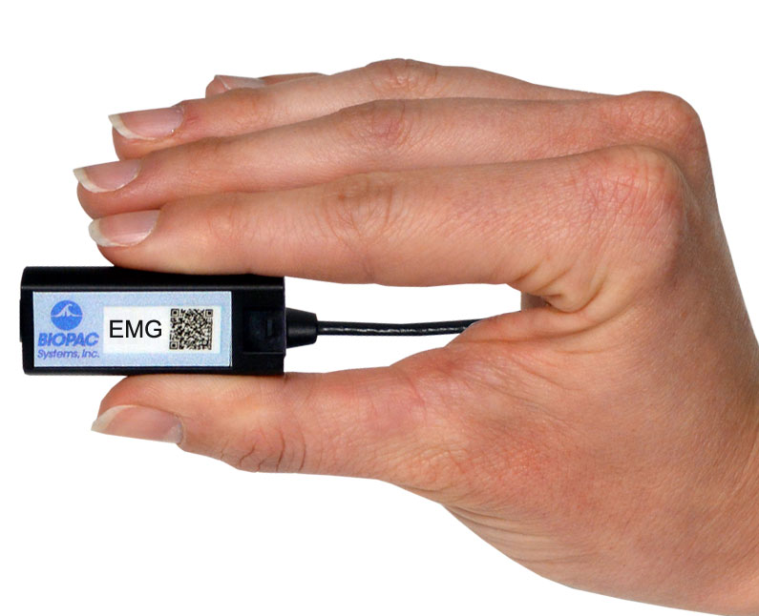
Hardware Components
Figure 13: Raspberry Pi 4 [10]
Figure 6: EMG sensor v1.1 [6]
Figure 12: Arduino Uno [12]
Figure 9: BIOPAC EMG100D [9]
Figure 10: TCA9140 Amplifier [7]
Figure 11: ADC 7 click 32-bit [11]

Slide 6
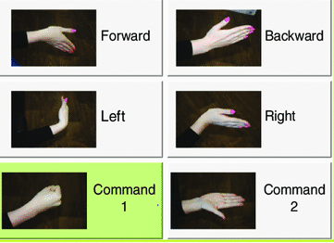


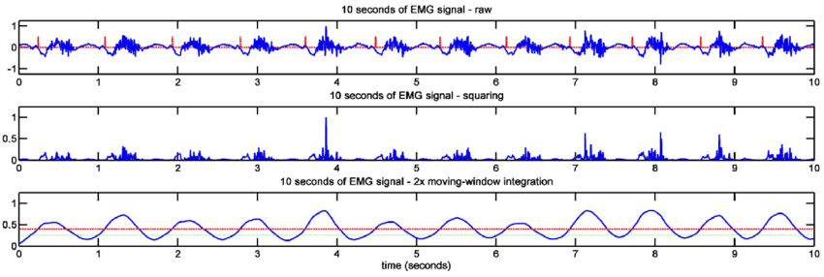



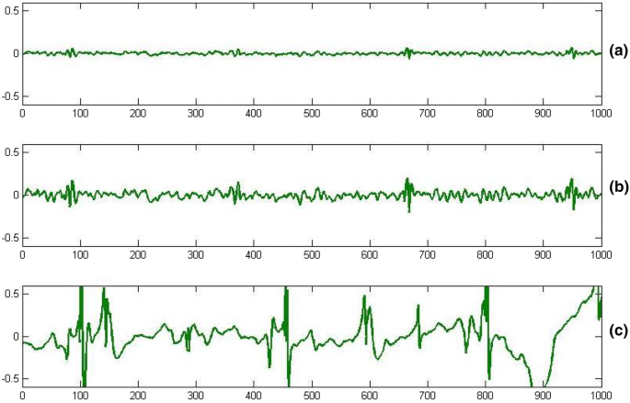







USER INTERFACE
[14]
first name
last name
female
arm
[13]

Slide 7
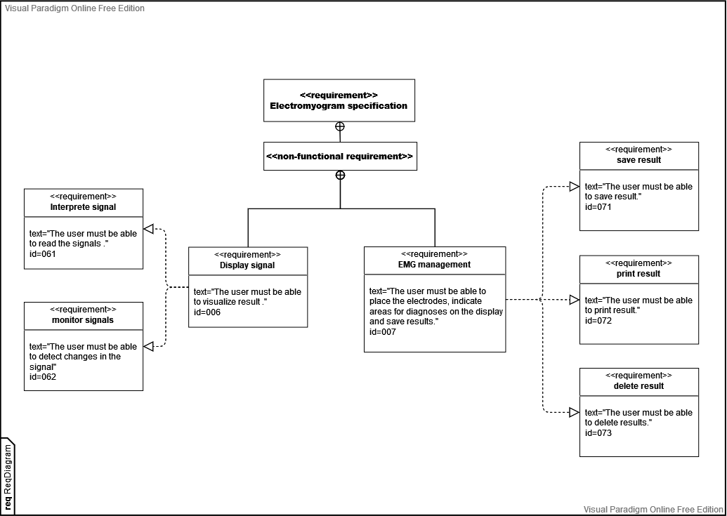
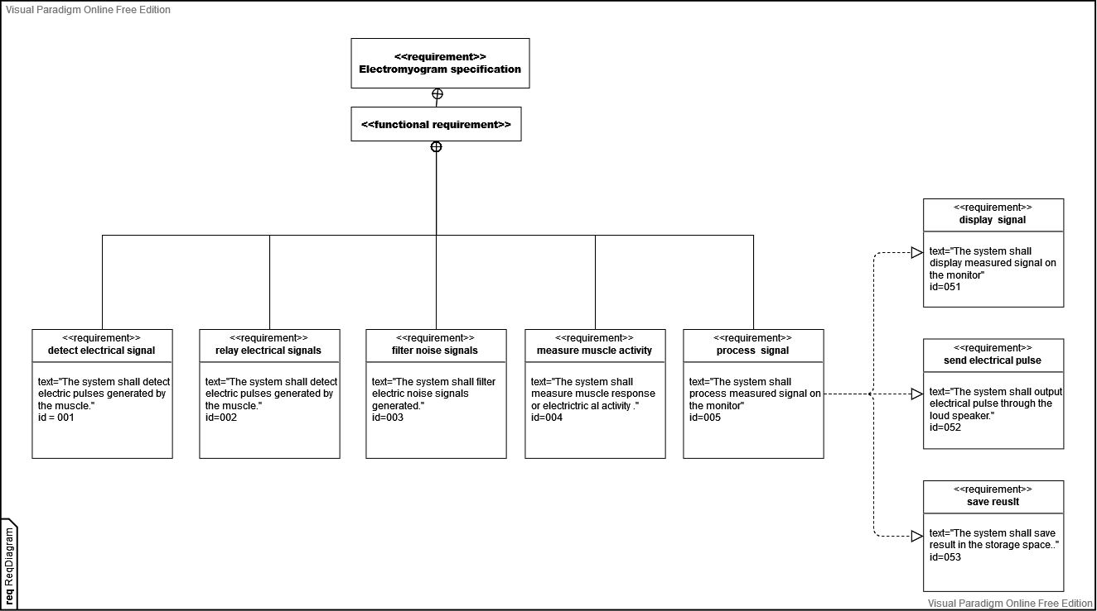
EMG REQUIREMENTS

Slide 8
CONCLUSION
Summary
Future Direction
EMG is used to detect and measure electrical activity of the muscles.
Advancement in signal detection.
Advanced algorithm to solve pattern recognition
Ways to reduce electrical signal noise.

Slide 9
Sources:
[1]"Chapter 4.2 Standards of instrumentation of EMG", D3i71xaburhd42.cloudfront.net, 2022. [Online]. Available: https://d3i71xaburhd42.cloudfront.net/7be421219b8a4f247e20bc2664eddda288a901b9/2-Figure1-1.png. [Accessed: 06- Jun- 2022].
[2]"Electromyography (EMG)", Hopkinsmedicine.org, 2022. [Online]. Available:
https://www.hopkinsmedicine.org/health/treatment-tests-and-therapies/electromyography-emg. [Accessed: 30- May- 2022].
[3] Thumbs.dreamstime.com, 2022. [Online].Available: https://thumbs.dreamstime.com/z/electromyography-test-procedure-illustrate-explain-use-medical-electrical-tools-to-checking-neuromuscular-disease-155497820.jpg. [Accessed: 30- Jun- 2022].
[4]Technomed.nl, 2022. [Online]. Available:
https://technomed.nl/sites/default/files/styles/max_size_responsive/public/article/images/EMG.jpg?itok=v6BFqlJt. [Accessed: 08- Jun- 2022].
[5]H. Yousif, A. Norasmadi, A. Bin Salleh, Z. Ammar and K. Alfarhan, "Assessment of Muscles Fatigue during 400-Meters Running Strategies Based on the Surface EMG Signals", 2022 [Accessed: 06-Jun-2022].
[6] J. Ghosh, "Electromyography (EMG) signal acquisition and processing by using surface electrodes", 2019. Available: https://www.researchgate.net/publication/333118571. [Accessed 4 June 2022].
[7]"TCA940 Datasheet | Thomson Components - Datasheetspdf.com", Datasheetspdf.com, 2022. [Online]. Available: https://datasheetspdf.com/datasheet/TCA940.html [Accessed: 10- Jun- 2022].
[8]"MP160 Starter Systems | BIOPAC", BIOPAC Systems, Inc., 2022. [Online]. Available:
https://www.biopac.com/product category/research/systems/mp150-starter-systems/. [Accessed: 10- Jun- 2022].
[9]"EMG Smart Amplifier | EMG100D | Research | BIOPAC", BIOPAC Systems, Inc., 2022. [Online]. Available: https://www.biopac.com/product/emg-smart-amplifier/. [Accessed: 10- Jun- 2022].
[10] Welectron.com, 2022. [Online]. Available:
https://www.welectron.com/media/image/product/20929/md/raspberry-pi-4-modell-b-8-gb-ram~3.jpg. [Accessed: 10- Jun- 2022].
[11]"ADC 7 Click | Mikroelektronika", MIKROE, 2022. [Online]. Available: https://www.mikroe.com/adc-7-click. [Accessed: 10- Jun- 2022].
[12]"Arduino Uno - Wikipedia", En.wikipedia.org, 2022. [Online]. Available: https://en.wikipedia.org/wiki/Arduino_Uno. [Accessed: 11- Jun- 2022].
[13]A. Verma and B. Gupta, "Detecting Neuromuscular Disorders Using EMG Signals Based on TQWT Features", Augmented Human Research, vol. 5, no. 1, 2019. Available: 10.1007/s41133-019-0020-7 [Accessed 10 June 2022].
[14] S. Lobov, V. Mironov, I. Kastalskiy and V. Kazantsev, "Combined Use of Command-Proportional Control of External Robotic Devices Based on Electromyography Signals", Sovremennye tehnologii v medicine, vol. 7, no. 4, pp. 30-38, 2015. Available: 10.17691/stm2015.7.4.04 [Accessed 15 June 2022].
THANKS FOR LISTENING

