Slide 1


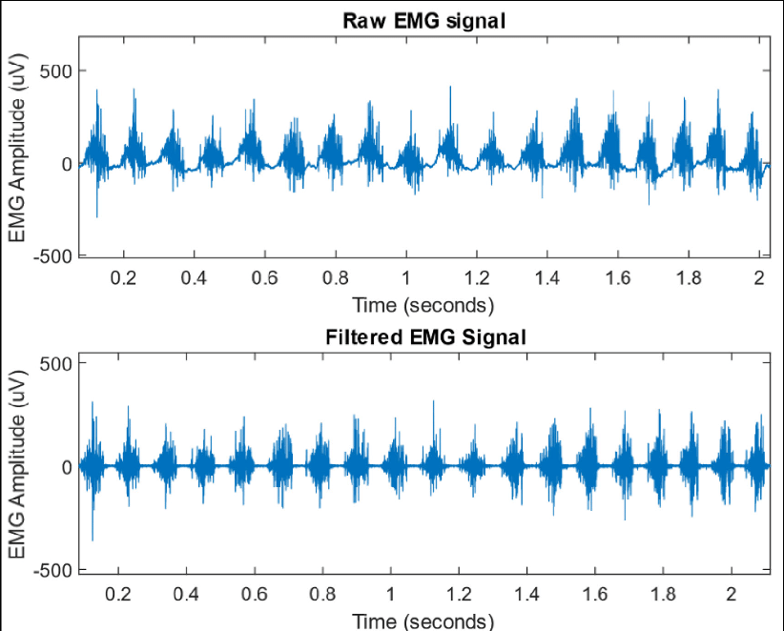

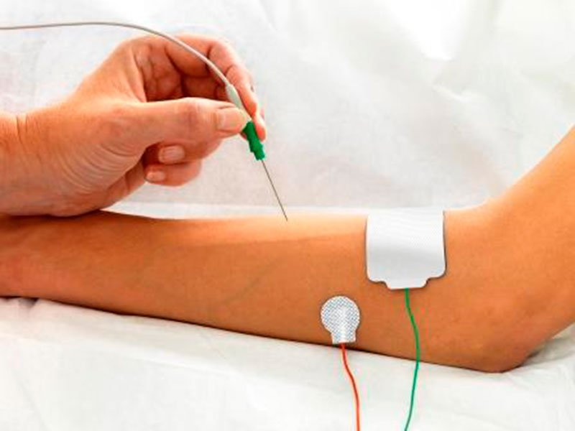
MEDICAL DEVICE (Electromyogram)
[5]
Presented by: Stephanie C. Okosa
Date: 15.06.22
[4]

Slide 2
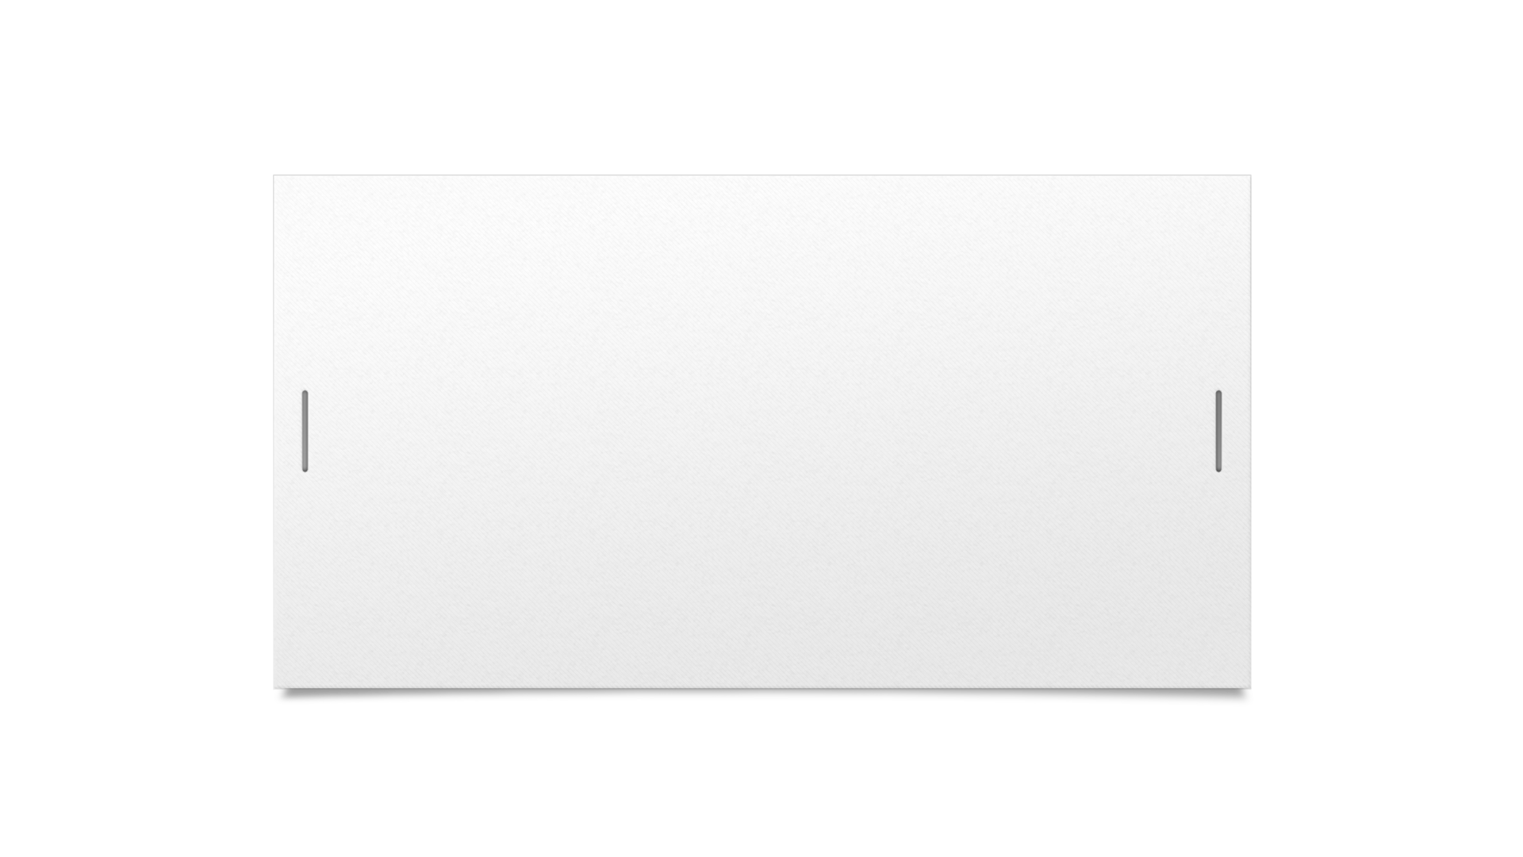
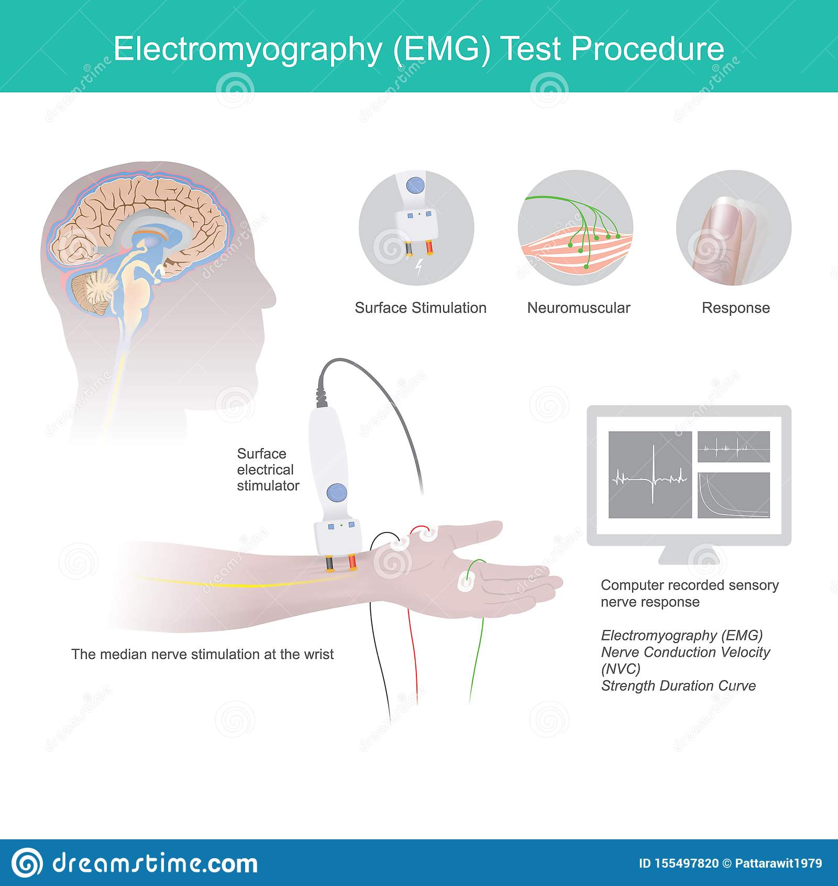

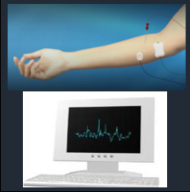
WHAT IS AN EMG
Fig. 1. Surface electrodes [3]
USERS
Patients
Doctors or hospital technicians
Specialists
Fig. 2. Needle electrodes [2]

Slide 3
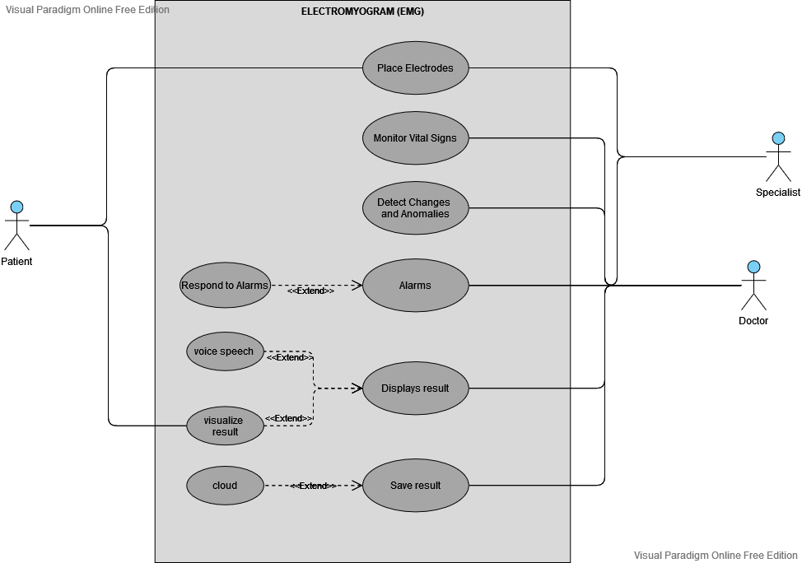
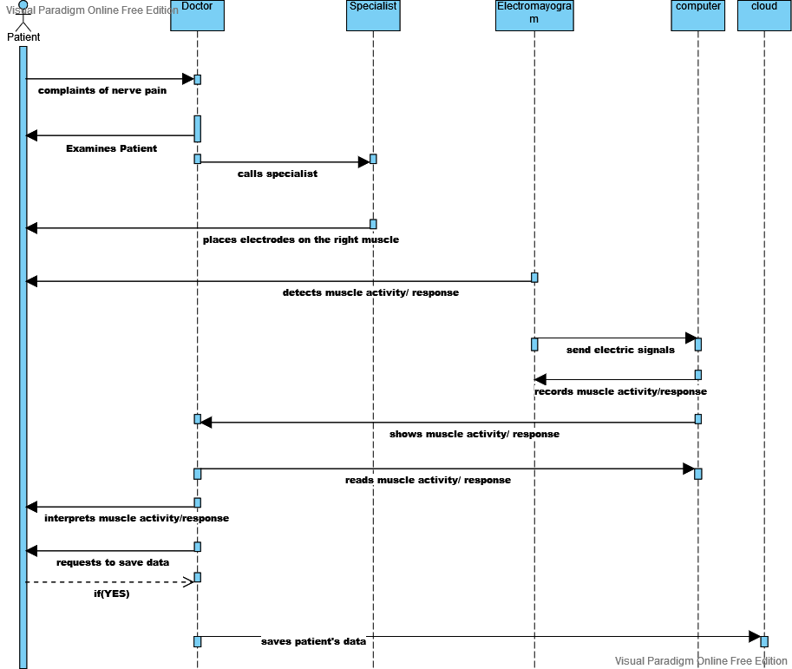
FUNCTIONS OF EMG
Fig. 3. Use case
Fig. 4. Sequence Diagram

Slide 4

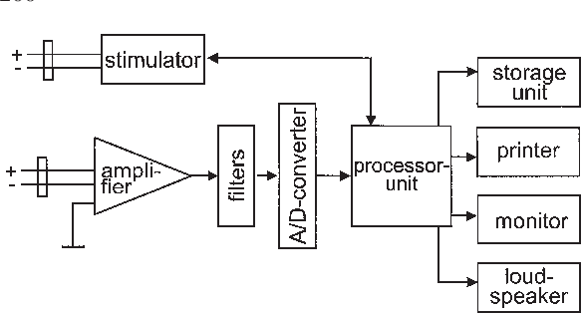
HARDWARE COMPONONENTS
EMG detector
Simulators
Microcontroller
Amplifier
Raspberry Pi 4
Loudspeaker
Screen
Storage Unit.
Fig. 3. Block Diagram EMG [1]

Slide 5


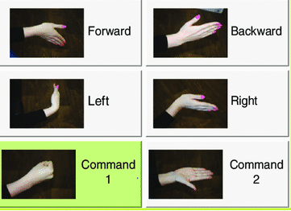
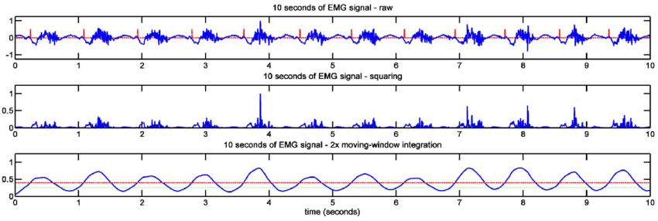


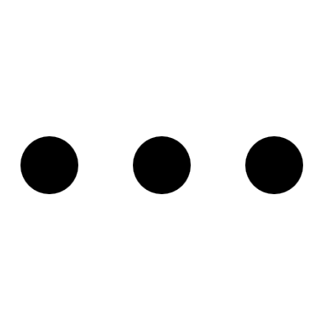
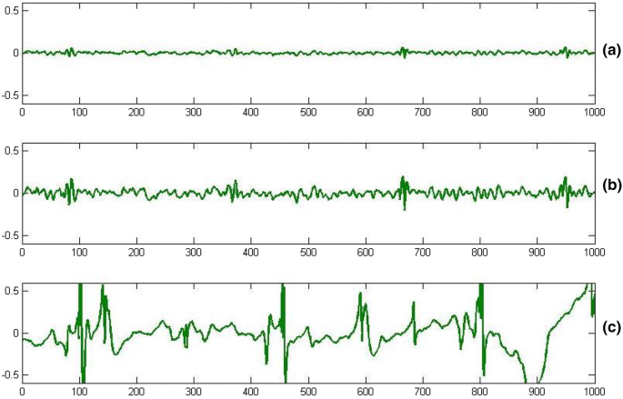







USER INTERFACE
first name
last name
female
arm

Slide 6
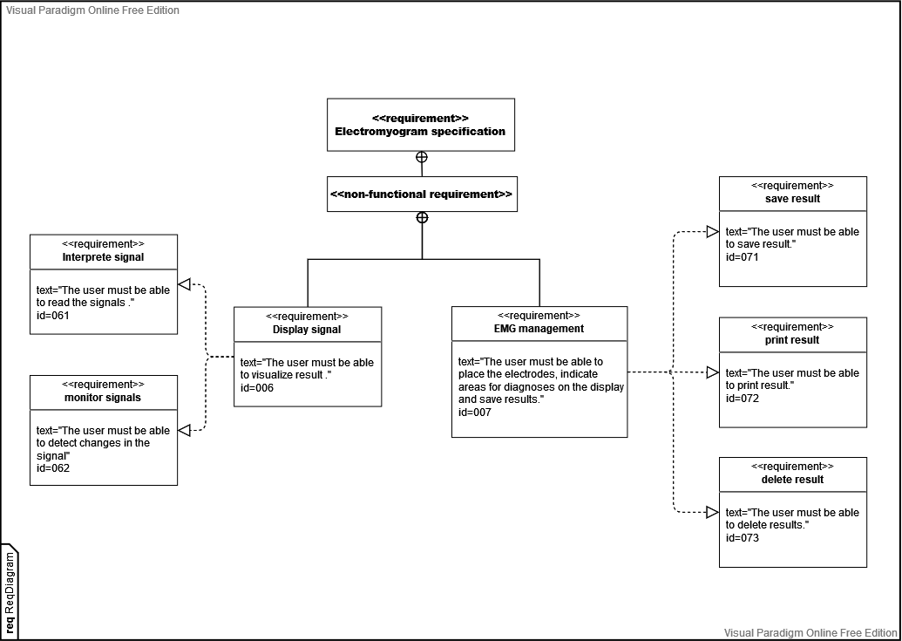
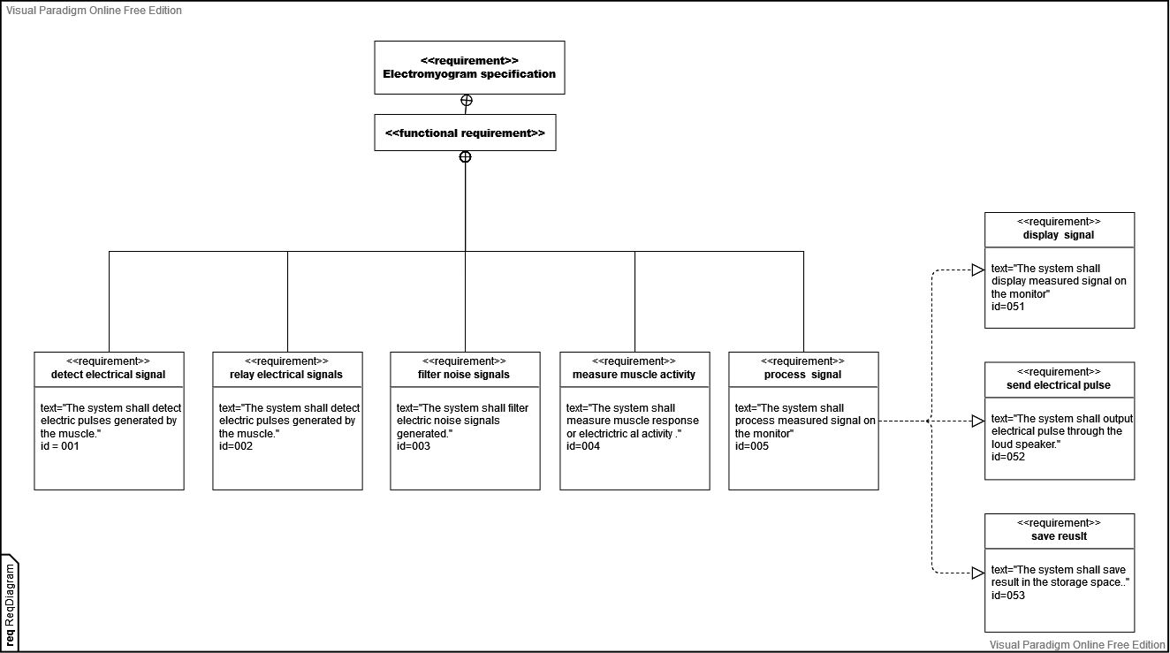
EMG REQUIREMENTS

Slide 7
CONCLUSION
Summary
Future Direction
EMG is used to detect and measure electrical activity of the muscles.
Advancement in signal detection.
Advanced algorithm to solve pattern recognition
Ways to reduce electrical signal noise.

Slide 8
Sources:
[1]"Chapter 4.2 Standards of instrumentation of EMG", D3i71xaburhd42.cloudfront.net, 2022. [Online]. Available: https://d3i71xaburhd42.cloudfront.net/7be421219b8a4f247e20bc2664eddda288a901b9/2-Figure1-1.png. [Accessed: 06- Jun- 2022].
[2]"Electromyography (EMG)", Hopkinsmedicine.org, 2022. [Online]. Available: https://www.hopkinsmedicine.org/health/treatment-tests-and-therapies/electromyography-emg. [Accessed: 30- May- 2022].
[3] Thumbs.dreamstime.com, 2022. [Online].Available: https://thumbs.dreamstime.com/z/electromyography-test-procedure-illustrate-explain-use-medical-electrical-tools-to-checking-neuromuscular-disease-155497820.jpg. [Accessed: 30- Jun- 2022].
[4]Technomed.nl, 2022. [Online]. Available: https://technomed.nl/sites/default/files/styles/max_size_responsive/public/article/images/EMG.jpg?itok=v6BFqlJt. [Accessed: 08- Jun- 2022].
[5]H. Yousif, A. Norasmadi, A. Bin Salleh, Z. Ammar and K. Alfarhan, "Assessment of Muscles Fatigue during 400-Meters Running Strategies Based on the Surface EMG Signals", 2022 [Accessed: 06-Jun-2022].
THANKS FOR LISTENING

