Slide 1


Naïve Bayes
By
Stephanie C. Okosa

Slide 2

Table of Content
Introduction to Machine Learning
Machine learning Algorithms
Definition of Naïve Bayes
Naïve bayes Classifications
Use case implementation
Summary
Bayesian Theorem
Advantages & Disadvantages

Slide 3
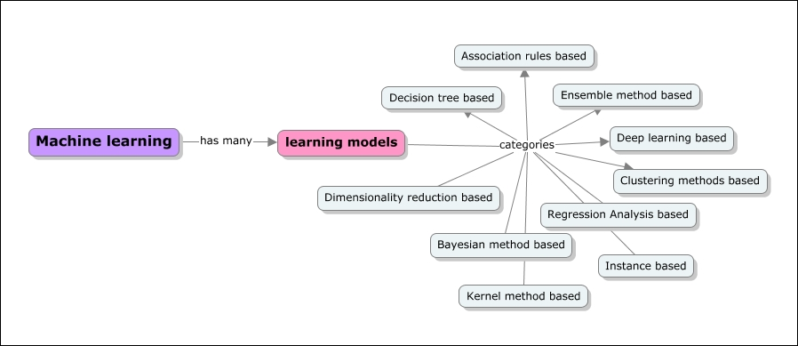
What is Machine Learning ?
Machine learning is a branch of artificial intelligence that is concerned with the design and development of algorithms that allow computers to evolve behaviours based on empirical data such as, from sensor data or databases.
[1]
The primary goal of a Machine learning implementation is to develop a general-purpose algorithm that solves a practical and focused problem.

Slide 4
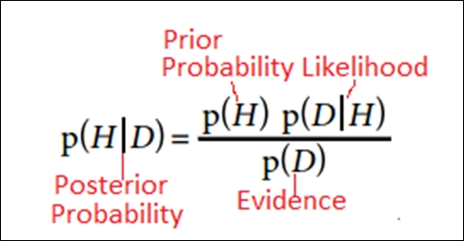
Bayesian Learning Algorithm
A statistical based method which is established on the probabilistic concept of the assumption of conditional independence of events
The primary goal is to build a model of the distribution of class labels that have a concrete definition of the target attribute
Notes:
The diagram displays the different types of probability.
-N/B it is a supervised learning technique
Applying Bayes theorem,

Slide 5
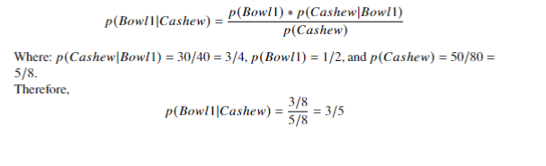
Bayes Theorem Example
Assume there are two bowls of nuts. The first bowl contains 30 cashew nuts, 10 pistachios and the second bowl contains 20 of each. What is the probability that a cashew nut is selected from the first bowl?
This is the base theorem assumption applied in Naïve Bayes Classification

Slide 6
Naïve Bayes
Naïve Bayes Classifiers
Gaussian
Multinomial
Bernoulli
Naïve Bayes is based on applying Bayes theorem with the ”naïve” assumption of independence between each and every pair of features i.e., knowing the value of one attribute does influence the value of any other attribute
The main aim of Naïve bayes is for classifying high dimensional data set.
Notes:
In order to apply Naïve Bayes to predict an overall outcome, we would run the formula for every outcome
-It also assumes that all features contribute equally to the outcome
The algorithm performs well, particularly with small sample sizes
There are different types of classifiers based on the distributions of the feature values.

Slide 7
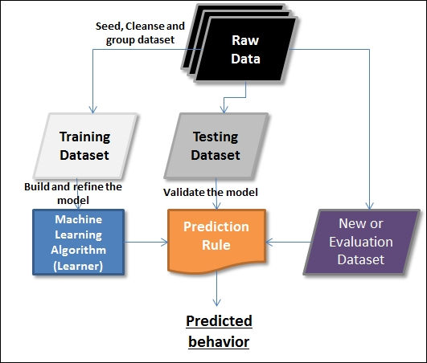
How Learning is Applied to Predict a Behaviour
A Dataset consists of features and instances. Any given comprehensive dataset is split into three categories of datasets and is usually in the following proportions: 60% training, 30% testing, and 10% evaluation.

Slide 8
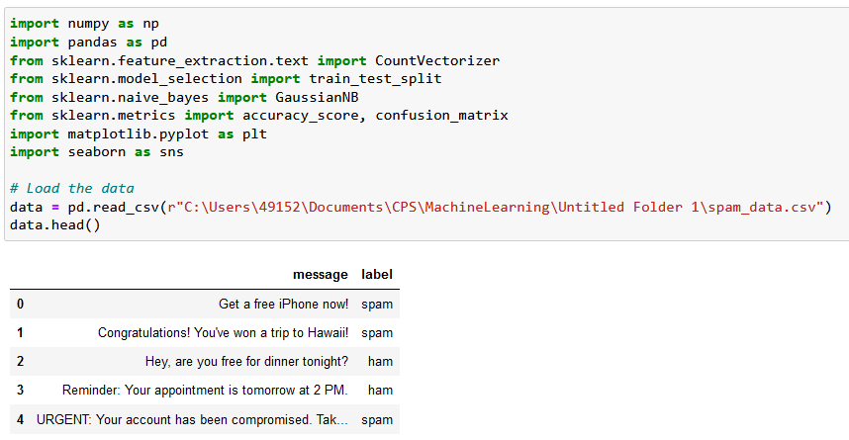
Gaussian Naïve Bayes Classifier
Used with Gaussian distributions i.e., normal distributions for each of the features
The model is fitted by finding the mean and standard deviation of each class
EXAMPLE: Spam Classification
Notes:
we will look at the Naïve Bayes classifiers and how they are used to solve the classification problems

Slide 9
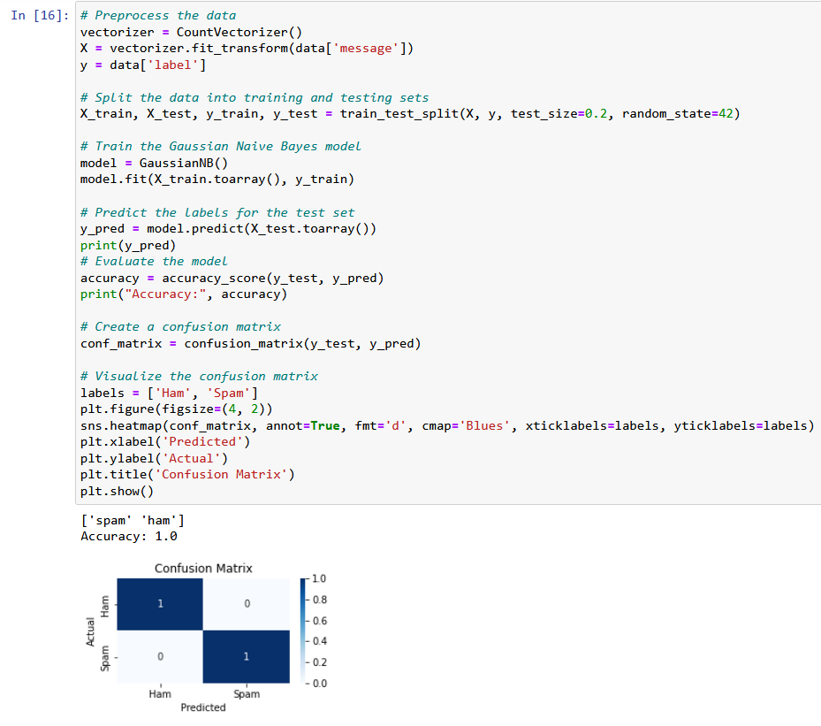
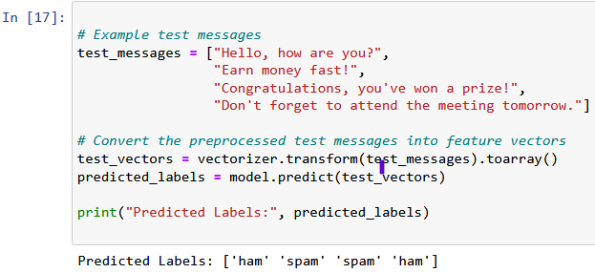
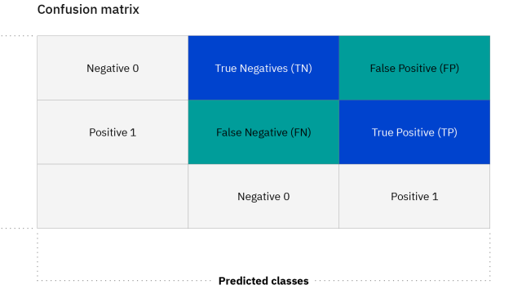
Gaussian Naïve Bayes Classifier
Notes:
we will look at the Naïve Bayes classifiers and how they are used to solve the classification problems
-The accuracy of the learning algorithm based on the training dataset is then evaluated based on the performance of the test dataset.

Slide 10
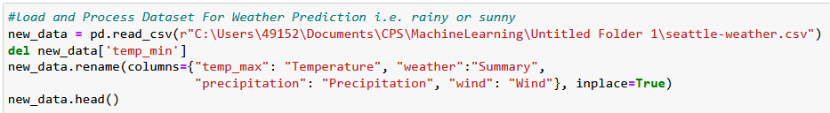
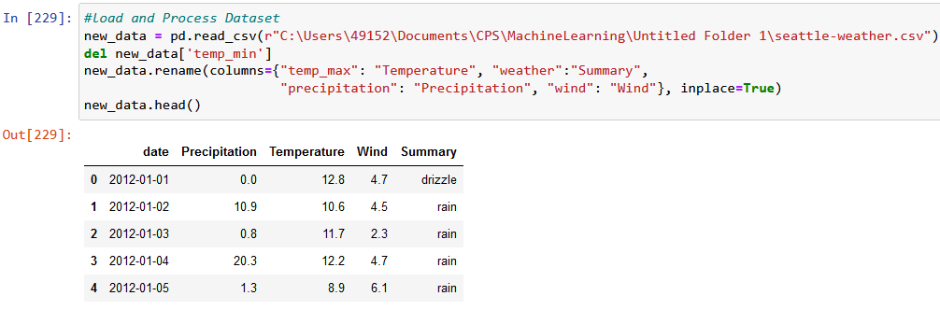
Bernoulli Naïve Bayes Classifier
Used in Boolean variables.
It attaches a Boolean indicator to a word when it belongs to a document.
EXAMPLE: Weather Prediction
Notes:
we will look at the Naïve Bayes classifiers and how they are used to solve the classification problems

Slide 11
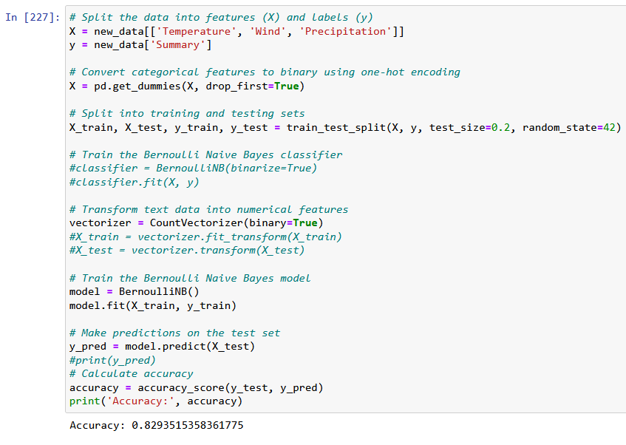
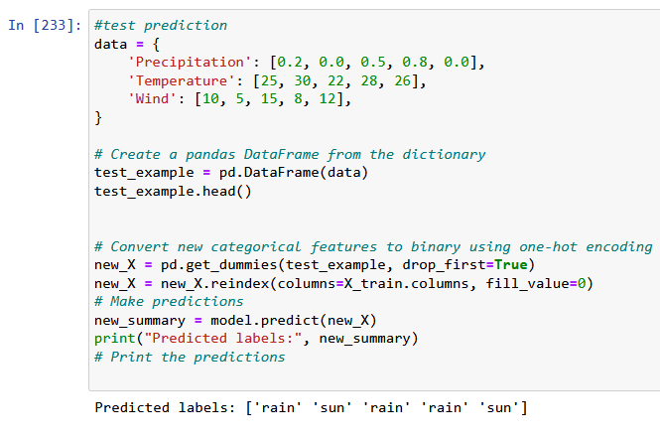
Bernoulli Naïve Bayes Classifier
Notes:
we will look at the Naïve Bayes classifiers and how they are used to solve the classification problems

Slide 12
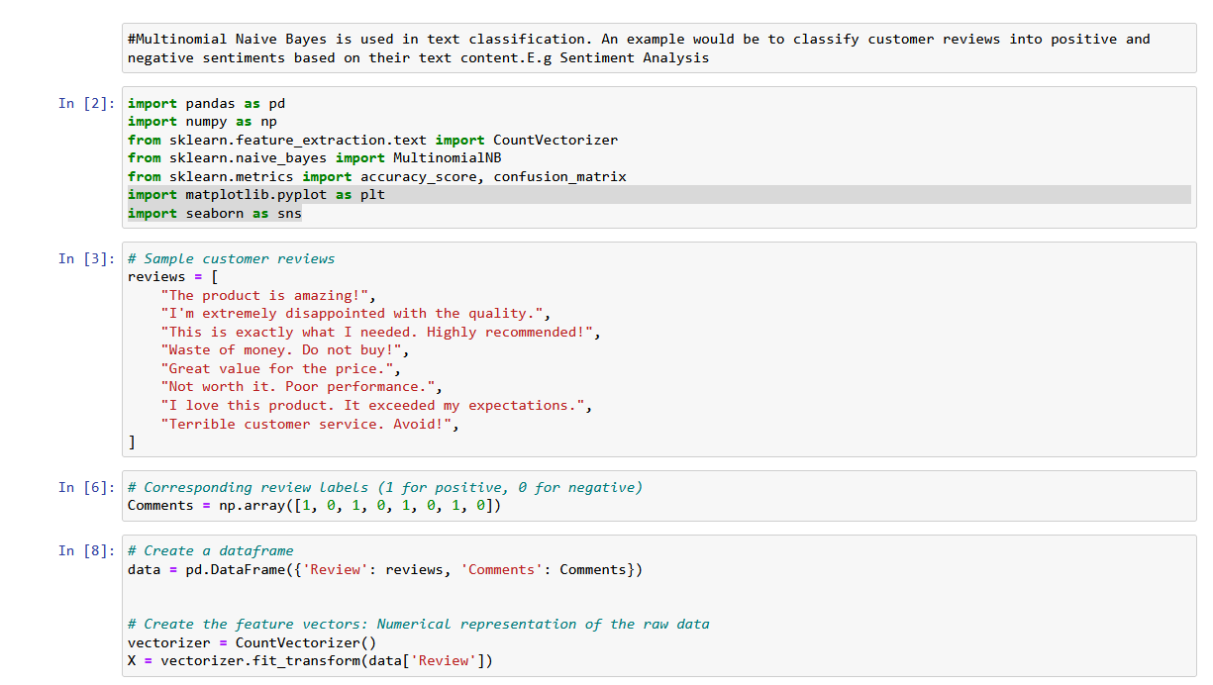
Multinomial Naïve Bayes Classifier
Assumes multinomial distributions for each of the features.
Useful when employing discrete data e.g., frequency counts
EXAMPLE: Sentiment Analysis
Notes:
we will look at the Naïve Bayes classifiers and how they are used to solve the classification problems

Slide 13
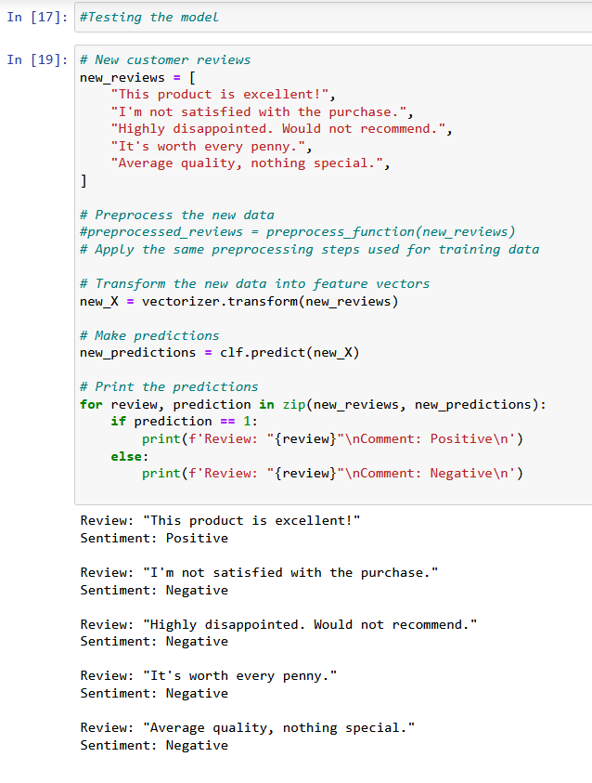
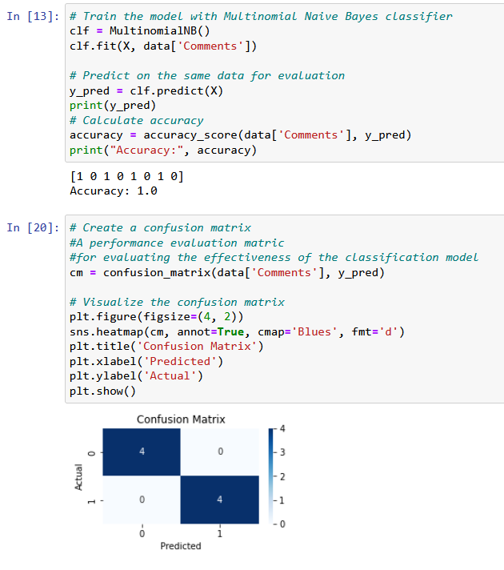
Multinomial Naïve Bayes Classifier
Notes:
we will look at the Naïve Bayes classifiers and how they are used to solve the classification problems

Slide 14
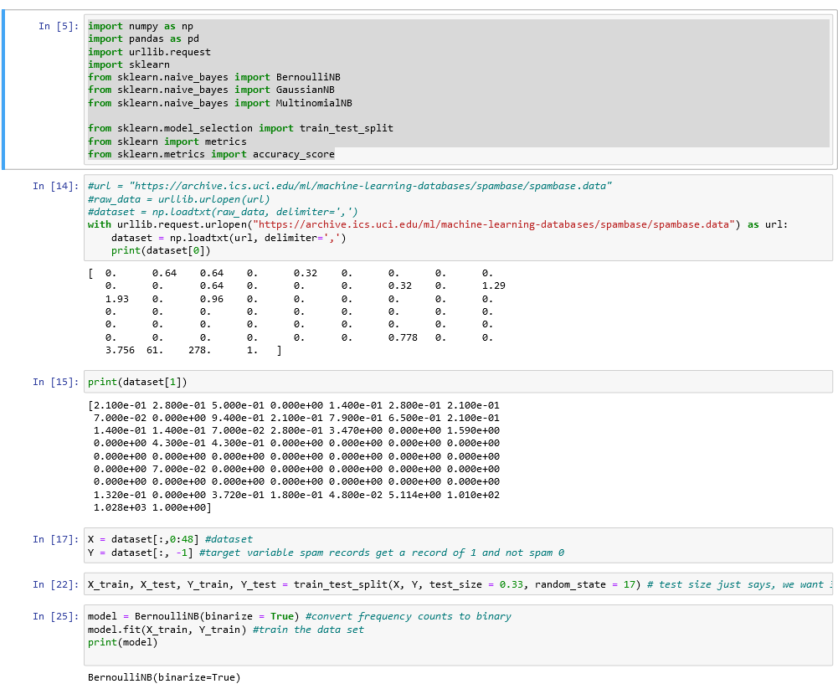
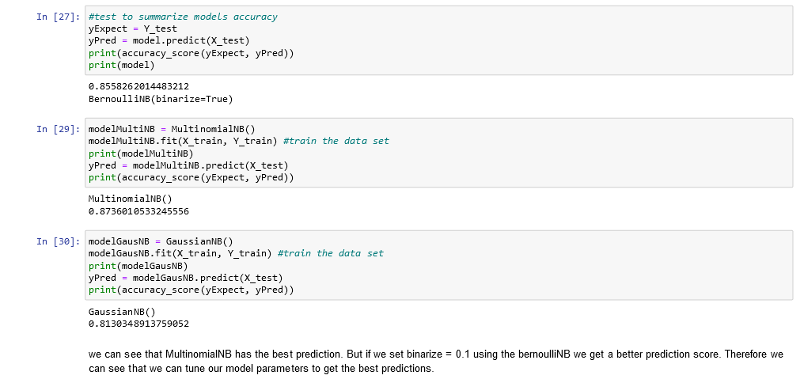
Naïve Bayes Classifier Comparison
Notes:
BernNB_GausNB_MultNB_Comparison

Slide 15
Naïve Bayes Advantages and Disadvantages
Advantages
It can efficiently work on a high dimensional dataset
Naive Bayes has a very low computation cost
When the assumption of independence holds, a Naive Bayes classifier performs better compared to other models like logistic regression
Disadvantages
The assumption of independent features. In practice, it is almost impossible that model will get a set of predictors which are entirely independent. This can lead to incorrect classifications.
If there is no training tuple of a particular class, this causes zero posterior probability. In this case, the model is unable to make predictions i.e., Zero frequency occurs when a categorical variable does not exist within the training set.
Notes:
we will look at the Naïve Bayes classifiers and how they are used to solve the classification problems

Slide 16
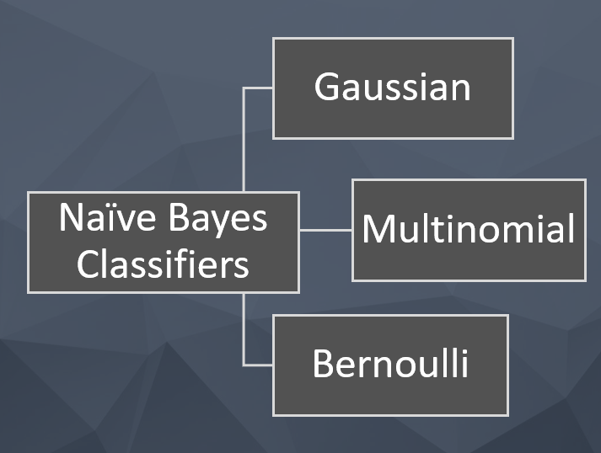
Summary
Naïve Bayes Classification is mostly used as a baseline for classification problem based on the principle of the Bayesian Theorem
BernoulliNB include better performance on some datasets.
Notes:
we will look at the Naïve Bayes classifiers and how they are used to solve the classification problems

Slide 17
References
[1] Sunila Gollapudi (2016): Practical Machine Learning (9781784399689). Available online at https://learning.oreilly.com/library/view/practical-machine-learning/9781784399689/ch01s05.html.
[2] https://www.datacamp.com/tutorial/naive-bayes-scikit-learn
[3] Jake VanderPlas (2022): Python Data Science Handbook, 2nd Edition (9781098121228). Available online at https://learning.oreilly.com/library/view/python-data-science/9781098121211/.

Slide 18
THANKS FOR LISTENING

