Slide 1


Naïve Bayes
By
Stephanie C. Okosa

Slide 2

Table of Content
Introduction to Machine Learning
Machine learning Algorithms
Definition of Naïve Bayes
Naïve bayes Classifications
Use case implementation
Summary
Bayesian Theorem
Advantages & Disadvantages

Slide 3
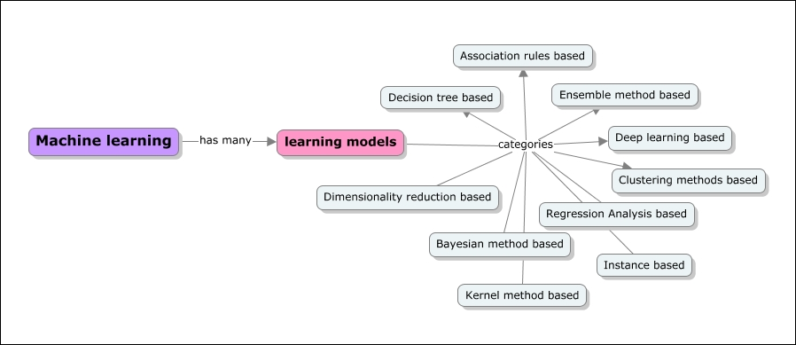
What is Machine Learning ?
Machine learning is a branch of artificial intelligence that is concerned with the design and development of algorithms that allow computers to evolve behaviours based on empirical data such as, from sensor data or databases.
[1]
The primary goal of a Machine learning implementation is to develop a general-purpose algorithm that solves a practical and focused problem.

Slide 4
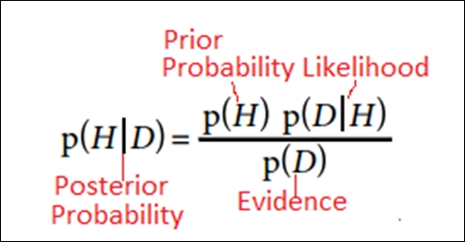
Bayesian Learning Algorithm
A statistical based method which is established on the probabilistic concept of the assumption of conditional independence of events
The primary goal is to build a model of the distribution of class labels that have a concrete definition of the target attribute
Notes:
The diagram displays the different types of probability.
-N/B it is a supervised learning technique
Applying Bayes theorem,

Slide 5
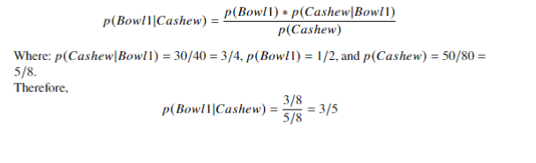
Bayes Theorem Example
Assume there are two bowls of nuts. The first bowl contains 30 cashew nuts, 10 pistachios and the second bowl contains 20 of each. What is the probability that a cashew nut is selected from the first bowl?
This is the base theorem assumption applied in Naïve Bayes Classification

Slide 6
Naïve Bayes
Naïve Bayes Classifiers
Gaussian
Multinomial
Bernoulli
Naïve Bayes is based on applying Bayes theorem with the ”naïve” assumption of independence between each and every pair of features i.e., knowing the value of one attribute does influence the value of any other attribute
Notes:
In order to apply Naïve Bayes to predict an overall outcome, we would run the formula for every outcome

Slide 7
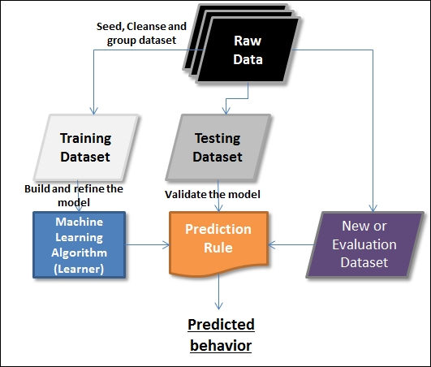
How Learning is Applied to Predict a Behaviour
A Dataset consists of features and instances. Any given comprehensive dataset is split into three categories of datasets and is usually in the following proportions: 60% training, 30% testing, and 10% evaluation.

Slide 8
Gaussian Naïve Bayes Classifier
Notes:
we will look at the Naïve Bayes classifiers and how they are used to solve the classification problems

Slide 9
Bernoulli Naïve Bayes Classifier
Notes:
we will look at the Naïve Bayes classifiers and how they are used to solve the classification problems

Slide 10
Multinomial Naïve Bayes Classifier
Notes:
we will look at the Naïve Bayes classifiers and how they are used to solve the classification problems

Slide 11
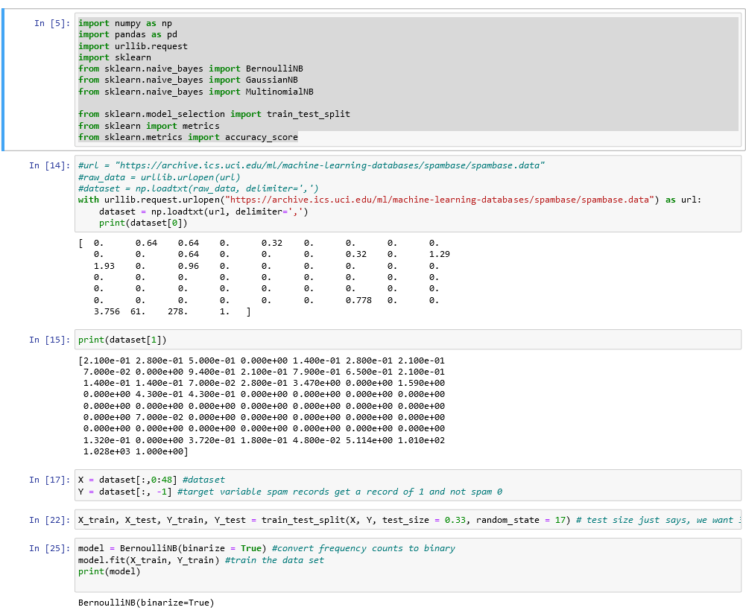
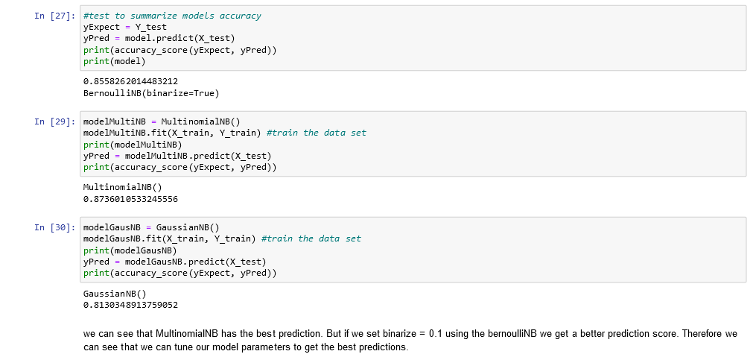
Naïve Bayes Classifier Comparison
Notes:
BernNB_GausNB_MultNB_Comparison

Slide 12
Naïve Bayes Advantages and Disadvantages
Notes:
we will look at the Naïve Bayes classifiers and how they are used to solve the classification problems

Slide 13
Summary
Notes:
we will look at the Naïve Bayes classifiers and how they are used to solve the classification problems

Slide 14
References
[1] Sunila Gollapudi (2016): Practical Machine Learning (9781784399689). Available online at https://learning.oreilly.com/library/view/practical-machine-learning/9781784399689/ch01s05.html.

Slide 15
THANKS FOR LISTENING

