Slide 1

LINE FOLLOWING ROBO
Jad Al Jourdi, Maxim Speczyk, Stephanie Okosa, Imad Chaa
T
r

Slide 2
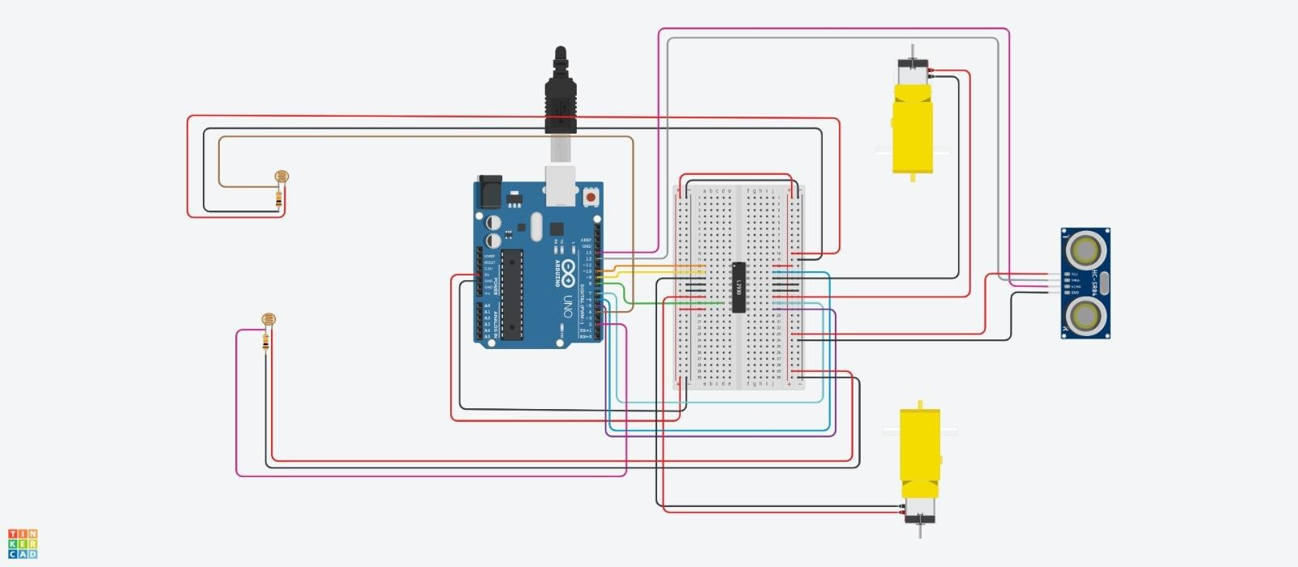

Slide 3
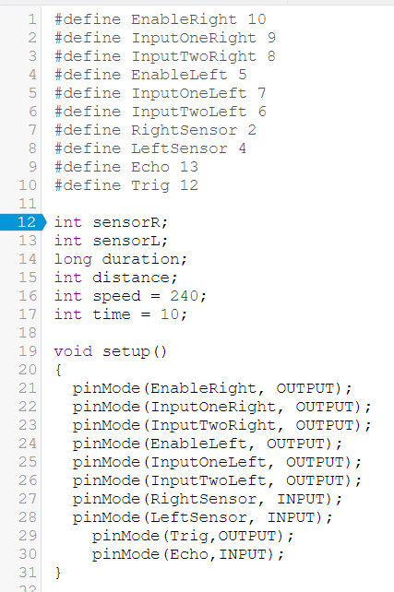
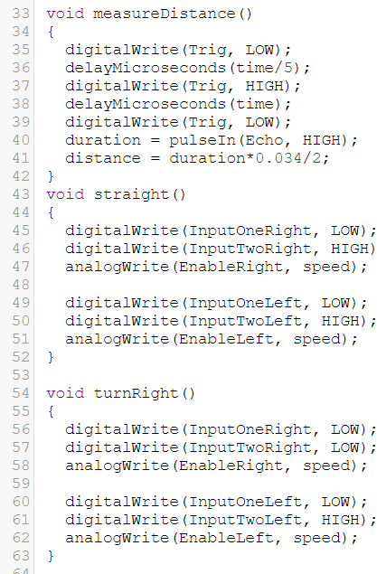
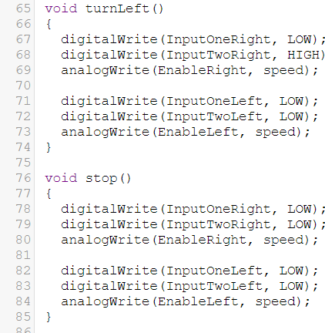
FUNCTIONS

Slide 4
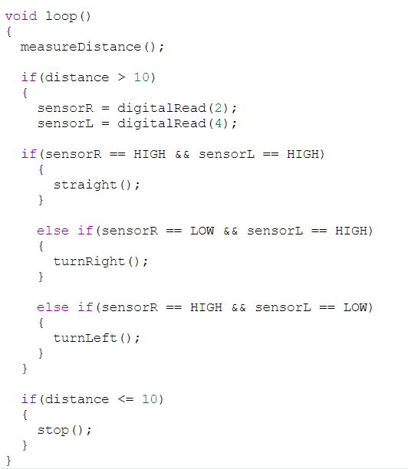
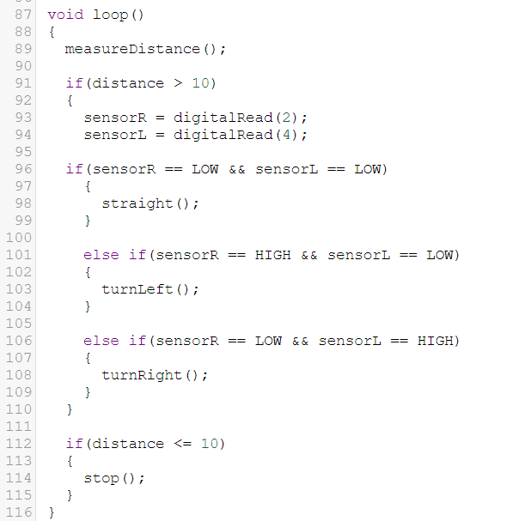
CODE COMPARISON; ON THE LINE // NEXT TO THE LINE

Slide 5
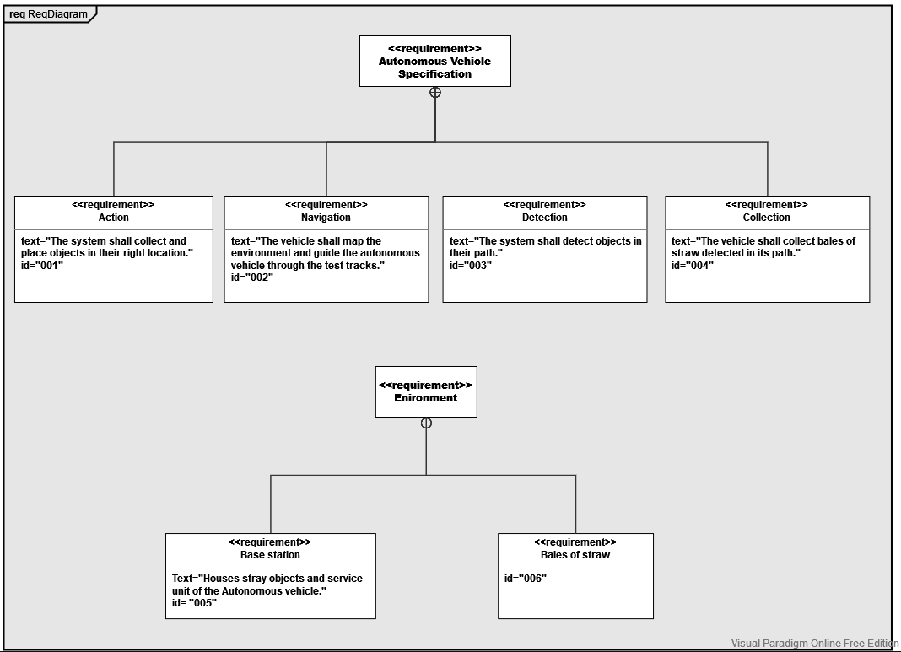
SYSML
REQUIREMENTS DIAGRAM

Slide 6
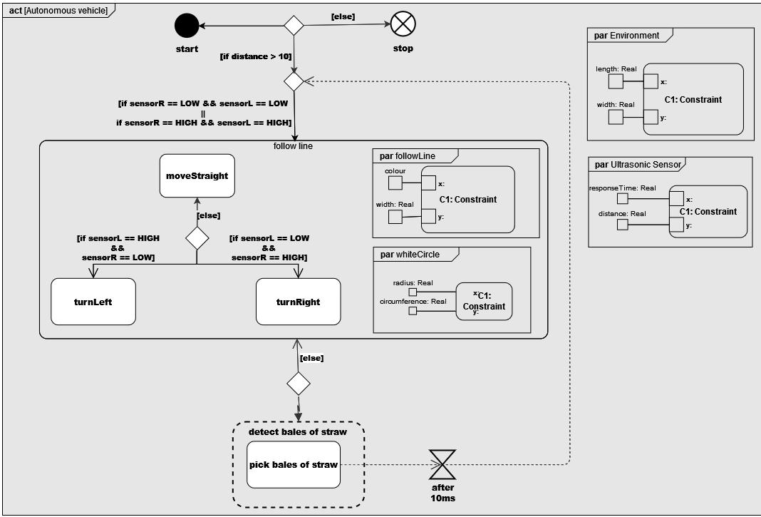
SYSML
ACTIVITY DIAGRAM

Slide 7
THANK YOU FOR LISTENING.

