Slide 1
Object Oriented Programming II
Implementation of Generic classes
Marcel Gygli

Slide 2
Overview
Goals of Generics
Introductory Example: TrashCan & RecyclingBin
Example: Bottle & Drink
Exercise
Advanced Generics
Generic Methods
Recap
Exercises
Assignment 1

Slide 3
Goals of Generics
Type Safety
ArrayList<String> vs. ArrayList()
String get(int i) vs. Object get(int i)
Compiller takes care of some of your tests
You need less Unit-Tests
Prevents Runtime-Errors
Prevents multiple, similar (Sub-)Classes through parametrisation of a class

Slide 4
TrashCan vs. RecyclingBin

Slide 5

Implementation WITHOUT Generics
public class TrashCan { private Object[] allTheWaste; public void trash(Object object){
... } public Object getLast(){ ... } public Object[] purge(){ ... } }
TrashCan trashCan = new TrashCan(); Banana banana = new Banana(); trashCan.trash(banana); Object o = trashCan.getLast(); if(o instanceof Banana){ banana = (Banana) o; }

Slide 6

What is missing?
Complete Implementation
Mainly: the parameters are of Type Object
All different Types can be put into the TrashCan
Conflicts with good «separation of waste»
No Type safety
No compiler-checks
Potential runtime errors

Slide 7

Approach WITHOUT Generics
public class BananaTrashCan { private Banana[] allTheWaste; public void trash(Banana object){
... } public Banana getLast(){ ... } public Banana[] purge(){ ... } }
BananaTrashCan trashCan = new BananaTrashCan(); Banana banana = new Banana(); trashCan.trash(banana); banana = trashCan.getLast();
TrashCan only for Bananas

Slide 8


Slide 9
Approach WITHOUT Generics
public class SaladTrashCan { private Salad[] allTheWaste; public void trash(Salad object){
... } public Salad getLast(){ ... } public Salad[] purge(){ ... } }
SaladTrashCan trashCan = new SaladTrashCan(); Salad salad = new Salad(); trashCan.trash(salad); salad = trashCan.getLast();
TrashCan only for Salad

Slide 10
Approach WITHOUT Generics
public class PaperTrashCan { private Paper[] allTheWaste; public void trash(Paper object){
... } public Paper getLast(){ ... } public Paper[] purge(){ ... } }
PaperTrashCan trashCan = new PaperTrashCan(); Paper paper = new Paper(); trashCan.trash(paper); paper = trashCan.getLast();
TrashCan only for Paper

Slide 11
public class BananaTrashCan { private Banana[] allTheWaste; public void trash(Banana object){
... } public Banana getLast(){ ... } public Banana[] purge(){ ... } }
public class SaladTrashCan { private Salad[] allTheWaste; public void trash(Salad object){
... } public Salad getLast(){ ... } public Salad[] purge(){ ... } }
public class PaperTrashCan { private Paper[] allTheWaste; public void trash(Paper object){
... } public Paper getLast(){ ... } public Paper[] purge(){ ... } }
“Same” implementation
Only used Type is different

Slide 12

Solution: Generics
Goal
Flexible Class for use with any Type of elements
Ensure, it contains only elements of that type
At Compile Time
IDE Support
How does a class with Generics look like?
Class defines a Type-parameter
Defines the Type of internal managed elements
Use this Type parameter at typespecific places

Slide 13
Type parameter
public class RecyclingBin<T> { private T[] allTheWaste; public void trash(T object){ } public T getLast(){ return null; } public T[] purge(){ return null; } }

Slide 14
Compiler-”Output”
new RecyclingBin<Banana>()
new RecyclingBin<Salad>()
public class RecyclingBin<Banana> { private Banana[] allTheWaste; public void trash(Banana object){ } public Banana getLast(){ ... } public Banana[] purge(){ ... } }
public class RecyclingBin<Salad> { private Salad[] allTheWaste; public void trash(Salad object){ } public Salad getLast(){ ... } public Salad[] purge(){ ... } }
1 container class
n material types

Slide 15
Bottle and Drink

Slide 16
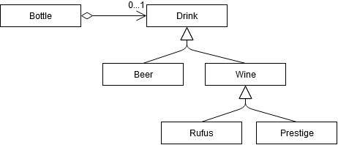
Bottle and Drink
Goal: Implementation of one generic Bottle class
Can be specialized for Wine bottles, Water bottles, …
Two operations
“fill” fills a Bottle with a specific Drink
“empty” clears the content of a bottle

Slide 17
Bottle usage
All wines use a “normal” wine bottle
Instantiate a Bottle of Type Wine
Bottle<Wine> wineBottle = new Bottle<>();
Fill it with Rufus
wineBottle.fill(new Rufus());
What won’t work is
wineBottle.fill(new Beer());
For wine specialised bottles:
Instantiate a special Bottle for Rufus
Bottle<Rufus> special = new Bottle<>(); special.fill(new Rufus()); special.fill(new Wine()); //???

Slide 18
Bottle Implementation
public class Bottle<T> { T content; public Bottle() { } public void fill(T content) { this.content = content; } public T empty() { T c = content; content = null; return c; } }

Slide 19
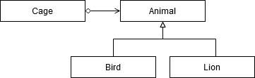
Simple Generic Class Cage
Create a class Cage
On Type of animal per cage
Unlimited amount of animals per cage
Animals can be released
Start with the test class CageTest
on AD

Slide 20
Advanced Generics

Slide 21
Further Generic Concepts
Multiple Type-Parameters
Nested Type-Parameters
Generics with Limitations
Subclasses of generic classes
Wildcards <?>

Slide 22
Multiple Type-Parameters
Example: A HashMap requires a Type for Key and Value
HashMap<Integer, Person> myMap = new HashMap<>()
Implementation of HashMap
public class HashMap<K,V> extends AbstractMap<K,V> implements Map<K,V>, Cloneable, Serializable
K, V are the Type parameters
A generic class can have unlimited Type parameters

Slide 23
Nested Type-Parameters
Situation: A generic class contains a second generic class
Example: Product Categories
Manage multiple elements of type Product
Products are aggregated to categories
The assignment of categories can change
A Product can belong to multiple categories
Each application contains
List of categories
Each category consists of multiple lists of Products
ArrayList<ArrayList<Product>> store = new ArrayList<>();
Category

Slide 24


Bounded Generics
Bottle should be used for Drinks
But the following works too!
Bottle<Djinn> magicBottle = new Bottle<Djinn>(); Bottle<Dog> dogBottle = new Bottle<Dog>(); Bottle<Student> studentBottle = new Bottle<Student>();
With bounded Generics we can restrict the Type parameter to a specific class hierarchy
Instead of
public class Bottle<T> {
We do
public class Bottle<T extends Drink> {

Slide 25
Bounded Generics – More Possibilities
All classes that implement an Interface
public class Bottle<D extends Comparable>
“extends” not “implements”
Drinks that implement Comparable
public class Bottle<D extends Drink & Comparable>
Class first, then Interface
Multiple Interfaces (but only a single class)
public class Bottle<D extends Drink & I & J & K>

Slide 26
Extension to Cage
Ensure that in Cage, only Animals and subclasses of Animal can be “stored”

Slide 27
Wildcards
Situation: Need a Method that prints the content of an ArrayList no matter the element type.
public static void main(String[] args) { ArrayList<String> list = new ArrayList<>(); printElements(list); } public static void printElements(ArrayList<?> list) { for (Object o : list) { System.out.println(o.toString()); } }

Slide 28
Wildcards
Restrictions with wildcards
Read-Only
Adding elements to the ArrayList<?> is not allowed
Example to empty Bottles
bounded Wildcard
public void emptyBottles(ArrayList<? extends Bottle> list) { for (Bottle bottle : list) { bottle.empty(); } }

Slide 29
Generic Methods

Slide 30
Generic Methods
Type parameters can be defined on methods
Example: generic method which copies elements from an Array into an ArrayList
Method should work with any type
Arrays can not be generic
Always defined for a specific type
String[], Integer[], …

Slide 31


static void fromArrayToCollection(Object[] a, List<?> l){ for(Object o : a){ l.add(o); //compile-time error } }
First try
With Wildcard
static <T> void fromArrayToCollection(T[] a, List<T> l){ for(T o : a){ l.add(o); //compile-time error } }

Slide 32
Generic Method
Extend Cage with a static method jailAll
@Test void testJailAll(){ //given Cage<Bird> c = new Cage<>(); Bird b1 = new Bird(); Bird b2 = new Bird(); Bird[] birds = {b1, b2}; //when Cage.jailAll(c, birds); //then assertEquals(2, c.numberOfAnimals()); assertTrue(c.shelters(b1)); assertTrue(c.shelters(b2)); }
Your methods might be named differently

Slide 33
Recap

Slide 34
Remarks
Generics can become very complex
Basic principles are simple and practical
Use with caution
When creating a class
Does this class manage objects of other classes?
Does it make sense to create a generic class?
When creating a method
Does the method word on Object?
Does it make sense to create a generic method?

Slide 35
Overview
Parameter-Type | Description
<T> | Unbounded generic type
<A,B> | Multiple unbounded generic types
<T extends B> | Bounded generic type (class or interface)
<T extends B & C> | Bounded generic type (multiple bases)
<?> | Wildcard
<? extends B> | Bounded wildcard
<? extends B & C> | Bounded wildcard (multiple bases)
<? super B> | Lower bounded wildcard
https://docs.oracle.com/javase/tutorial/java/generics/index.html

Slide 36
Exercises

Slide 37
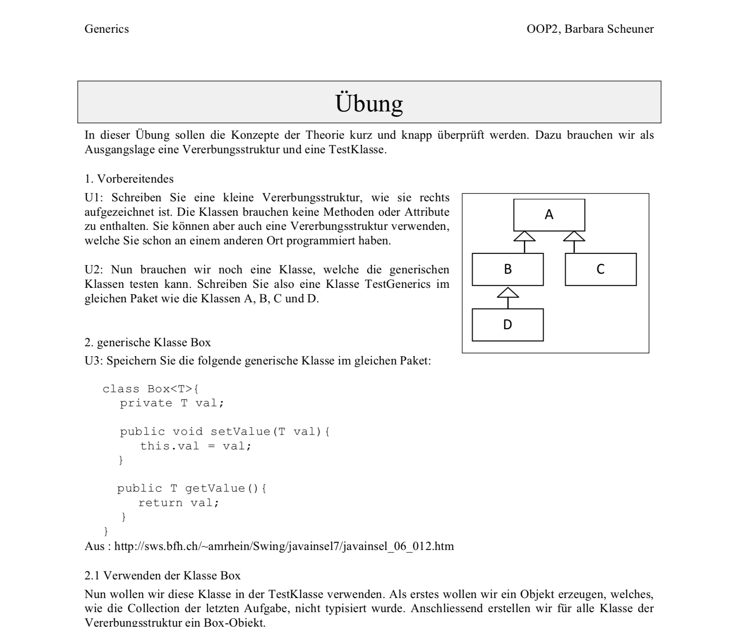
03_Uebung.pdf of Barbara Scheuner

Slide 38
Assignment 1

Slide 39
Generic Portfolio
Implement a Generic Portfolio
Buy and Sell different Investments
Make the tests in PortfolioTest succeed
https://classroom.github.com/a/c94dvR6_
Commit & Push until 16.03 – 23:00

Slide 40


