Slide 1
Dataset Pivot & Extended Findings
Scaling Up: A New Dataset, RQ1 Revisited, and First RQ2 Results
Stephan Botha · 2654125
Supervised by Pravesh Ranchod & Branden Ingram
Notes:
Intro: this update covers three things - why and how we switched to a much larger dataset, what happened when RQ1 was re-run at that scale, and the first results from RQ2's event-driven analysis.

Slide 2
Why we moved away from OpenDota
1
2
3
Parse-on-request only
Unreliable, slow queue
Sparse resulting chat
Public matches aren't pre-parsed — each one had to be individually requested and queued.
Yield swung 0–56% batch to batch; some jobs took days, others failed with no explanation.
Even successful matches often had almost no usable chat — median just 2 messages.
The result: 609 usable matches, after weeks of collection work
A working pipeline — but a much larger, more reliable public dataset would let every analysis run with far more statistical power.
Notes:
Quick recap of the pain points that motivated the switch: OpenDota only parses on request, the parse queue was slow and unreliable, and even successful parses often had very little chat. After weeks of work this yielded 609 usable matches - a working pipeline, but underpowered for what a much larger dataset could offer.

Slide 3
The new data source
A pre-parsed bulk export, not a live API
Source
Kaggle “Dota 2 Matches” dataset (devinanzelmo)
Match date
November 2015 — ranked ladder / public matchmaking
Scale
50,000 matches, bulk-exported in one download
Structue
Not directly linked to the OpenDota-collected matches — a separate, self-contained export with its own match IDs, outcomes, chat, and event log all bundled together.
Notes:
The new source is a bulk, pre-parsed Kaggle export from November 2015 - real ranked ladder matches, not pro play. 50,000 matches in one download, with match outcomes, chat, and a gameplay event log all bundled together and already linked by match ID - no live API calls needed at all.

Slide 4
The scale difference, in real numbers
Before
After
Usable matches
609
38,810
Chat coverage rate
~35–40%
99.5%
Team-trajectories (RQ1)
1,138
77,620
Same pipeline, same scoring, same lexicon override — just vastly more data to run it on.
Notes:
The scale jump is dramatic: 609 to 38,810 usable matches, chat coverage from around a third of matches to essentially all of them, and team-trajectories available for RQ1 growing from about 1,100 to over 77,000. Same methodology throughout - just far more statistical power behind it.

Slide 5
RQ1 revisited at 68× scale
Same test (Mann-Whitney U + Cohen's d), same three features, vastly larger sample
Feature
Old p-value
New p-value
Old d
New d
Slope
0.311 (ns)
4.1×10⁻⁶⁴ (sig.)
−0.007
0.009
Volatility
0.131 (ns)
3.8×10⁻⁵⁰ (sig.)
0.065
0.116
Phase delta
0.903 (ns)
2.1×10⁻¹⁹ (sig.)
0.050
0.079
Every feature is now statistically significant — but effect sizes barely moved
All three Cohen's d values remain under 0.12 — still far below 0.2, the threshold for even a “small” effect.
Notes:
Re-running the exact same RQ1 test at full scale: every feature that was not significant before is now significant, with extremely small p-values. But look at the effect sizes - Cohen's d barely changed and all three remain under 0.12, well below the 0.2 threshold for even a small effect.

Slide 6
Why: it's about statistical power, not a bigger effect
A kitchen scale
A lab-grade scale
Can't tell 500g from 500.1g — the difference is real, but the instrument isn't precise enough to register it. It just reads “the same.”
Registers that same 0.1g difference clearly. The weight didn't change — the precision of the measurement did.
→
The small dataset wasn't wrong — it simply lacked the statistical power to detect a difference this subtle. At scale, the same small difference becomes measurable.
Notes:
The intuition: a p-value is sensitive to sample size, Cohen's d mostly isn't. With about 68 times more data, a genuinely small, real difference between winners and losers becomes statistically detectable - not because the difference grew, but because the tool for detecting it got much more sensitive. The honest conclusion: real, but small.

Slide 7
RQ2: do sentiment shifts track real events?
PELT change-point detection finds sudden mood shifts; each is checked against the game's event log
51,940
88.7%
1.64
sentiment shift
points detected
matched to a real
game event nearby
average shifts
per team
Which events trigger the strongest reaction? (per-occurrence rate)
Notes:
51,940 sudden mood shifts were detected across team chat, and 88.7% of them happened within two minutes of a real gameplay event - strong evidence sentiment tracks the game, not random noise. Tower kills are the single strongest trigger even after controlling for how often each event type happens at all.

Slide 8
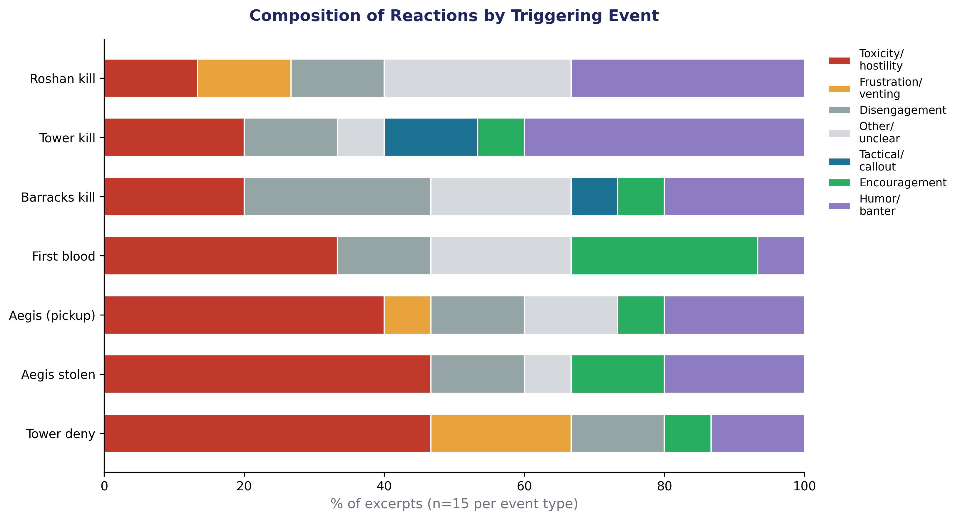
What kind of reaction, and to what?
105 real chat excerpts manually read and categorised, 15 per event type
31%
of all reactions were toxicity/hostility — the single most common response overall
47%
toxicity rate for Tower Deny & Aegis Stolen — both moments of visible, unambiguous setback
Notes:
Beyond just detecting shifts, we manually read and categorised the actual chat around a sample of them. Toxicity and hostility was the single most common reaction overall, at 31 percent. It's especially concentrated around tower deny and Aegis stolen - both moments where a team has to visibly accept a setback - at 47 percent toxicity each. Routine tower kills, by contrast, mostly produced humor and banter.

Slide 9
Next steps
1
RQ3: phase-level correlation
Now practical at this scale — decide whether to recompute slope/volatility within each phase, not just reuse RQ1's whole-match values
2
RQ3: phase-level correlation
Now practical at this scale — decide whether to recompute slope/volatility within each phase, not just reuse RQ1's whole-match values
3
Full write-up
Bring the dataset pivot, both RQ1 runs, and RQ2 together into the results and discussion chapters
Thank you — questions welcome
Notes:
Closing: three remaining pieces - finishing the RQ2 write-up including the ethics/content-handling note, tackling RQ3's phase-level design question which is now practical given the larger dataset, and pulling everything together into the full results and discussion chapters.

