Slide 1
SOFT
Self-Supervised Optical Flow Tuning
Per-Pixel Quality Estimation Without Ground Truth
Stephan Koehler
Koehler Data Analytics and Insights

Slide 2
What is Optical Flow?
A segmentation-free method of tracking pixel motion. Minimize energy with two components:
E(u,v) = Σ ρ_D(I₁(x,y) − I₂(x+u, y+v)) + λ Σ ρ_S(∇u, ∇v)
Data term: brightness constancy — pixels maintain intensity as they move
Smoothness term: spatial regularization — neighboring pixels move similarly
Applications
Advantages
Video stabilization
Object tracking
Action recognition
Autonomous vehicles
Video compression
Motion segmentation
Dense motion field — every pixel gets a velocity
No object detection or segmentation required
Works with arbitrary textures and objects
Foundation for higher-level motion analysis
Sun, Roth & Black (2010). Secrets of Optical Flow Estimation and Their Principles. CVPR.

Slide 3
The Problem
No ground truth at deployment
Optical flow algorithms are tuned offline on benchmarks, but deployed on arbitrary content with no way to measure quality.
Scene changes invalidate tuning
Parameters optimal for one scene may fail catastrophically on another. Different regions need different configurations.
Silent failures
Without quality estimation, bad optical flow propagates downstream undetected — affecting tracking, segmentation, and reconstruction.

Slide 4
SOFT Approach
1. Sweep Configurations
2. Compute Quality Metrics
3. Select Best
Run optical flow with multiple parameter settings (window sizes, pyramid levels, iterations)
For each config, compute per-pixel photometric error and 3 flow errors: consistency, traction, and sensitivity
Per-pixel: choose config with lowest error. Per-image: choose config with best median.
Blind Config (per-image)
Ensemble (per-pixel)
Best single config based on metrics: either photometric error or the product of photometric and mean of the three flow errors.
Best config at each pixel. Adapts to scene — smooth regions vs boundaries.
No ground truth required — all metrics computed from image pair alone

Slide 5
Quality Metrics
Photo
Log-RGB photometric error after warping
E = √[(log R₁ - log R₂)² + (log G₁ - log G₂)² + (log B₁ - log B₂)²]
Log-space: robust to illumination changes
RGB: detects color errors invisible to grayscale algorithms
Why Photo works
Under brightness constancy, photometric error scales with flow error wherever image gradients exist.
Why Flow Errors help
Flow metrics measure algorithmic stability. For stable algorithms, they reduce noise in per-pixel selection.
Flow Errors
Consistency: forward vs backward flow difference
Traction: track translation perturbations in frame A
Sensitivity: detect translation perturbations in frame B
Key insight
Optimal metric depends on algorithm. Farneback: Photo wins. DIS: Product wins.

Slide 6
Farneback Results (96 configurations)
Blind Config
Ensemble
Sequence | Oracle | Best | Photo | Product | Photo | Product
Dimetrodon | 0.51 | 0.61 | 0.61 (7) | 0.92 (91) | 0.60 (-1%) | 0.74 (+21%)
Grove2 | 0.24 | 0.42 | 0.53 (89) | 0.53 (90) | 0.34 (-20%) | 0.45 (+6%)
Grove3 | 0.57 | 1.05 | 1.07 (13) | 1.10 (28) | 0.93 (-12%) | 1.05 (-1%)
Hydrangea | 0.27 | 0.45 | 0.46 (15) | 0.47 (31) | 0.38 (-16%) | 0.46 (+4%)
RubberWhale | 0.18 | 0.32 | 0.32 (27) | 0.32 (29) | 0.24 (-22%) | 0.28 (-10%)
Urban2 | 0.36 | 0.95 | 1.43 (38) | 1.84 (47) | 1.10 (+16%) | 1.75 (+85%)
Urban3 | 1.17 | 2.19 | 2.37 (22) | 3.29 (56) | 2.14 (-3%) | 3.20 (+46%)
Venus | 0.84 | 1.26 | 1.56 (75) | 1.39 (60) | 1.16 (-8%) | 1.31 (+4%)
Average | 0.52 | 0.91 | 1.04 (36) | 1.23 (54) | 0.86 (-5%) | 1.16 (+27%)
Photo Ensemble beats Best Config by 5% — without ground truth
Blind Config: EPE (rank/96) · Ensemble: EPE (% vs Best)

Slide 7
DIS Results (96 configurations)
Blind Config
Ensemble
Sequence | Oracle | Best | Photo | Product | Photo | Product
Dimetrodon | 0.07 | 0.12 | 0.12 (41) | 0.13 (43) | 0.13 (+11%) | 0.12 (+3%)
Grove2 | 0.10 | 0.15 | 0.15 (10) | 0.15 (8) | 0.18 (+21%) | 0.15 (+3%)
Grove3 | 0.41 | 0.55 | 0.59 (12) | 0.57 (6) | 0.65 (+17%) | 0.57 (+4%)
Hydrangea | 0.12 | 0.17 | 0.18 (6) | 0.18 (6) | 0.20 (+18%) | 0.18 (+4%)
RubberWhale | 0.07 | 0.10 | 0.10 (8) | 0.10 (7) | 0.15 (+45%) | 0.10 (+0%)
Urban2 | 0.25 | 0.41 | 0.41 (1) | 0.41 (1) | 0.53 (+28%) | 0.38 (-9%)
Urban3 | 0.84 | 1.40 | 1.64 (13) | 1.84 (42) | 1.68 (+20%) | 1.42 (+1%)
Venus | 0.20 | 0.30 | 0.31 (21) | 0.31 (18) | 0.35 (+18%) | 0.30 (+1%)
Average | 0.26 | 0.40 | 0.44 (14) | 0.46 (16) | 0.48 (+20%) | 0.40 (+1%)
Product Ensemble matches Best Config (+1%) — Photo fails (+20%)
Different algorithm, different metric. DIS is inherently stable — per-pixel Photo adds noise.

Slide 8
Conclusions
1. Self-supervised quality estimation with per-pixel uncertainty
Blind Config selection ranks in top 40% without any labels.
2. Ensemble flows match or beat Best Config
Photo Ensemble: -5% for Farneback. Product Ensemble: +1% for DIS. All without ground truth.
3. Ensemble approach suits heterogeneous scenes
Large windows for smooth flow, small windows for boundaries. Per-pixel selection captures this automatically.
4. Computational cost is 10-50× single config
However, config evaluations are independent and embarrassingly parallel — wall-clock approaches single-config with sufficient cores.

Slide 9
SOFT
Know when to trust your optical flow —
without ground truth, without training, at runtime.
-5%
+1%
Top 40%
vs Best Config
vs Best Config
Blind Config
Farneback Photo
DIS Product
Without GT

Slide 10
Appendix: Sun et al. (2010)
Key Secrets Adopted
The Paradox
Median filtering increases energy but improves accuracy. Led to new objective with non-local term.
Image preprocessing: Normalize/filter images
Median filtering: 5×5 after each warp iteration
Coarse-to-fine: Multi-resolution pyramid
Texture decomposition: ROF separation
Bicubic interpolation: Spline-based warping
Graduated non-convexity: Quadratic → robust
Generalized Charbonnier: ρ(x)=(x²+ε²)^0.45
Drawbacks
Computational cost: ~70 min/image
Weighted non-local term: Complex implementation
No per-pixel quality: Single config for image
Sun, Roth & Black. "Secrets of Optical Flow Estimation and Their Principles." CVPR 2010.

Slide 11
Appendix: Quality Metrics — Detailed Formulations
Photometric Error
Normalization: Pollution Depth
Log-RGB residual after warping:
norm = pollution_depth² + displacement²
E = √[Σ(log I_A^c - log I_B^c(x+u))²]
Area compensation: Pollution depth is the smoothing radius. Squaring gives smoothing area — multiply to compensate for spatial averaging.
Log-space: robust to illumination. RGB: detects color errors.
Flow Errors
Product Metric
Consistency: |u_fwd(x) + u_bwd(x + u_fwd)|
Traction: |u(A_shifted, B) - u(A,B) - δ| / |δ|
Sensitivity: |u(A, B_shifted) - u(A,B) - δ| / |δ|
E_prod = E_photo × mean(consistency, traction, sensitivity)
Photometric is primary accuracy proxy. Flow errors provide stability weighting.

Slide 12
Appendix: Understanding Sensitivity and Texture
The Tradeoff at Boundaries
The Aperture Problem
Same large windows cause problems at motion boundaries:
In regions with little texture or color variation, optical flow is underconstrained. Algorithm can only estimate motion perpendicular to local gradients.
Low texture: Large window optimal ✓
Motion boundary: Small window optimal (avoid bleeding) ✗
Why Larger Windows Help
In low-texture patches:
Small window: Insufficient texture → erratic response
Large window: Grabs surrounding texture → stable response
Practical Implication
Sensitivity measures stability, not accuracy. Works best as complement to photometric:
Photometric: accurate where gradients exist
Sensitivity: stable in low-texture regions
Product: combines both signals
Sensitivity correctly identifies this — larger sampling = better flow in homogeneous regions.

Slide 13
Appendix: RAFT (2020)
Key Innovations
All-pairs correlation: 4D cost volume for all pixel pairs
Recurrent refinement: GRU iteratively updates flow
Multi-scale lookups: Correlation pyramid pooling
No coarse-to-fine: Single resolution, iterative
Strong generalization: Cross-dataset transfer
Supervised Training
Trained on synthetic datasets (FlyingChairs, FlyingThings3D) with ground truth flow. Fine-tuned on target benchmarks.
SMURF Extension (2021)
Unsupervised RAFT using photometric + bidirectional consistency losses. 36-40% improvement over prior unsupervised methods.
Results
Relation to SOFT
KITTI: 5.10% F1-all (16% improvement)
Sintel: 2.86 EPE (30% improvement)
Current state-of-the-art architecture
RAFT is a single trained network; SOFT selects among classical algorithm configurations per-pixel. Complementary approaches for different use cases.
Teed, Z. & Deng, J. "RAFT: Recurrent All-Pairs Field Transforms for Optical Flow." ECCV 2020.
Stone, A. et al. "SMURF: Self-Teaching Multi-Frame Unsupervised RAFT with Full-Image Warping." CVPR 2021.

Slide 14
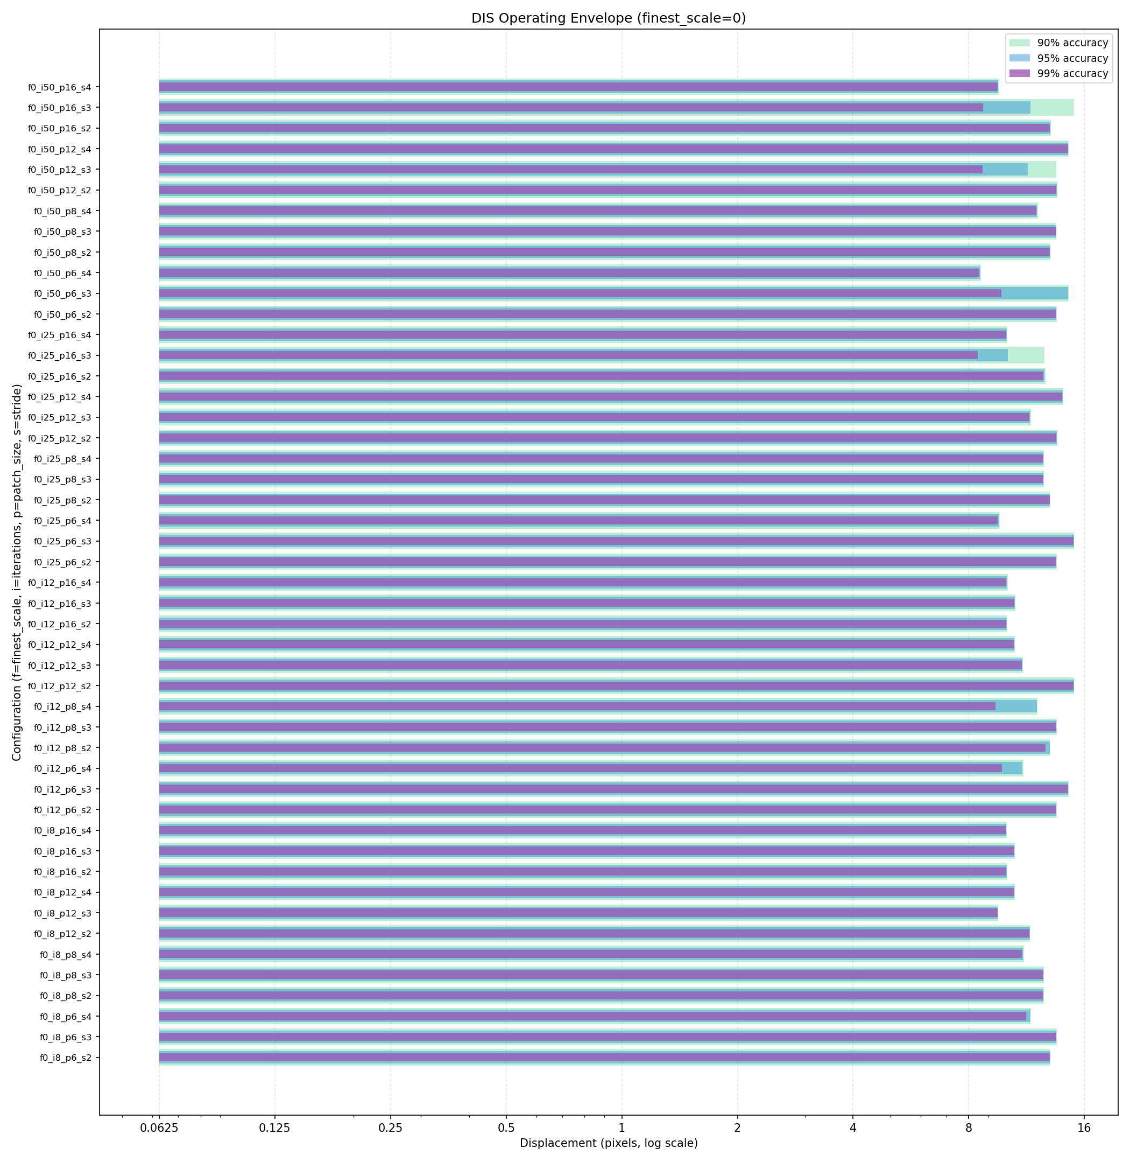
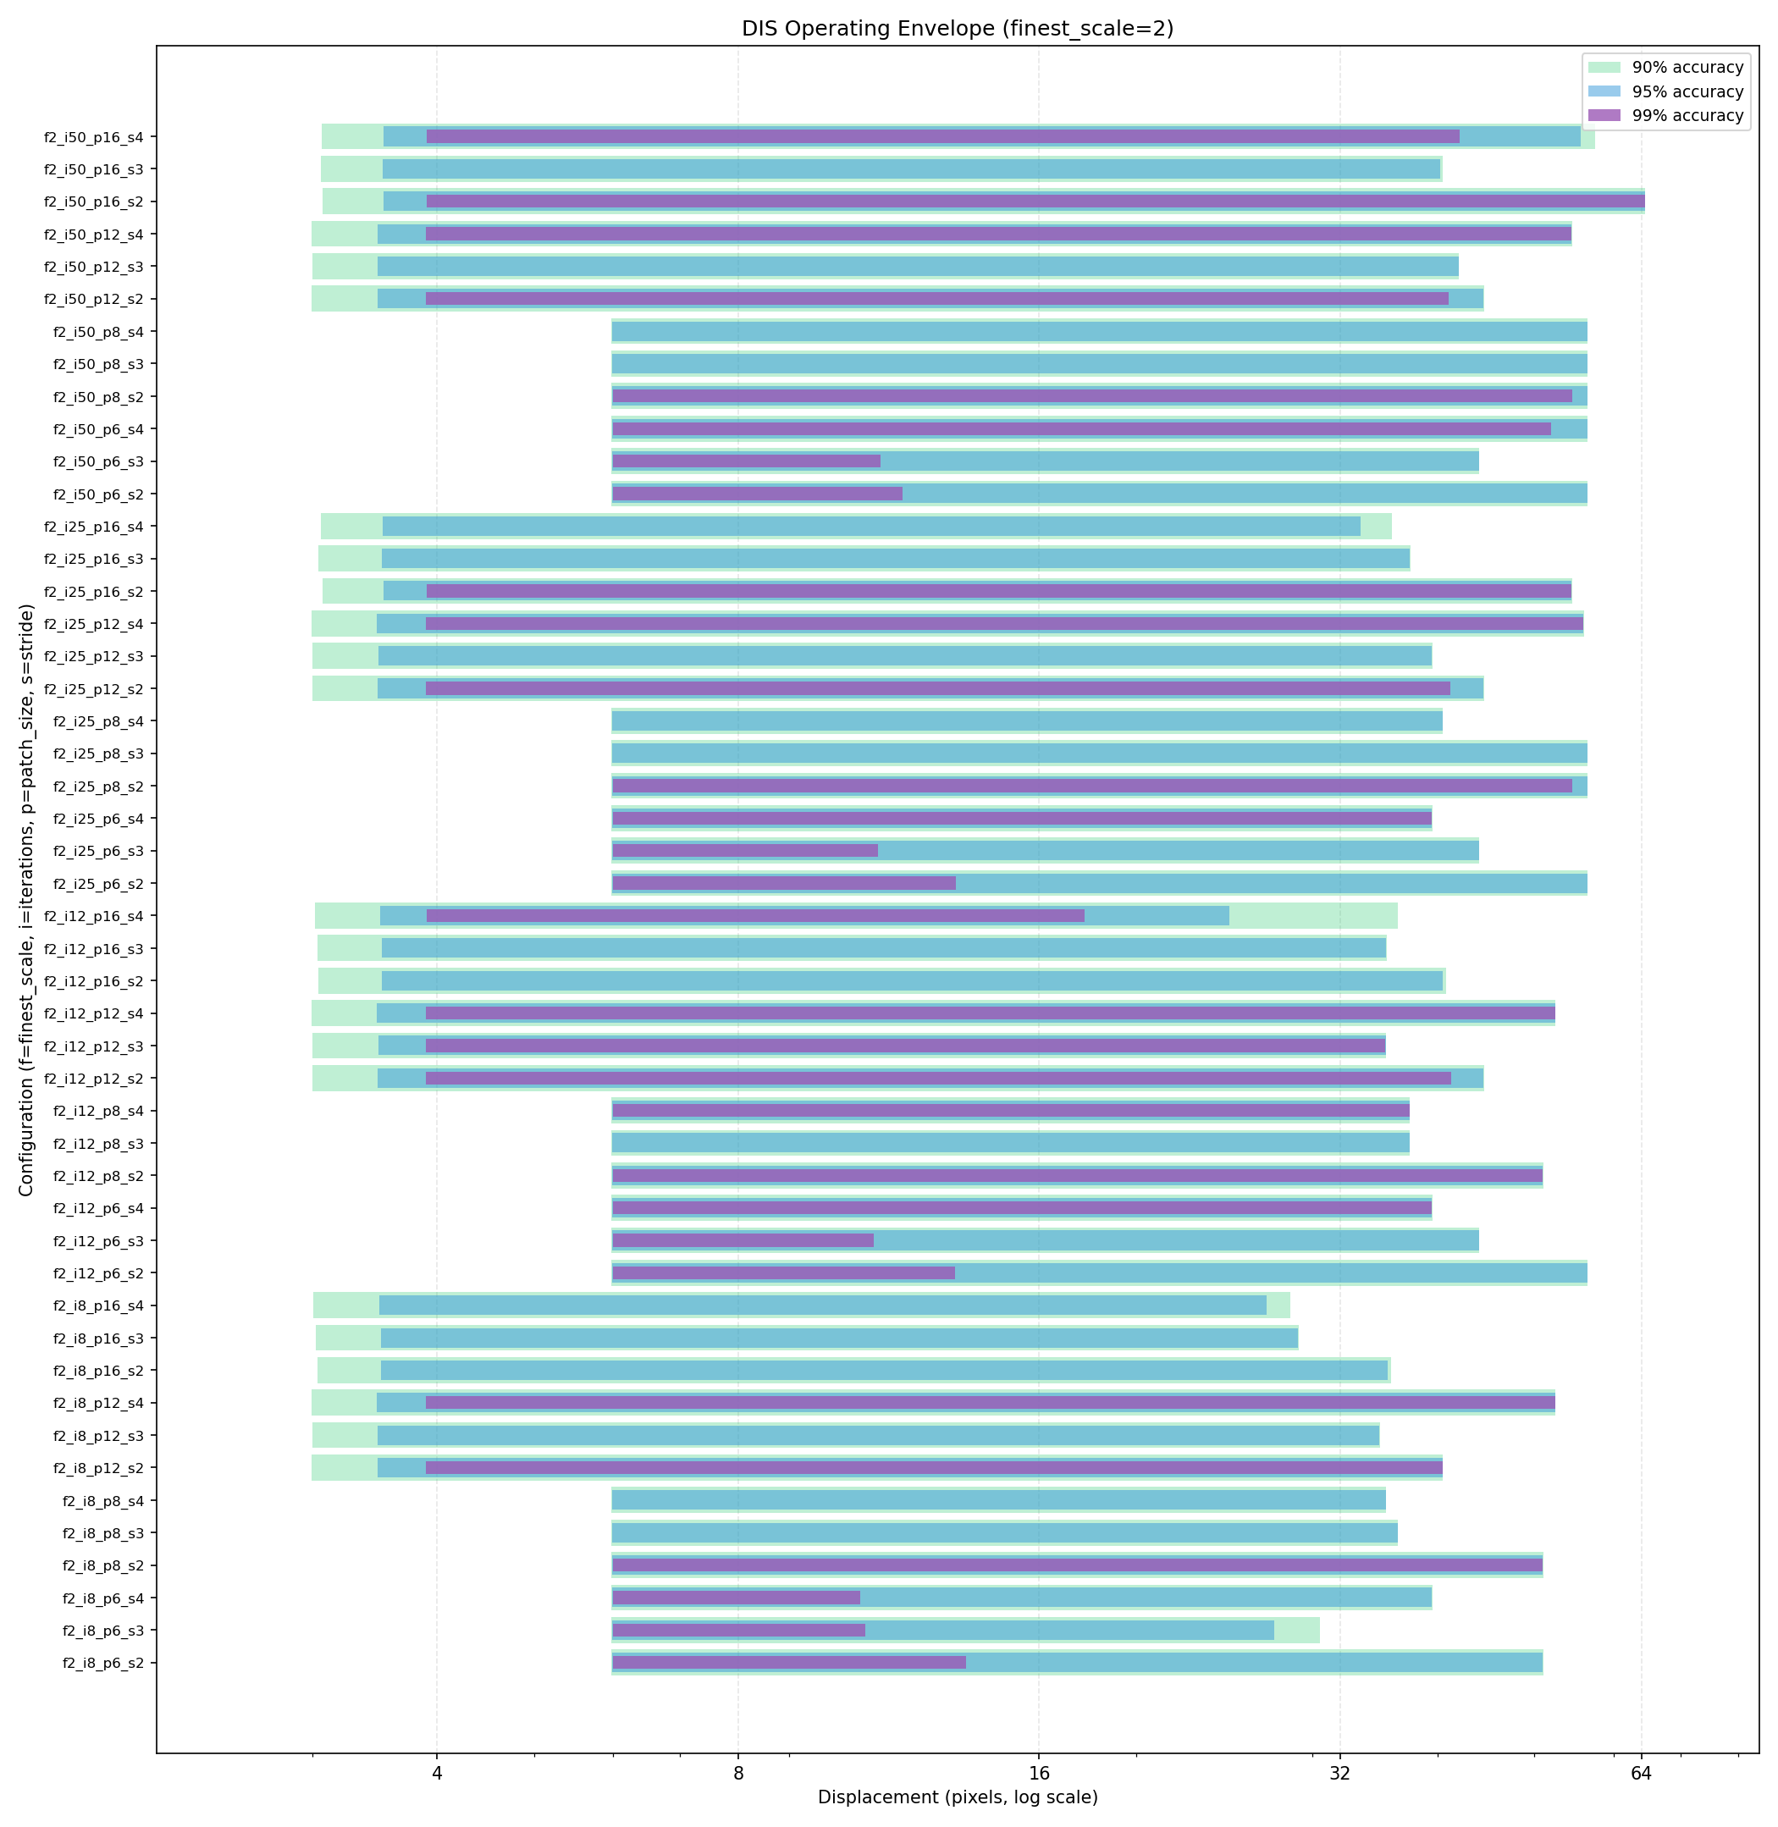
operating envelope for half-plane sprite

