Slide 1
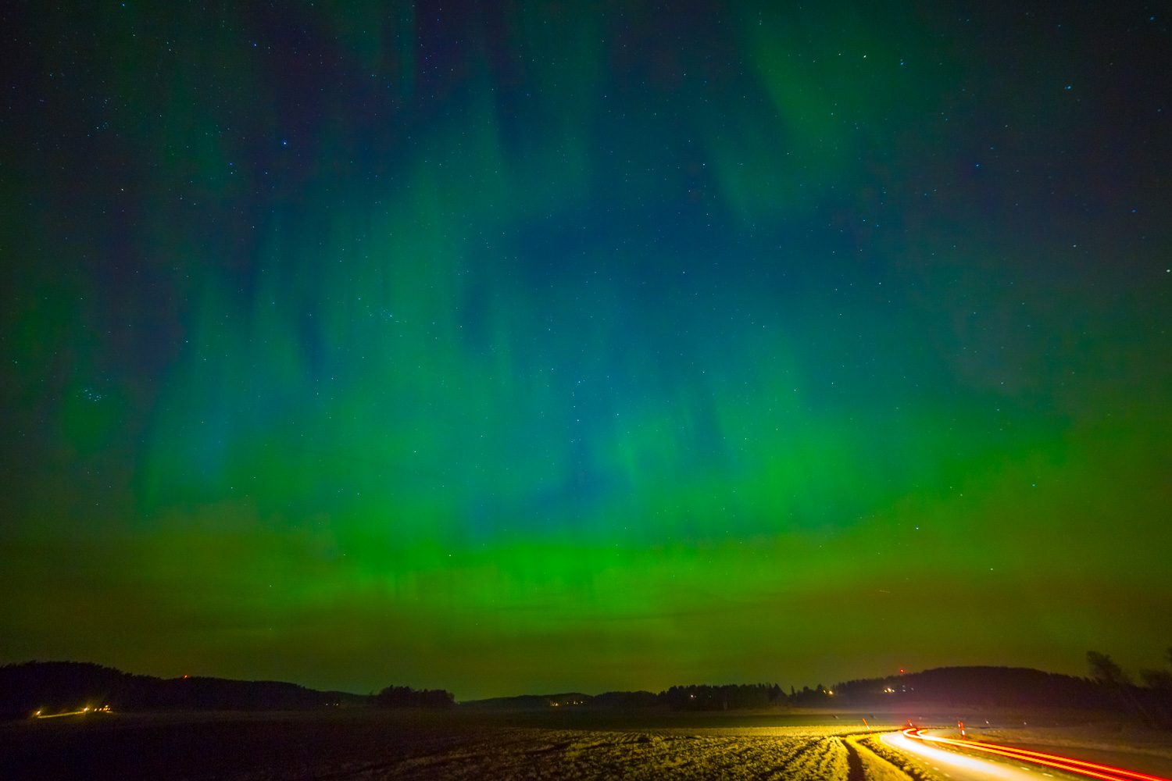
Apache Aurora in Action
Hands-on Introduction
@ErbStephan | Blue Yonder GmbH | 19.04.2016

Slide 2


Apache Aurora
https://aurora.apache.org
Mesos framework for the deployment and scaling of stateless and fault tolerant services in a datacenter
Apache Mesos
https://mesos.apache.org
Cluster manager providing fault-tolerant, fine-grained multitenancy via containers

Slide 3
Apache Aurora
https://aurora.apache.org
„distributed supervisord“

Slide 4
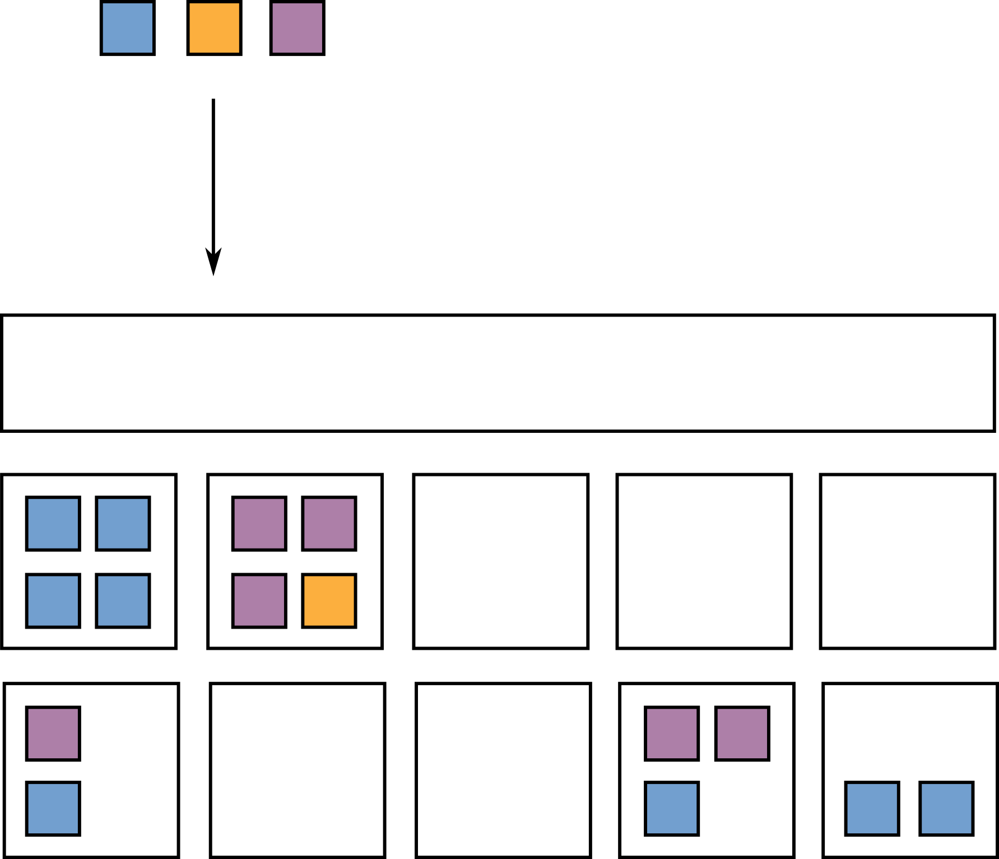
Apps/Services
Cluster Manager

Slide 5
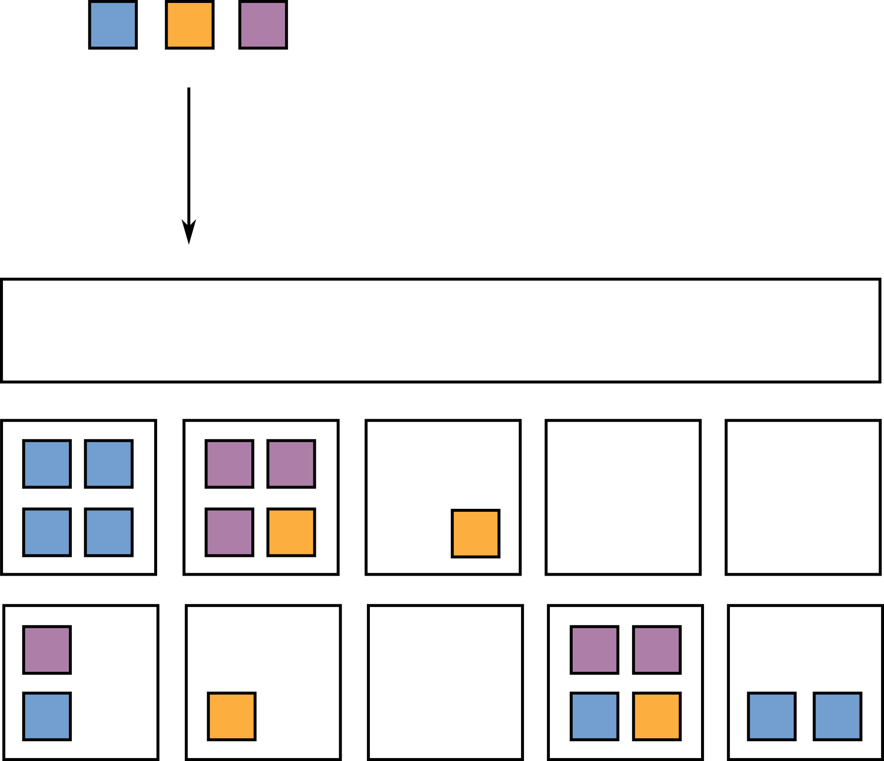
Apps/Services
Cluster Manager

Slide 6
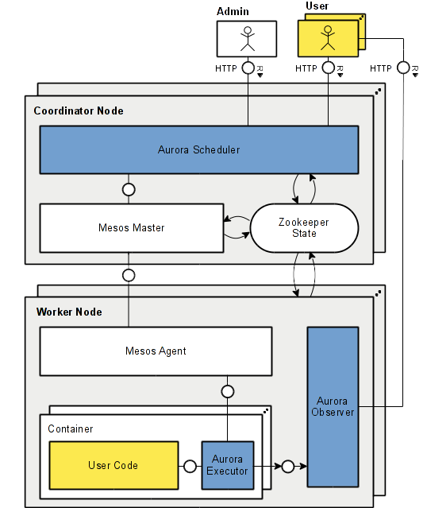

Slide 7
Jobs
www-data/devel/toyserver
Tasks (job instances)
www-data/devel/toyserver/0
(www-data-devel-toyserver-0-5706d058-60c7-40ae-8115-d71206e291ed)
www-data/devel/toyserver/1
(www-data-devel-toyserver-1-b6f51ef0-820b-4640-8971-607b0309b246)
Processes (per task)
install
serve (wsgi flask app)

Slide 8
Questions?
Stephan Erb
Blue Yonder GmbH
stephan.erb@blue-yonder.com
@ErbStephan
@BlueYonderTech
https://github.com/StephanErb/aurora-expedition
Image by Joakim Berndes

Slide 9
