Slide 1

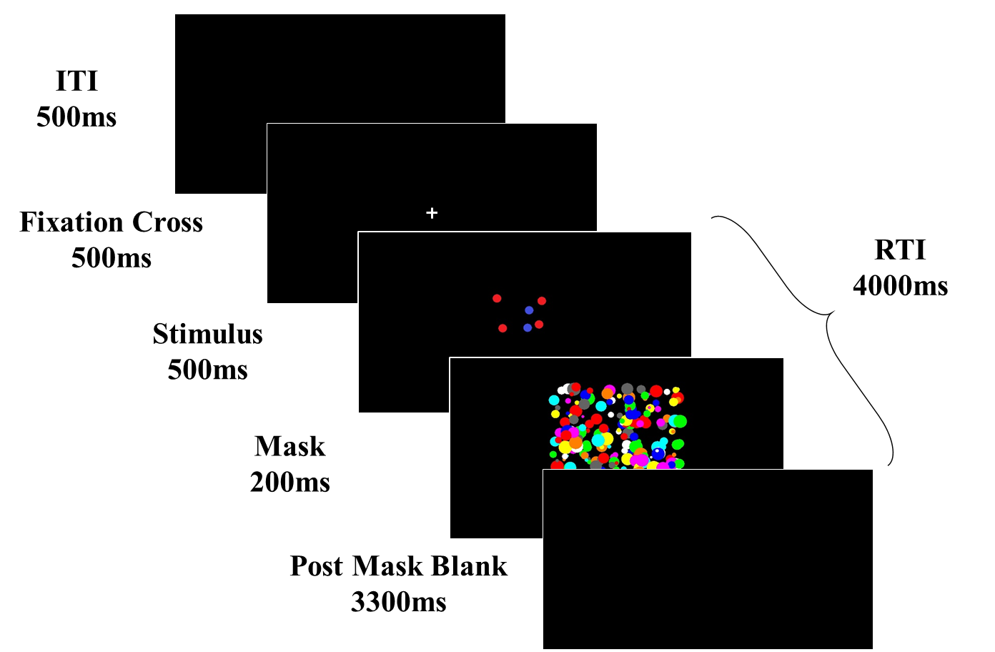
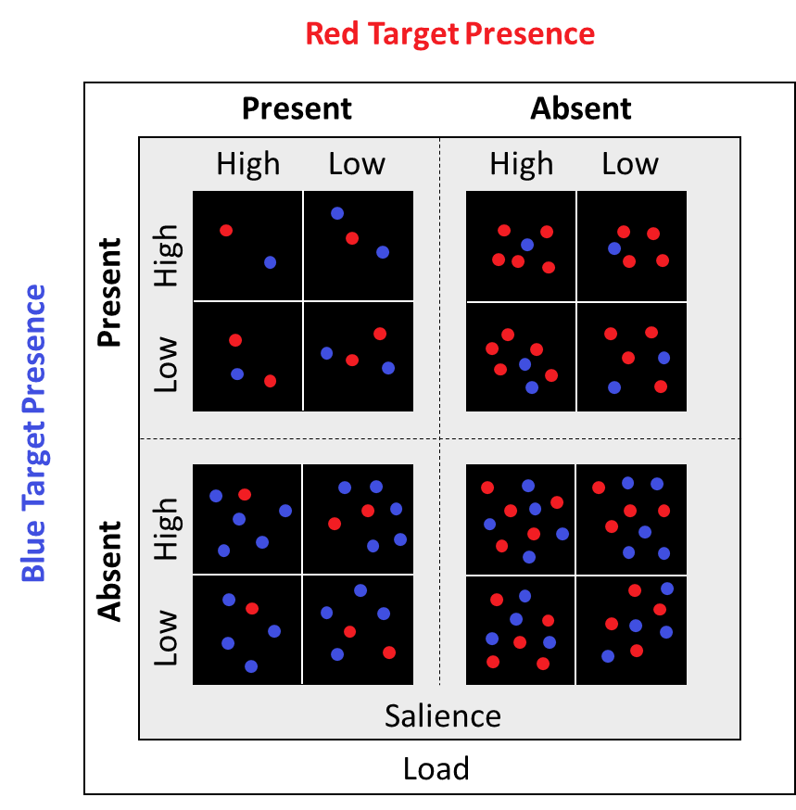
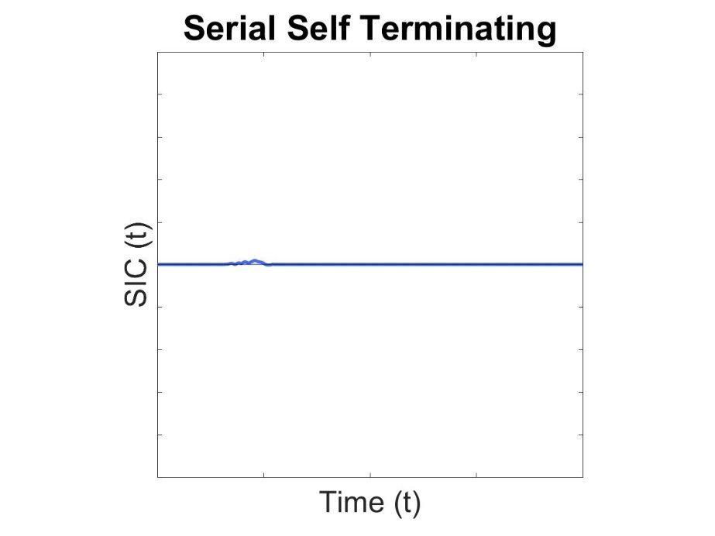
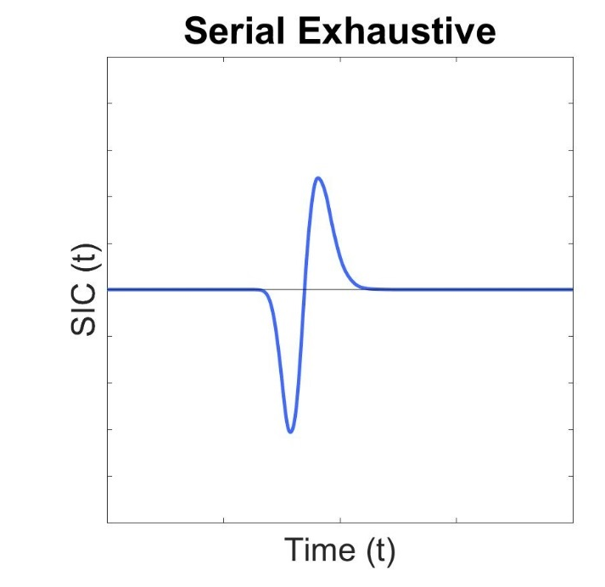
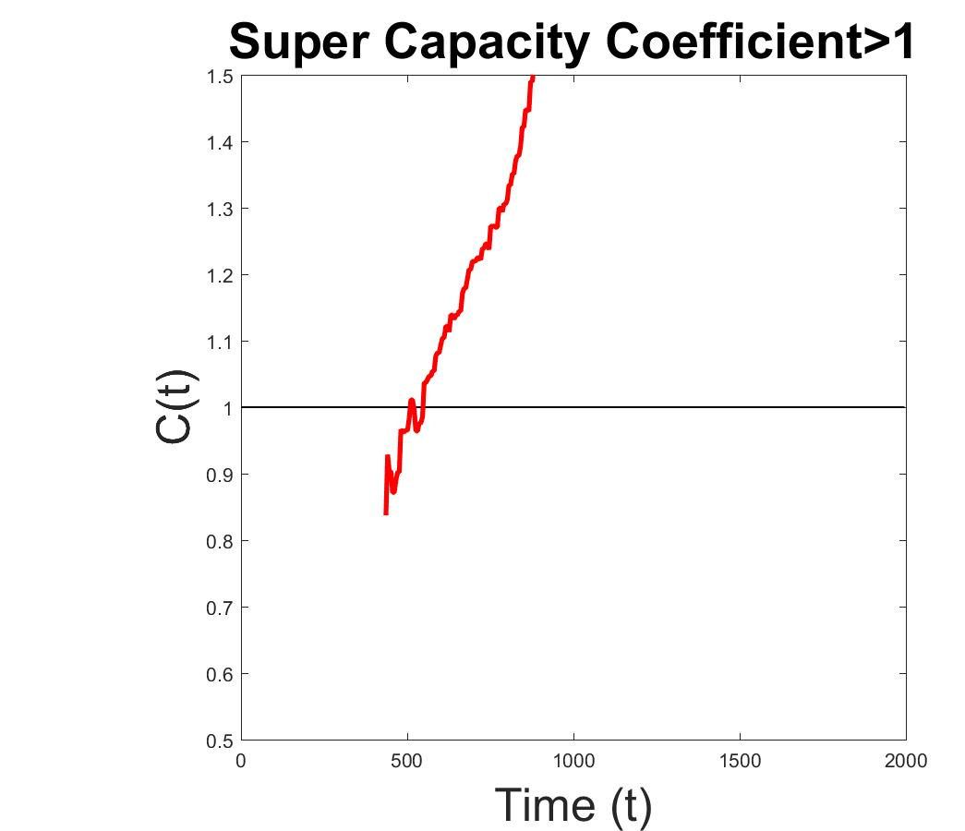
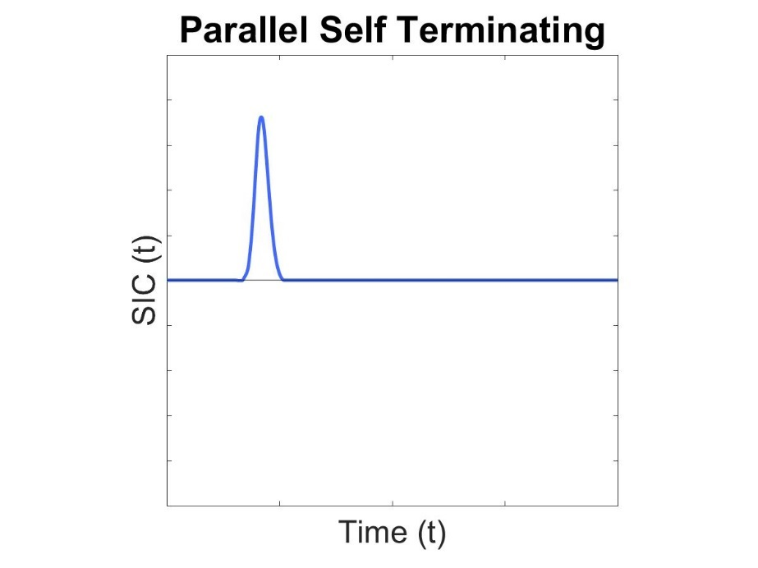
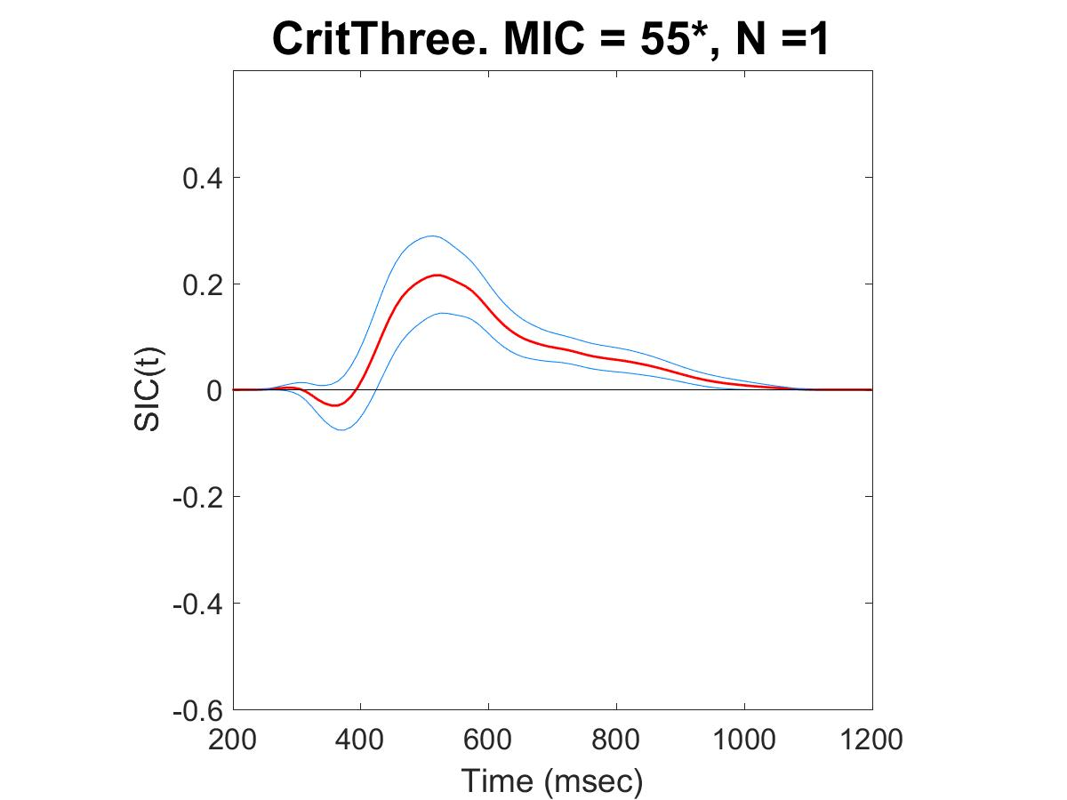
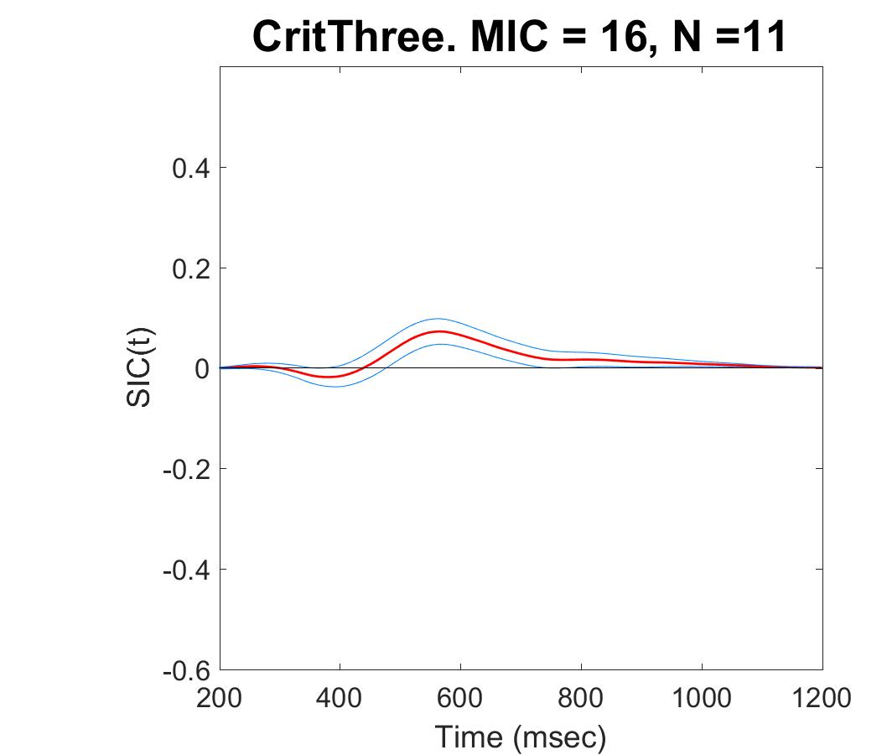
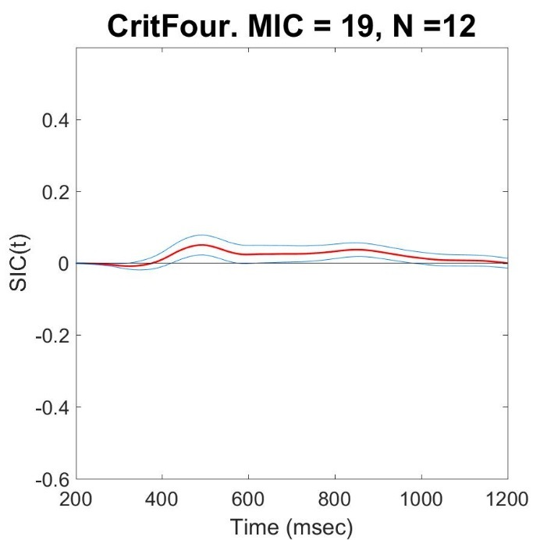
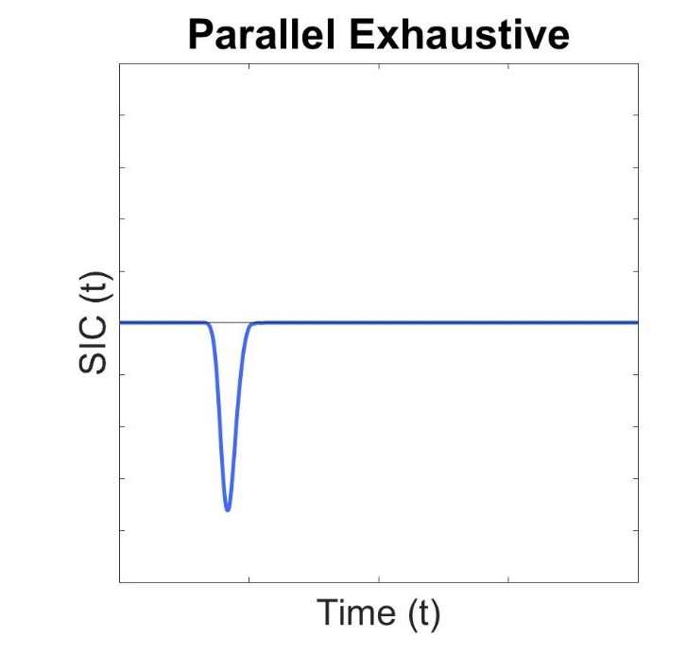
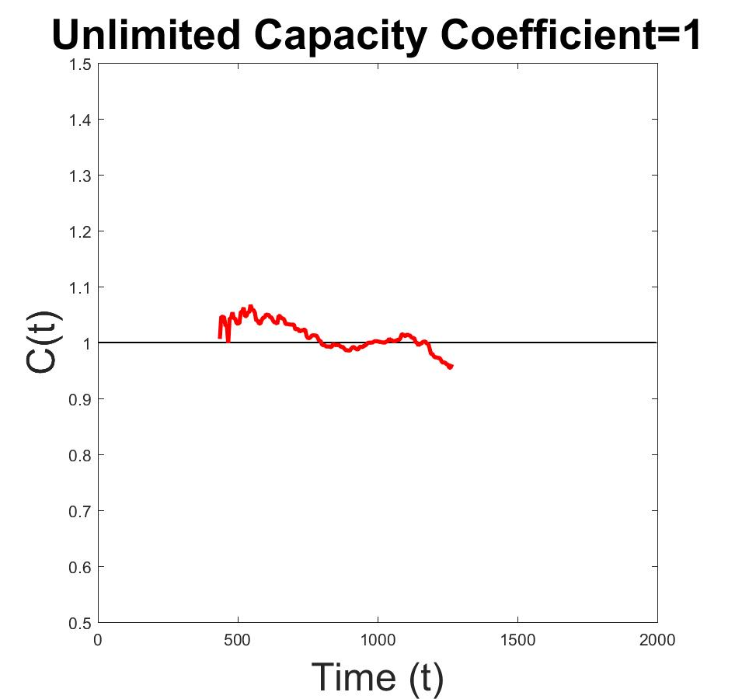
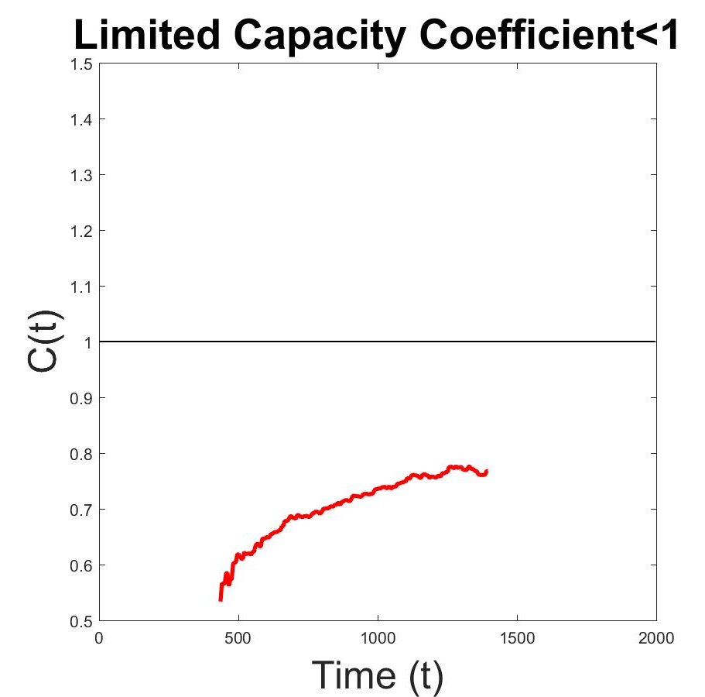
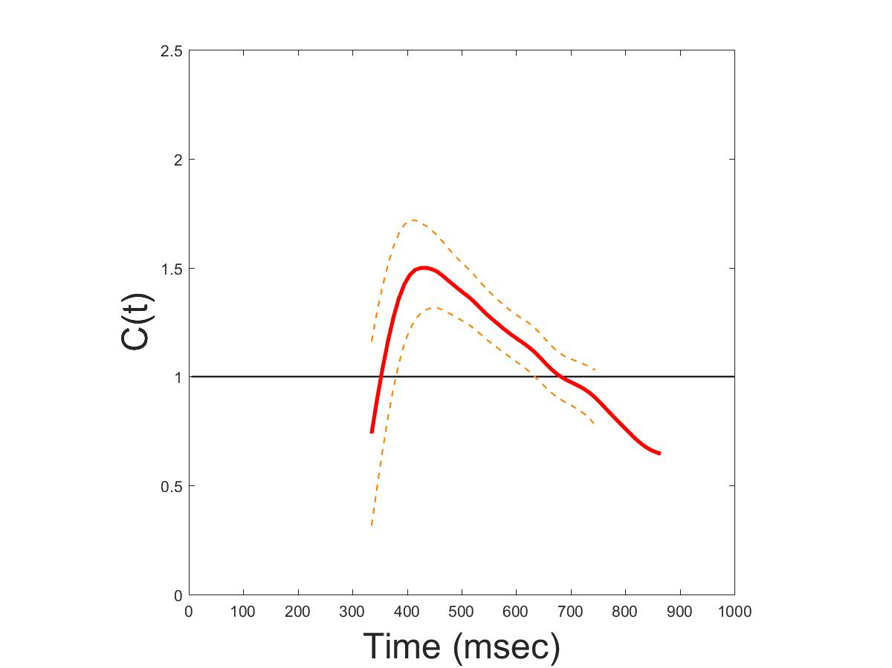
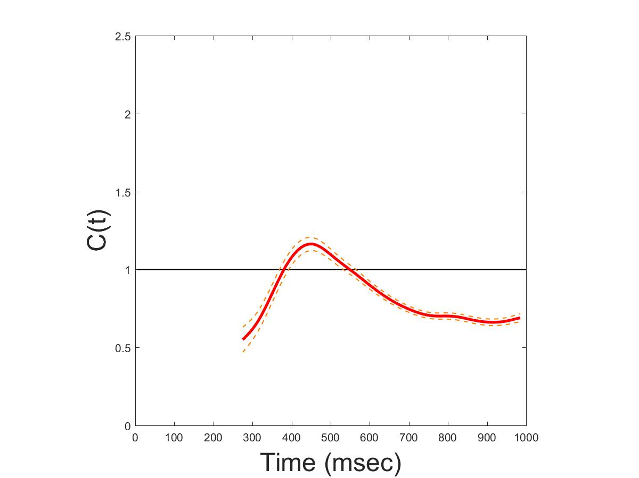
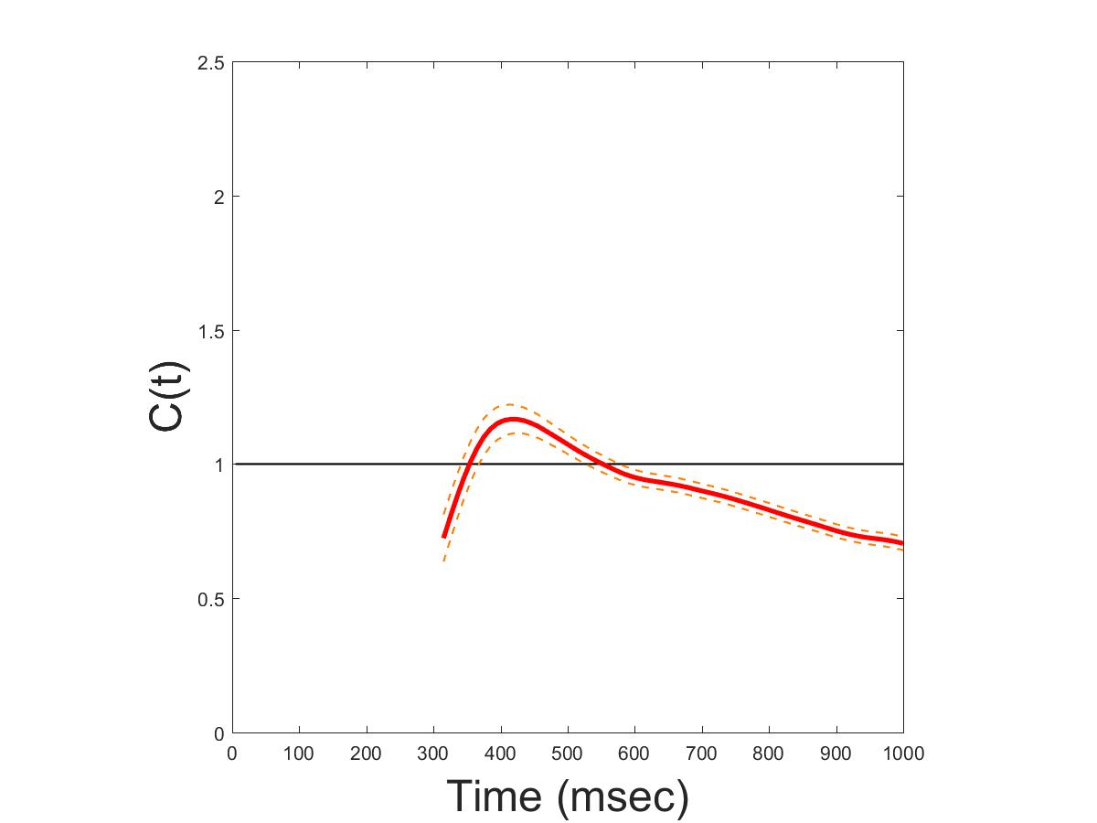
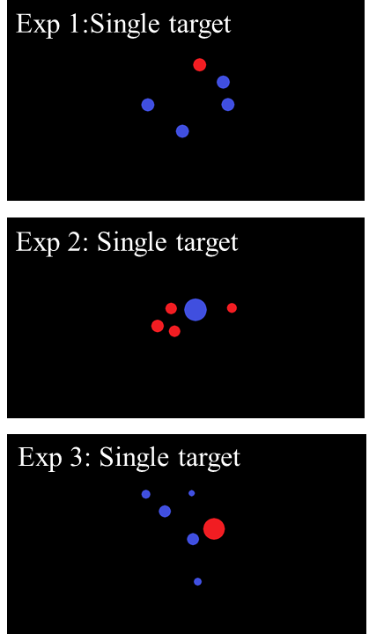
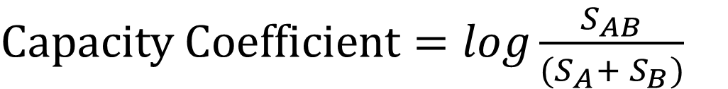
How Do You Count?
Cognitive Processing Systems of Enumeration
Paul Garrett^{1,} Alexander Thorpe¹, David Landy², Joseph Houpt³ & Ami Eidels¹
Paul.Garrett@newcastle.edu.au
¹ The University of Newcastle, Australia, ² Indiana University, Bloomington, USA, ³ Wright State University, Ohio, USA
Background
Enumeration – the ability to quantify item sets, basic to our everyday life.
For example, choosing the least busy queue at airport security. How is it that we make these decisions with such speed and accuracy?
Subitizing¹, for the rapid and effortless enumeration of item sets 1-4
Counting² for the slow and accumulative enumeration of item sets 5-12. If subitizing is effortless, then subitizing two independent item sets (i.e., queues) may occur simultaneously or in a Parallel System. We applied an advanced Mathematical Framework method and Analysis Technique, called Systems Factorial Technology (SFT)³.
SFT affords unique System Signatures to diagnose Parallel and Serial (Sequential) Systems (Figure 1a), while independently assessing System Workload or ‘Effort’ (Figure 1b). If Parallel System Subitizing were Effortless, System Capacity would be classified Unlimited.
2a)
Blocks = 13
Trials = 96
2b)
Time (ms)
$$Mean Interaction Contrast (MIC)= {RT}_{HH} − {RT}_{HL} − {RT}_{LH}+ {RT}_{LL}$$
Target Criterion < 3
$$Survivor Interaction Contrast (SIC)= S_{HH} − S_{HL} − S_{LH}+ S_{LL}$$
$Capacity Coefficient=log\frac{S_{AB}}{(S_{A}+ S_{B})}$
Where RT = meanRT, H = High Salience, L = Low Salience, S = Hazard Function,
AB = Double Target, A = Single Target Red and B = Single Target Blue
Results
1a)
1b)
Experiment 1: Evenly Sized Dots (Analysis Example)
Hypotheses
Outcome
Figure 1.a. Survivor Interaction Contrasts (SIC) used to diagnose Parallel and Serial Systems
1.b. Capacity Coefficient. Diagnose Workload: Unlimited equates to Effortless processing
Experiment | Criterion Three | Capacity | Criterion Four | Capacity
Even Size Dots | Serial N = 11 Parallel N = 1 | Unlimited | Serial N = 12 | Unlimited
Predictive Surface Area | Serial N = 8 | Unlimited | Serial N = 11 | Unlimited
Forced Subitizing | Serial N = 12 Parallel N = 2 | Unlimited | Serial N = 12 Parallel N = 2 | Unlimited
Methods
Undergraduate students (N=71) were tested at the University of Newcastle Cognition Laboratory. Participants viewed two intermixed item sets, a Red set and Blue set. Using a keyboard, participants responded ‘z’ if at least one colour set was less than three, or ‘/’ if neither colour set was less than three (see Figure 2a). An alternate criterion of four was also used.
Experiment 1:
Even size dots in both Color-Sets
See Figure 2b for Stimulus combinations.
Experiment 2:
Color-Set Surface-Area constant both Within and Across trials.
Made Surface Area predictive of number.
Experiment 3:
Color-Set Surface-Area constant Within but not Across trials.
Forced the use of subitizing or counting for accurate trial discrimination
Conclusion
Two item-sets may be subitized in Parallel under conditions of Unlimited or Effortless Workload, however Sequential or Serial subitizing was preferred (66 / 71 Ps).
Serial and Parallel System Subitizing showed effortless (Unlimited) processing. Serial and Parallel groups showed no mean RT difference. This indicates no advantage in either strategy. These results suggest that the observed preference for Serial Subitizing may be a learned phenomenon, which may stem from our everyday use of Sequential Counting.
Future Research
Investigate whether Parallel System Subitizing is a learned enumeration strategy
If Parallel System Subitizing is present in children and when Serial System Subitizing becomes the preferred strategy
If learning Parallel System Subitizing as a child may help to expand our Mental Number Line past the boundary of four.
References
¹ Kaufman, E. L., Lord, M. W., Reese, T. W., & Volkmannm J. (1949). The discrimination of visual number. The American Journal of Psychology. 2 (4), 498-525
² Gelman, R. & Gallistel, C. R., (1978). The child’s understanding of number. Cambridge, MA. Harvard University Press Gullaume, Bys, Mussollin & Content, 2013
³ Townsend, J., & Nozawa, G. (1995). Spatio-temporal properties of elementary perception: an investigation of Parallel, Serial and Coactive theories. Journal of Mathematical Psychology. 39 (2), 321-359

Slide 2




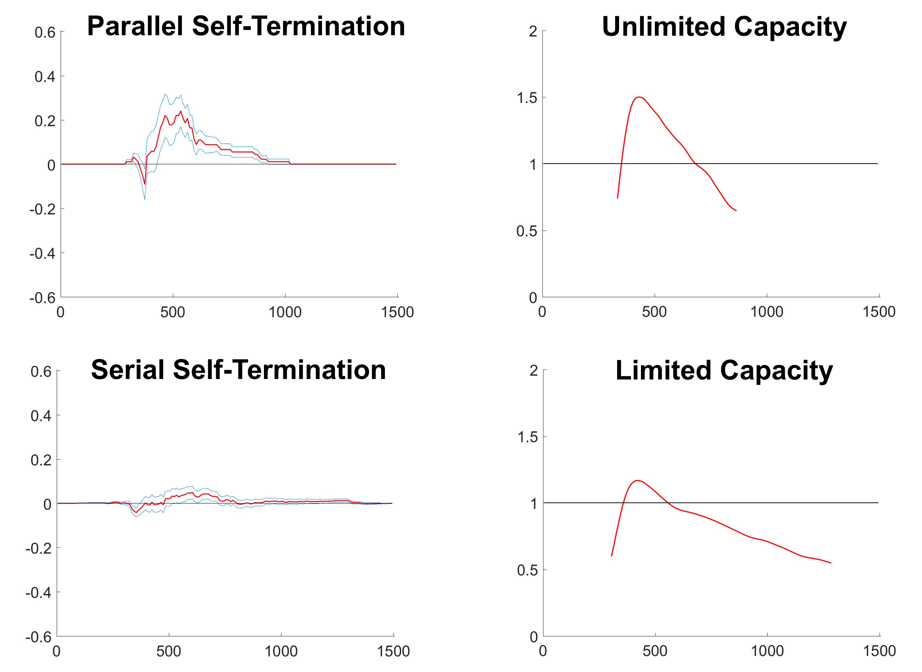
A New Approach to Understanding Systems of Subitizing - The Comparison of Small Quantities
Paul Garrett^{1,} Alexander Thorpe¹, David Landy², Joseph Houpt³ & Ami Eidels¹
¹ The University of Newcastle, Australia, ² Indiana University, Bloomington, USA, ³ Wright State University, Ohio, USA
Paul.Garrett@newcastle.edu.au
Background
Every day, we perform important tasks that require the comparison of small quantities, such as when choosing the shortest queue at the grocery checkout. Typically, small quantities (i.e., queues) are quantified or enumerated through one of two processes. Subitizing for the rapid enumeration of one to four items, and Counting for the slow and accumulative enumeration of five or more items. The current study investigates how we combine two subitizing processes into a single Subitizing System, using the methodological framework provided by Systems Factorial Technology.
SFT Non-Parametric System Measures
Survivor Interaction
Contrast
Assess Parallel vs
Serial Systems
Parallel – Simultaneous
Serial – Sequential Subitizing
Capacity Coefficient
Assess System
Capacity
Limited – Slows with Workload
Unlimited – Unaffected by WL
Method
Undergraduate students N=71 viewed two RED and BLUE intermixed item sets.
Participants responded ‘yes’ or ‘no’ to: ‘Is at least one of these colour sets less than a criterion number?’
Criterions of Three and Four items responded to.
Target items equal the criterion minus One or Two items. Distractor items equal the criterion plus One or Two items.
Participants were assigned to one of three experimental conditions to control for perceptual covariates of number.
Even Disc Sizes
Equal Disc Area
Enforced Subitizing
The experiment was a 3 (Experimental Condition) x 2 (Criterion) Between-Subjects Design
Example SFT Output – Exp 3 Criterion Three
Results
Experiment | Criterion Three | Capacity | Criterion Four | Capacity
Even Size Dots | Serial N = 11 Parallel N = 1 | Unlimited | Serial N = 12 | Unlimited
Equal Disc Area | Serial N = 8 | Unlimited | Serial N = 11 | Unlimited
Enforced Subitizing | Serial N = 12 Parallel N = 2 | Unlimited | Serial N = 12 Parallel N = 2 | Unlimited
Example Stimuli Target Criterion Three
Double Target
Single Target
No Target
Even Disc Size
Conclusion
Two Item sets may be subitized in Parallel under conditions of (apparently) Unlimited or Effortless workload.
Sequential Subitizing was the preferred method.
Equal Disc
Area
Additional Analyses
A modified version of this task was completed (N=5), with the addition of trials containing single-target item sets without distractors.
Results suggest the presence of distractor items biased the Capacity Coefficient towards unlimited processing.
We suspect further testing will reveal that both Parallel and Serial System Subitizing can be performed only under conditions of Limited System Workload Capacity
Enforced
Subitizing
Formula. SIC = $S_{AB_HH} − S_{AB_HL} − S_{AB_LH}+ S_{AB_LL}$ Capacity Coefficient = $log\frac{S_{AB}}{(S_{A}+ S_{B})}$
Where S=Survivor Function. AB = Double Target. H=High Salience. L=Low Salience. Salience – Proximity to Criterion.
References
¹ Kaufman, E. L., Lord, M. W., Reese, T. W., & Volkmannm J. (1949). The discrimination of visual number. The American Journal of Psychology. 2 (4), 498-525
² Gelman, R. & Gallistel, C. R., (1978). The child’s understanding of number. Cambridge, MA. Harvard University Press Gullaume, Bys, Mussollin & Content, 2013
³ Townsend, J., & Nozawa, G. (1995). Spatio-temporal properties of elementary perception: an investigation of Parallel, Serial and Coactive theories. Journal of Mathematical Psychology. 39 (2), 321-359

Slide 3





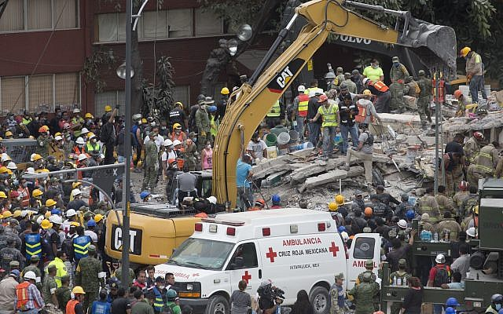

How Many Jelly Beans in Two Jars?
Evidence for the Parallel Estimation of Two Quantities
Paul Garrettª, Laura Watersª, David Landy^{b}, Joseph Houpt^{c} & Ami Eidelsª
Paul.Garrett@newcastle.edu.au
ª The University of Newcastle, Australia, ^{b} Indiana University, Bloomington, USA, ^{c} Wright State University, Ohio, USA
1
Background
3
Results
Estimation: Rapid and inaccurate enumeration of large quantities
Estimation System: How we compare two large quantities.
Importance:
Emergency rescue, quickly identifying groups in distress
Air Traffic Controllers
Crowds finding the fastest Exit during an emergency
High Scores in Candy Crush
Research Question:
All Participants completed the task with high accuracy (>80%).
Analyses were conducted using the techniques provided by Systems Factorial Technology¹
Bayesian hierarchical analysis² was completed on Participant MIC’s*. The MIC is a diagnostic mean response-time tool. Parallel architectures predict positive (min time) and negative (max time) MICs. Serial architectures a zero MIC.
Table 1. Group and subject posterior predictions for parallel and serial MIC model fits. The winning model is highlighted in bold with accompanying Bayes factors. Strength of evidence is provided for easy interpretation.
Sub ID | MIC | Parallel (Min Time) | Serial | Parallel (Max Time) | BF₁₀ | Evidence
Group Posterior | 23* | 0.58 | 0.24 | 0.18 | 4.14 | Positive
SM01 | 38 | 0.77 | 0.15 | 0.08 | 10.04 | Strong
SM02 | 23 | 0.59 | 0.28 | 0.13 | 4.32 | Positive
SM03 | 75 | 0.85 | 0.10 | 0.05 | 17.00 | Strong
SM04 | -22 | 0.43 | 0.33 | 0.24 | 2.26 | Weak
SM05 | 5 | 0.50 | 0.35 | 0.15 | 3.00 | Positive
SS01 | 48 | 0.83 | 0.11 | 0.06 | 14.65 | Strong
SS02 | 22 | 0.54 | 0.33 | 0.13 | 3.52 | Positive
SS03 | 59 | 0.84 | 0.12 | 0.04 | 15.75 | Strong
SS04 | -6 | 0.42 | 0.38 | 0.20 | 2.17 | Weak
SS05 | 48 | 0.78 | 0.13 | 0.08 | 10.64 | Strong
SS06 | -44 | 0.28 | 0.32 | 0.40 | 2.00 | Weak
AM01 | 33 | 0.62 | 0.22 | 0.15 | 4.89 | Positive
AM02 | 26 | 0.67 | 0.21 | 0.12 | 6.09 | Strong
AM03 | 98 | 0.81 | 0.15 | 0.04 | 12.79 | Strong
AM04 | 33 | 0.72 | 0.18 | 0.10 | 7.71 | Strong
AS01 | 38 | 0.61 | 0.32 | 0.07 | 4.69 | Positive
AS02 | -35 | 0.40 | 0.22 | 0.38 | 2.00 | Weak
AS03 | -59 | 0.31 | 0.24 | 0.45 | 2.45 | Weak
AS04 | 58 | 0.83 | 0.12 | 0.05 | 14.65 | Strong
Under which Cognitive Architecture does the estimation system operate, parallel or serial?
H₁ Parallel Architecture
Estimate
22
Response
Estimate
18
H₂ Serial Architecture
Note. Subject ID indicates experimental condition. SM – Even Size, Mixed.
SS – Even Size, Split. AM – Even Area, Mixed. AS – Even Area, Split.
Estimate
Estimate
Response
4
Discussion
Hierarchical fits indicate all subjects applied a Parallel Estimation system with relatively high accuracy, supporting H₁
Future research must now consider the cognitive workload imposed by estimating two groups, simultaneously.
This research can be applied to the training of emergency response teams and air traffic control officers, facilitating fast and accurate estimates of multiple large quantities.
Future research may look at application to young children when learning to compare quantities during development of their approximate number system.
2
Method
Undergraduate students N=19 viewed a RED and BLUE dot array
Individual colour arrays contained either 10, 14, 29 or 41 dots.
Participants were asked to respond ‘yes’ or ‘no’ with a keyboard, to the question: “Is at least one colour set less than twenty?”
Participants were allocated to one of four conditions: 2 (Control: Array Area vs. Dot Size) x 2 (Array: Mixed vs. Split) Design
The task was a redundant target design. Participants could respond at the first detection of a target with a minimum time search.
Even Size, Mixed
Even Size, Split
Even Area, Mixed
Even Area, Split
5
References
¹ Townsend, J., & Nozawa, G. (1995). Spatio-temporal properties of elementary perception: an investigation of Parallel, Serial and Coactive theories. Journal of Mathematical Psychology. 39 (2), 321-359
² Houpt, J., & Fific, M. (2017). A hierarchical Bayesian approach to distinguishing serial and parallel processing. Journal of Mathematical Psychology. 79, 13-22
*MIC = mRT( HH ) – mRT( HL ) – mRT( LH ) + mRT( LL ), where H and L indicate the high (easy) or low (hard) identifiability of a target array. Their combination identifies a redundant (double) target condition. As the MIC is an interaction contrast, the significncae of this effect may be assessed through a between subjects ANOVA, and is indicated by an *.

