Slide 1




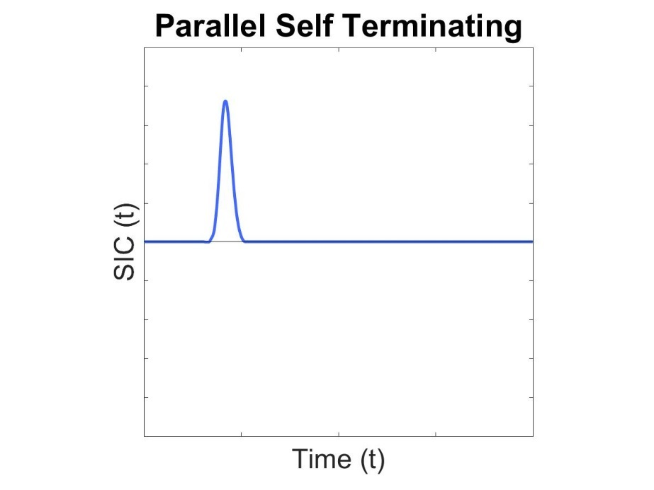
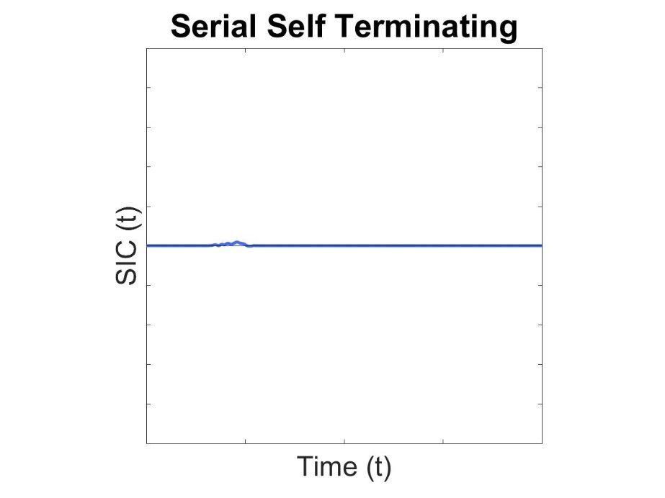
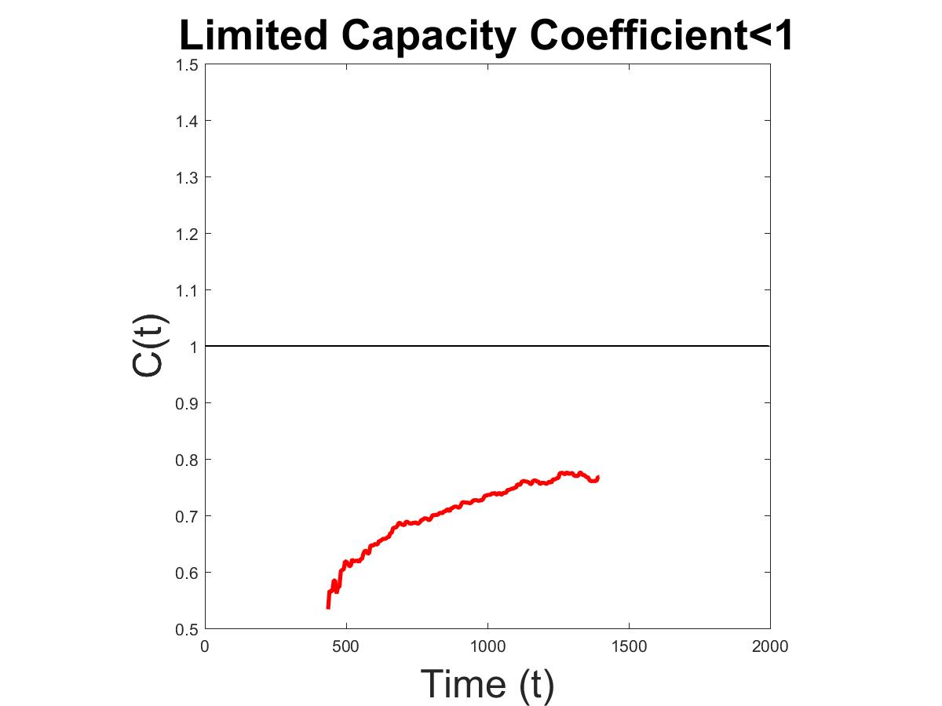
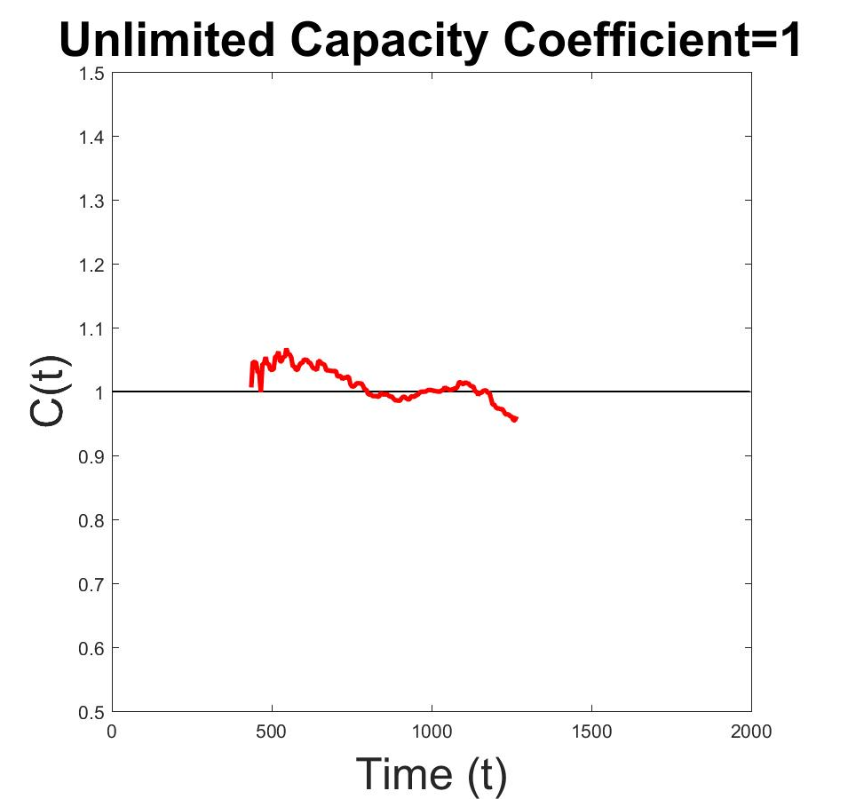
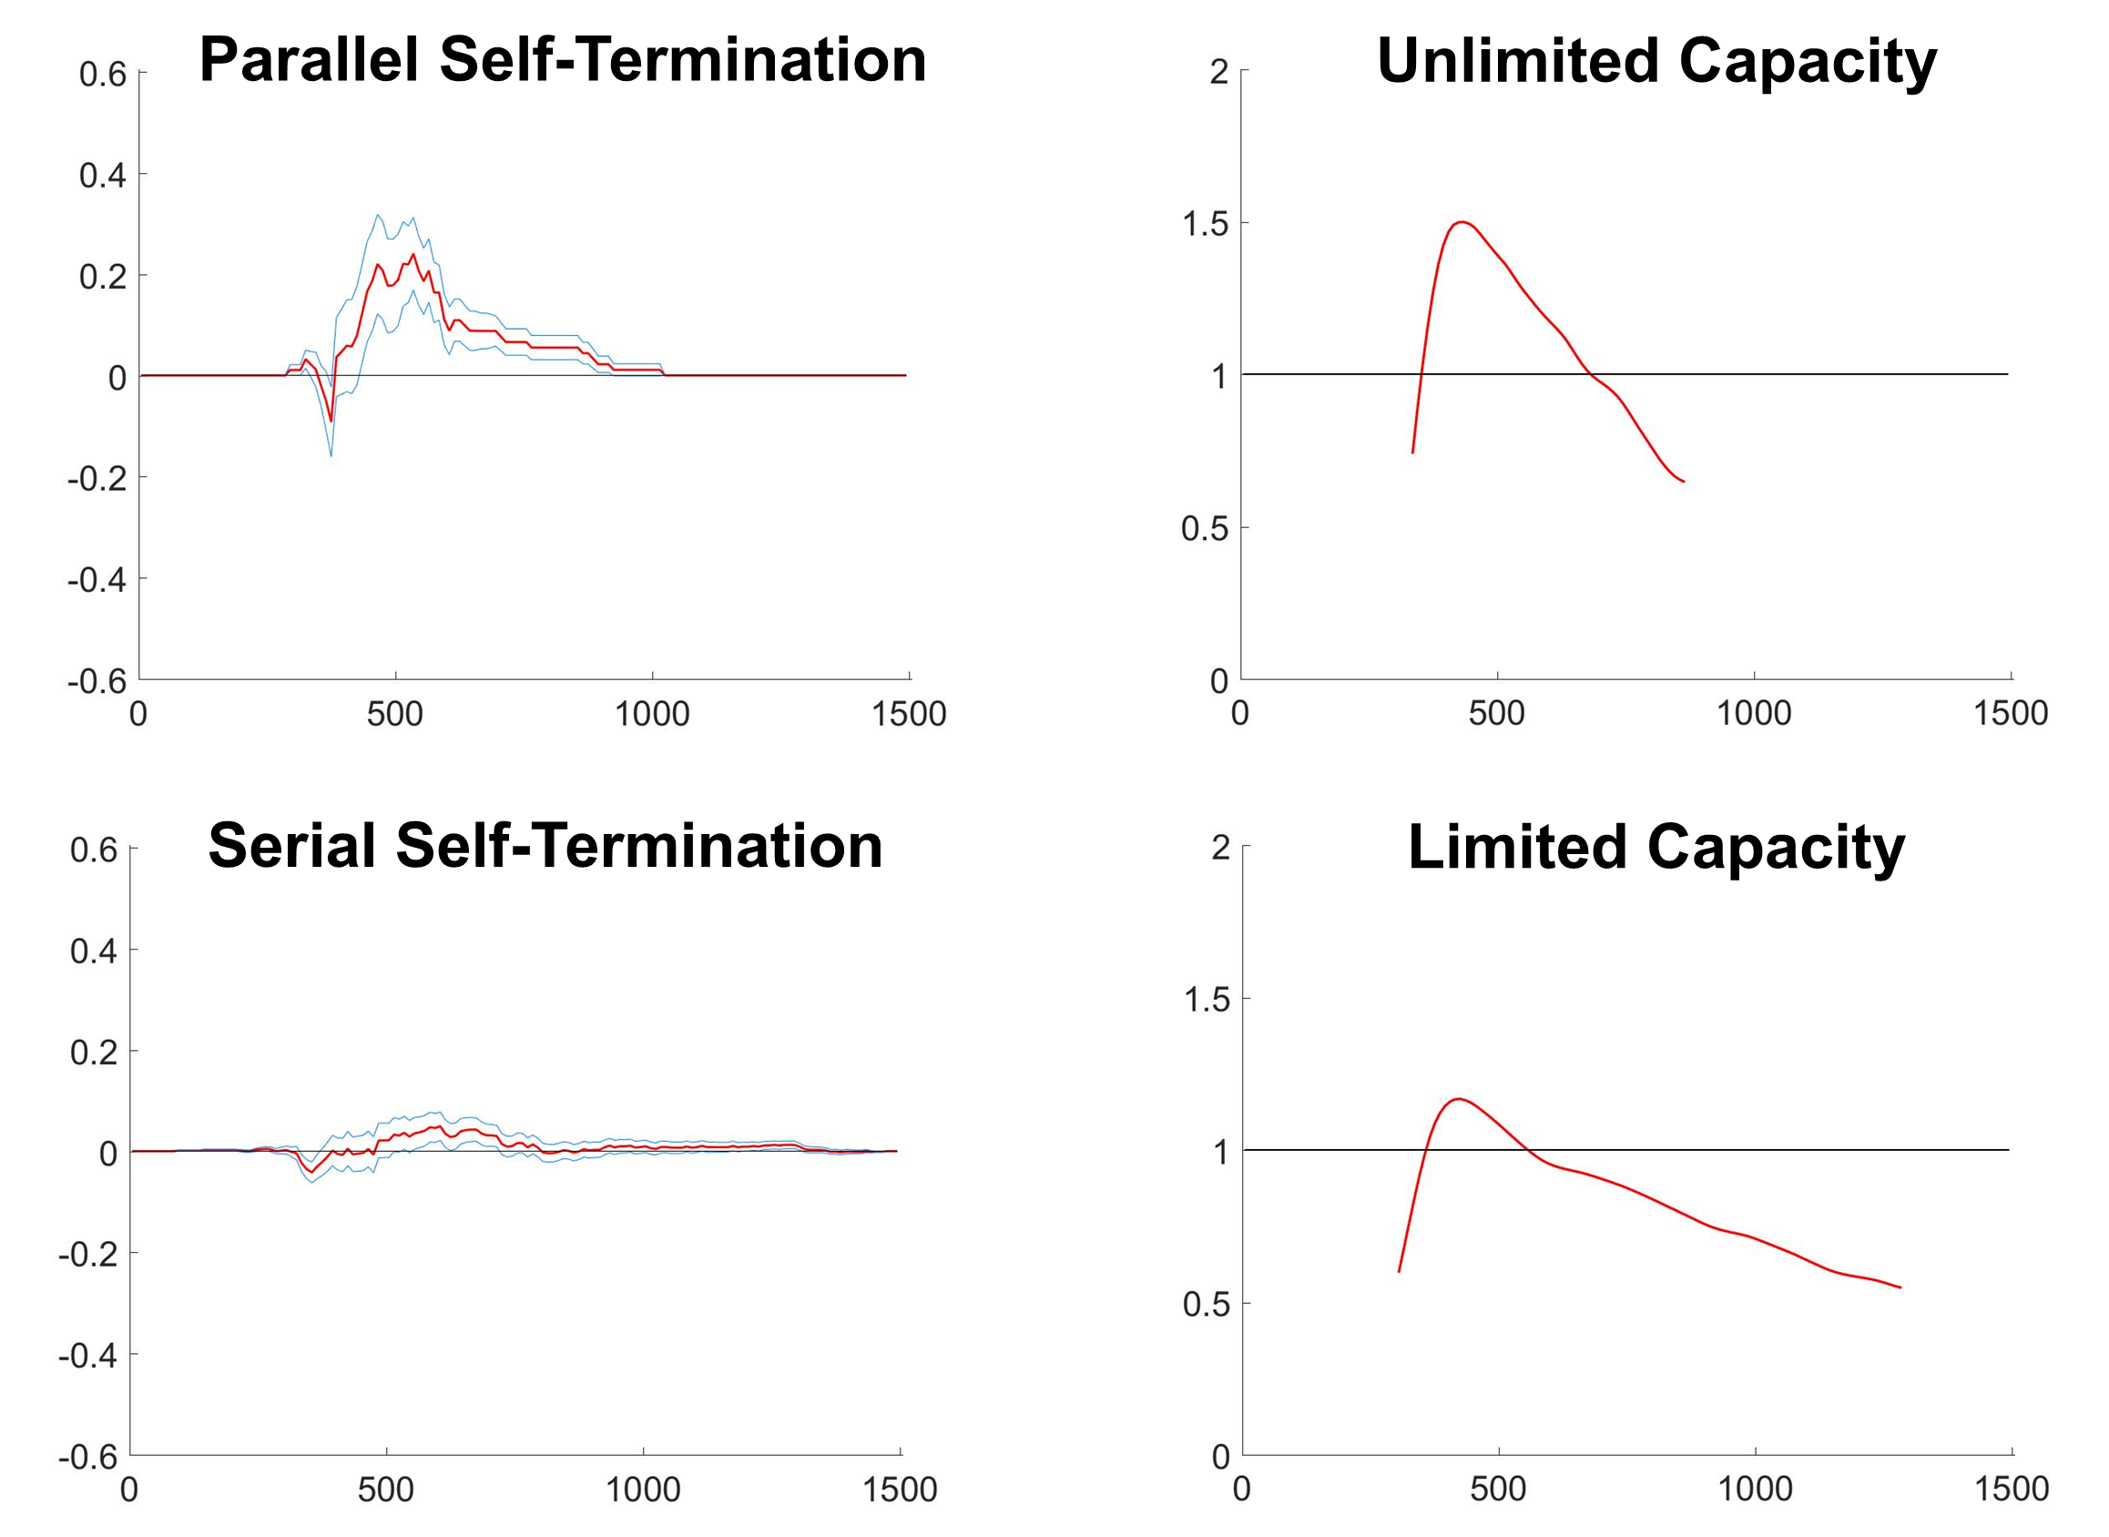
A New Approach to Understanding Systems of Subitizing - The Comparison of Small Quantities
Paul Garrett^{1,} Alexander Thorpe¹, David Landy², Joseph Houpt³ & Ami Eidels¹
¹ The University of Newcastle, Australia, ² Indiana University, Bloomington, USA, ³ Wright State University, Ohio, USA
Paul.Garrett@newcastle.edu.au
Background
Every day, we perform important tasks that require the comparison of small quantities, such as when choosing the shortest queue at the grocery checkout. Typically, small quantities (i.e., queues) are quantified or enumerated through one of two processes. Subitizing for the rapid enumeration of one to four items, and Counting for the slow and accumulative enumeration of five or more items. The current study investigates how we combine two subitizing processes into a single Subitizing System, using the methodological framework provided by Systems Factorial Technology.
SFT Non-Parametric System Measures
Survivor Interaction
Contrast
Assess Parallel vs
Serial Systems
Parallel – Simultaneous
Serial – Sequential Subitizing
Capacity Coefficient
Assess System
Capacity
Limited – Slows with Workload
Unlimited – Unaffected by WL
Method
Undergraduate students N=71 viewed two RED and BLUE intermixed item sets.
Participants responded ‘yes’ or ‘no’ to: ‘Is at least one of these colour sets less than a criterion number?’
Criterions of Three and Four items responded to.
Target items equal the criterion minus One or Two items. Distractor items equal the criterion plus One or Two items.
Participants were assigned to one of three experimental conditions to control for perceptual covariates of number.
Even Disc Sizes
Equal Disc Area
Enforced Subitizing
The experiment was a 3 (Experimental Condition) x 2 (Criterion) Between-Subjects Design
Example SFT Output – Exp 3 Criterion Three
Results
Experiment | Criterion Three | Capacity | Criterion Four | Capacity
Even Size Dots | Serial N = 11 Parallel N = 1 | Unlimited | Serial N = 12 | Unlimited
Equal Disc Area | Serial N = 8 | Unlimited | Serial N = 11 | Unlimited
Enforced Subitizing | Serial N = 12 Parallel N = 2 | Unlimited | Serial N = 12 Parallel N = 2 | Unlimited
Example Stimuli Target Criterion Three
Double Target
Single Target
No Target
Even Disc Size
Conclusion
Two Item sets may be subitized in Parallel under conditions of (apparently) Unlimited or Effortless workload.
Sequential Subitizing was the preferred method.
Equal Disc
Area
Additional Analyses
A modified version of this task was completed (N=5), with the addition of trials containing single-target item sets without distractors.
Results suggest the presence of distractor items biased the Capacity Coefficient towards unlimited processing.
We suspect further testing will reveal that both Parallel and Serial System Subitizing can be performed only under conditions of Limited System Workload Capacity
Enforced
Subitizing
Formula. SIC = $S_{AB_HH} − S_{AB_HL} − S_{AB_LH}+ S_{AB_LL}$ Capacity Coefficient = $log\frac{S_{AB}}{(S_{A}+ S_{B})}$
Where S=Survivor Function. AB = Double Target. H=High Salience. L=Low Salience. Salience – Proximity to Criterion.
References
¹ Kaufman, E. L., Lord, M. W., Reese, T. W., & Volkmannm J. (1949). The discrimination of visual number. The American Journal of Psychology. 2 (4), 498-525
² Gelman, R. & Gallistel, C. R., (1978). The child’s understanding of number. Cambridge, MA. Harvard University Press Gullaume, Bys, Mussollin & Content, 2013
³ Townsend, J., & Nozawa, G. (1995). Spatio-temporal properties of elementary perception: an investigation of Parallel, Serial and Coactive theories. Journal of Mathematical Psychology. 39 (2), 321-359

