Slide 1


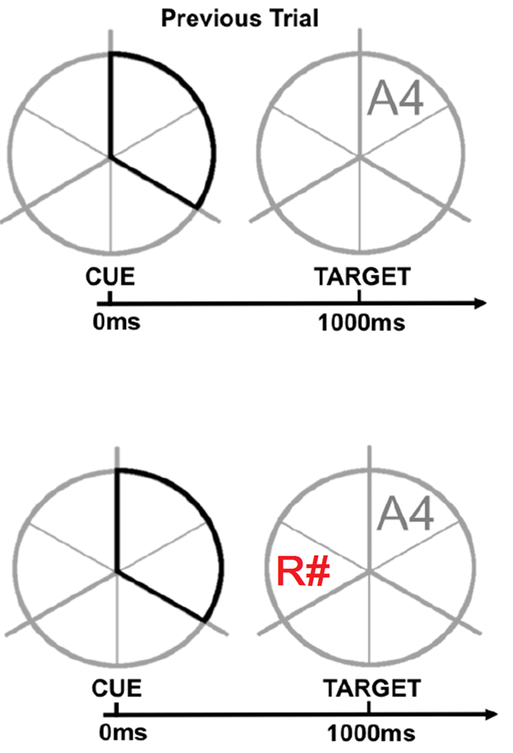
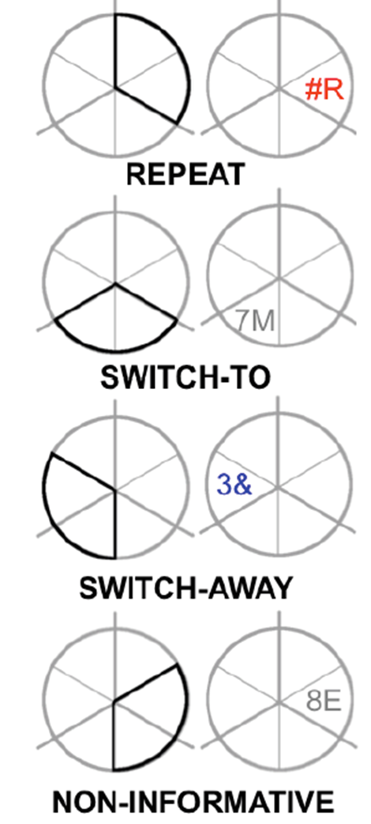
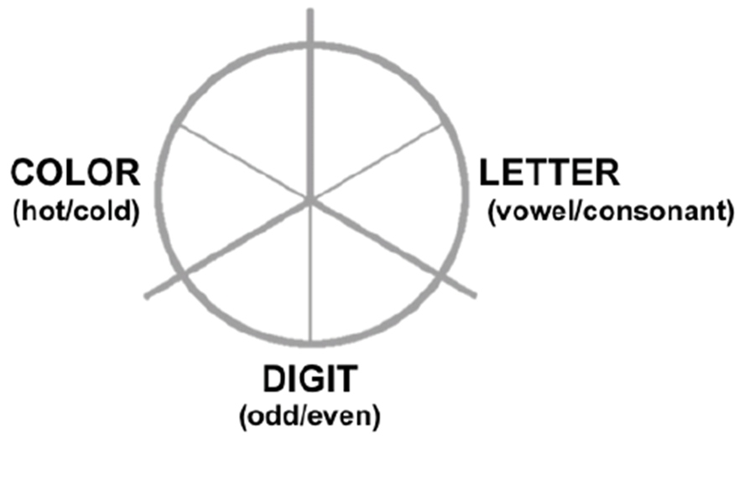
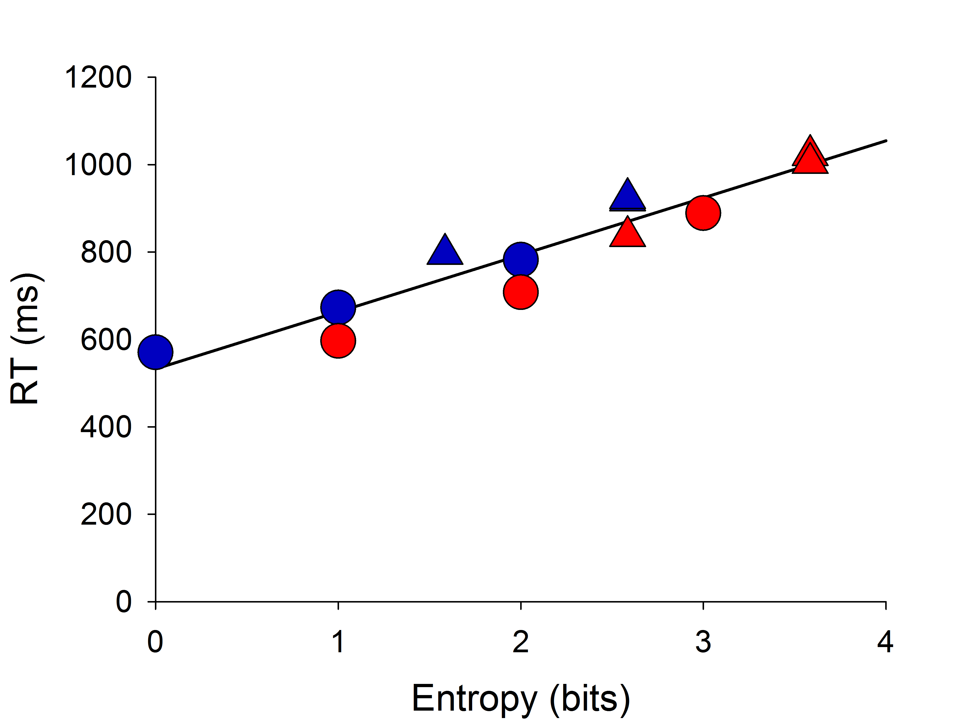




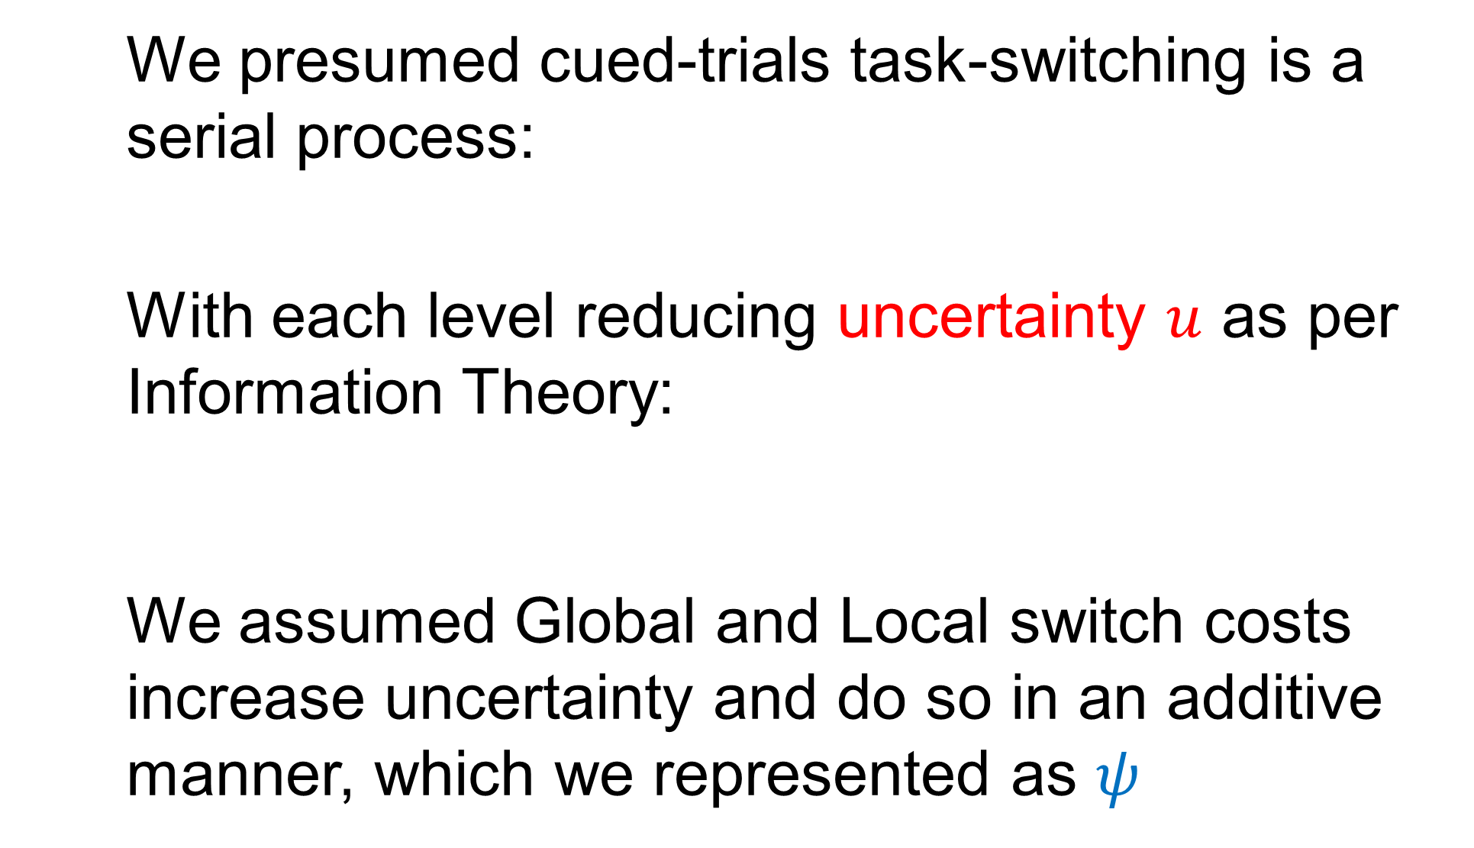
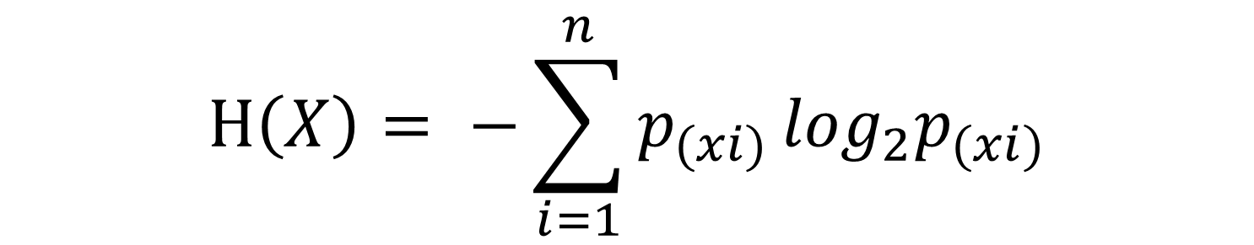
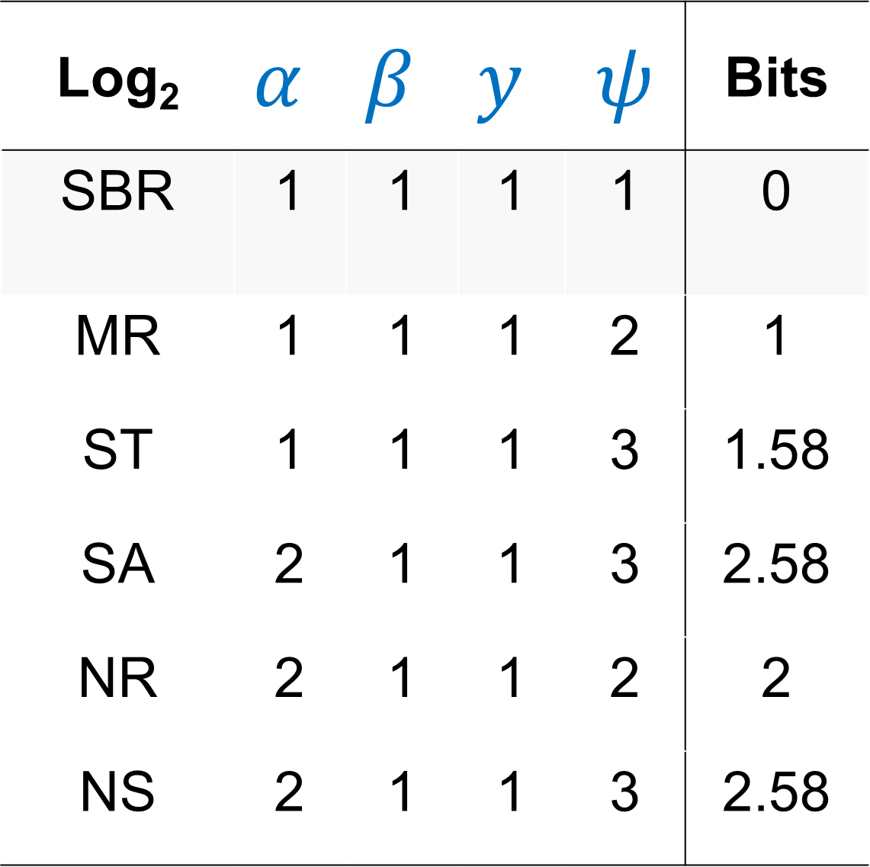
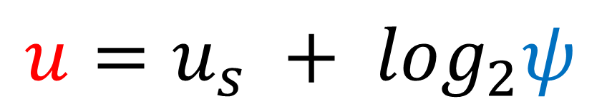
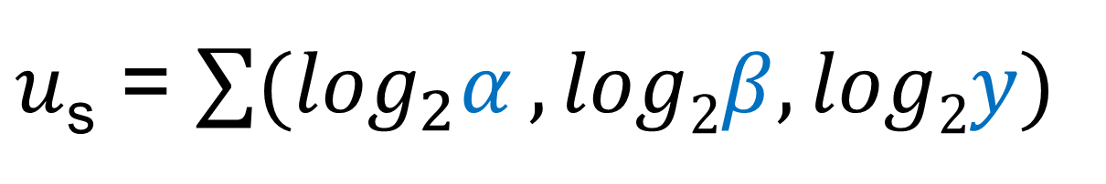
Using cognitive control to resolve information content predicts both global and local switch costs
Paul Garrett¹ Patrick S. Cooper^{1,2} & Frini Karayanidis^{1,2}
Paul.Garrett@newcastle.edu.au
¹ Functional Neuroimaging Laboratory, School of Psychology ²Centre for Translational Neuroscience and Mental Health
1.a Cognitive Control 1.b Information Theory 1.c Uncertainty 1.d Measures
Cognitive Control may occur when there is a need to prioritise information processing, such as in the presence of uncertainty (Mackie et al., 2013).
In Information Theory uncertainty is a measure of the information content that a given signal contains characterised by Shannon Entropy (bits).
Here we attempt to explain the range of control processes in a cued-trials task-switching paradigm as a function of environmental uncertainty.
We investigate proactive and reactive control, in addition to specific indices of control, the Local and Global Switch Cost in a standard (n=94) and distractor paradigm (n=19).
$$Η\left(X\right)= −\sum_{i=1}^{n}{p_{(xi)}}\log_{2}p_{(xi)}$$
2. Method
Standard Paradigm
Task
100% Informative Cue
100% Repeat
100% Informative Cue
100% Switch
Distractor
Distractor Paradigm
50% Informative Cue
100% Switch
50% Informative Cue
50% Repeat/Switch
3. Equation
Log₂ | $$α$$ | $$β$$ | $$y$$ | $$ψ$$ | Bits
SBR | 1 | 1 | 1 | 1 | 0
MR | 1 | 1 | 1 | 2 | 1
ST | 1 | 1 | 1 | 3 | 1.58
SA | 2 | 1 | 1 | 3 | 2.58
NR | 2 | 1 | 1 | 2 | 2
NS | 2 | 1 | 1 | 3 | 2.58
4. Results
We presumed cued-trials task-switching is a serial process:
With each level reducing uncertainty $u$ as per Information Theory:
We assumed Global and Local switch costs increase uncertainty and do so in an additive manner, which we represented as $ψ$
Switch
SA
SA-D
Repeat
NS
SA
Cue (α) Target (𝛽) Response (y)
ST
ST
NR
NS
NS-D
MR
MR
NR
ST-D
NR-D
SBR
ST-D
AR
MR-D
AR-D
MR-D
$u$_{s} = $\sum{{(log}_{2}α},log2β,log2y)$
SBR-D
R²adj = 0.89
$$u=u_{s} + \log_{2}ψ$$
SBR: Single Block Repeat, MR: Mixed Repeat, ST: Switch-To, SA: Switch-Away, NR: Noninformative-Repeat, NS: Noninformative-Switch
‘D’ denotes distractor paradigm where one additional bit was added at the target
5. External Validity
6. Conclusions
Author | Experiment | R²adj
Braverman et al. (2010) | One | .803
 | Two | .716
 | Three | .652
Goffaux et al. (2010) | - | .992
Grange et al. (2010) | - | .855
Jost et al. (2008) | - | .915
Kray (2006) | Young | .884
 | Old | .820
Meiran et al. (2000) | Congruent | .804
 | Incongruent | .678
Meiran et al. (2005) | Unspeeded | .733
 | Speeded | .776
Braver et al. (2003) | - | .970
Ruge et al. (2005) | - | .874
Increases in information uncertainty require increased information prioritisation.
Information prioritisation may occur both in a proactive (informative tasks at cue) and reactive (non-informative tasks at target) fashion.
Specific indices, the Local and Global Switch Costs require increased information prioritisation to reduce task uncertainty.
External validity of the switch-penalty model was established amongst other cued-trials task-switching paradigms.
Acknowledgements
The current study was funded by an Australian Research Council Discovery Project (The Age-ility Project)
We thank Gavin Cooper for programming of the paradigm and Samantha Allen and Natalie Lantry for the collection of the data.
Distractor Tasks (D) equated one additional bit at the target
References
Braver et al. (2003)., Neuron. Braverman et al. (2010). Psychological Research.
Goffaux et al. (2010). Biological Psychology. Grange et al. (2010). Psychological Research.
Jost et al. (2008). Psychonomic Society. Kray (2006). Brain Research.
Mackie et al. (2013). Brain Cognition. Meiran et al. (2005). Memory and Cognition.
Meiran et al. (2000). Cognitive Psychology . Ruge et al. (2005). Neuropsychologica.

