Slide 1

How Do You Count?
Paul Garret¹, Alexander Thorpe¹, David Landy², Joseph Houpt³ & Ami Eidels¹
¹ The University of Newcastle, Australia
² Indiana University, Bloomington, USA
³ Wright State University, Ohio, USA
The University of
Newcastle Australia
Notes:
Typically, when we think of counting, we think of the slow, additive process we learn as children. By this process, we count by ones until we reach our target number.
But did you ever stop and ask yourself, how did we learn to count our first number? The answer to this, is Subitizing.

Slide 2
Paul Garrett
Subitizing
Kaufman, Lord, Reese & Volkmann, 1949
“The Instantaneous Counting of one to four items…”
“Simultaneous and Attentive…”
The University of
Newcastle Australia
Background
Notes:
Subitizing is the rapid or instanteous counting of one to four dots.
Unlike typical counting, subitizing is considered an effortless process
and requires only a fraction of a second to make an accurate judgement of number
This process is so basic, it is present in both babies and animals and is responsible for our ability to differentiate one item from a group of similar items

Slide 3



Paul Garrett
Screen
Subitizing
Starkey & Cooper, 1980
The University of
Newcastle Australia
Background
Notes:
In a classical example of subitizing, Wynn showed that three month old babies were sensitive to the absence of a single item within the subitizing range.
As you can see, the baby is conditioned in the presence of four items, one item is hidden and the baby stares at the group in puzzlement for a period longer than chance.

Slide 4

Paul Garrett
Screen
Subitizing
Starkey & Cooper, 1980
The University of
Newcastle Australia
Background
Notes:
Repeating this experiment, Wynn showed that babies were insensitive to the removal of a single item if the group was larger than four. Now up until a limit of around eight, Adults find this same task very easy, but that is because we have the ability to Groupitize.

Slide 5
Paul Garrett
Groupitizing
Starkey & McCandliss, 2014
Process by which we ‘Group’ items so as to be easily Subitized
Research Question
Can we still Groupitize if item sets are randomly allocated?
The University of
Newcastle Australia
Background
Notes:
Groupitizing is the effortless grouping and subitizing of items. Groupitizing is considered much faster than Counting, and like normal subitizing is apparently effortless. Now the reason I say apparently, is that the properties of Groupitizing are not well understood outside of canonical patterns such as Dominos or Dice. Of course, this hasn’t stopped it from being taught as a new tool for learning the number line in some American schools. So we thought we should test Groupitizing, by seeing what happened if rather than choosing your own groups, an Experimenter randomly grouped the items for you?
If the literature is true, under these conditions you are left with two choices, to groupitize both groups at the same time, or subitize one group and then the other.

Slide 6
Paul Garrett
System Processes
“Parallel or Serial Processing…”
Parallel Groupitizing
Serial Subitizing
The University of
Newcastle Australia
Background
Notes:
Of course, what I’ve just described is a difference in System Processing.
For example, Groupitizing is formed form a Parallel System where both colour sets are grouped and quantified at the same time.
By Contrast, Subitizing is a serial process where you subitize one colour set and then the next.
Typically, people consider parallel processes faster than serial processes, a notion that makes some sense. After all, you are doing two things at once.
But this is not always the case, and comes down to Cognitive Workload.

Slide 7
Paul Garrett
Cognitive Workload
“Efficiency or Speed of Processing…”
High Workload Parallel
Low Workload Serial
>
The University of
Newcastle Australia
Background
Notes:
Cognitive Workload can be thought of as the efficiency or Speed of Processing. Now, Given all other things are equal, a System under High Workload will be slower than a system under Low Workload.
In a drastic example, you can see how a Parallel System under High Load can in fact be slower than a Serial System under Low Load.
For this reason we cannot infer Parallel and Serial Systems from Mean Response Time alone, especially since Parallel Groupitizing and Serial Subitizing are both evenly effortless processes. What we need is a way of differentiating System Processes from Workload Capacity. For this, we turned to SFT.

Slide 8

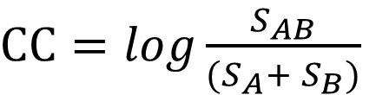
Paul Garrett
Systems Factorial
Technology (SFT)
Townsend & Nozawa, 1995
“Assess Parallel and Serial Systems independent of Workload…”
Requires MATH
M.A.T.H. – Mental Abuse To Humans
$$MIC= {RT}_{HH} − {RT}_{HL} − {RT}_{LH}+ {RT}_{LL}$$
$$SIC= S_{HH} − S_{HL} − S_{LH}+ S_{LL}$$
$CC=log\frac{S_{AB}}{(S_{A}+ S_{B})}$
The University of
Newcastle Australia
Background
Notes:
SFT or Systems Factorial Technology is a non-parametric methodology and analysis technique that utilises Response Time Distributions to assess System Processes and Workload Capacity.
How does it do this, with Math, a term better understood as Mental Abuse To Humans. In fact, this is so true that the only known individual to like Math is the Grumpy Cat.
Because of this, I’m going to skip over the math and tell you about the Tools SFT provides to differentiate between Parallel and Serial Systems, and levels of Workload.

Slide 9
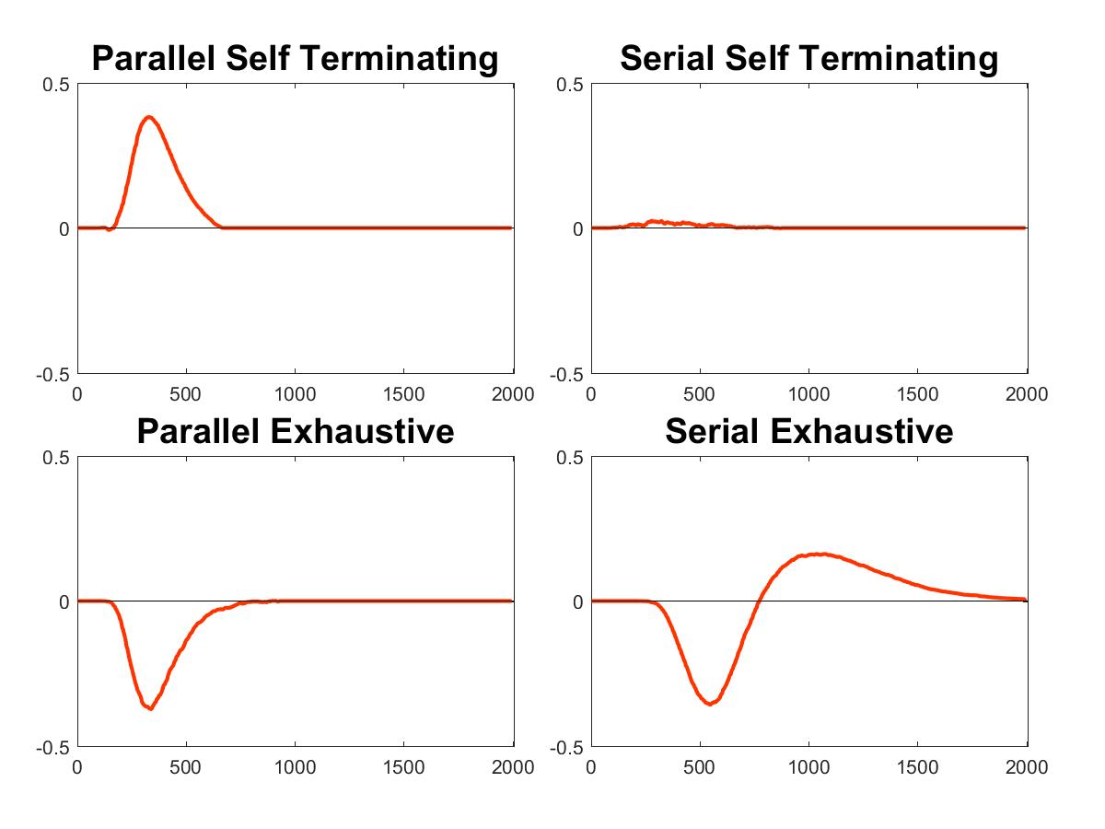
Paul Garrett
Survivor Interaction Contrast (SIC)
“Assess Parallel and Serial systems in addition to stopping rule”
The University of
Newcastle Australia
Background
Notes:
Our first Tool is the SIC or Survivor Interaction Contrast. The SIC allows for the direct assessment of Parallel and Serial Systems, in addition to the stopping rule, and when applied results in one of four unique System Signatures.

Slide 10
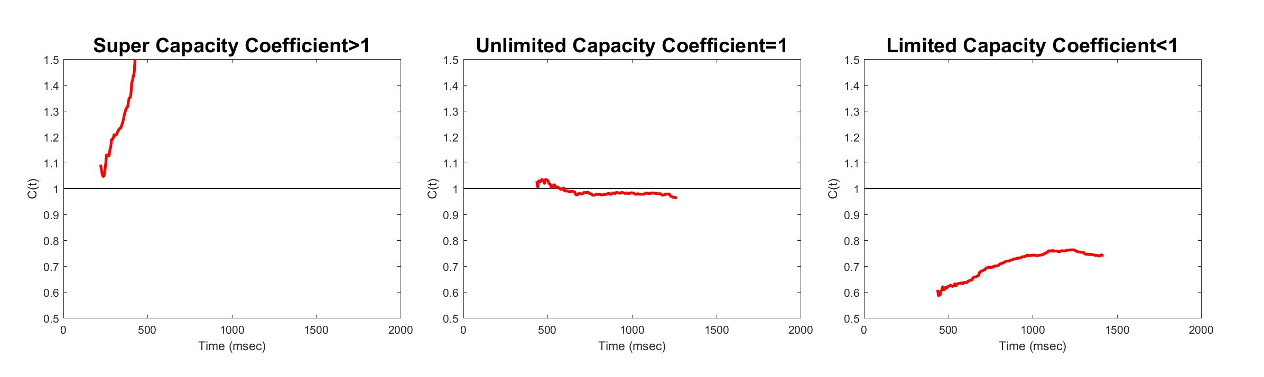
Paul Garrett
Capacity Coefficient
“Assess Workload independent of System Type”
The University of
Newcastle Australia
Background
Notes:
Our second tool is the Capacity Coefficient which allows for the direct assessment of Workload, independent of System Process.
A proper explanation of the Capacity Coefficient would require some math, so I will simplify this down for you.
If Parallel Groupitizing were faster than subitizing both Colour Sets alone, the Coefficient would be Greater than One, or Green.
If Parallel Groupitizing were equally fast as subitizing both Colour Sets alone, the Coefficient would equal to One, or Yellow. This is what we expect for Effortless Processing
Finally, if Groupitizing were slower than subitizing both Colour Sets alone, the Coefficient would be less than One or Red.
We term these Super, Unlimited and Limited Capacity but for today, you only need to know Green, Yellow and Red.

Slide 11


Paul Garrett
Methods
ITI
500ms
Fixation Cross
500ms
RTI
4000ms
Does Either Set Contain Less Than Three?
Stimulus
500ms
Mask
200ms
Target Yes
Post Mask Blank
3300ms
Target No
The University of
Newcastle Australia
Method
Notes:
Moving onto the methods, SFT requires a rather complex methodology, so I’m going to start by showing you a single trial.
At the start of every Block, Participants were asked a simple Question: Is Either Colour Set Less Than Three? The trial then began with a Fixation Cross, a Stimulus (in this case a Target Trial as the Red Dots are less than three), a Mask and a response interval of four seconds.
Each Participant Completed one practice block and twelve experimental blocks of 96 trials each.

Slide 12
Paul Garrett
Methods
The University of
Newcastle Australia
Method
Notes:
I’ve already mentioned that SFT is a Methodology and Analysis Technique, what I meant was that each stimulus combination was derived from the following Double Factorial Design.
But Don’t Worry, you don’t need to know any of this except that we had a Double Target Condition made of one and two dots;
A single Target condition with Distractor Items, and a Double Distractor conditions to keep participants honest.

Slide 13
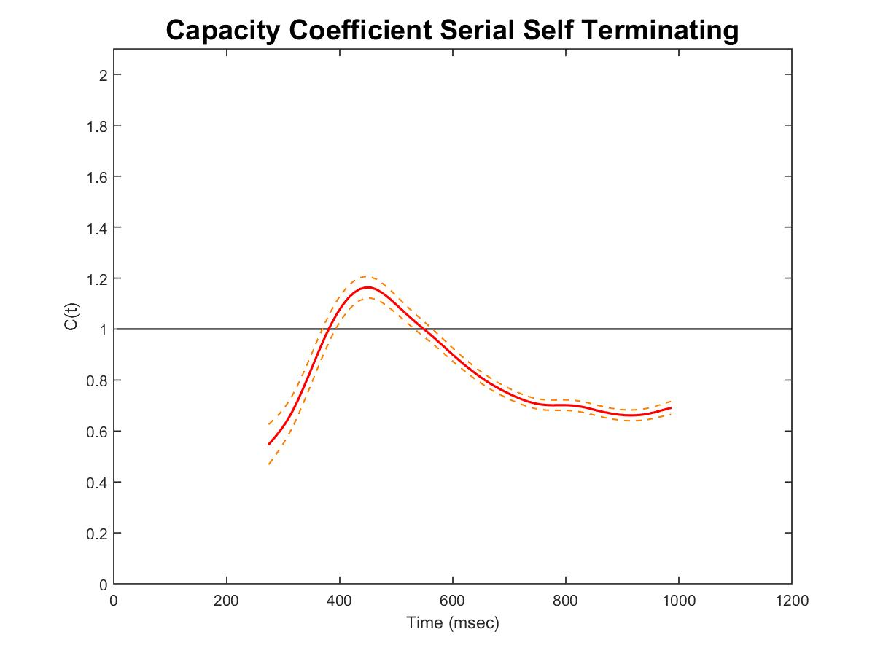
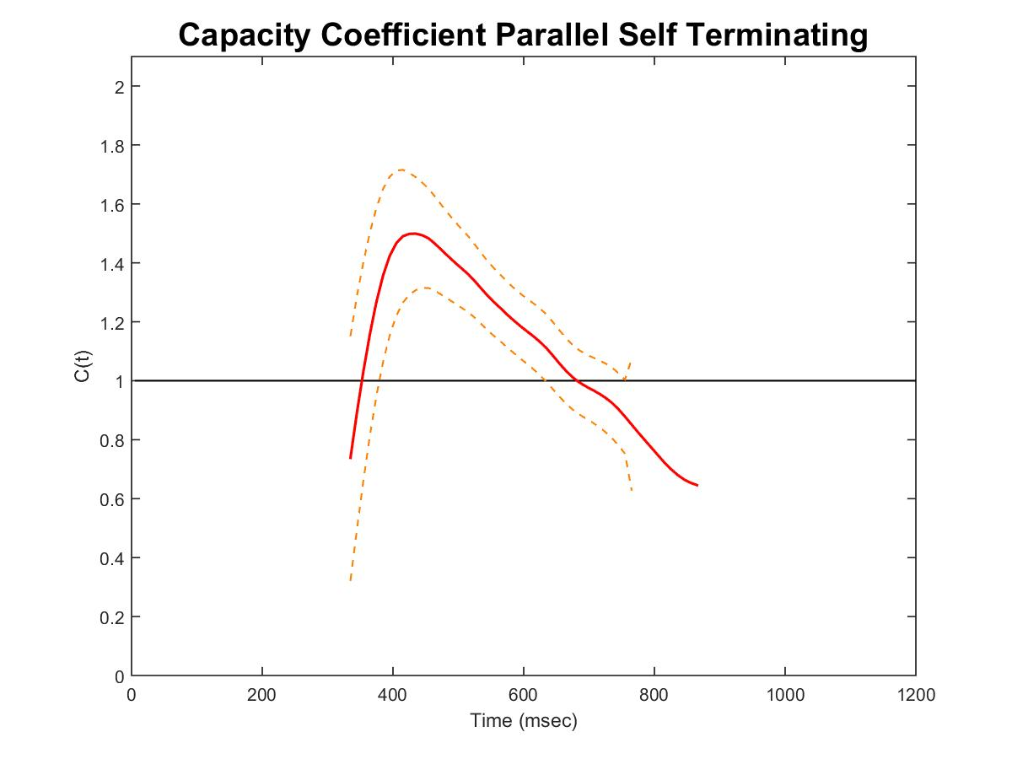
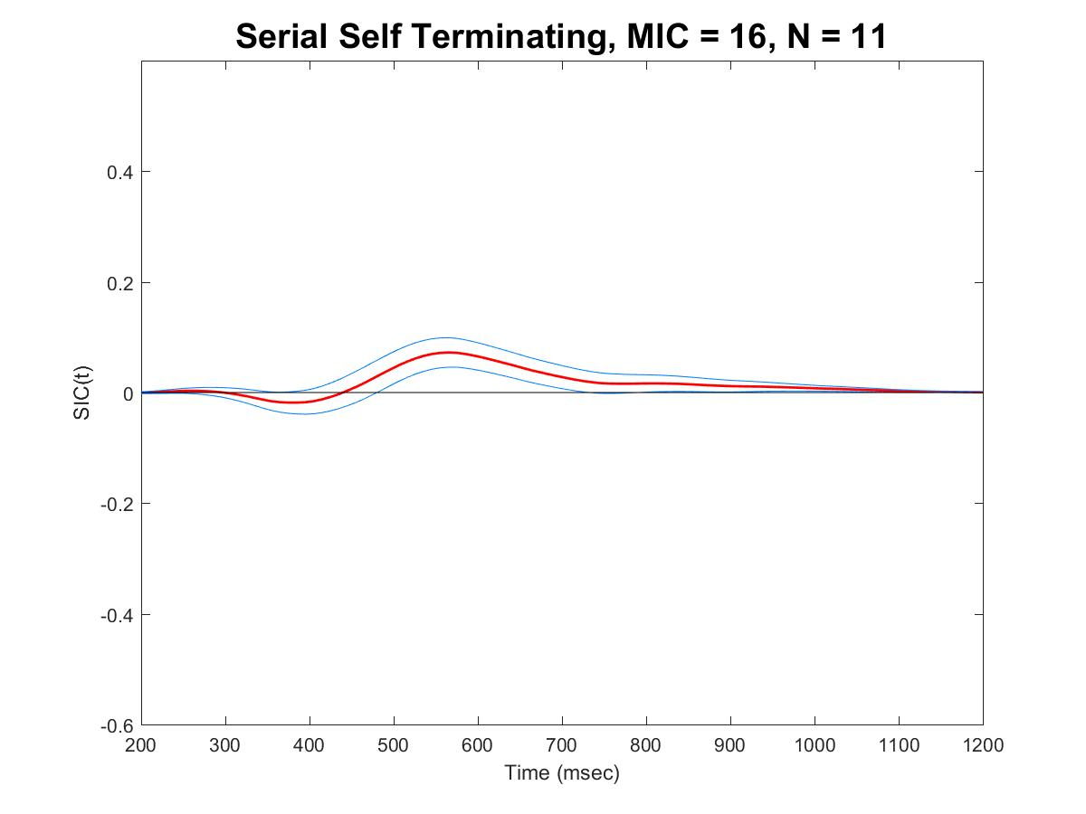
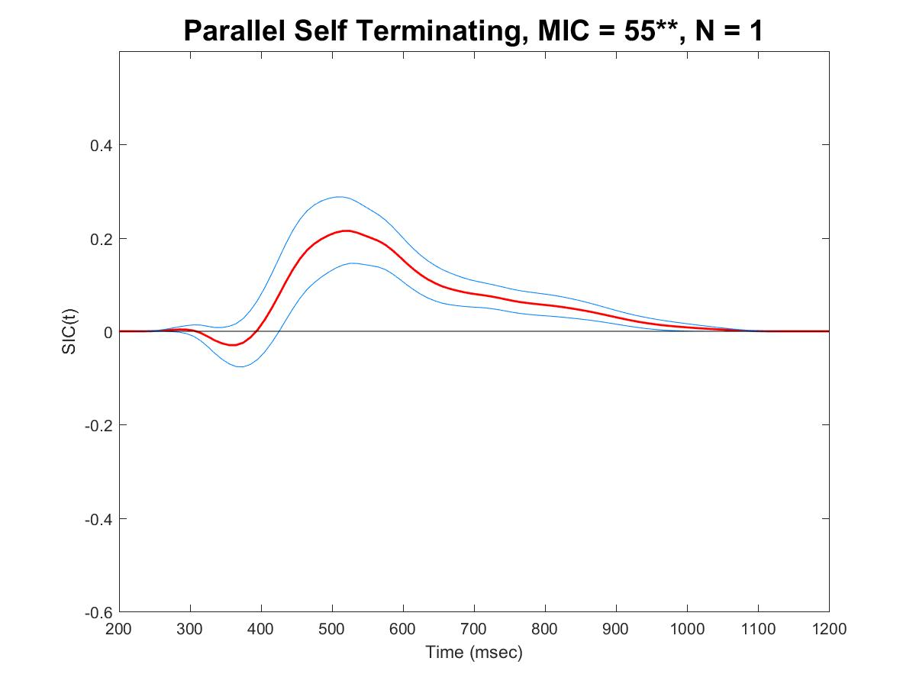
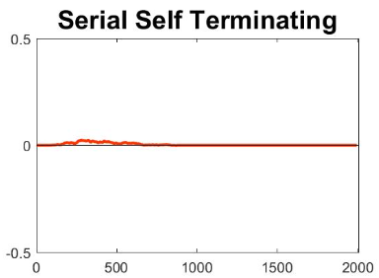
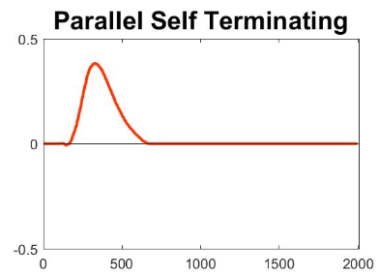
Paul Garrett
Experiment One – Evenly Sized Dots
The University of
Newcastle Australia
Experiment One – Evenly Sized Dots
Notes:
In experiment one, we were interested in seeing if Parallel Groupitizing were possible using stimuli of evenly sized dots.
In total we tested thirteen people and excluded one for not reaching an accuracy of 80%.
SFT analysis revealed twelve people useing a Serial Subitizing system, and one person a Parallel Groupitizing system. Mean Response Time was not significantly different between the groups and appropriate for subitizing.
Upon assessment of Capacity, we see that Serial Subitizing was effortless, resting within the yellow region. We can also clearly see that Capacity was far greater for Parallel Groupitizing, lying firmly within the Green.
Now at this point we had some concerns, that maybe the singular Parallel System we observed was due to some anomaly resulting from one of the Target Stimuli being only One Dot, and the difference between detection and subitizing.

Slide 14
Paul Garrett
Results – Experiment One
Conclusion – Experiment One
Experiment | Criterion Three | Capacity | Criterion Four | Capacity
Evenly Sized Dots | Serial / Parallel | Unlimited / Super | Serial / Parallel | Unlimited / Super
Parallel Groupitizing is possible when groups are randomly allocated if the individual has no upper limit to capacity.
As most individuals show some upper bound to capacity, Serial Subitizing was the preferred strategy.
Parallel Groupitizing is possible when groups are randomly allocated…
- If the individual has learned to use the more efficient strategy of Parallel Groupitizing
OR
- If the individual has no upper limit to capacity
The University of
Newcastle Australia
Conclusion – Experiment One
Notes:
So we replicated the study using twelve participants and found the same thing. One participant used a Parallel Groupitizing system, and this system was of greater capacity than the effortless Serial Subitizing system.
From here we had to decide between two conclusions. Either Parallel Groupitizing was possible when items are randomly allocated, because the individual has previously learned to use this strategy. OR, Parallel Groupitizing was possible because this individual had no upper limit to their capacity.
As one of the main arguments for Groupitizing is it’s intuitive nature, it seems unlikely that the first explanation would be the case, so for now we conclude that Parallel Groupitizing is most possible in individuals who do not exhibit any capacity limitations. As most people seem to show an upper bound to capacity in this task, Serial Subitizing was the preferred strategy.
Its about here that we were ready to leave off, but then we came across a 2006 paper by Halberda, Sires and Fig, which suggested processes such as Parallel Groupitizing might be dependant upon Item Surface Area. So we thought, sure. We’ll give it a go.

Slide 15
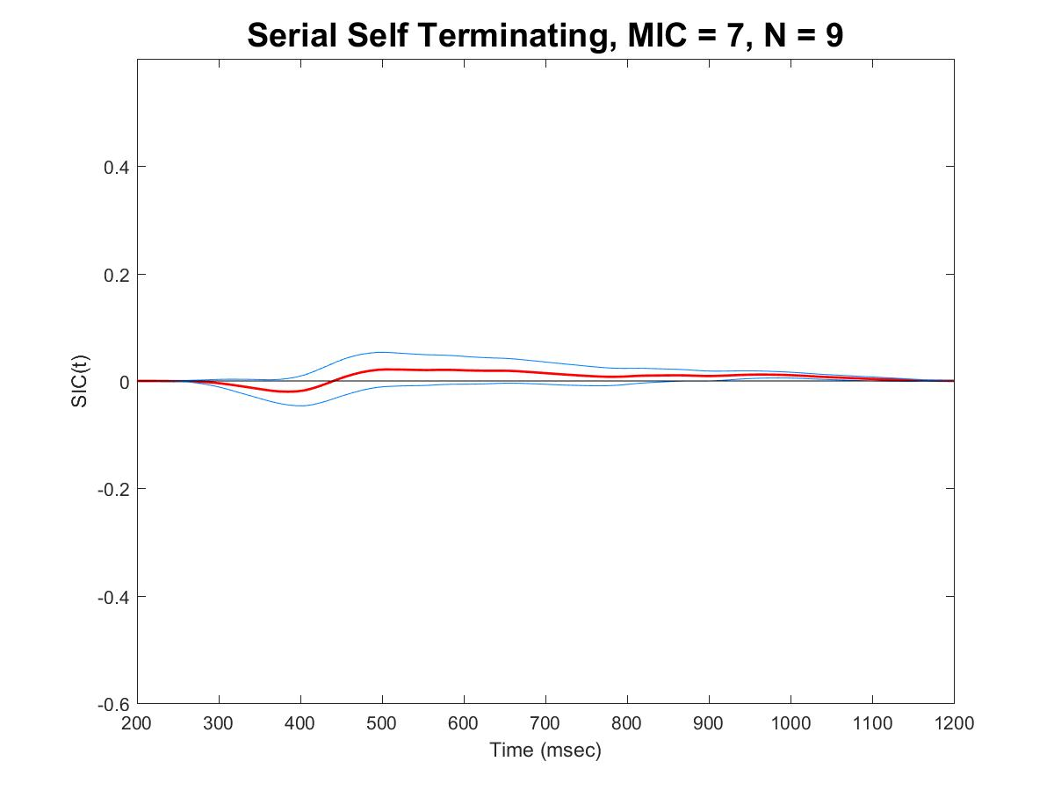
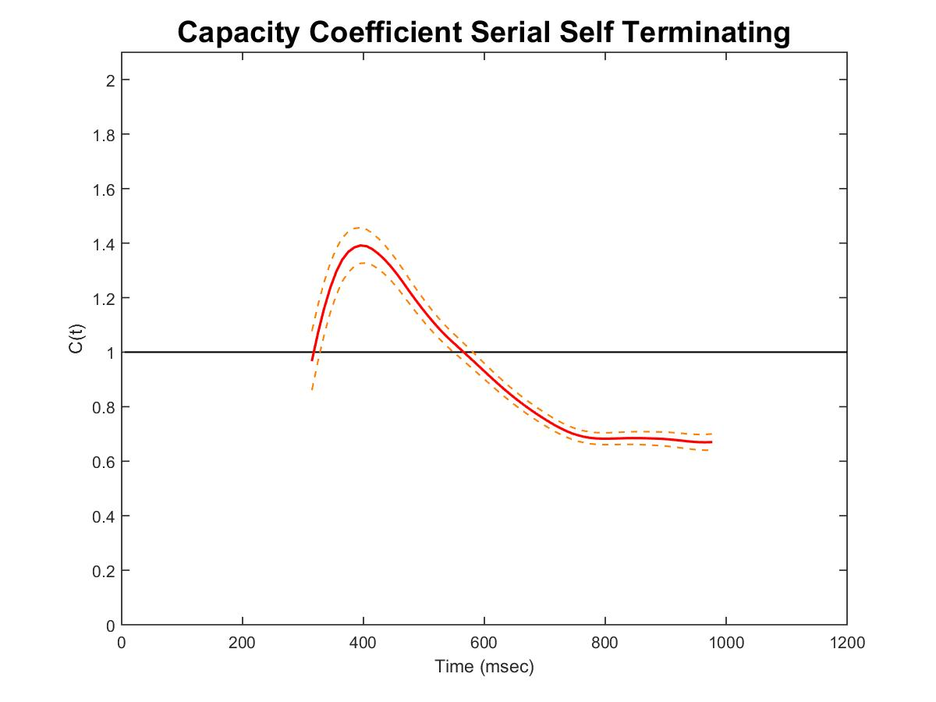
Paul Garrett
Experiment Two –
Predictive Area Across Trials
The University of
Newcastle Australia
Experiment Two – Predictive Area Across Trials
Notes:
In experiment two we kept the total Area of Both Colour Sets equal both within and across trials. In this way, area was totally predictive of each colors Set Size even though the radii of the dots varied.
Upon SFT analysis of Nine People, we found that processing was purely Effortless and Serial. Now, unlike the findings from our previous experiment, this Serial Processing was not the result of Serial Subtizing. It was due to participants being able to look for the biggest dot and self-terminate once they assessed it.

Slide 16
Paul Garrett
Results – Experiment Two
Conclusion – Experiment Two
Experiment | Criterion Three | Capacity | Criterion Four | Capacity
Evenly Sized Dots | Serial / Parallel | Unlimited / Super | Serial / Parallel | Unlimited / Super
Predictive Surface Area | Serial | Unlimited | Serial | Unlimited
Low level perceptual covariates, such as Surface Area, are preferred over strategies of Groupitizing or Subitizing if they hold reliable information about quantity.
Against Halberda, Sires & Feig’s (2006) predictions, this process was Serial and most likely does not drive Parallel Groupitizing.
The University of
Newcastle Australia
Conclusions
Notes:
Again we tested this with a Criterion of Four Dots and found the same results. What we concluded was that Low Level Pserceptual Covariates, such as Surface Area, are preferred over strategies of Groupitizing or Subitizing, if they hold reliable information about quantity.
Against Halberda, Sires and Feig’s predictions, this process was Serial in nature, and most likely was not driving Parallel Groupitizing.

Slide 17
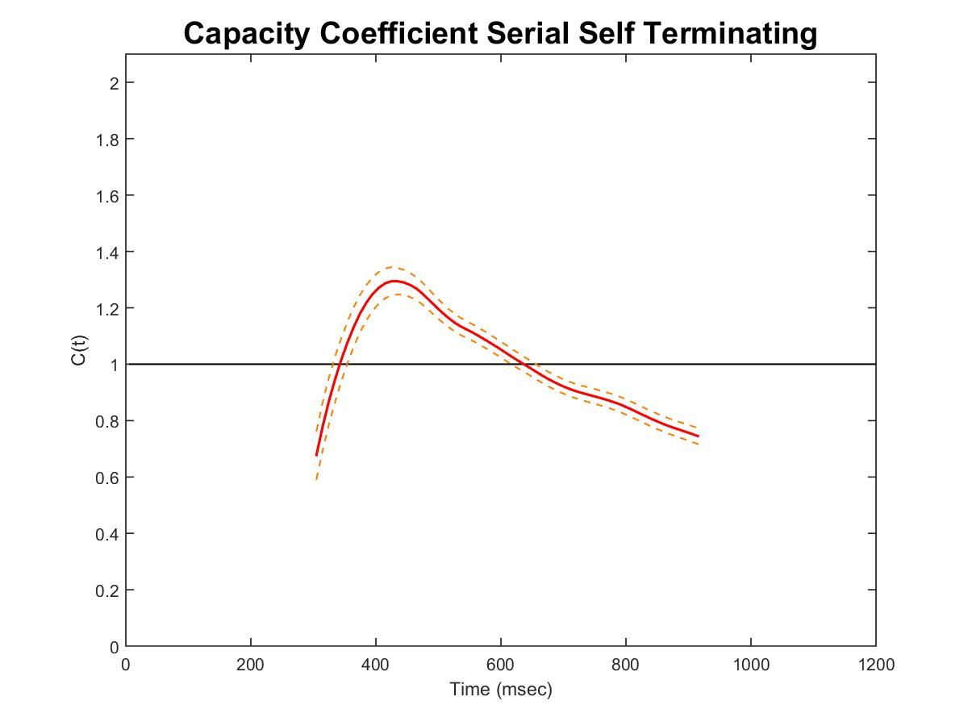
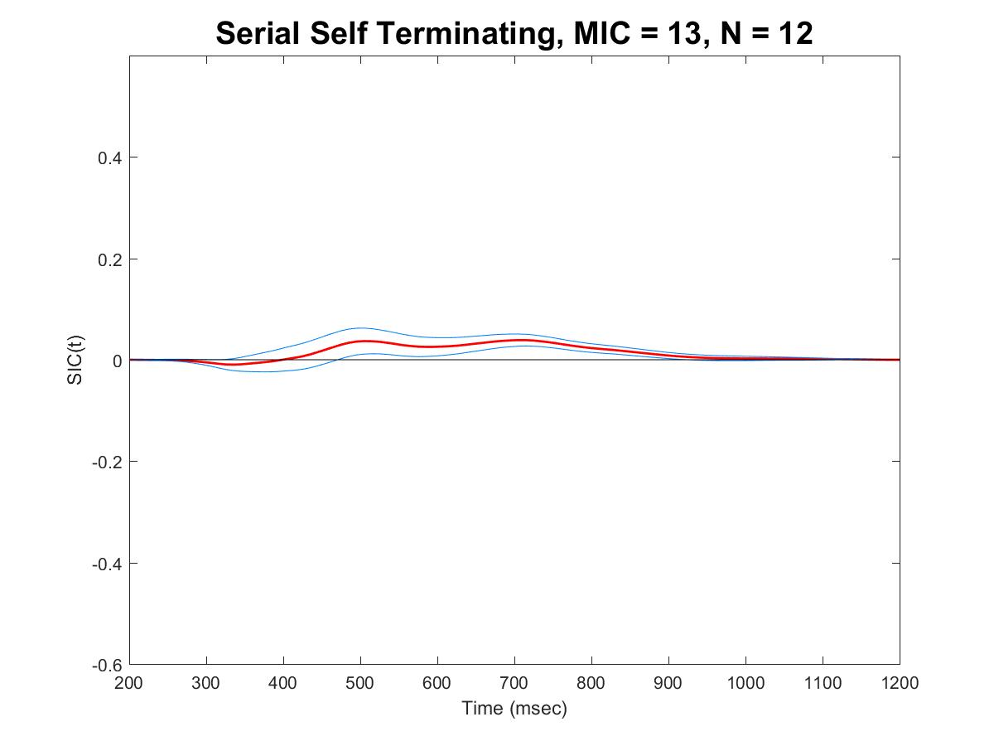
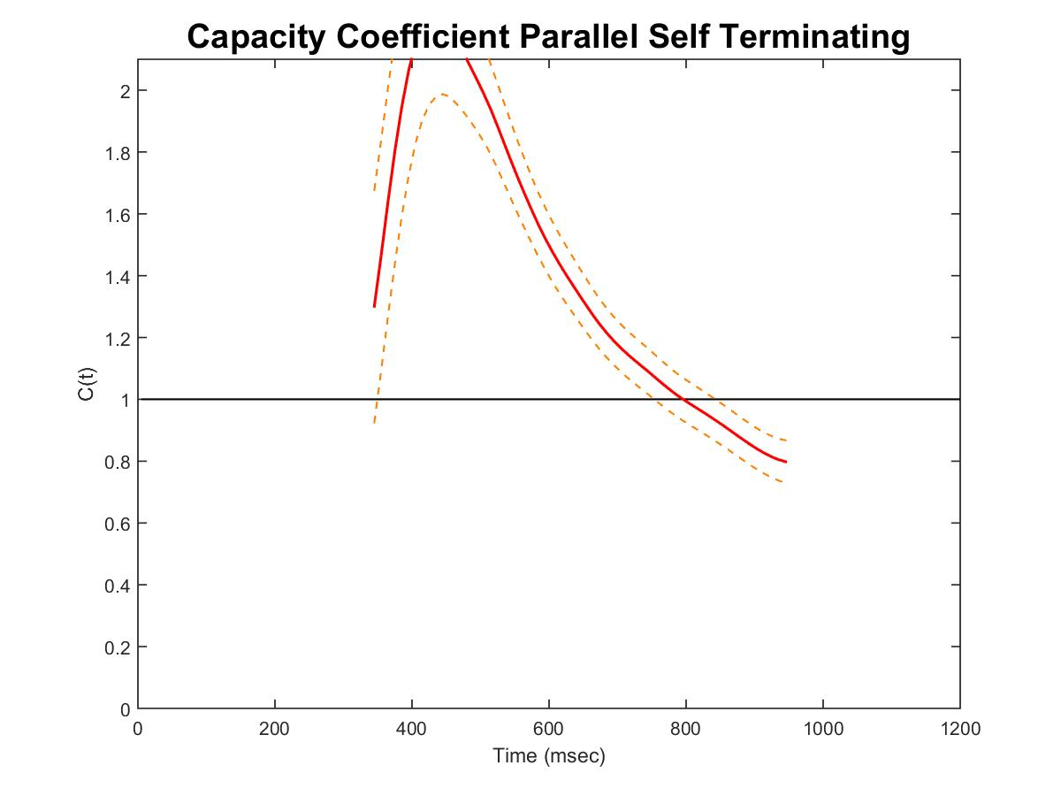
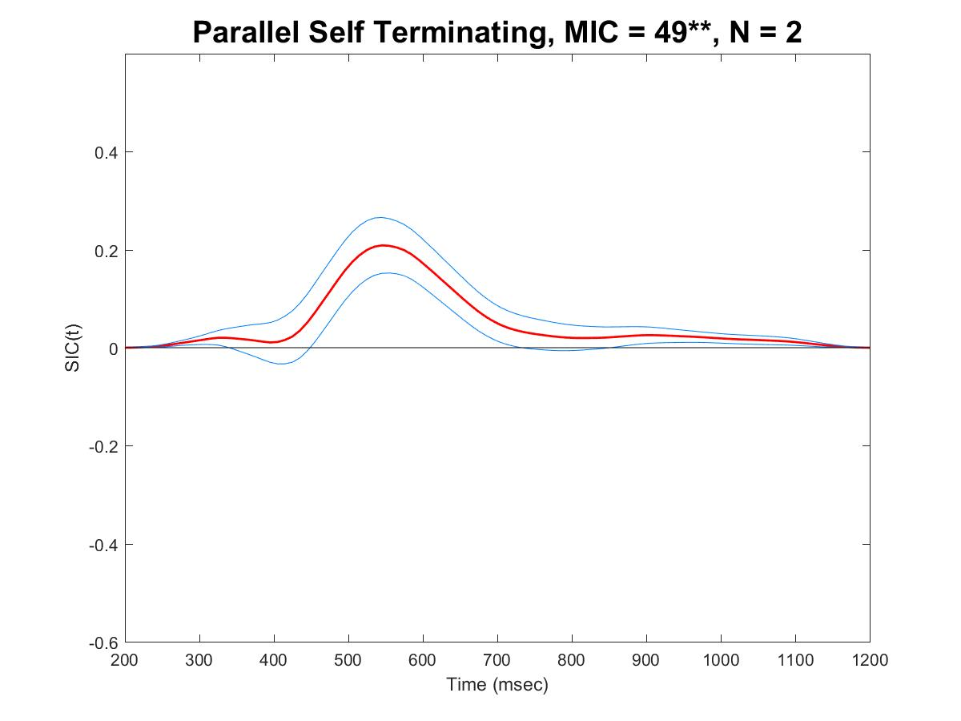
Paul Garrett
Experiment Three –
Non-Predictive Area Across Trials
The University of
Newcastle Australia
Experiment Three – Non-Predictive Area Across Trials
Notes:
Last but not least, this brings us to Experiment Three. Here we considered our findings from Experiment One and Two. We showed that Parallel Groupitizing was possible, and that it was not driven by lower level covariates; but we did not show that it was dependent upon the numerically based strategies. So for this experiment, we varied Area and Radii across trials, but kept the Colour Set area equal within a trial.
Results were strikingly similar to Experiment One. Twelve Participants used a Serial Subitizing Strategy, and Two a Parallel Groupitizing Strategy.
Again Capacity was effortless for Subitizing and once more, greater still for Groupitizing. RT was once more not significantly different across groups.

Slide 18
Paul Garrett
Results – Experiment Three
Conclusion – Experiment Three
Experiment | Criterion Three | Capacity | Criterion Four | Capacity
Evenly Sized Dots | Serial / Parallel | Unlimited / Super | Serial / Parallel | Unlimited / Super
Predictive Surface Area | Serial | Unlimited | Serial | Unlimited
Non-Predictive Surface Area | Serial / Parallel | Unlimited / Super | Serial / Parallel | Unlimited / Super
Parallel Groupitizing was found to be possible under forced conditions if there was no limit to the individual participants Capacity.
Most individuals show an upper bound to capacity, as such Serial Subitizing was the preferred strategy.
The University of
Newcastle Australia
Conclusions
Notes:
We repeated this with a Criterion of Four and found exactly the same thing, three Parallel and eight Serial.
From this we concluded that Parallel Groupitizing was possible under forced conditions if the individual showed no limit to Capacity.
Most individuals show an upper bound to capacity, and as such, Serial Subitizing was the preferred strategy.

Slide 19
Paul Garrett
Future Directions and Applications
- Can Parallel Groupitizing be Learned with Practice?
- Can Capacity be Expanded with Practice?
- Education and the teaching of Numbers
- High Workload Capacity Environments which require Easily Interpretable Signals
The University of
Newcastle Australia
Conclusions
Notes:
This brings us to our Future Directions and Further Applications.
The two questions we want to explore further from these studies are: Can Parallel Groupitizing be Learned with Practice? And can Capacity be Expanded with Practice? Using SFT, we are in a unique position to address these questions and maybe come up with some insightful answers.
Applications of this work extend into Education, where the concept of Groupitizing has already found a place in the American Education System. Although it is taught as a precursor to addition, it seems understanding this process better now might lead to better teaching practices in future.
Finally, this work lends itself to application in environments under High Cognitive Workload which require Easily Interpretable Signals and Quantities, jobs such as Air Traffic Controllers and Pilots.

Slide 20
Paul Garrett
Thankyou
The University of
Newcastle Australia
Notes:
That concludes my talk for today, thankyou all for listening. Please feel free to ask me any questions that you might have.

