Slide 1
Representation
Frank Mollica
22 September 2014
University of Rochester
Notes:
Given the historical readings, my goal is to address the questions: What do scientists mean when they say representation across time. I also want to briefly touch on the significance of representations for cognitive science.

Slide 2
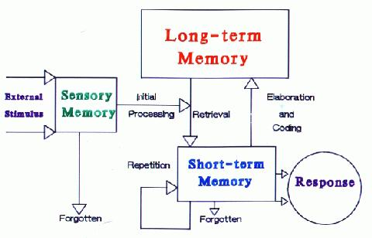
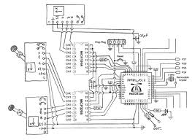
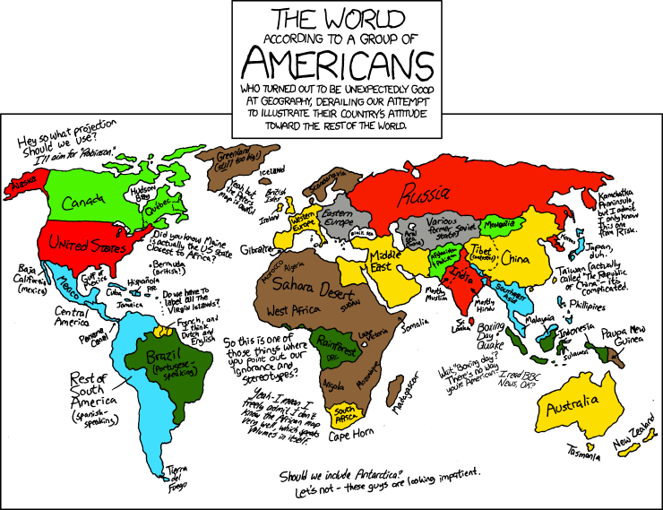
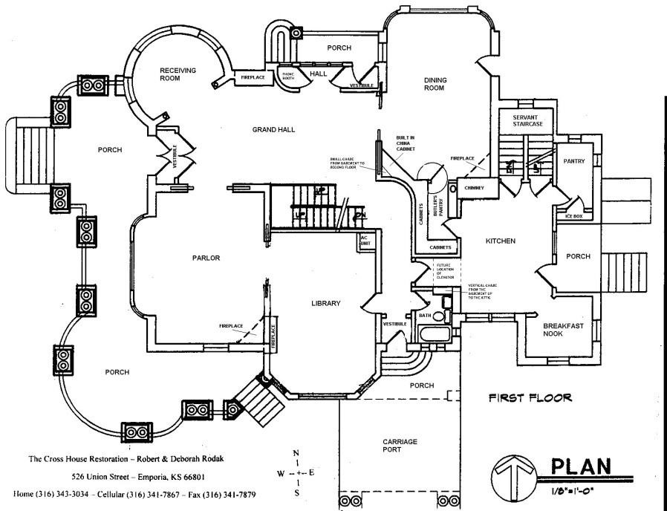
What do scientists mean when they say representation?

Slide 3
Ask a Structuralist . . .
There are a set number of elemental “states of consciousness” that can combine to explain consciousness.
or a Functionalist
There are a set number of elemental “processes of consciousness” that can combine to explain consciousness.
Watson (1913)
Notes:
To name a few: quality, extension, duration, intensity. But if you ask another order, clarity, etc.

Slide 4
Watson’s Criticism of the Field
Consciousness is the tool and the phenomena of study
Data only has value as it licenses the analogy to human consciousness
Non-replicability = Faulty Introspection
Watson (1913)

Slide 5
The Response
Redefine the domain of study.
Instead of focusing on introspective attributes, elements, or processes,
Focus on what can be seen
External Stimuli
Behavioral Responses
Stimulus
MIND
Response
Watson (1913)
Notes:
Basically we have removed internal mental representation from the domain of study!
Oh no, why am I standing here trying to talk to you about mental representations it’s all over!

Slide 6
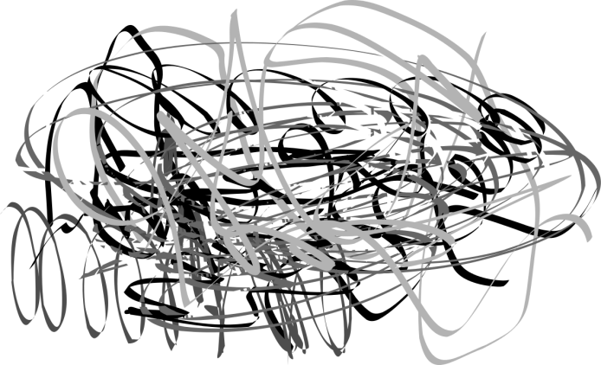

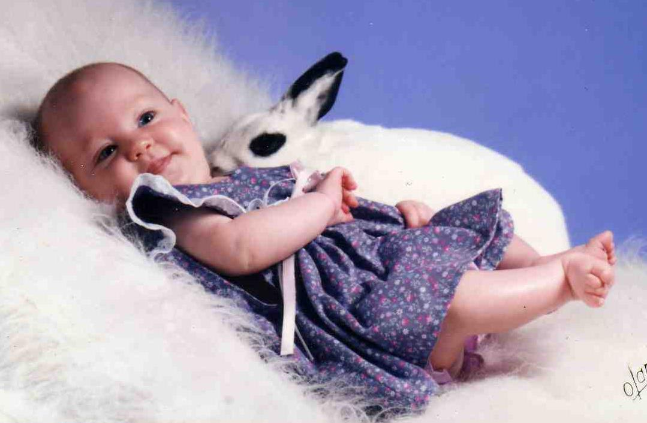

Epic Success!
*As long as you ignore ethical violations!
Watson & Rayner (1920)
Notes:
Little Albert (Watson & Rayner, 1920)
US → UR : loud noise → fear
NS → null : white rat → no response
US + NS → UR : white rat + loud noise → fear
Rinse and Repeat
CS → CR : white rat → fear

Slide 7
Operant Conditioning
Provided by a Random
Person on the Internet
Notes:
Statistical Rigor!
Does a good job!

Slide 8
Where Skinner Went Wrong
The behaviorist generalized their theory to a domain where it is very hard to reject the notion of internal representations: Language.
Chomsky (1959) ceremoniously critiques this thesis.
Notes:
If you haven’t read the supplemental, that is a classic paper in language and cognitive science.
Caveat about Strawmen!
The arguments for Skinner’s application to speech is well motivated when you look at the evidence he presents.

Slide 9
Terminology of Verbal Behavior
Controlling Stimulus – something in the environment that controls the response
Operants (Response) – “emitted responses, for which no obvious stimulus can be discovered.”
Chomsky (1959)
Notes:
Narrow (lawful): In the presence of a stimulus, a particular predictable response is realized.
Broad: Something in the environment caused the response.
The not obvious stimulus for operants is normally a reward?

Slide 10
Does it generalize to language?
“A group of cats is called a ‘clowder’. ”
Even if there was a controlling stimulus, how do we identify its response?
Answer: Post-hoc.
Displacement in language warrants internal representations
Chomsky (1959)
Notes:
What is the controlling stimulus of my random cat facts?
It is easy to build a strawman and knock it down, but by limiting the evidence Skinner used to build his argument, it is clear that he overgeneralizes his hammer.

Slide 11

Verbal Behavior: Reinforcement
Reinforcement— the outcome of an operant leads to a reward, which increases the response strength.
The problems is how to measure response strength?
Chomsky (1959)
Notes:
The application to speech was well motivated, the reinforcing quality of speech was it’s ability to affect changes in reality

Slide 12
Why the field could not explain Language
Drive Reduction – Rewards relieve a need
Language use can be drive reduction.
To explain all language though, we may need to posit drives.
The Curiosity Drive
Chomsky (1959)
Notes:
Putting Skinner and operant conditioning aside, the field believed that drive reduction could explain behavior (meaning no need for int rep)?
Bottom Line: Behaviorism cannot explain language. We need internal mental representations. And this was being acknowledged by certain “behaviorists”
Try and be at 15 minutes

Slide 13
Edward Tolman “The Behaviorist”
Two camps
Switchboard Operator (Reflex Chains)
↑ ↓ ↑ ↓ ← → ← → (B A …)
Field Maps (Internal Representations)
Latent Learning (Positive Evidence)
Latent Learning (Negative Evidence)
Searching for the Stimulus
Spatial Orientation
Tolman (1948)
Notes:
Positive Evidence means learning to reach X.
Negative Evidence means learning to avoid X.

Slide 14
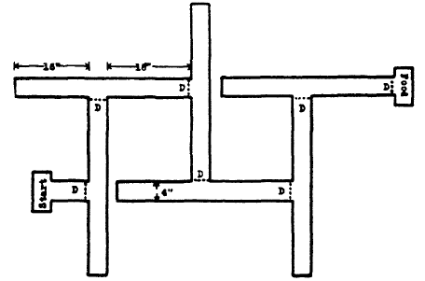

Latent Learning (Positive Evidence)
Group I
Group II
Group III
Blodgett (1929)
Notes:
One trial per day
Group I (Control) → Food @ goal every day
Group II (7 days) → Fed in cage for 6 days, food @ goal on day 7
Group III (3 days) → Fed in cage for 2 days, food @ goal on day 3

Slide 15
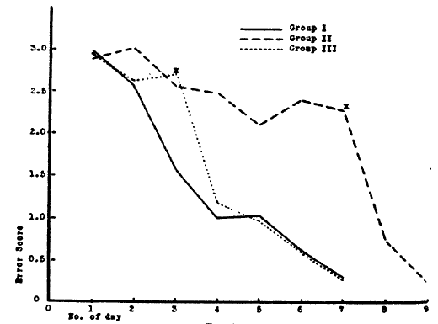
Latent Learning (Positive Evidence)
Blodgett (1929)

Slide 16

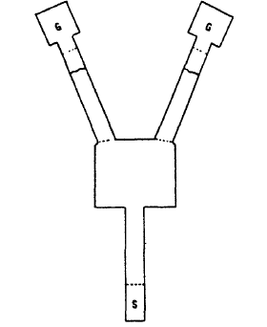
Latent Learning (Positive Evidence)
Spence & Lippitt (19XX)
Notes:
Always satiated before entry to maze. Reward for maze was friend time.
Trained for a week, 4 trials per day. Food and water were counterbalanced but more frequently in one location than the other.

Slide 17
Latent Learning (Negative Evidence)
Black Box
White Box
S
Tolman & Gleitman (1949)
Notes:
Forced exploration of both boxes
In the detached goal box, animals were shocked
Placed in the maze, most went to the non-aversive box.
Starved One mouse made the wrong decision, realized it before the box, squealed, became visibly distressed and eventually ran back the other way

Slide 18
What does this tell us about Representations?
Rats learn more than just the reflex chain!
But how far does this field representation or cognitive map go?
Notes:
Maybe, it might just be that the rats learned several reflex chains
Do we encode stimulus in the environments?
How deeply do we encode these stimuli
Stay tuned . . .

Slide 19
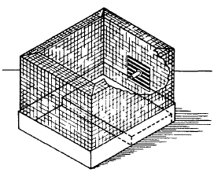
Searching for the stimulus
Hudson (19XX)
Notes:
Single Trial Avoidance.
Eat from pattern food → Shock → Avoidance
What they are avoiding?
Eat → Shock → Blackout + Pattern (disappear) → No Avoidance

Slide 20
What does this tell us about Representations?
Rats look for stimuli to encode into their cognitive map!

Slide 21
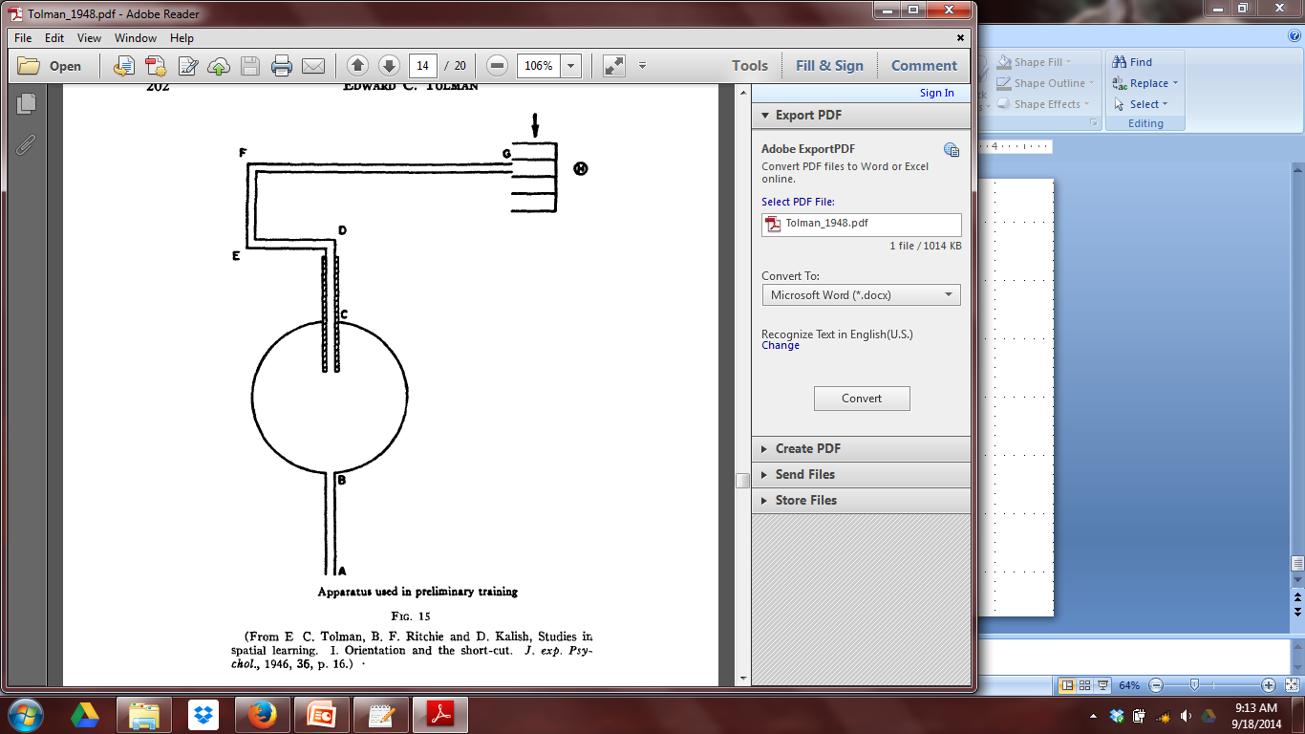
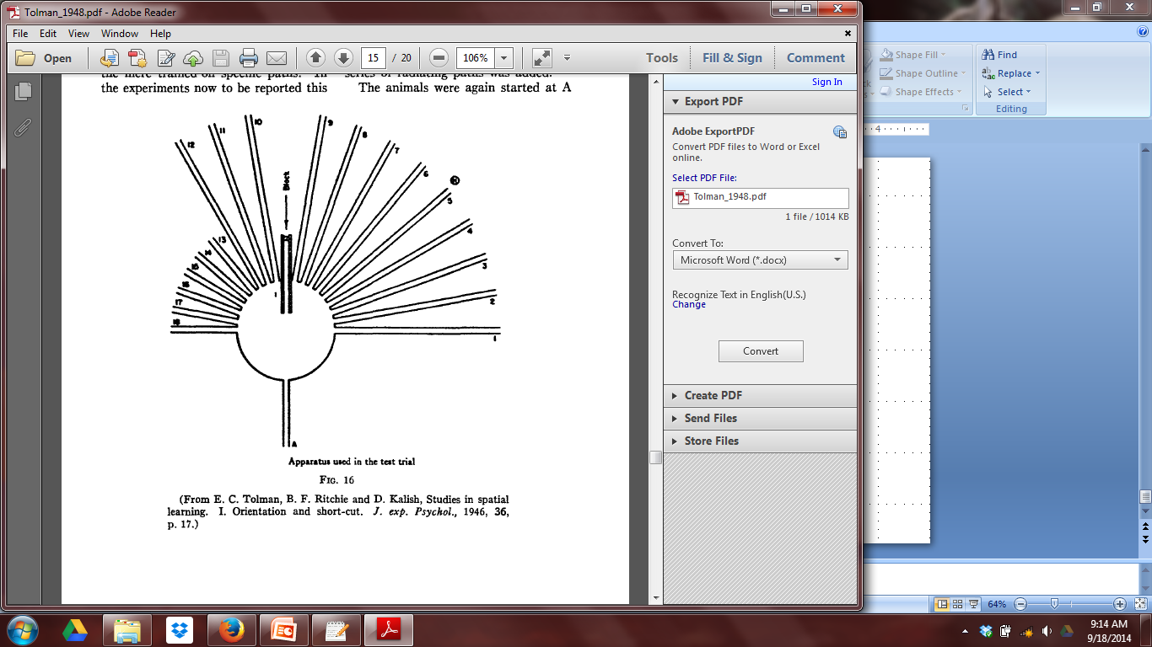
Spatial Orientation
Tolman, Ritchie & Kalish (19XX)
Notes:
Trained 4 nights, 3 trials per night on the left maze and food was rewarded
Then let loose into the mohawk maze. Walked a few inches and doubled back decided on 1 path.
Histo

Slide 22
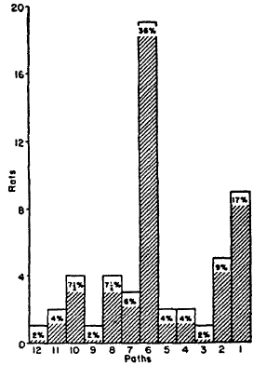
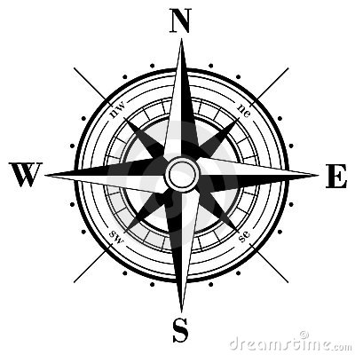
What does this tell us about Representations?
Rats encode maps, relevant stimuli and spatial orientation.
Cognitive Maps
Tolman, Ritchie & Kalish (19XX)
Notes:
Try and be at 25 minutes

Slide 23
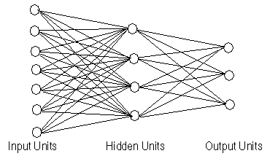
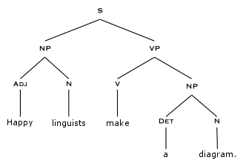
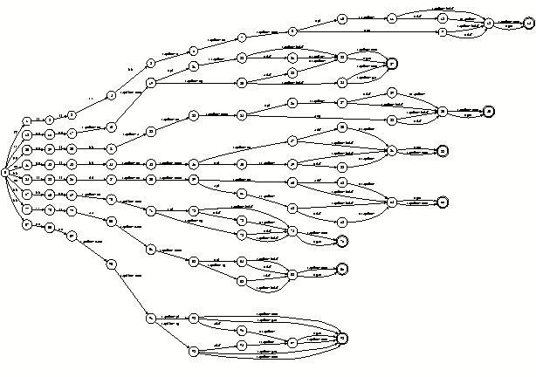
The Cognitive Revolution
( (CHAIR=C1)
(BACK=b1)
(SEAT=s1)
(LEGS=l1) )
Notes:
Connectionist Models
Feature Lists
Finite State Autotomata
Syntactic Tree Parsing

Slide 24
Formalizing Representations
Domain – World and the Representational Domain
Content – Features in the World encoded in Representational Domain
Code – Rules for relating features of the World and Content of the Representational Domain
Medium – Physical Instantiation of the Representation
Dynamics – How representations change
Roitblat (1982)
Notes:
Domain – World and the Representational Domain, but the representational domain is not the full picture of the world. It is delimited by things such as task or features. Why would we want to store the color of the maze? Why might we have wanted to store the illumination of the maze? Based on task, different things are considered in our representational structure.
Content – The features of the represented world that are preserved in representation and any dependecies or information that can be derived from it.

Slide 25



Case Study: Distributed Network Model of Semantic Memory
Domain: Identifying fake college students
Content: Book, backpack, smile, headphones, smart phone, hoodie
Code: Salient features get represented
Medium: <unspecified>

Slide 26
Case Study: Distributed Network Model of Semantic Memory
Head-
phones
Book
Scowl
Smart Phone
Smile
Ironic
T-Shirt
Glasses
Cynicism
Hoodie
Plaut & Bootj (2000)

Slide 27
Criticisms of Amodal Models
They are not grounded representations
There is no straightforward biologically plausible coding mechanism
Explanatory Power is post-hoc
Not parsimonious
Models do not generate hypotheses
Barsalou (1999)
Notes:
Caveat – Strawman coming up!
This is actually oversimplification (assumed the brain and Hebbian learning) but that is how most strawmen are formed in the introduction of a paper.
Issue of Medium

Slide 28
Case Study: Perceptual Symbol Systems
Domain: Identifying fake college students
Content: Same as before
Code: Selective attention picks out features
Medium: Areas of the brain corresponding to perception and motion
Dynamics: Features are converted into simulators
Barsalou (1999)
Notes:
Not a recording system but an actual conceptual system

Slide 29

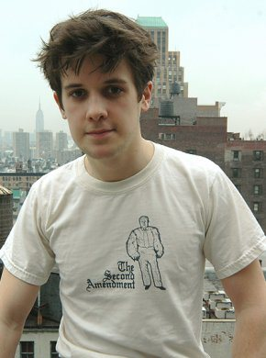

Case Study: Perceptual Symbol Systems

Slide 30
Why are representations useful?
Cognitive scientists propose representation at both the computational and algorithmic level of explanation (Marr, 1982) with the intent that neuroscientists will eventually be able to provide explanations at the implementational level.
Notes:
Having representations and proposing changes in representations via mental processes informs the questions that cognitive neuroscientists ask.
Try and be at 33 minutes

Slide 31
Conclusions
What is a representation?
Barsalou’s
Grounded
Cognition
Structuralist &
Functionalists
Tolman’s
Cognitive Maps
Cognitive
Revolution
Watson’s
Behaviorism
Chomsky’s
Review
Roitblot’s
Metatheory

Slide 32
Conclusions
Structuralists & Functionalist
There are a set number of elemental “states / processes of consciousness” that can combine to explain consciousness.
Watson’s Behaviorism
Complete rejection of internal mental representations
Introduced meaningful applications of psychology to the world.

Slide 33
Conclusions
Tolman’s Cognitive Maps
Rats have internal mental representations, or cognitive maps that include relevant stimuli and are not fixed in spatial orientation.
Skinner’s Verbal Behavior & Chomsky’s Review
While Skinner’s generalization of operant conditioning to language has modest evidence, language cannot be completely explained without internal mental representations.

Slide 34
Conclusions
The Cognitive Revolution
Multiple models, or representational systems, were created based on analogies made to programming languages, linguistics, and formal logic.
Most of these models are amodal.

Slide 35
Conclusions
Roitblot’s Metatheory of Representation
Domain- the world and the task to be modeled
Content- the features of the world represented in the model
Code- the rules to go from features in the world to features in the model and vice versa
Medium- the physical instantiation of the model
Dynamics- how representations change over time

Slide 36
Conclusions
Barsalou’s Embodied Cognition
Amodal models typically do not specify their medium.
Amodal models do not always specify biologically plausible methods of encoding representations
The Embodied Cognition Hypothesis specifies medium and biological encoding as the perceptual system.
Notes:
Summarizing with the weaker hypothesis

Slide 37
Conclusions
Why have representations?
Representations bridge the gab between Cognitive Science and Neuroscience

