Slide 1
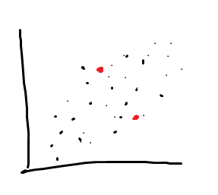
Kmeans
Is a method of putting data into groups.
This is done by:
finding random values x

Slide 2
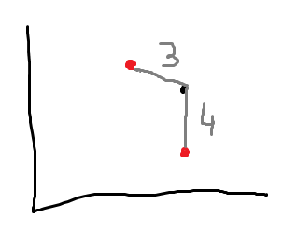
kmeans
Calcuating the mean to all values from x and picking the x closest to each value

Slide 3
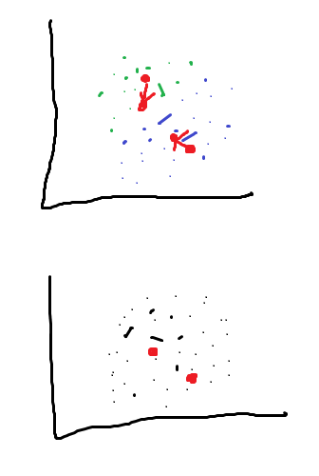
kmeans
Find the center point of the cluster
Drop the values and redo until the new calculation of the center point is the same as the last one

Slide 4
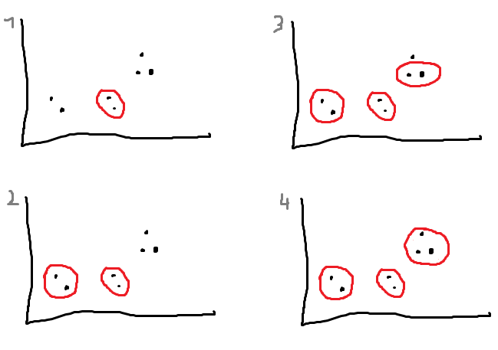
Hierachical Clustering
Find two closest points and group them
Then find the next closest points and join them and if the distance is to far stop.

Slide 5
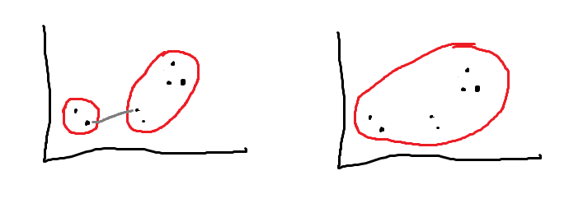
Hierachical Clustering

