Slide 1
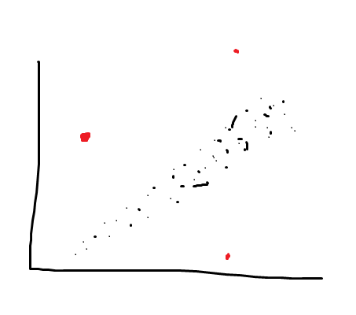
An outlier is any data point that is distinctly different from the rest of the data points (seen in red).

Slide 2
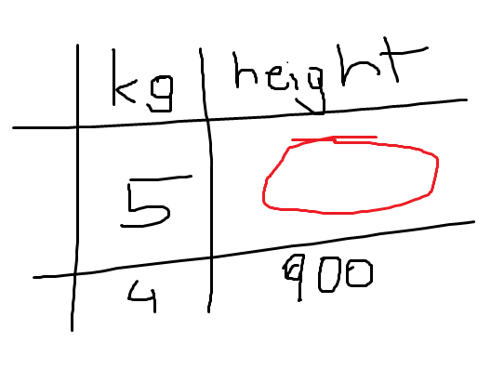
Missing values are dataentries in a dataset that are not present in said dataset

