Slide 1
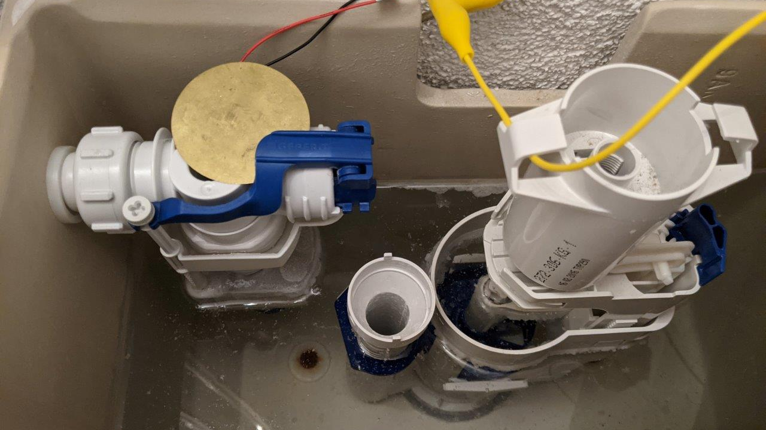
Water saving and leakage Protection System Semesterproject Group02 - HS2020 Bosshard Nico, calovic Alexandar, Kozlov Victor, Stofer Stephan

Slide 2
Agenda
Intro
Project Organisation
Integrated Circuits
ESP32
Raspberry Pi

Slide 3
Intro
Some Intro

Slide 4
Project Organisation
Defined structure and roles

Slide 5
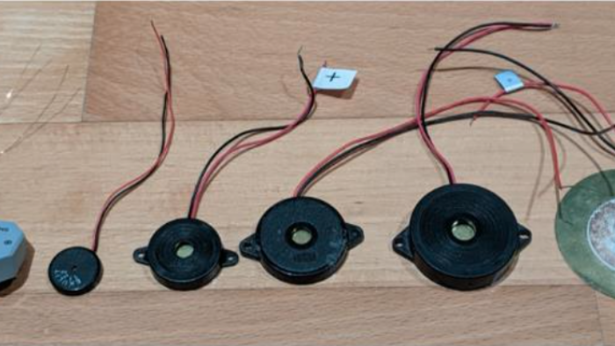
Integrated Circuits

Slide 6
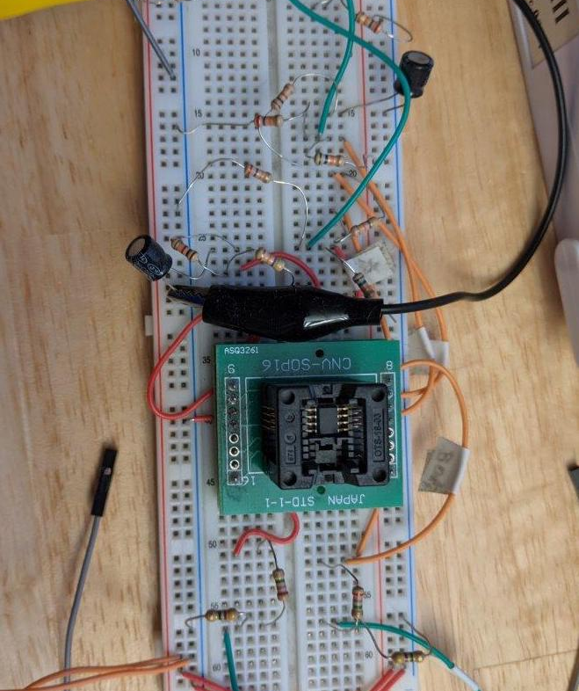
Integrated Circuits
Text for

Slide 7
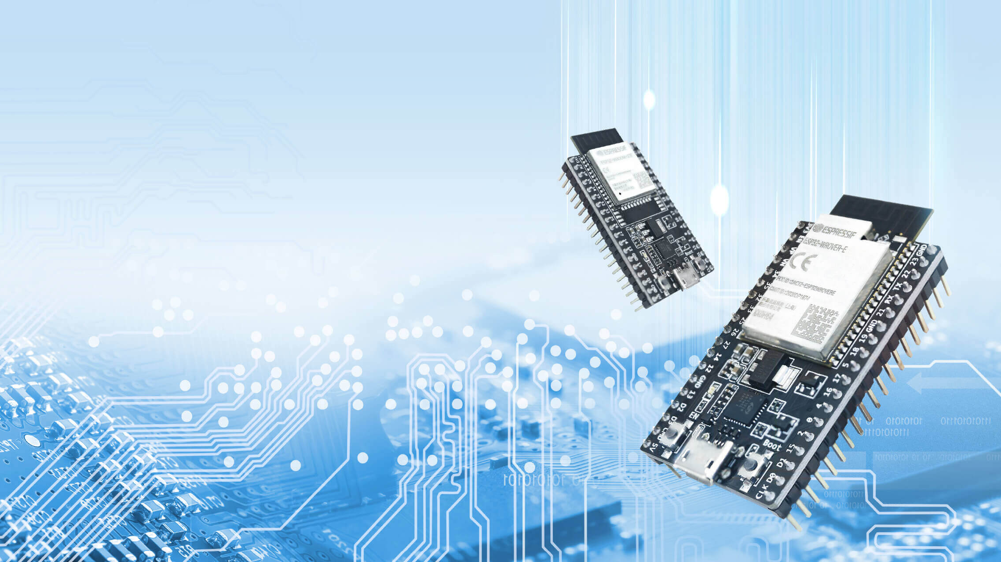
Espressif ESP32

Slide 8
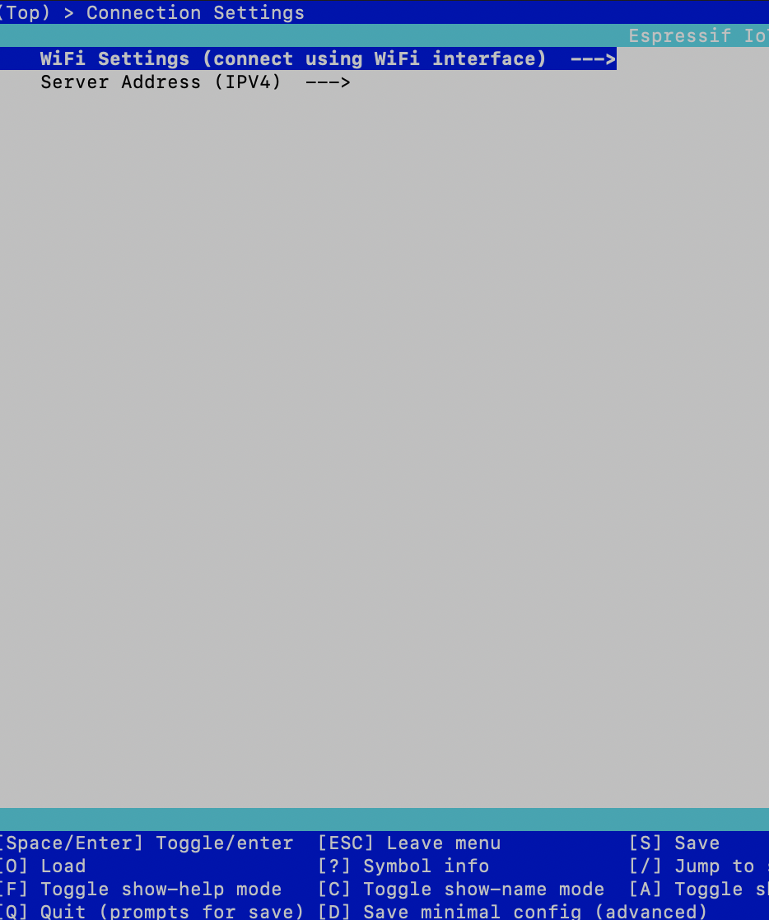
ESP32 Configuration
WiFi Settings and Server-Address is configurable through terminal with command «idf.py menuconfig»
IDF-Environment required

Slide 9
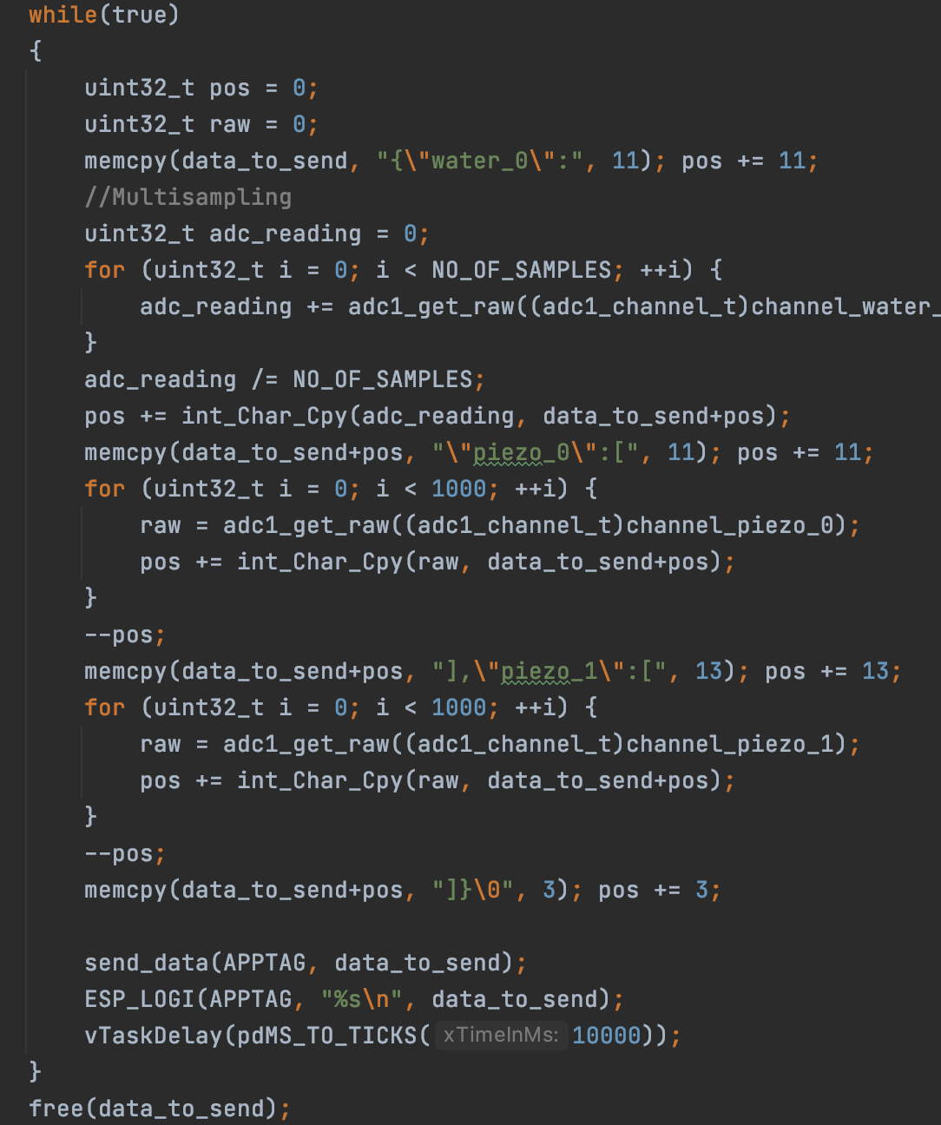
ESP32 Application
Consists of 3 Basis Modules
ADC Reader
WiFi connector establish connection to an Access Point
TCP-Client transmits data through TCP Sockets
Sleep Mode

Slide 10
Backend Server
Implemented in Python
Sends email if threshold is exceeded
blabla

Slide 11
Frontend
Shows latest logged measures
Implemented in angular

Slide 12
Techstack
LANGUAGES
C++
Python
Typescript
FRAMEWORKS
Espressif
Angular
HARDWARE
ESP32
Raspberry Pi zero
Piezo Sensors
Voltage pulse circuits

Slide 13
Questions
Thank you for your attention
Group02, HS2020

