Slide 1
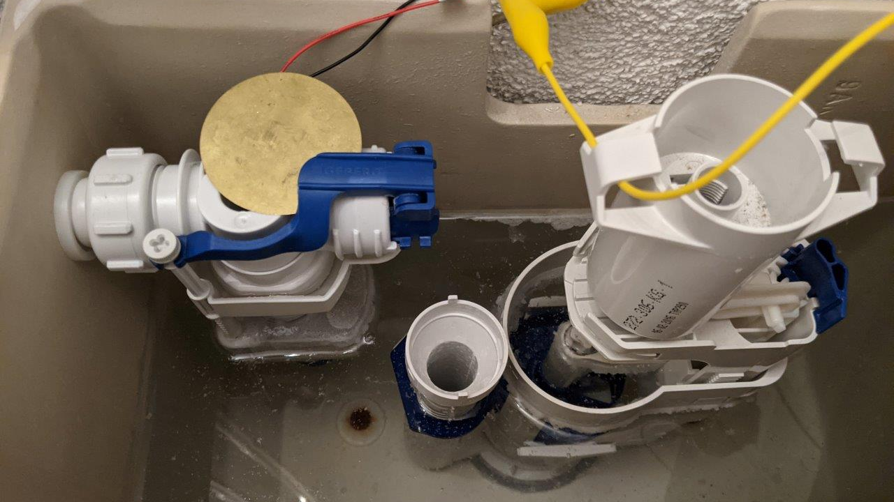
Water saving and leakage Protection System Semesterproject Group02 - HS2020 Bosshard Nico, calovic Aleksandar, Kozlov Victor, Stofer Stephan

Slide 2

AGENDA
Introduction
Integrated Circuits
Sensors
ESP32
Server
Frontend

Slide 3
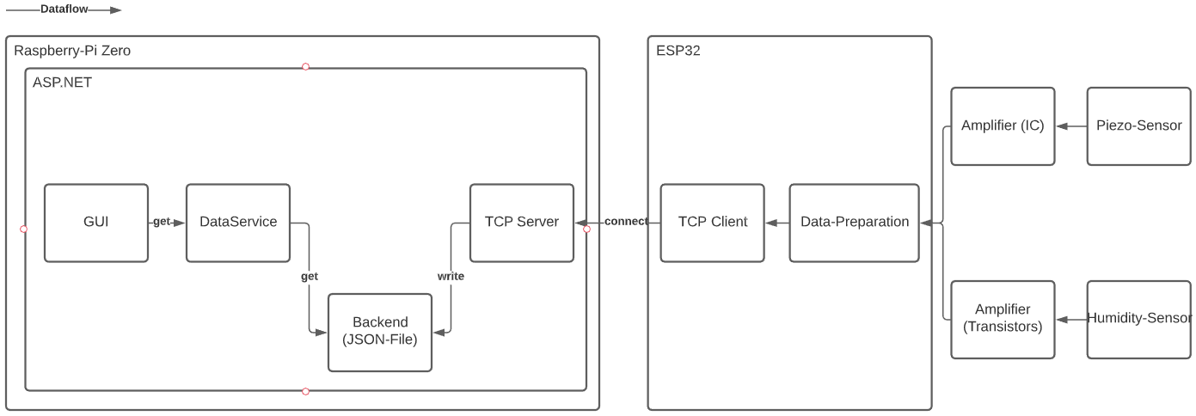
IntroDUction

Slide 4
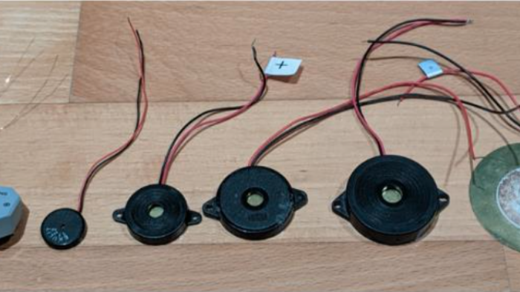
Integrated Circuits

Slide 5
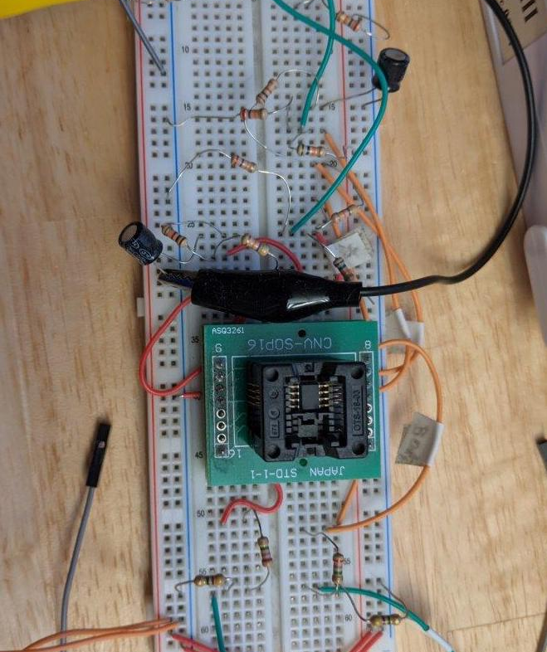
Integrated Circuits
Text for

Slide 6
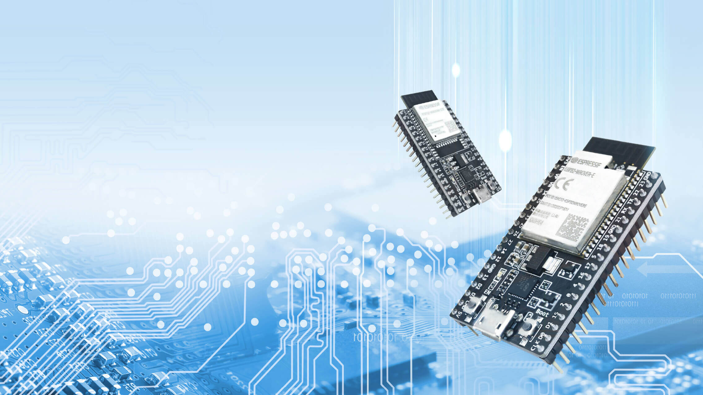
Espressif ESP32

Slide 7
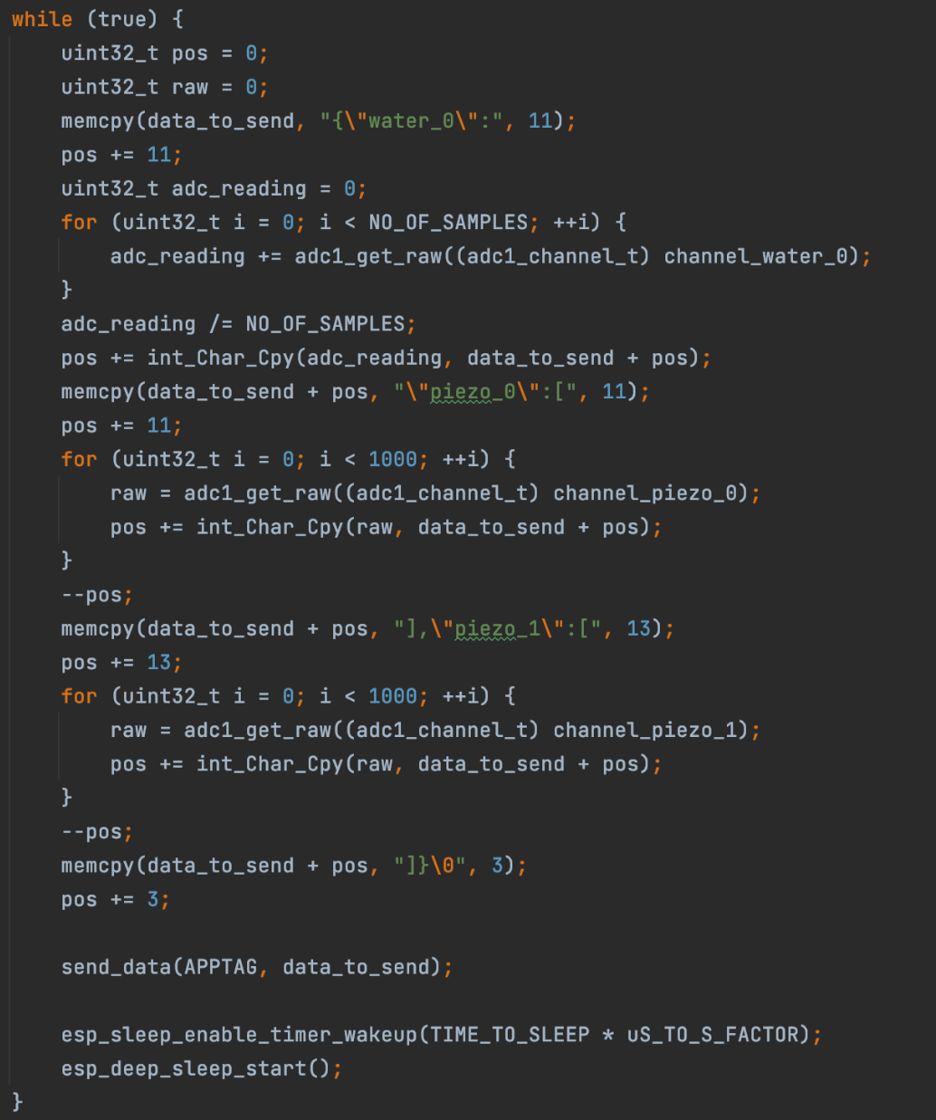
ESP32 Application
Consists of 3 Basis Modules
ADC Reader measure sensors
WiFi connector establish connection to an Access Point
TCP-Client transmits data through TCP Sockets

Slide 8
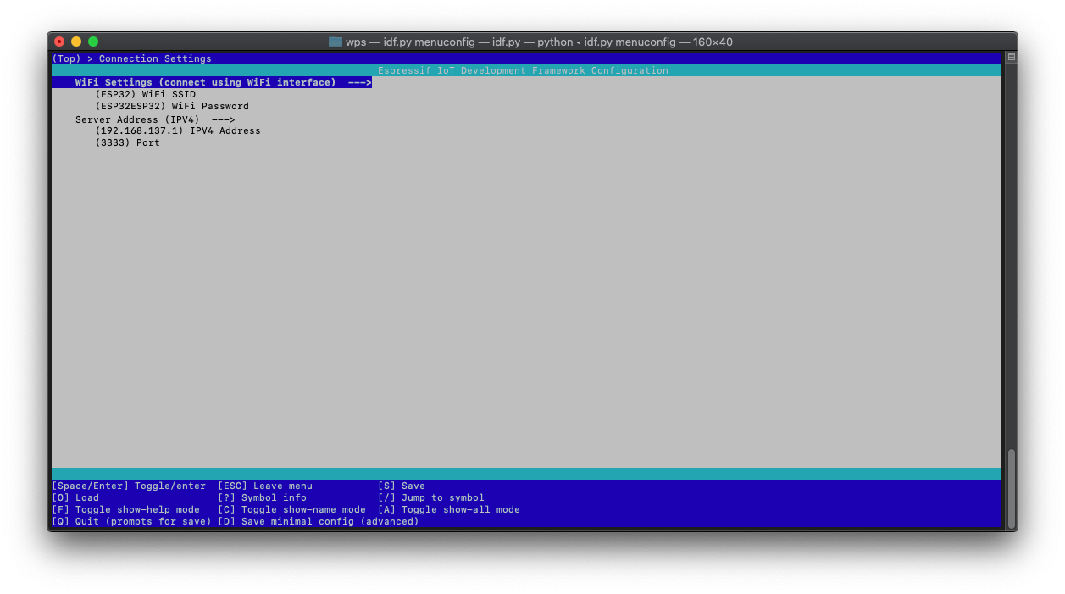
ESP32 Config
WiFi Settings
Server Address

Slide 9
Backend Server
Implemented in .NET Core
Receives TCP packages from ESP32
Sends email if threshold is exceeded

Slide 10
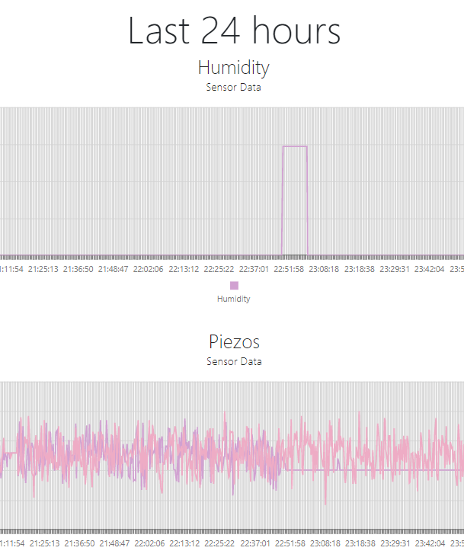
Frontend
Shows whole measurement history and last 24h history in a chart
Implemented in ASP.NET Core
Hosted on Raspberry Pi 0 W
Buildable for all plattforms (inclusive Linux)

Slide 11
Demonstration
Thank you for your attention
Group02, HS2020

