Slide 1
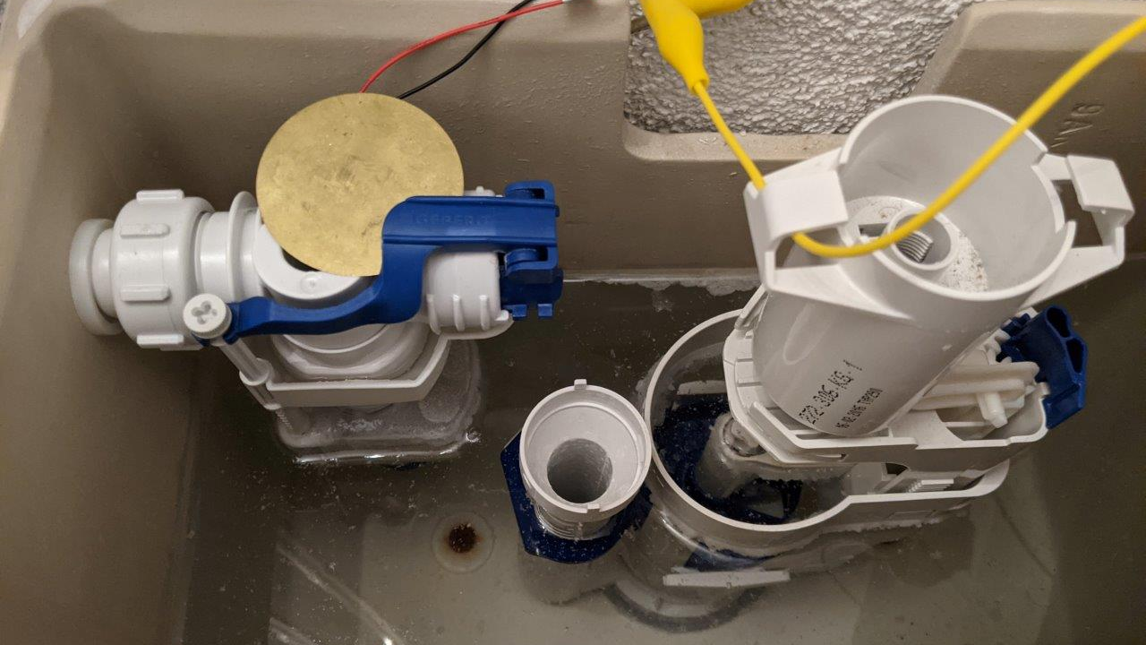
Water saving and leakage Protection System Semesterproject Group02 - HS2020 Bosshard Nico, calovic Alexandar, Kozlov Victor, Stofer Stephan

Slide 2
Project Organisation
Defined structure and roles

Slide 3
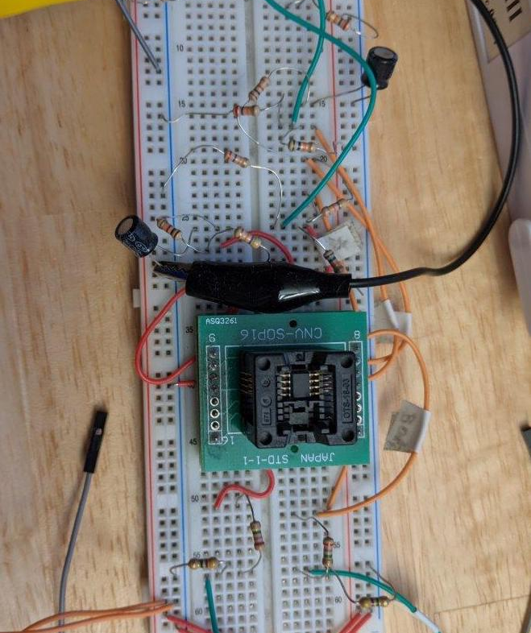
Integrated Circuits
Text for

Slide 4
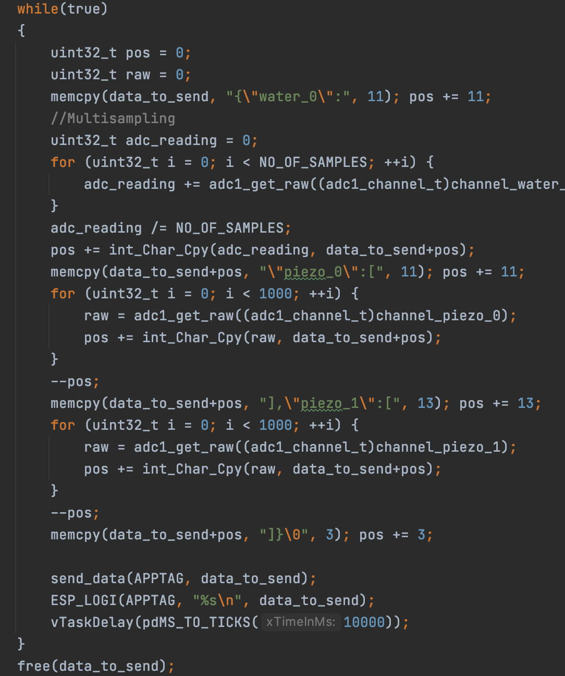
ESP32 Application
Consists of 3 Basis Modules
Reader on ADC Pins
TCP-Client transmit data through TCP Sockets
WiFi connector establish connection to Access Point

Slide 5
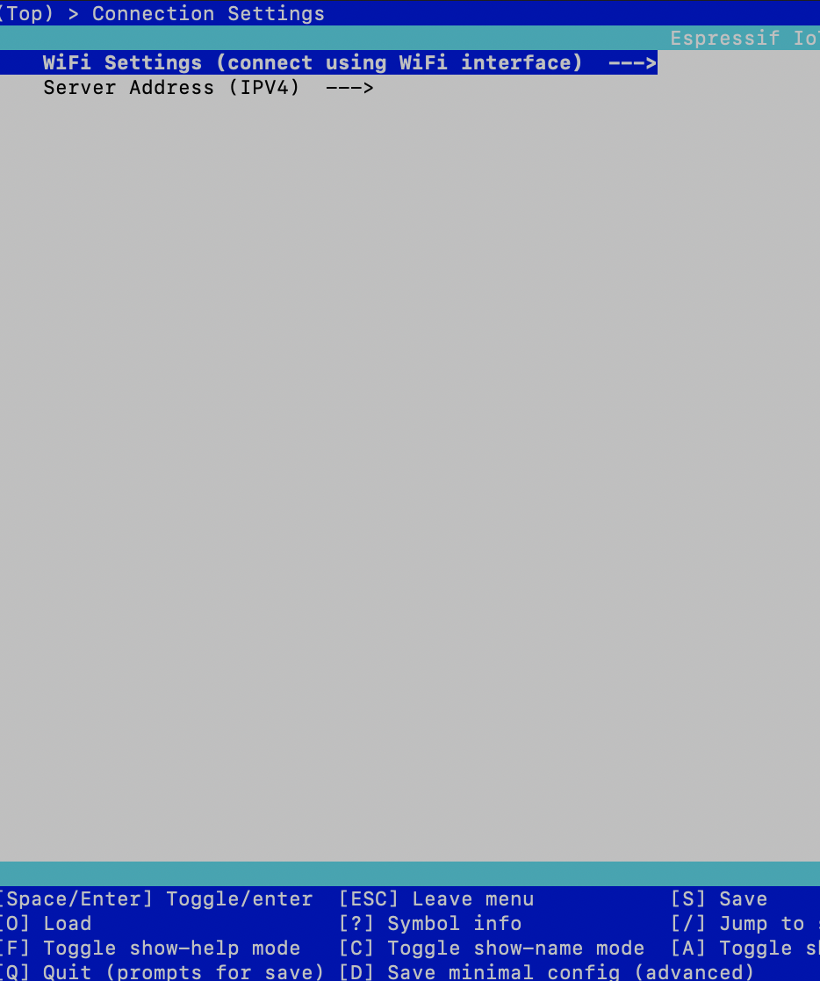
ESP32 Configuration
WiFi Settings and Server-Address is configurable through terminal command idf.py menuconfig
IDF-Environment required

Slide 6
Backend Server
Implemented in Python
Sends email if threshold is exceeded
blabla

Slide 7
Frontend
Shows latest logged measures
Implemented in angular

Slide 8
Techstack
LANGUAGES
C++
Python
Typescript
FRAMEWORKS
Espressif
Angular
HARDWARE
ESP32
Raspberry Pi zero
Piezo Sensors
Voltage pulse circuits

Slide 9
Questions
Thank you for your attention
Group02, HS2020

