Slide 1
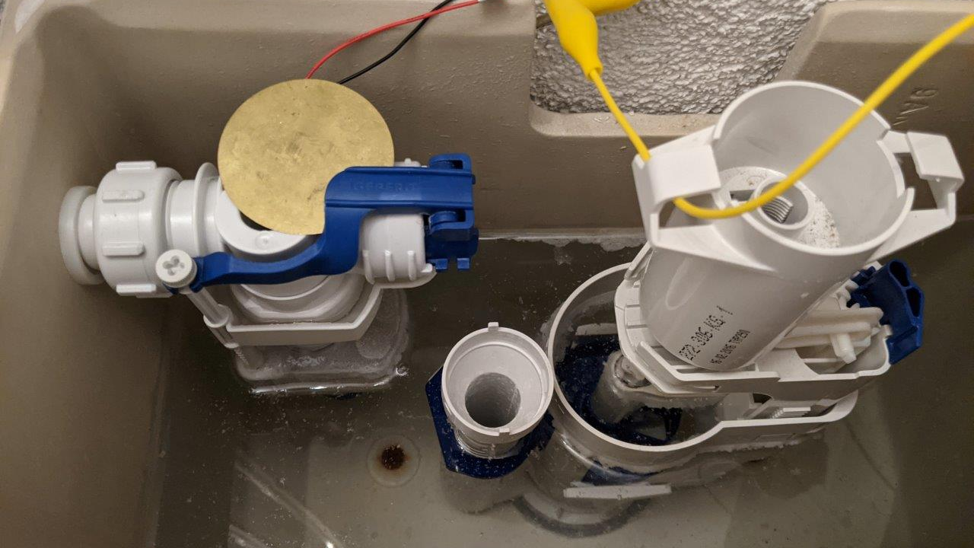
Water saving and leakage Protection System Semesterproject Group02 - HS2020 Bosshard Nico, calovic Alexandar, Kozlov Victor, Stofer Stephan

Slide 2
Agenda
Intro
Project Organisation
Integrated Circuits
ESP32
Raspberry Pi

Slide 3
Intro
Some Intro

Slide 4
Project Organisation
Defined structure and roles

Slide 5
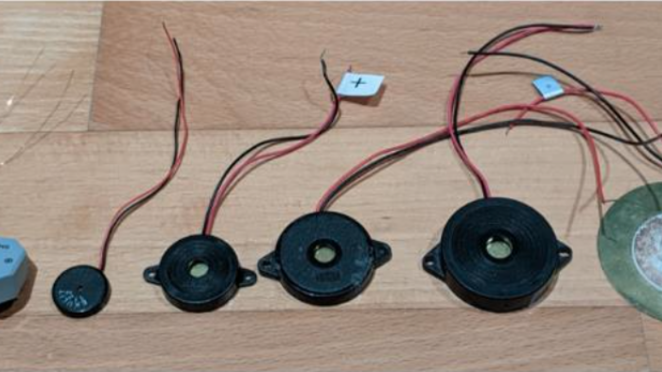
Integrated Circuits

Slide 6
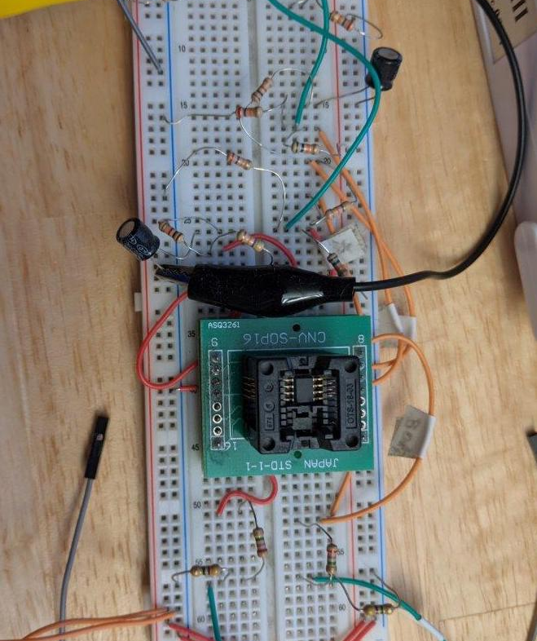
Integrated Circuits
Text for

Slide 7
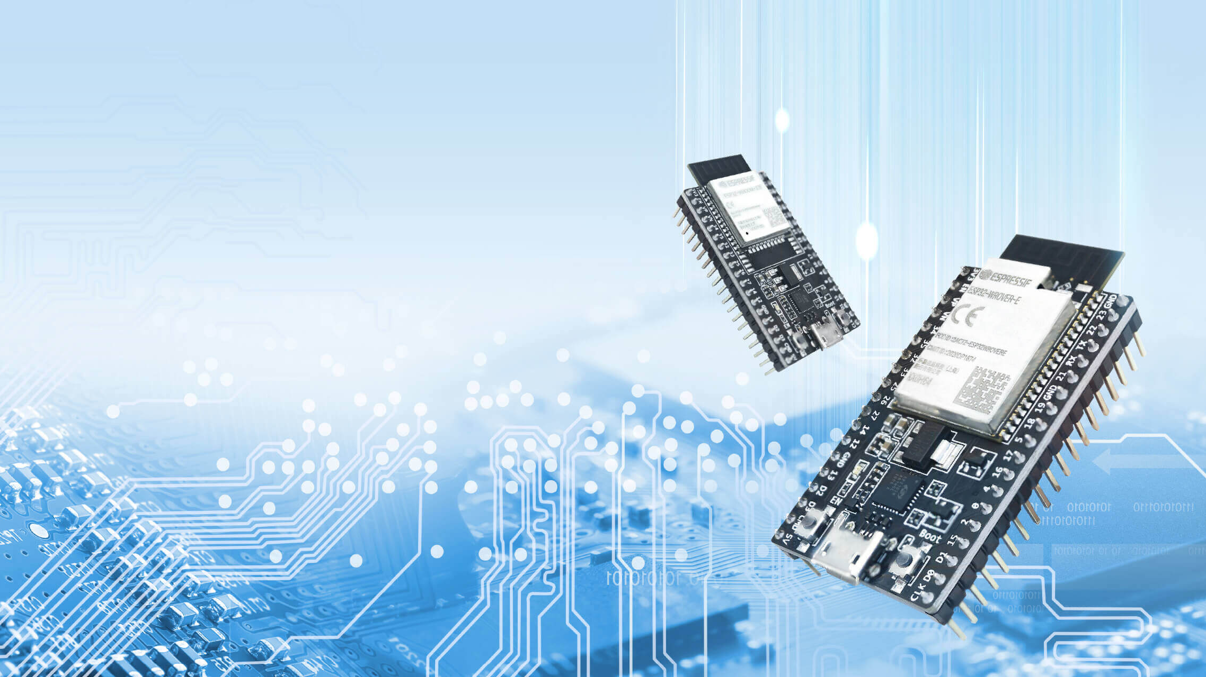
Espressif ESP32

Slide 8
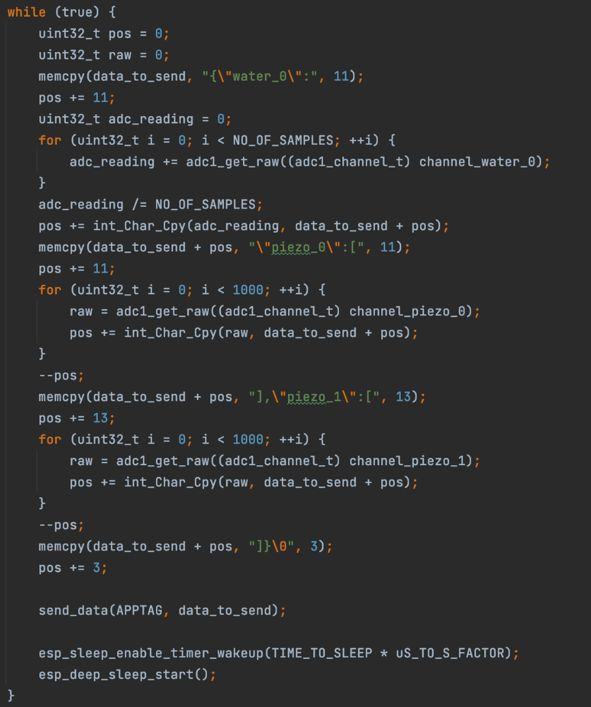
ESP32 Application
Consists of 3 Basis Modules
ADC Reader measure sensors
WiFi connector establish connection to an Access Point
TCP-Client transmits data through TCP Sockets

Slide 9
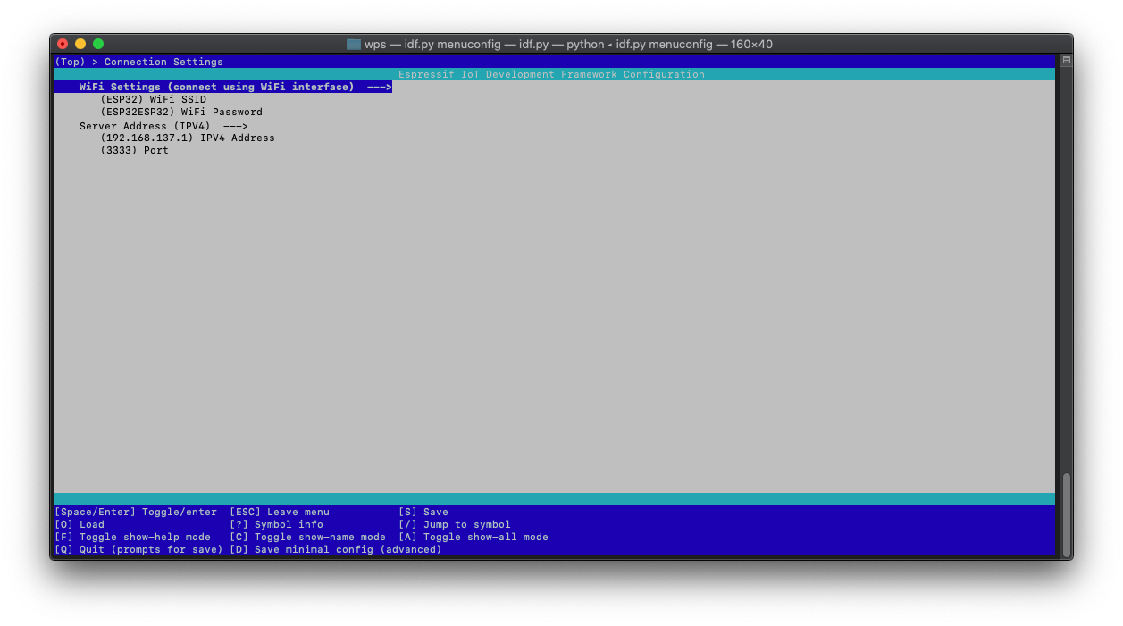
ESP32 Config
WiFi Settings
Server Address

Slide 10
Backend Server
Implemented in .NET Core
Receives TCP packages from ESP32
Sends email if threshold is exceeded

Slide 11
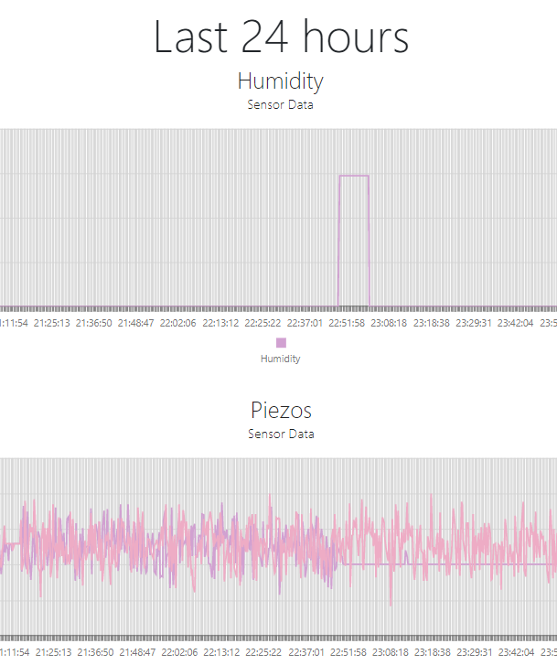
Frontend
Shows whole measurement history and last 24h history in a chart
Implemented in ASP.NET Core
Hosted on Raspberry Pi 0 W
Buildable for all plattforms (inclusive Linux)

Slide 12
Techstack
LANGUAGES
C++
Python
Typescript
C#
FRAMEWORKS
Espressif
.NET Core
ASP.NET Core
HARDWARE
ESP32
Raspberry Pi zero
Piezo Sensors
Voltage pulse circuits

Slide 13
Questions
Thank you for your attention
Group02, HS2020

