Slide 1
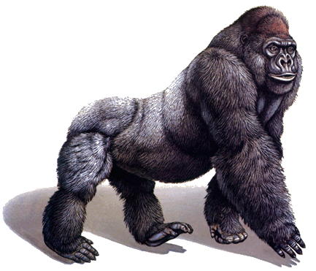
GO enrichment and GOrilla
Roy Navon
Agilent Labs
Tel-Aviv

Slide 2
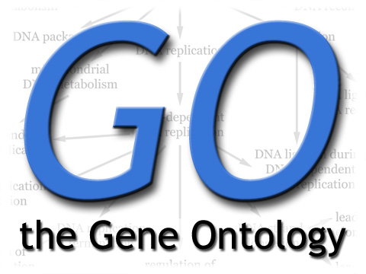
Gene Ontology (GO)
The Gene Ontology (GO) project is a major bioinformatics initiative with the aim of standardizing the representation of gene and gene product attributes across species and databases.
These GO terms are represented in an hierarchical manner as a Directed Acyclic Graph (DAG).
Most GO terms contain several genes and each gene may belong to several GO terms.

Slide 3
Gene Ontology (GO) - 2
The ontology covers three domains:
  cellular component, the parts of a cell or its extracellular environment such as rough endoplasmic reticulum or nucleus.
  molecular function, the elemental activities of a gene product at the molecular level, such as binding or catalysis.
  biological process, operations or sets of molecular events with a defined beginning and end, such as cell cycle or immune response.

Slide 4
Motivation
Current high throughput experiments (such as microarrays) often generate gene lists as a result.
Instead of analyzing these genes one by one, a more global approach can be used.
We can use to GO database to find genes with a common annotation in our data.

Slide 5
GO Enrichment Tools
Several tools that perform GO enrichment are currently available.
Most of these tools require as input a target set of genes and a background set and seek enrichment in the target set compared to the background set.
Typically, the hyper geometric distribution is used to test this enrichment.
Notes:
Add heatmap

Slide 6
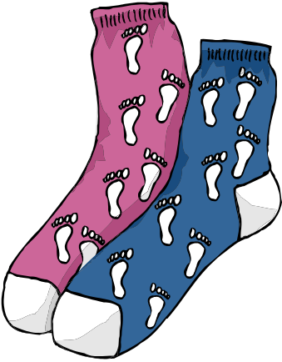
The hypergeometric distribution
Consider the following scenario:
  A drawer contains N socks.
  Exactly B of the socks are black and the remaining (N − B) are white.
  We pick n socks by random and b of them are black.
Do the n socks we picked contain significantly more black socks than we expected?
In other words, are the black socks enriched in the n socks we randomly chose?

Slide 7
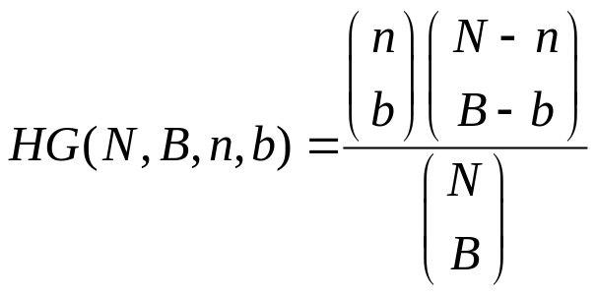
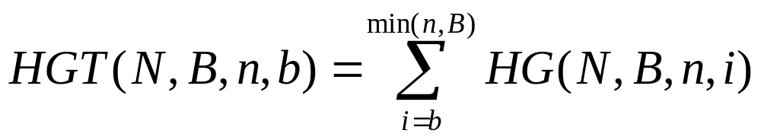
The hypergeometric distribution (2)
Under a uniform distribution the probability of finding exactly b black socks in the n randomly chosen socks is described by the hyper-geometric function:
We are usually intersted in the tail probability: finding b or more black socks :

Slide 8

Flexible Threshold
The hyper geometric method requires the user to define what is the target set and what is the background set.
In most experiments (such as differential expression) the user ranks all genes (by, for example, fold change) and then needs to set an arbitrary threshold (such as fold change>x, p-value<y, top 50 genes, etc.) to define the target set.
A better solution is to use the entire list and find GO terms enriched at the TOP of this list (without defining what “top” is).

Slide 9
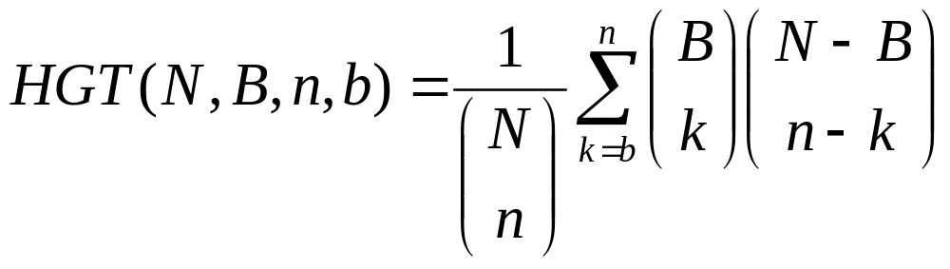
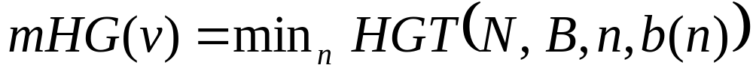
mHG score
0
1
1
0
1
1
0
.
.
.
0
0
0
b(n) 1s
Threshold n
|v| = N, with B 1s

Slide 10
mHG p-values
Consider a random vector V uniformly distributed in {0,1}^{N}, with B 1s.
What is the distribution of mHG(V)?
What is the probability of mHG(V) ≤ s?
Union bound (Bonferroni): p-val(s) ≤ Ns .
A more subtle bound (Eden et al):
p-val(s) ≤ Bs
Dynamic programming in O(N²) yields the exact distribution (Eden et al).

Slide 11
GOrilla
GOrilla is a web based tool we developed for GO enrichment analysis.
Its main advantages over other GO enrichment tools are:
  Flexible threshold and exact p-value (no simulations)
  Graphical output – color coded GO DAG bases on enrichment p-values.
  Fast and easy to use. Takes only a few seconds (while other tools take minutes)

Slide 12
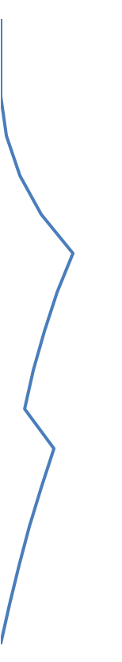
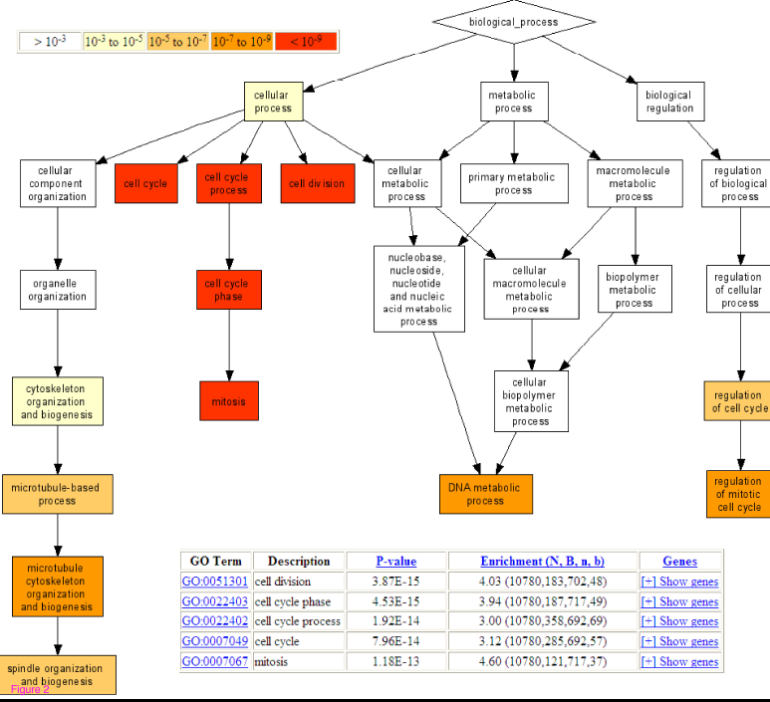

GOrilla – GO enrichment analysis tool
-log HG p-value
gene 1
gene 2
gene 3
gene 4
gene 5
gene 6
gene 7
gene 8
gene 9
gene 10
gene 11
gene 12
gene 13
gene 14
gene 15
.
.
.
1
0
0
0
1
1
0
1
0
0
0
1
1
0
0
.
.
.
0
0
0
1
1
1
1
0
0
0
0
1
0
0
0
.
.
.

Slide 13
Summary of GOrilla’s advandages
While most other tools require the user to explicitly define a target list and a background list, GOrilla searches for GO terms enriched at the top of the list – without requiring the user to explicitly set the threshold that defines what “top” is.
An exact p-value for the enrichment of each GO term is reported as part of the output.
GOrilla provides an easy to use intuitive web based interface.
The enriched GO terms are graphically presented in the context of the complete GO DAG, in addition to tabular results.
GOrilla is very fast taking only a few seconds for each analysis.
Accepts RefSeq accessions, gene symbols and others.

Slide 14
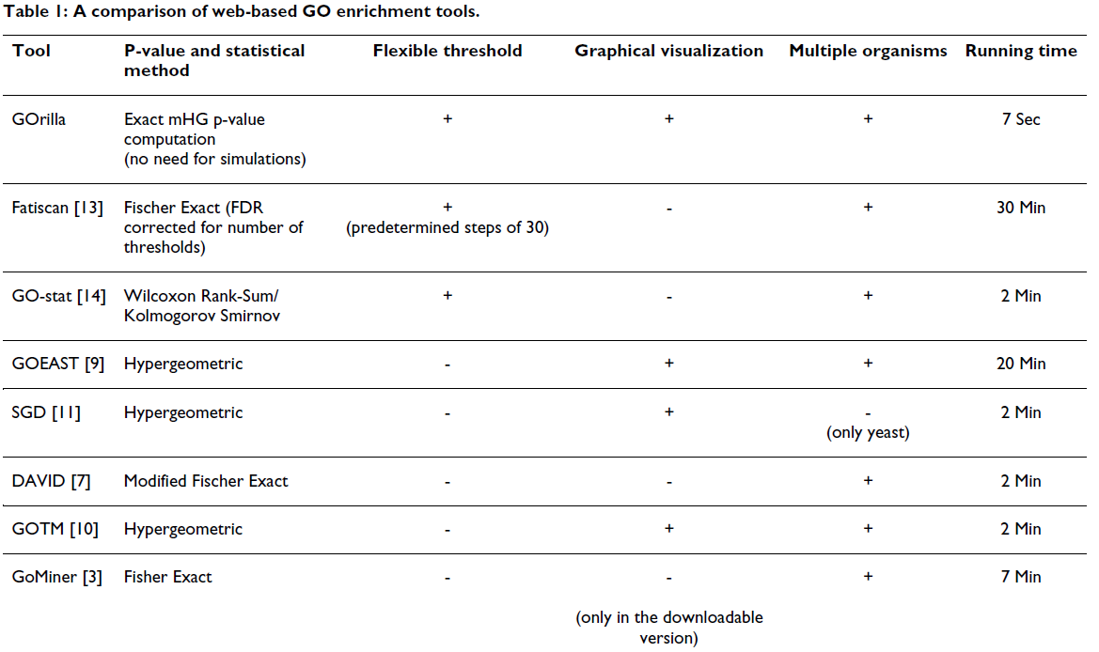
Comparison to other GO enrichment tools (as of late 2008)

Slide 15
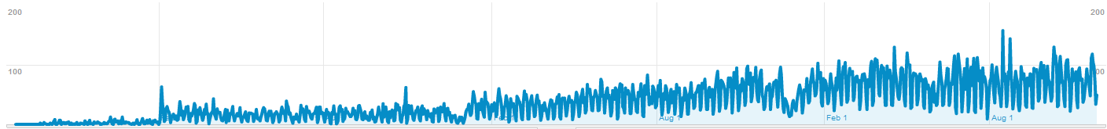
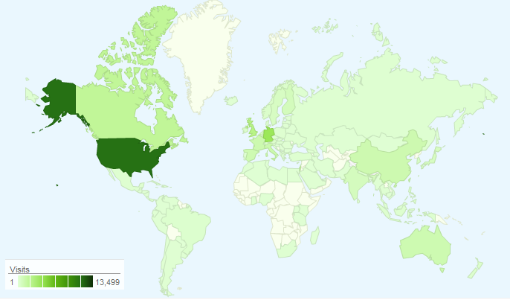
GOrilla usage statistics http://cbl-gorilla.cs.technion.ac.il/

Slide 16
Thanks to:
Israel Steinfeld
Eran Eden
Doron Lipson
Zohar Yakhini

Slide 17
Demo and
Hands-On

Slide 18
Rank by t-test: =TTEST(classA,classB,2,2)
Up/down regulated:
Calculate the 2 averages - =AVERAGE(classA)
Calculate fold change – average1 – average2
-log(pvalue): =-LOG(ttest p-value)
Up/down regulated: =SIGN(fold change)*(-logpvalue)

Slide 19
1. Van’t veer:
  Rank all genes according to t-test
  Run GOrilla (and go over all the parameters)
  Rank genes again according to up regulated genes
  Run GOrilla again
  Random permutation
  HG
2. Espen
  Correlation (positive) with miR-18 (cell cycle)
3. Kittelson – ischemic vs. non ischemic

Slide 20
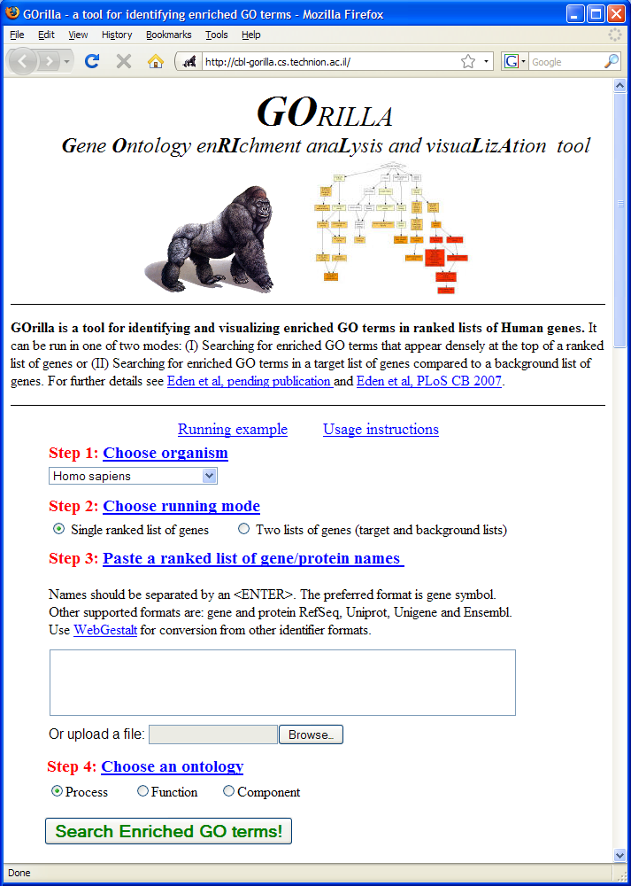
GOrilla webpage http://cbl-gorilla.cs.technion.ac.il/
Eden, Navon et al – BMC Bioinformatics

