Slide 1
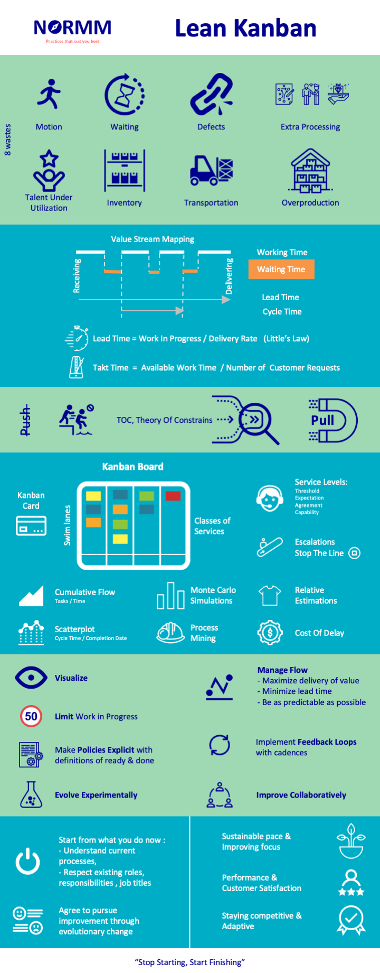
Lean Kanban

Slide 2
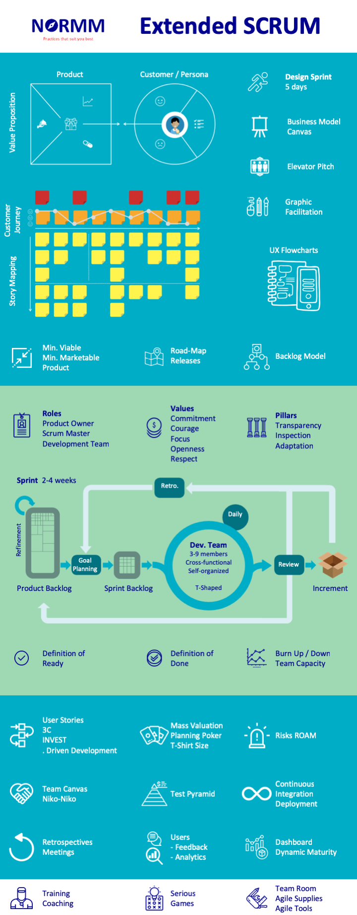
Extended SCRUM

Slide 3
