Slide 1








Wasabi Cards
Roles to improve your meetings
Meeting
Facilitator
Time
Keeper
Technology
Keeper
Note Taker
(Anti-)
Patterns Observer
Conflicts
Arbitrator
Decisions
Facilitator
Host

Slide 2
Makes reservations of meeting room, drinks, food, travel & hotel.
Sends invitations. Welcomes participants.
Sends minutes.
Identifies
Meeting
Best Practices & Anti-Patterns.
Helps to solve conflicts positively.
Helps to make decisions.
Conflicts
Arbitrator
Decisions Facilitator
Observer
Host
Guides meeting participants through the agenda.
Keeps the team on track to achieving the meeting’s objectives.
Ensure everyone’s voice is heard.
Records Tasks, Decisions, …
Takes general notes
Provides a verbal high level summary at the end of the meeting.
Reminds people of meeting time constrains.
Calls the question of whether to continue the discussions if time runs out.
Steps up meeting technology (video call, microphone, …) and troubleshoots as needed.
Meeting
Facilitator
Note Taker
Time Keeper
Technology Keeper

Slide 3










Wasabi Cards
Meetings Anti-Patterns
Blah …
Undercuts and distracts others with sarcasm and jokes
Shows impatience.
Interrupts others.
Dominates others.
Judges and/or
Investigates
Monologue
Makes Presumptions
Distractions by Phones and/or Computers
Questions AND Answers.
Closed Questions.
Negative and/or
Defensive

Slide 4
Makes Presumptions
Distractions by Phones and/or Computers
Questions AND Answers.
Closed Questions.
Negative and/or
Defensive
Blah …
Undercuts and
distracts others with sarcasm and jokes
Shows impatience.
Interrupts others.
Dominates others.
Judges and/or
Investigates
Monologue

Slide 5



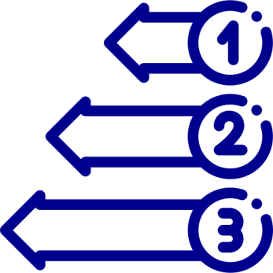





Wasabi Cards
Patterns to improve your meetings
At Start,
Remind
Objectives
Break (s)
depending on
duration
At End,
Remind Decision(s)
& Conclude
Start & End
On Time
Encourage Everyone
to Contribute
Listen to One Another
Repeat and Review People’s Points
Be Curious, Caring and Open-Minded

Slide 6
Encourage Everyone
to Contribute
Listen to One Another
Repeat and Review People’s Points
Be Curious, Caring and Open-Minded
At Start,
Remind
Objectives
Break (s)
depending on
duration
At End,
Remind Decision(s)
& Conclude
Start & End
On Time

