Slide 1
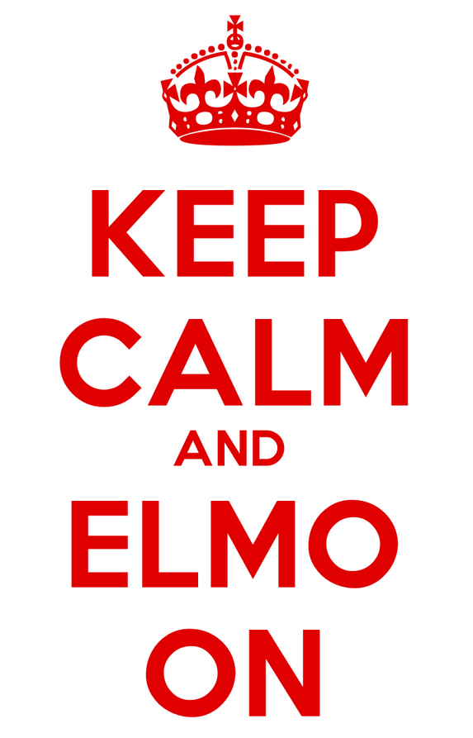
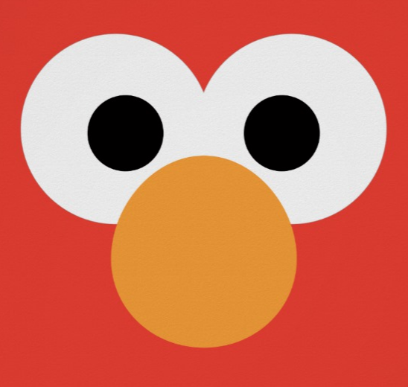
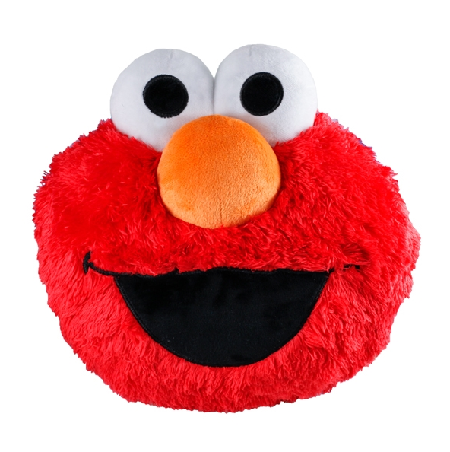
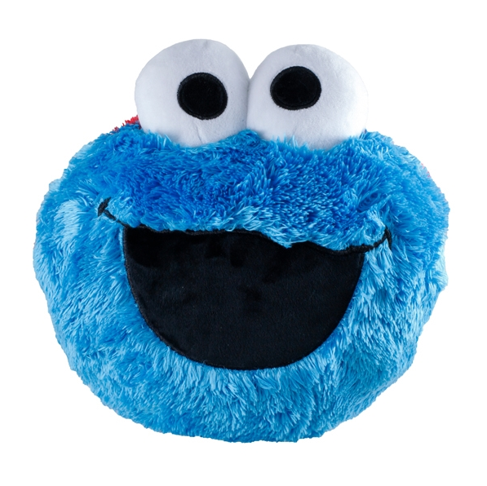
Enough!
Let’s Move On
Enough!
Let’s Move On
Enough!
Let’s Move On
Notes:
Enough! Let’s Move On” Everyone has been in a meeting where someone went on too long and it was difficult to interrupt. An ELMO card is a friendly, visual sign that shows you get the point and are ready to move on. This is a great facilitation technique for any workshop or meeting, online and in person!

