Slide 1
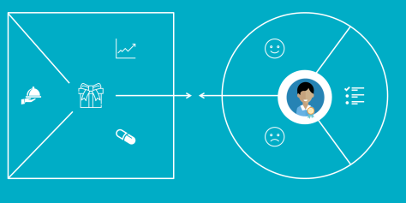



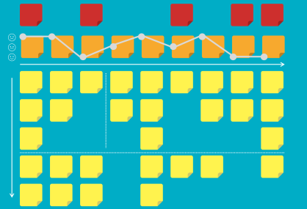








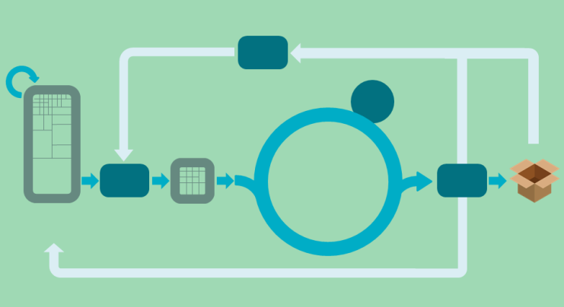














Extended SCRUM
Product
Customer / Persona
Design Sprint
5 days
Value Proposition
Business Model Canvas
Elevator Pitch
Customer Journey
Graphic
Facilitation
UX Flowcharts
Story Mapping
Min. Viable
Min. Marketable
Product
Road-Map Releases
Backlog Model
Roles
Product Owner
Scrum Master
Development Team
Values
Commitment
Courage
Focus
Openness
Respect
Pillars
Transparency
Inspection
Adaptation
Sprint 2-4 weeks
Retro.
Refinement
Daily
Goal
Planning
Dev. Team
3-9 members
Cross-functional
Self-organized
T-Shaped
Review
Product Backlog
Sprint Backlog
Increment
Definition of
Ready
Definition of
Done
Burn Up / Down
Team Capacity
User Stories
3C
INVEST
. Driven Development
Mass Valuation
Planning Poker
T-Shirt Size
Risks ROAM
Team Canvas
Niko-Niko
Test Pyramid
Continuous
Integration
Deployment
Retrospectives
Meetings
Users
- Feedback
- Analytics
Dashboard
Dynamic Maturity
Training
Coaching
Serious
Games
Team Room
Agile Supplies
Agile Tools

