Slide 1
















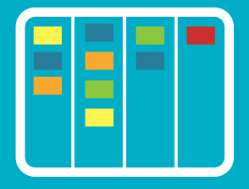





















Lean Kanban
Motion
Waiting
Defects
Extra Processing
8 wastes
Talent Under Utilization
Inventory
Transportation
Overproduction
Value Stream Mapping
Working Time
Receiving
Delivering
Waiting Time
Lead Time
Cycle Time
Lead Time = Work In Progress / Delivery Rate (Little’s Law)
Takt Time = Available Work Time / Number of Customer Requests
Push
TOC, Theory Of Constrains
Pull
Kanban Board
Service Levels:
Threshold
Expectation
Agreement
Capability
Kanban
Card
Swim lanes
Classes of Services
Escalations
Stop The Line
Cumulative Flow
Tasks / Time
Monte Carlo Simulations
Relative Estimations
Scatterplot
Cycle Time / Completion Date
Process Mining
Cost Of Delay
Visualize
Manage Flow
- Maximize delivery of value
- Minimize lead time
- Be as predictable as possible
Limit Work in Progress
Make Policies Explicit with
definitions of ready & done
Implement Feedback Loops
with cadences
Evolve Experimentally
Improve Collaboratively
Start from what you do now :
- Understand current processes,
- Respect existing roles, responsibilities , job titles
Sustainable pace &
Improving focus
Performance &
Customer Satisfaction
Agree to pursue improvement through evolutionary change
Staying competitive &
Adaptive
“Stop Starting, Start Finishing”

