Slide 1


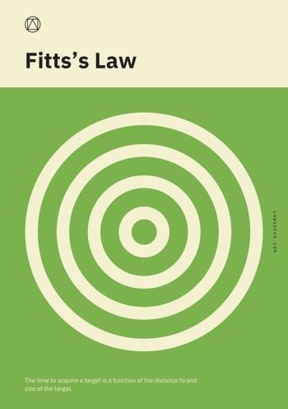
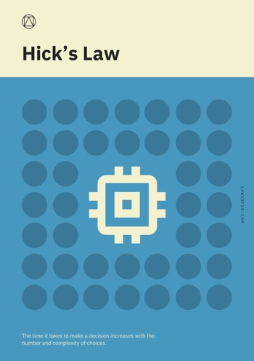
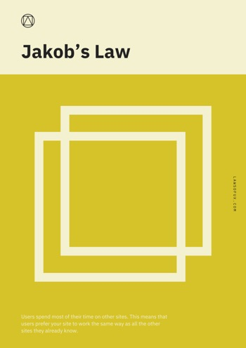
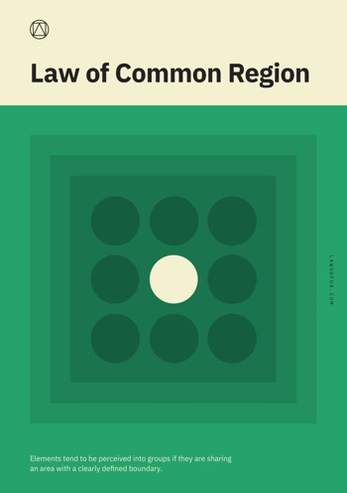
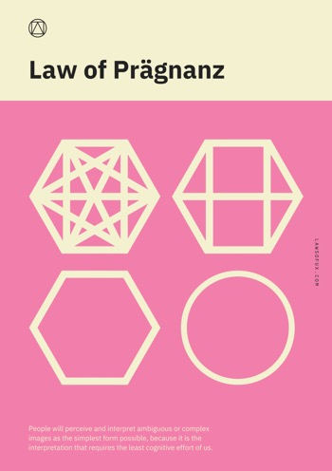
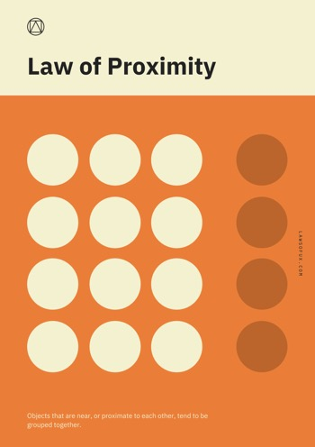
Notes:
Hauteur = 11

Slide 2
Law of Prägnanz.
People will perceive and interpret ambiguous or complex images as the simplest form possible, because it is the interpretation that requires the least cognitive effort of us.
The human eye likes to find simplicity and order in complex shapes because it prevents us from becoming overwhelmed with information.
Law of Common Region.
Elements tend to be perceived into groups if they are sharing an area with a clearly defined boundary.
Adding borders (creating common regions) around an element or group of elements is an easy way to create separation from surrounding elements.
Jakob’s Law.
Users spend most of their time on other sites. This means that users prefer your site to work the same way as all the other sites they already know.
You can simplify the learning process for users by providing familiar design patterns.
Law of Proximity.
Objects that are near, or proximate to each other, tend to be grouped together.
Objects that are near, or proximate to each other, tend to be grouped together.
Hick’s Law.
The time it takes to make a decision increases with the number and complexity of choices.
More choices results in longer to think about these choices and make a decision. Simplify choices for the user to ensure by breaking complex tasks into smaller steps. Avoid overwhelming users by highlighting recommended options.
Aesthetic Usability Effect.
Users often perceive aesthetically pleasing design as design that’s more usable.
Aesthetically pleasing design can make users more tolerant of minor usability issues. Aesthetically pleasing design can mask usability problems and prevent issues from being discovered during usability testing.
Fitts’s Law.
The time to acquire a target is a function of the distance to and size of the target.
Make elements you wish to be easily selectable large and position them close to users. This law especially applies to buttons, which the purpose of these elements is to be easy to find and select.
Doherty Threshold.
Productivity soars when a computer and its users interact at a pace (<400ms) that ensures that neither has to wait on the other.
Provide system feedback within 400ms in order to keep users’ attention and increase productivity.

Slide 3
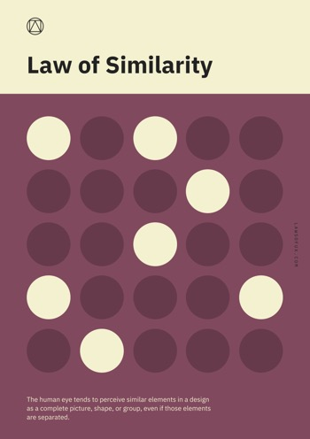
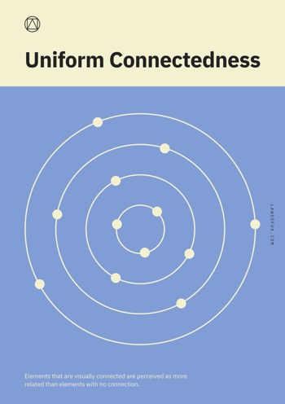
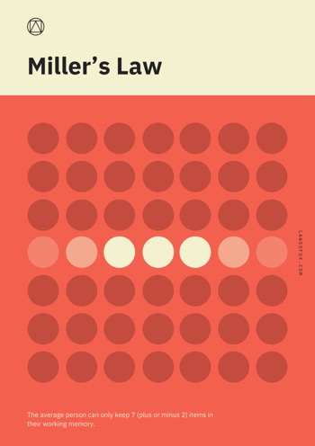
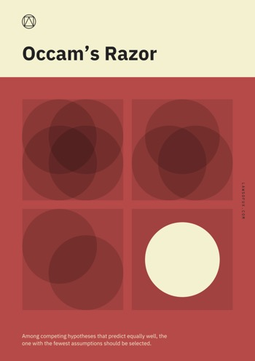
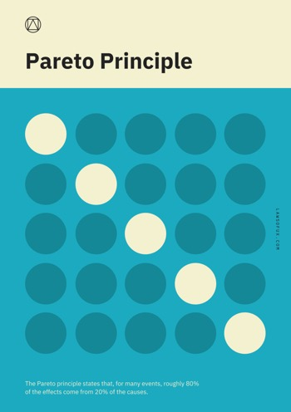
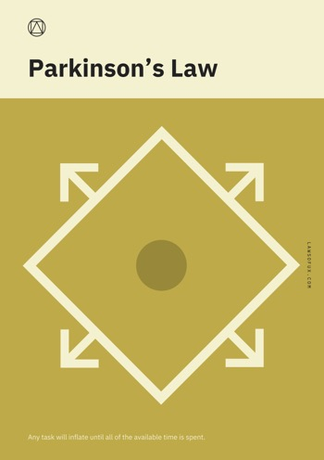
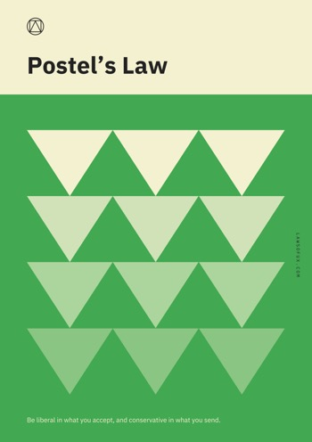
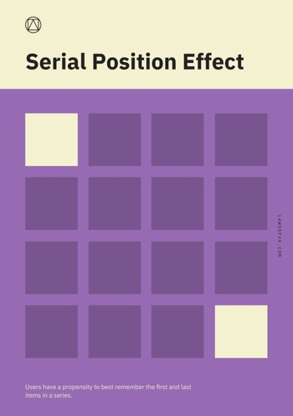

Slide 4
Postel’s Law.
Be liberal in what you accept, and conservative in what you send.
Be empathetic, flexible, and tolerant to any number of actions the user could possibly take. This means accepting variable input from users, translating input to meet the requirements, defining boundaries for input, and providing clear feedback to the user.
Serial Position Effect.
Users have a propensity to best remember the first and last items in a series.
Placing the least important items in the middle of lists can be helpful because these items tend to be stored less frequently in long-term and working memory. Positioning key actions on the far left and right within elements such as navigation can increase memoriziation.
Pareto Principle.
The Pareto principle states that, for many events, roughly 80% of the effects come from 20% of the causes.
Focus the majority of effort on the areas that will bring the largest benefits to the most users.
Parkinson’s Law.
Any task will inflate until all of the available time is spent.
Law of Similarity.
The human eye tends to perceive similar elements in a design as a complete picture, shape, or group, even if those elements are separated.
Ensure that links and navigation systems are visually differentiated from normal text elements, and are consistently styled.
Miller’s Law.
The average person can only keep 7 (plus or minus 2) items in their working memory.
Chunking is an effective method of presenting groups of content in a manageable way. Organize content in groups of 5-9 items at a time.
Occam’s Razor.
Among competing hypotheses that predict equally well, the one with the fewest assumptions should be selected.
Analyze each element and remove as many as possible, without compromising the overall function.
Law of Uniform Connectedness.
Elements that are visually connected are perceived as more related than elements with no connection.
Group functions of a similar nature so they are visually connected via colors, lines, frames, or other shapes.

Slide 5
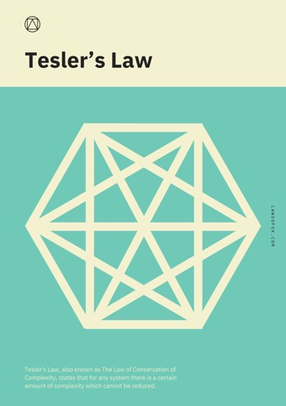
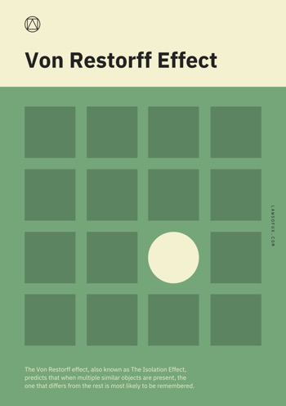
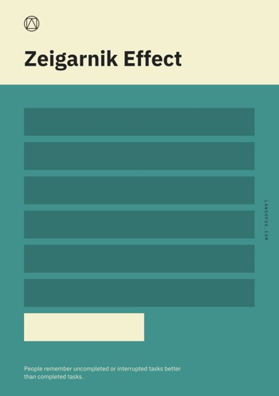

Slide 6
Von Restorff Effect.
The Von Restorff effect, also known as The Isolation Effect, predicts that when multiple similar objects are present, the one that differs from the rest is most likely to be remembered.
Make important information or key actions visually distinctive.
Zeigarnik Effect.
People remember uncompleted or interrupted tasks better than completed tasks.
Use progress bars for complex tasks to visually indicate when a task is incomplete, and thus increase the likelihood it will be completed.
Tesler’s Law.
Tesler's Law, also known as The Law of Conservation of Complexity, states that for any system there is a certain amount of complexity which cannot be reduced.

