Slide 1

Checking Account Customer Acquisition Report at Santander Bank
Stephanie Chew

Slide 2

Objective
To analyze new customers who open checking accounts at Santander Bank and how to gain younger customers.
What is the age group of the new customers?
When did they open the accounts?
How many checking accounts are opened by new customers vs. existing customers?

Slide 3
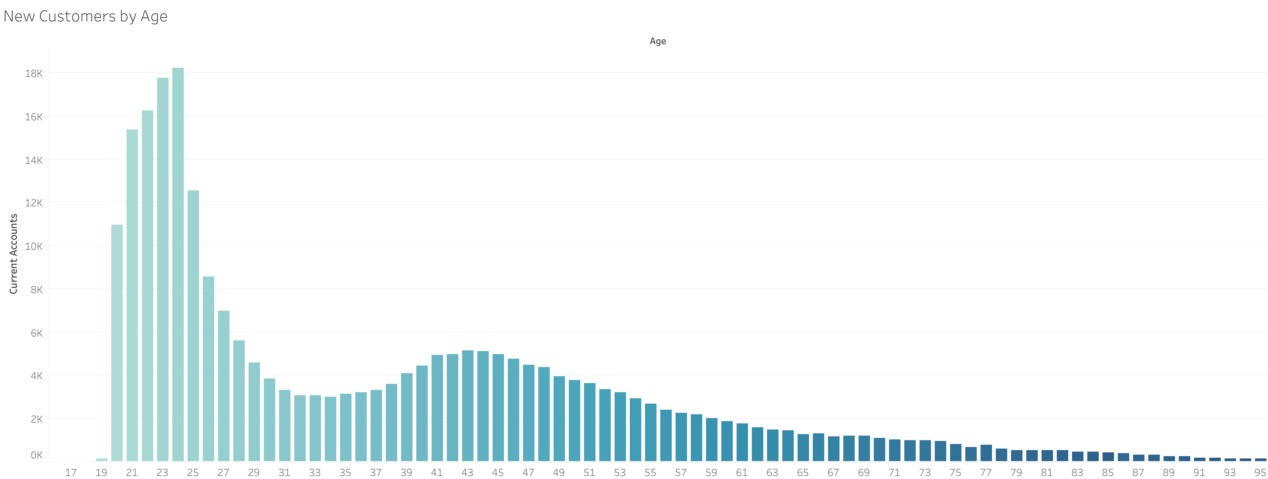
New Customers By Age
Ages for checking accounts.
High number of new customers in the 20s signed up for checking accounts.

Slide 4
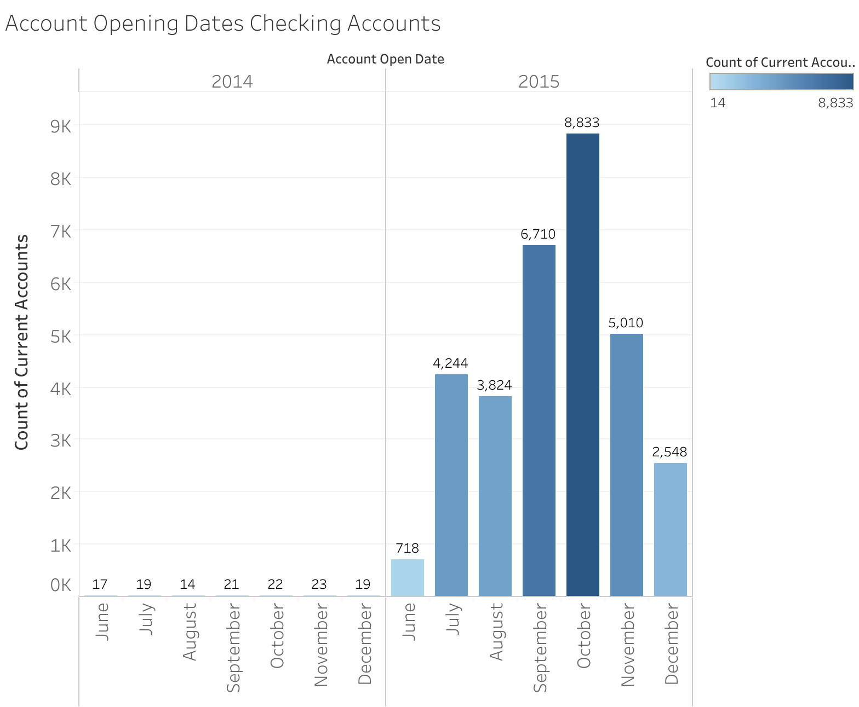
New Customer Account Openings
New customers open checking accounts the most on October 2015.
Most likely an effective marketing campaign attracted new customers between September 2015 and October 2015.
September and October is when new school year starts.

Slide 5
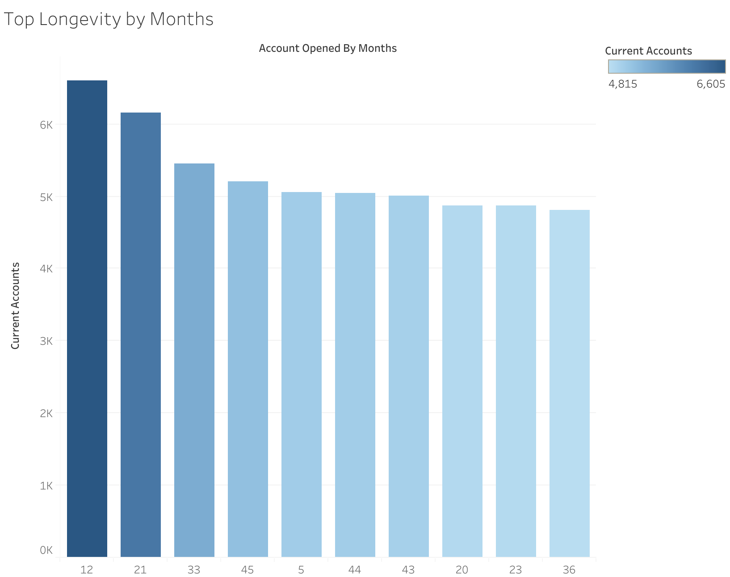
Checking Account Longevity
Top 10 longest months checking accounts are open.
Highest number of accounts opened for 1 year.
5 months longevity has the highest number of accounts with shortest amount of time of account opening.

Slide 6
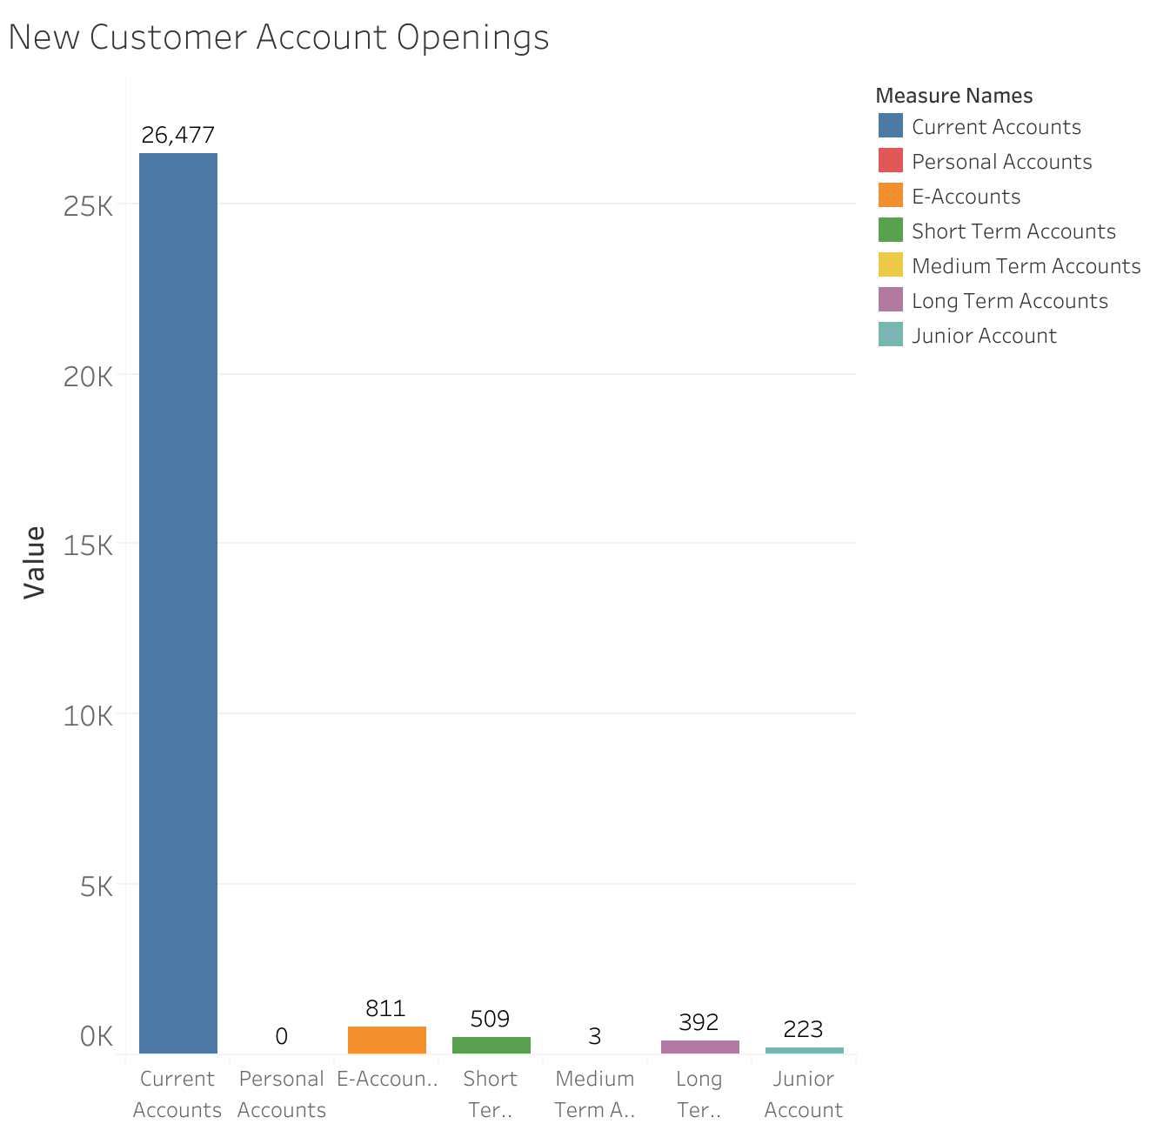
New Customer Deposit Accounts
Majority of new customers open checking accounts.
Not too many open other deposit accounts.

Slide 7
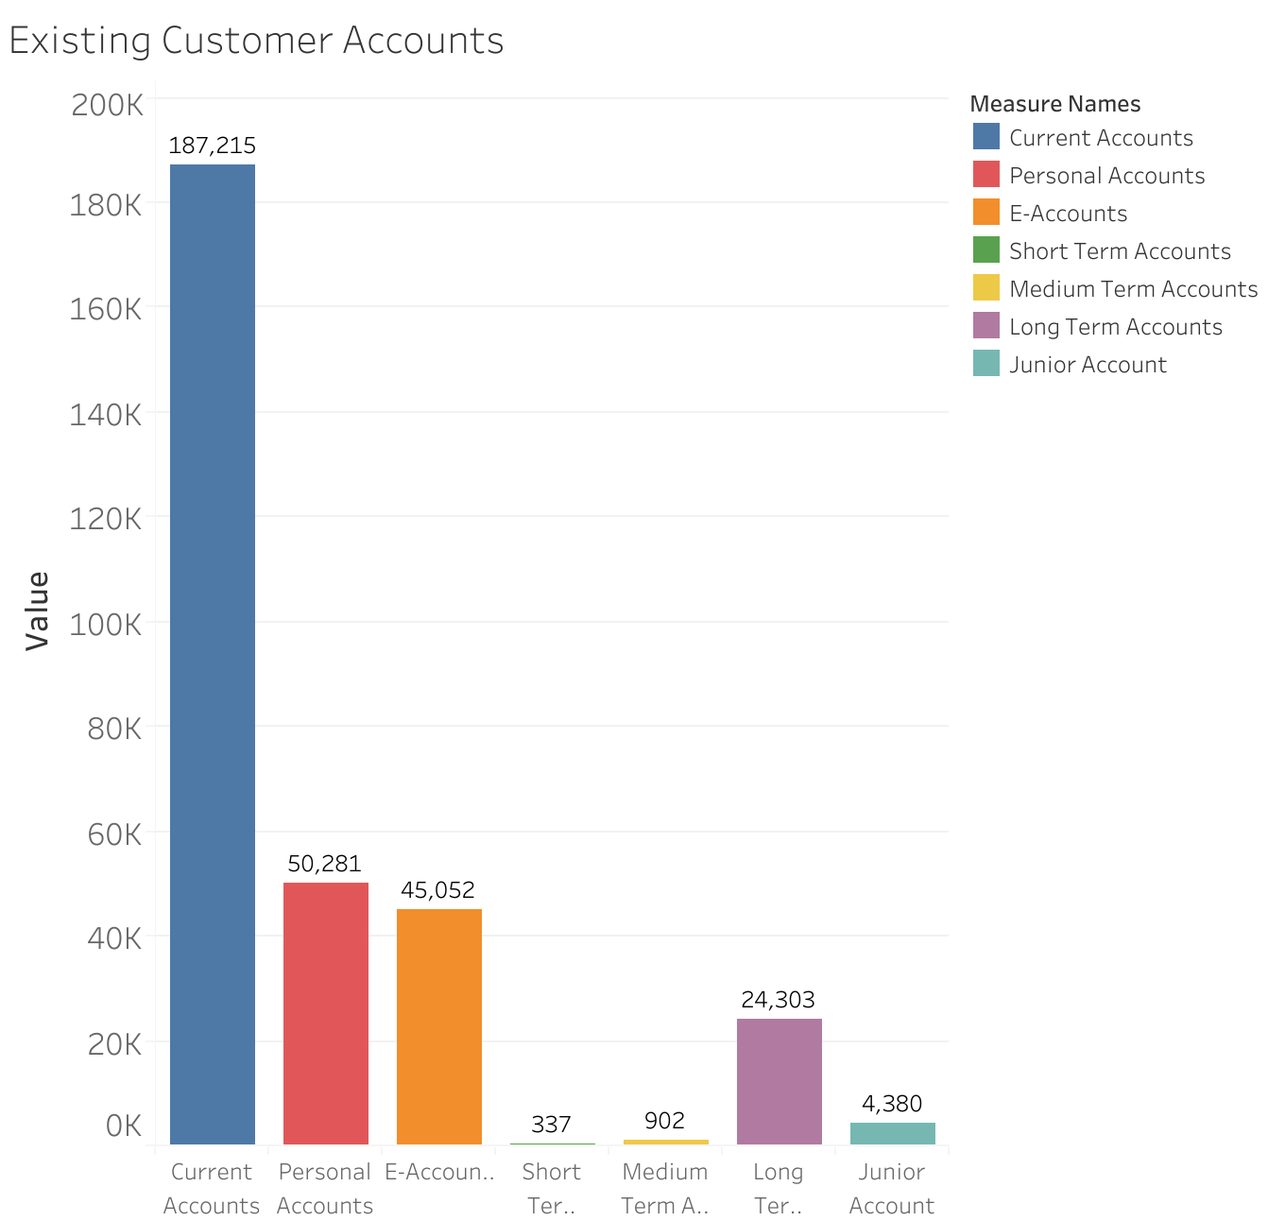
Existing Customer Deposit Accounts
High customer loyalty with existing customers, especially with checking accounts.
Higher number of long-term account openings than short and medium terms.

Slide 8
Hypothesis T-Test
H₀: The number of new customers is the same as existing customers for checking account.
H_{a}: The number of new customers is different from existing customers for checking account.
T-Test: P-Value = 0.017
Reject the null hypothesis.
Overall: High customer loyalty with existing customers.

Slide 9
Next Steps
Dig Deeper
Dig deeper on customer acquisition analysis for remaining deposit accounts.
Analyze
Analyze marketing campaigns (digital ads, social media, etc.) and find out how to attract the younger audience.
Deposit Amount
Find out the total deposit amount.

Slide 10
Contact Info
Email: Stephanie.a.chew@gmail.com
Github: StephanieChew-nyc
Linkedin: linkedin.com/in/chewstephanie

