Slide 1

Certificate of Deposit Survey Quarterly Report
Stephanie Chew

Slide 2
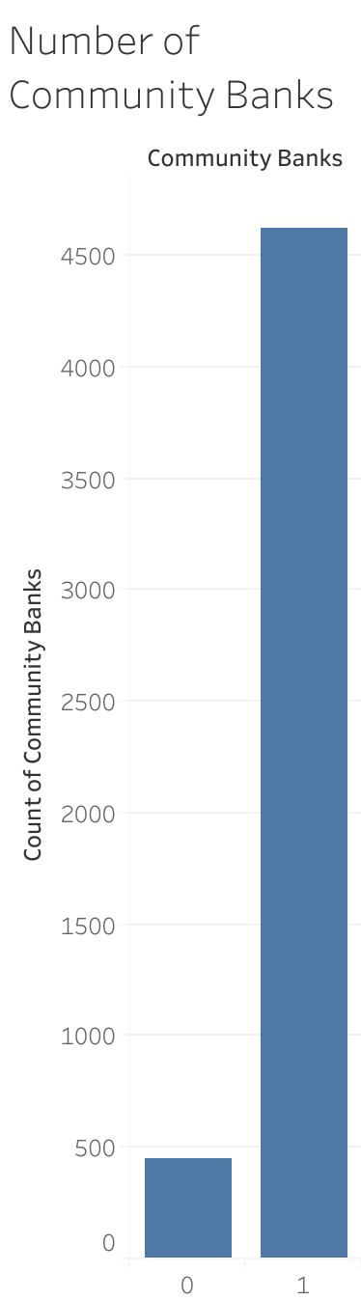
Community Banks in the US

Slide 3
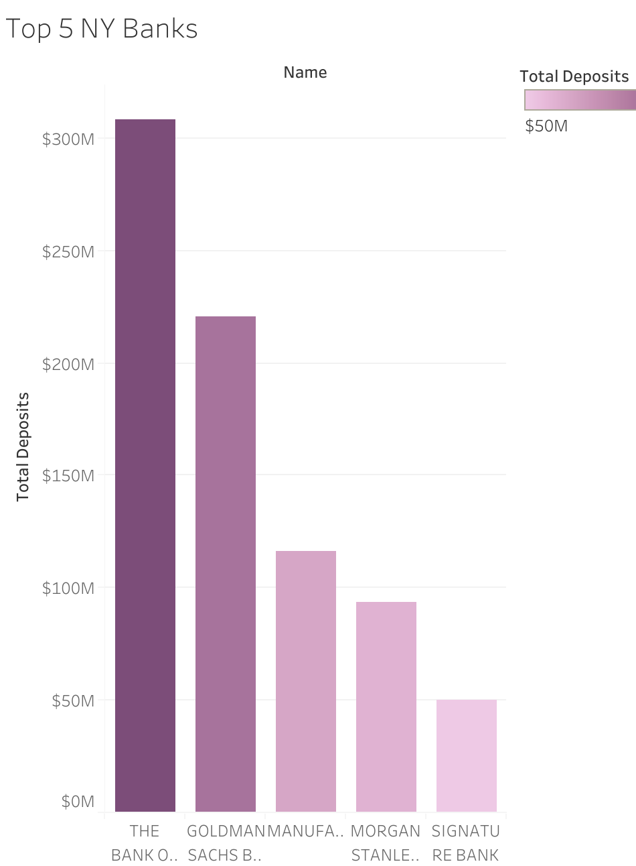
Top 5 NY Banks
Based on the total deposits.
#1 bank with highest total deposits is Bank of New York Mellon.
Signature Bank is the only community bank with the highest total deposits.

Slide 4
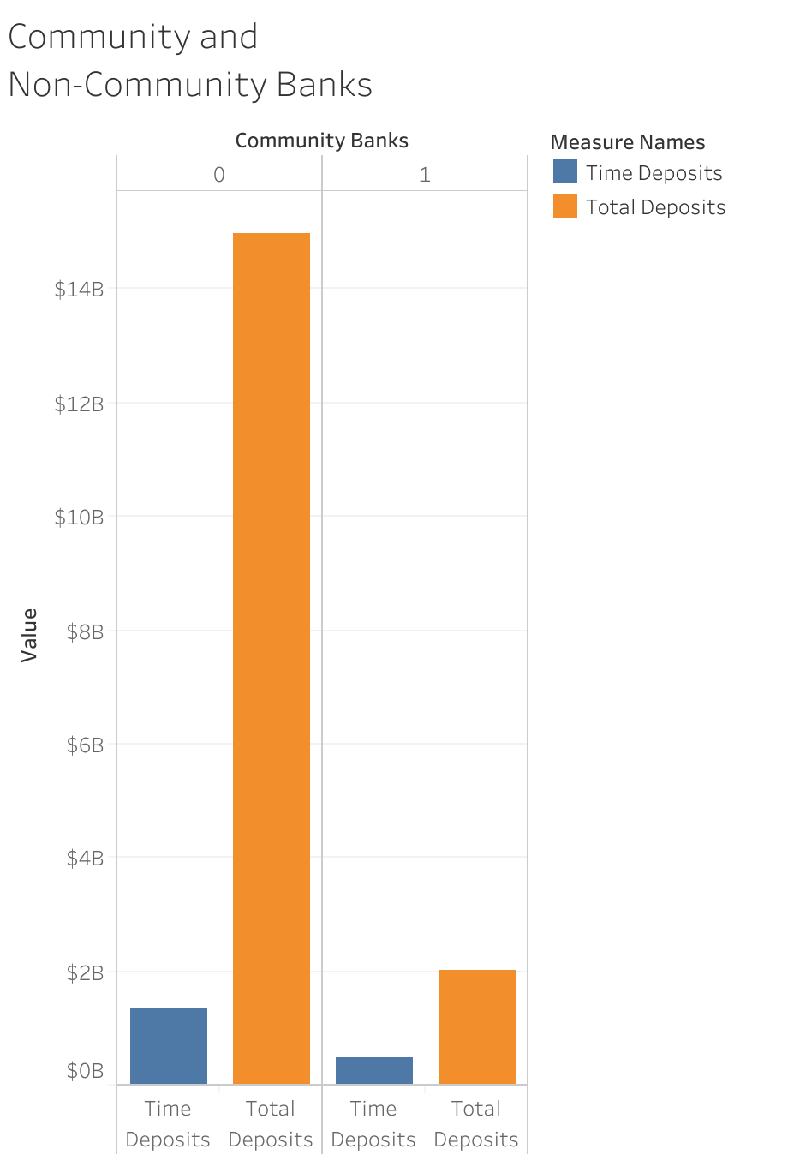
Total Deposits Vs. Time Deposits
Total time deposits and all deposit accounts by Community vs Non-Community Banks.

Slide 5
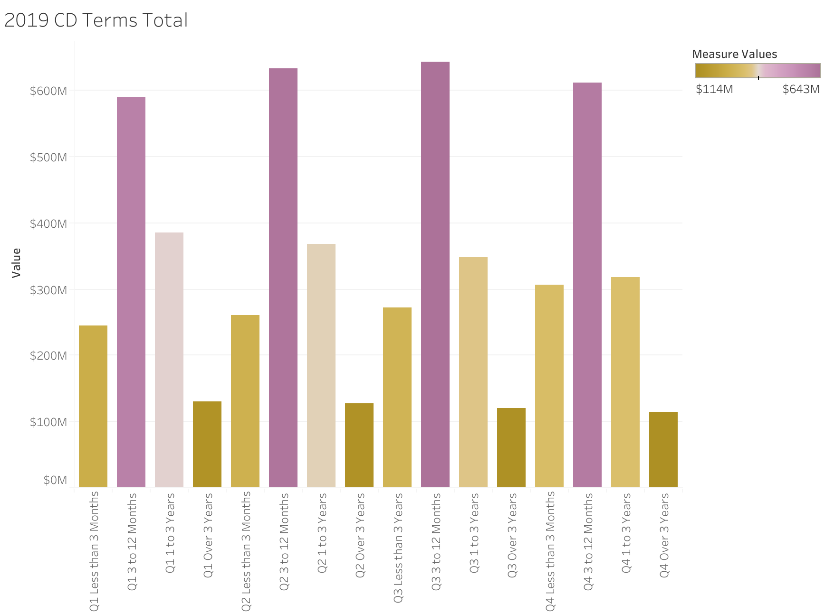
2019 CD Terms

Slide 6
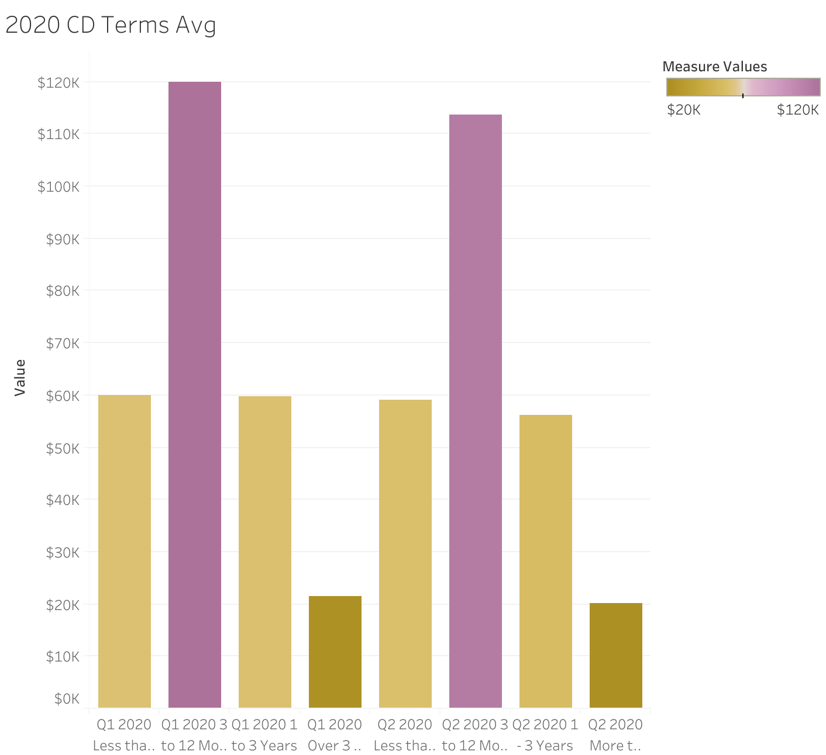
2020 CD Terms Average
Average amount is steady for Q1 and Q2 2020.

Slide 7
National CD Rates

Slide 8
2020 Predicted Vs. Actual CD Rates
Placeholder for time series model

Slide 9
Contact Info
Email: stephanie.a.chew@gmail.com
Github: github.com/StephanieChew-nyc
Linkedin: linkedin.com/in/chewstephanie/

