Slide 1

Certificate of Deposit Survay Report
Stephanie Chew

Slide 2
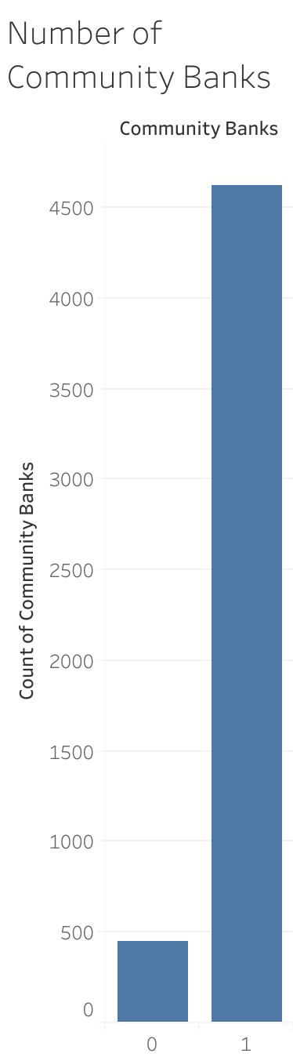
Community Banks in the US

Slide 3
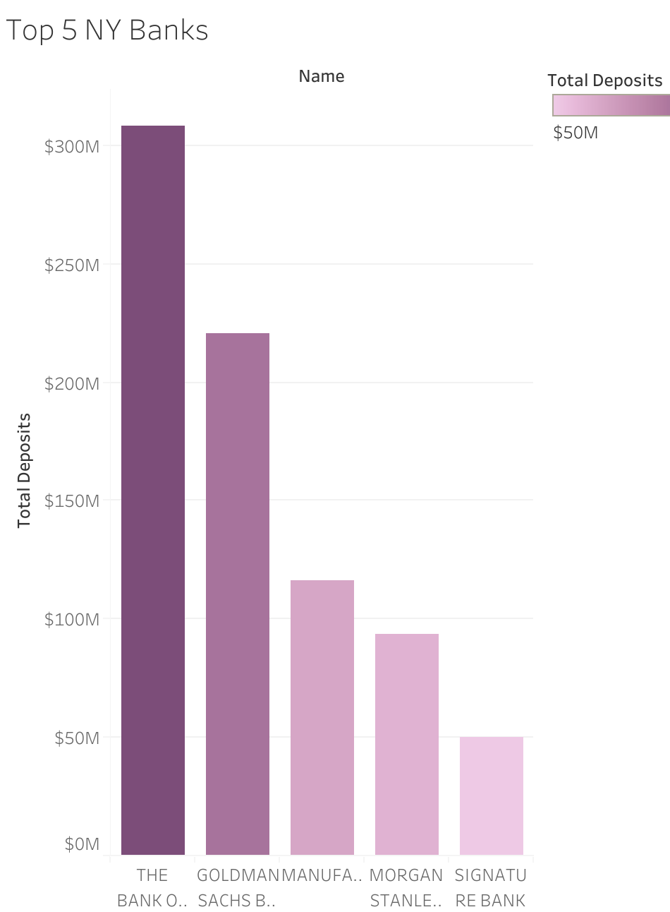
Top 5 NY Banks

Slide 4
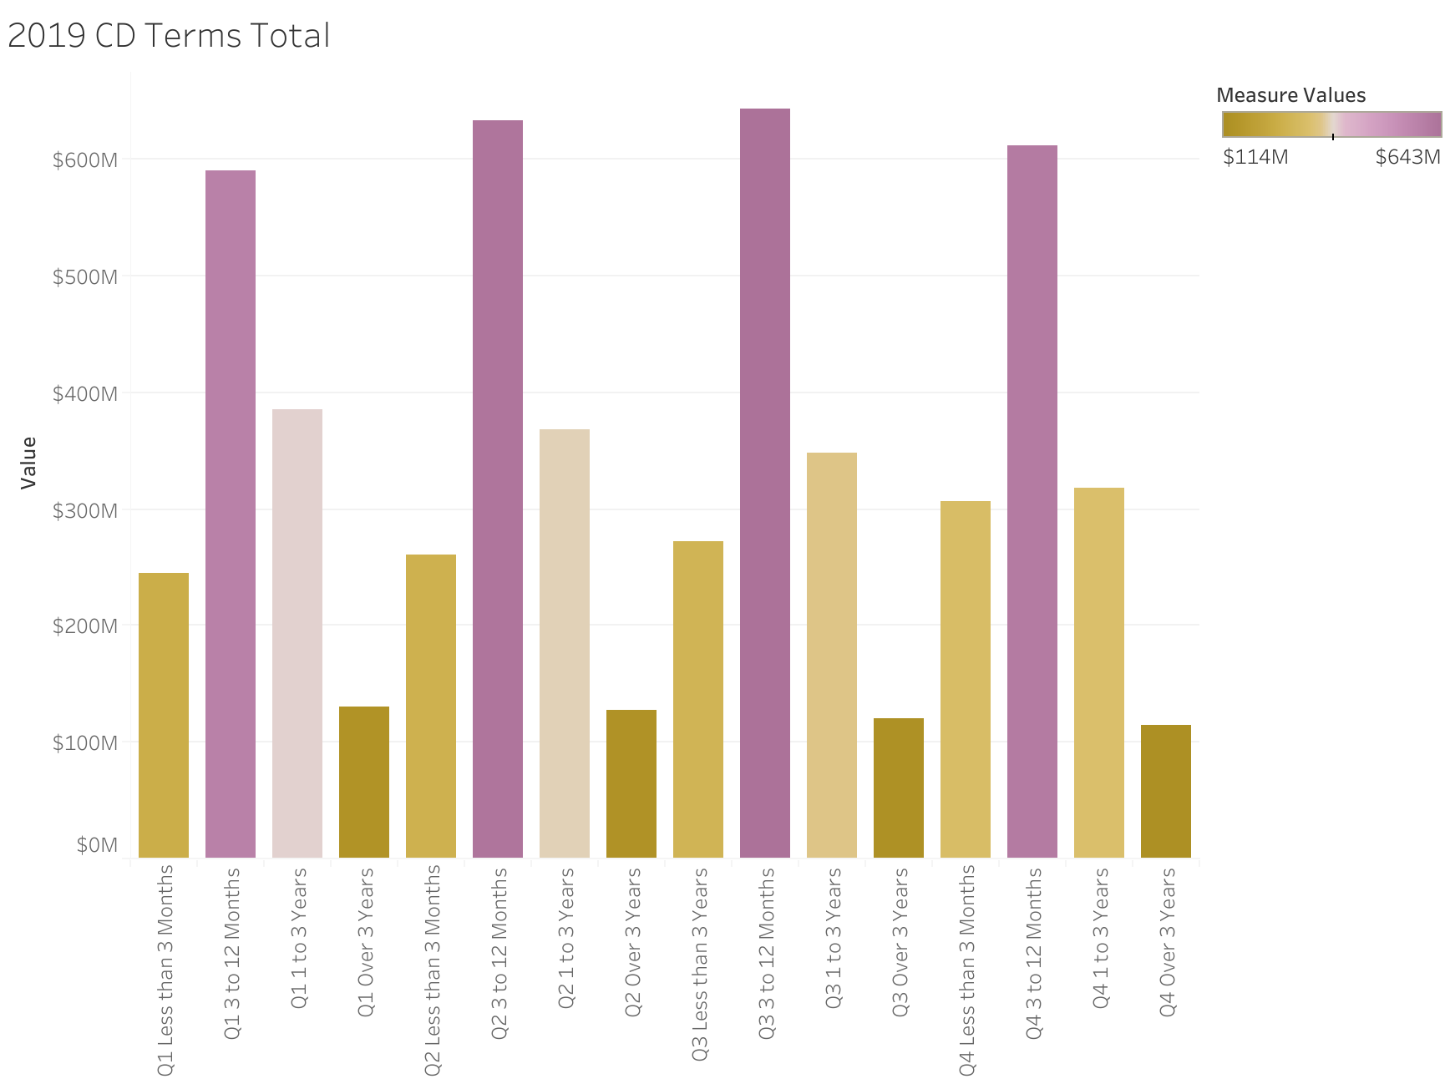
2019 CD Terms

Slide 5
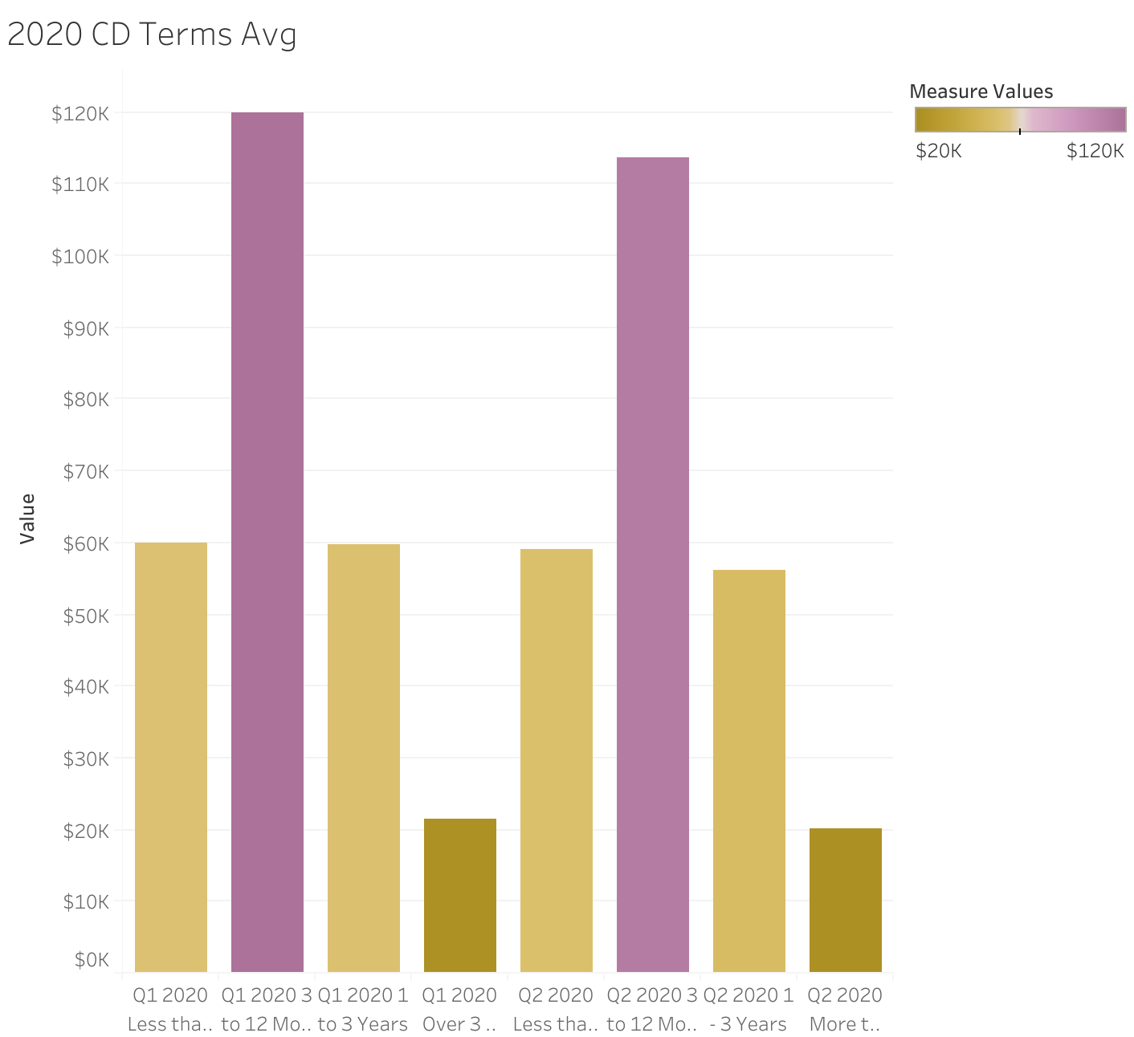
2020 CD Terms Average
Average amount is steady for Q1 and Q2 2020.

Slide 6
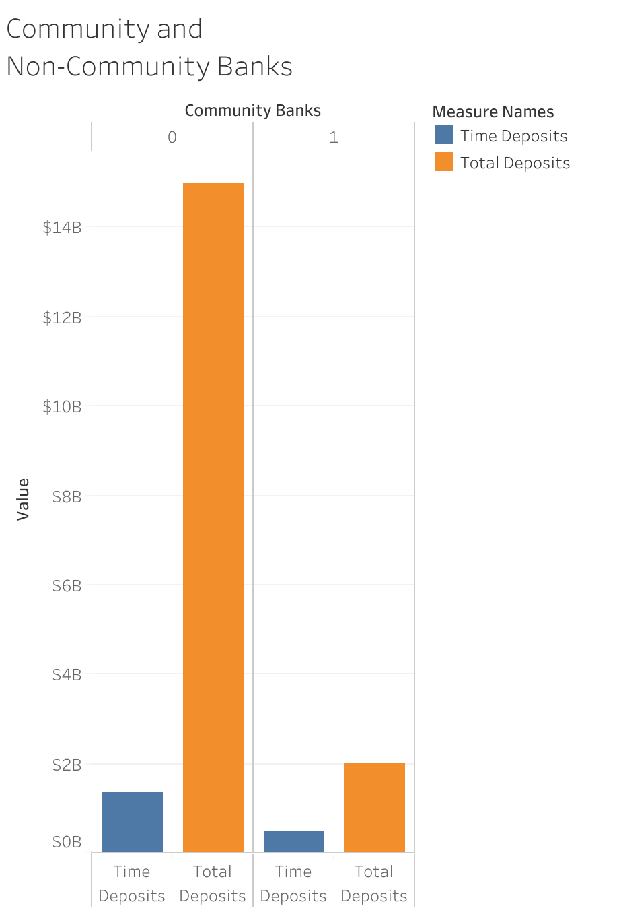
Total Time Deposits
Total time deposits by Community vs Non-Community Banks.

