Slide 1

Certificate of Deposit Survey Quarterly Report
Stephanie Chew

Slide 2


Objective
Predict 2020 CD rates according to the prior quarterly reports, and which is the most popular CD term to create marketing campaign.
Market/Advertise future terms and rates to obtain new deposits by next quarter.

Slide 3
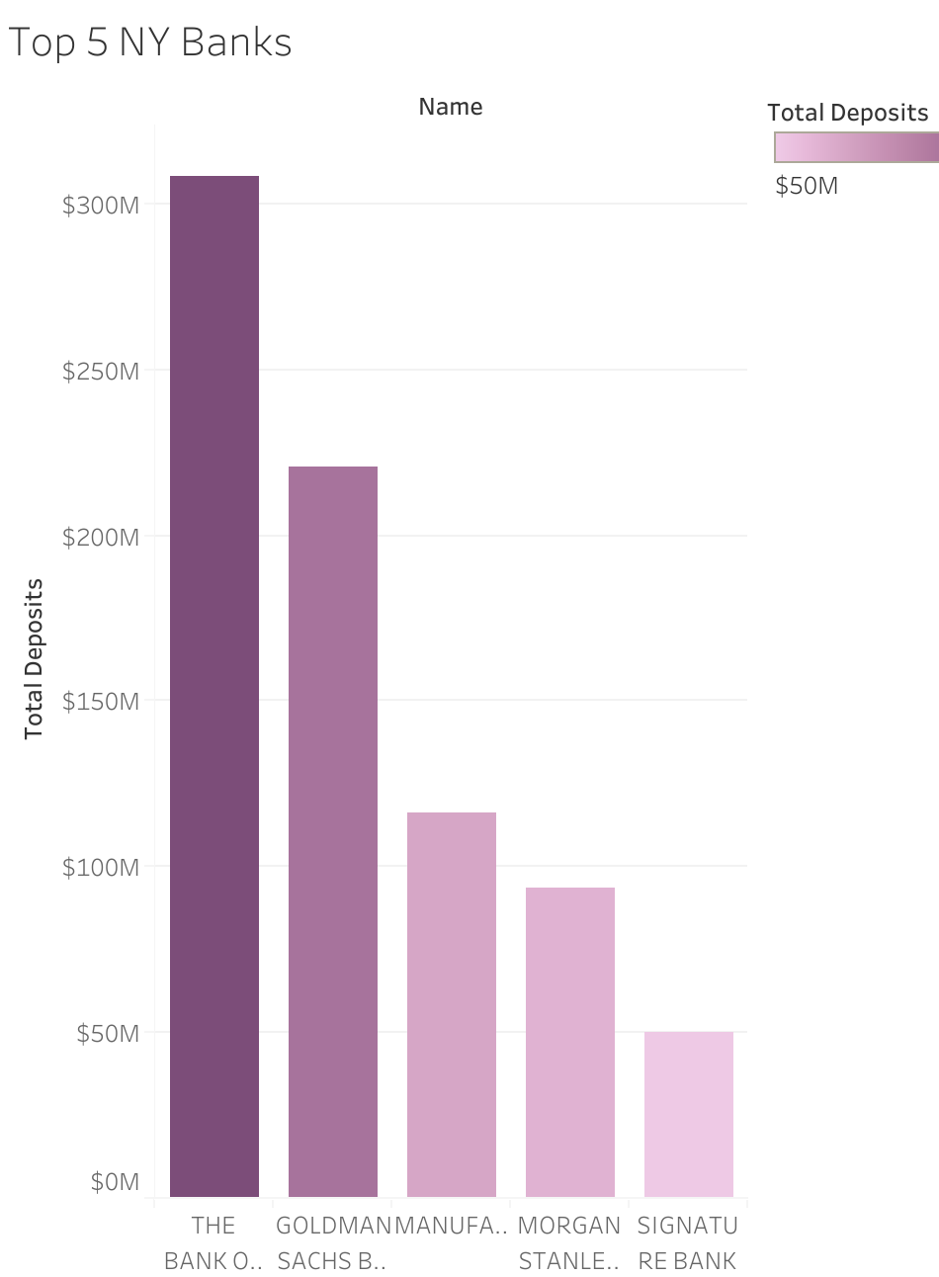
Top 5 NY Banks as of Q2 2020
Based on the total deposits.
#1 bank with highest total deposits is Bank of New York Mellon.
BNY Mellon is an investment bank and operates in 35 countries. Primarily offers commercial banking products, investment services and investment management.

Slide 4
Total Amount Per Product Type
Total Deposits include Money Market, Savings, Time Term Accounts, Interest-Bearing, Non-Interest-Bearing, and Retail Deposit Accounts.
Non-Community Banks is significantly higher in overall total amount of deposits.
Interest-Bearing and Savings accounts are part of the banks’ assets.
Retail Deposits makes up $12B.

Slide 5
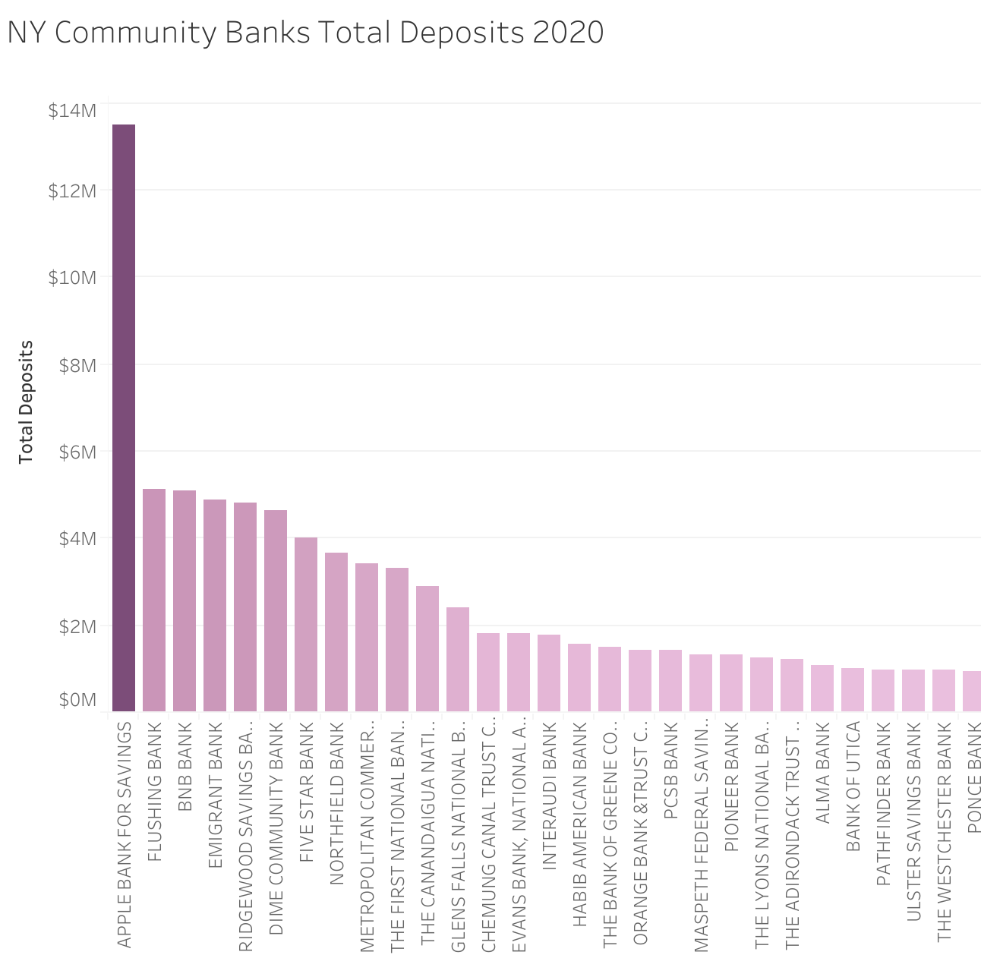
NY Community Banks as of Q2 2020
Apple Bank for Savings is the #1 community bank who makes the most total deposits.
This is due to the fact they are one of the the oldest community bank in New York with 80 branches across the state.

Slide 6
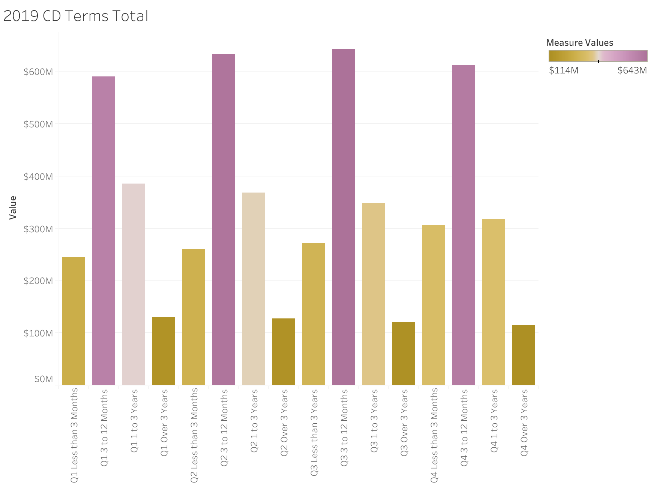
Historical CD Terms

Slide 7
2020 Predicted Vs. Actual CD Rates
Placeholder for time series model

Slide 8
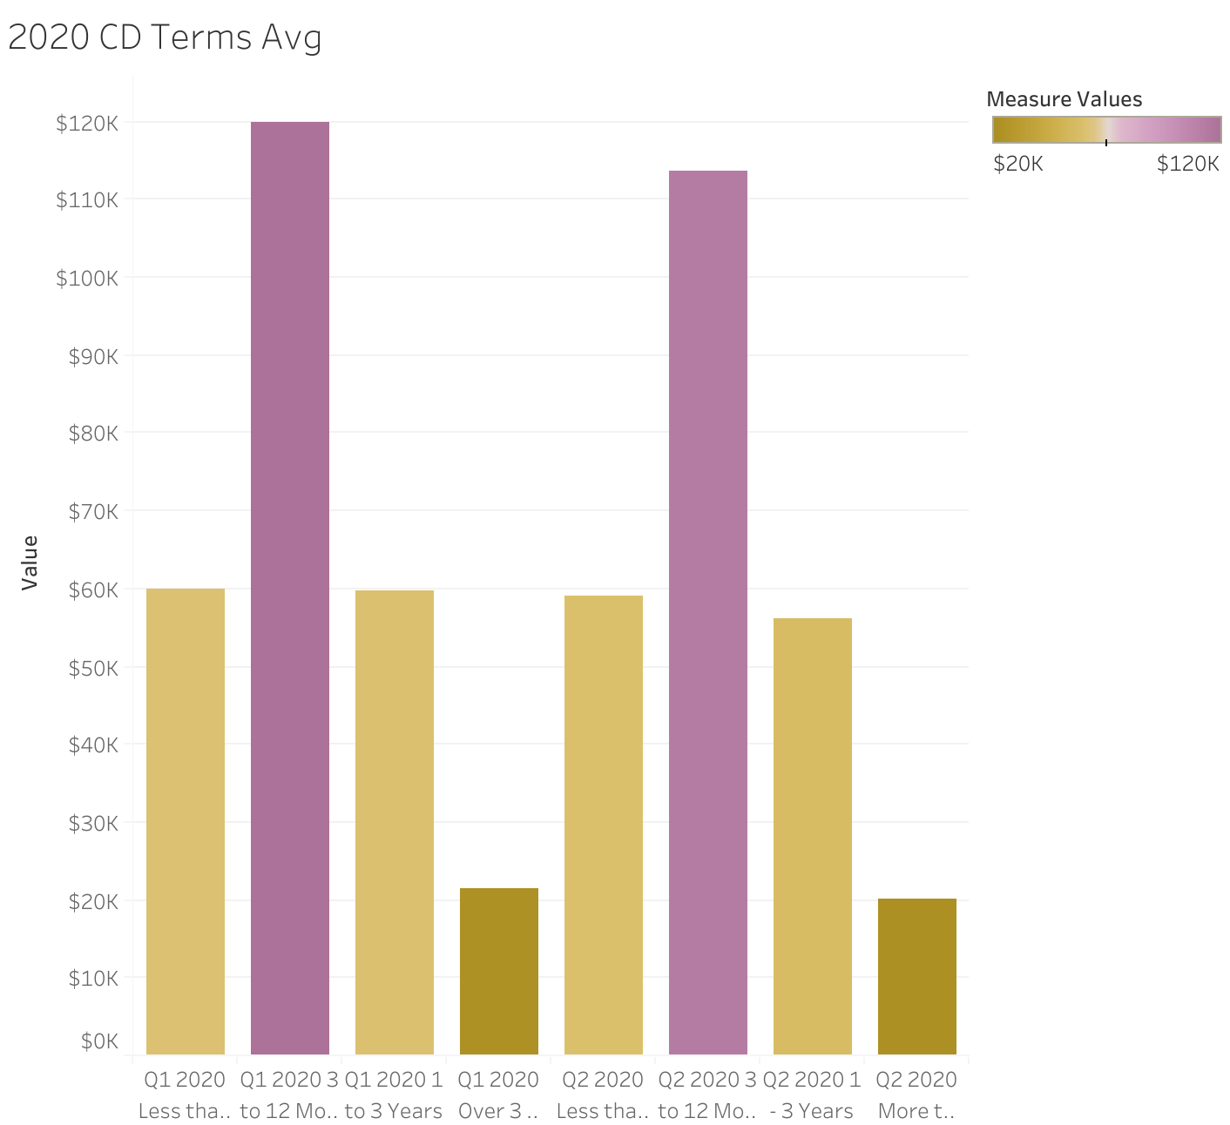
2020 CD Terms Average
Average amount is steady for Q1 and Q2 2020.

Slide 9

Next Steps
Check account opening requirements by following legal guidelines.
Research individual competitor banks' rates and terms.
Work with the marketing and product team for prior ads on CD terms.
Meet with compliance team to review disclosures.

Slide 10
Contact Info
Email: stephanie.a.chew@gmail.com
Github: github.com/StephanieChew-nyc
Linkedin: linkedin.com/in/chewstephanie/

