Slide 1
Design Thinking Project
Aida Motamer
HCI TA
Oct 2th 2019

Slide 2
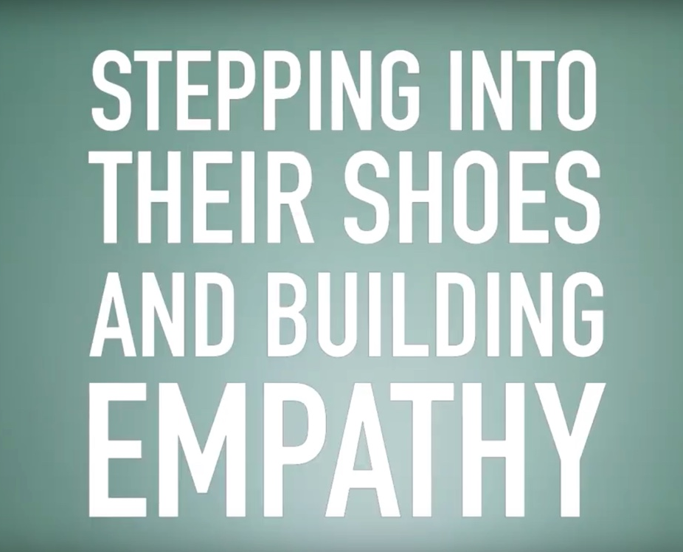
Design Thinking is not about what do you think your users want
Design thinking is all about putting the users first
Notes:
design thinking is both an ideology and a process it's all about solving complex problems in a user centric way ensuring great experiences and outcomes for the user. Design Thinking was created as a way of taking the processes and approaches the designers use and applying them to problems that designers don't typically approach . for example organizational design business or marketing issues within a company problems that don’t typically fall under the design umbrella

Slide 3


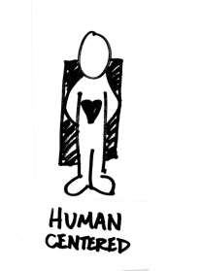
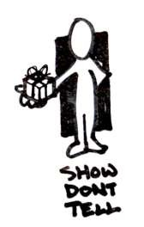

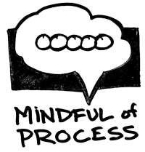

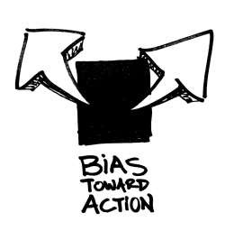


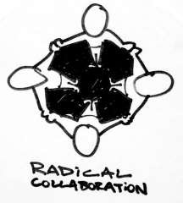
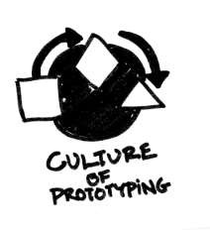
What is Design Thinking?
Notes:
It is a user-centred approach to problem solving with these ingredients:
Human centred
Mindful of process
Show don’t tell
Bias towards action
Radical collaboration
Culture of prototyping

Slide 4
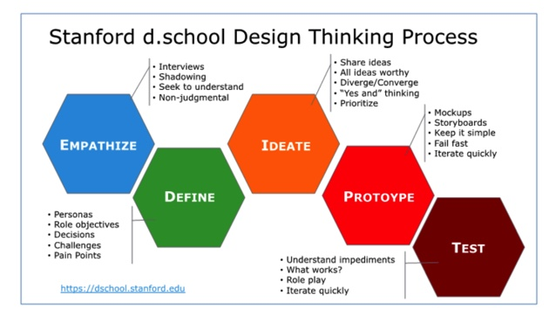

Slide 5
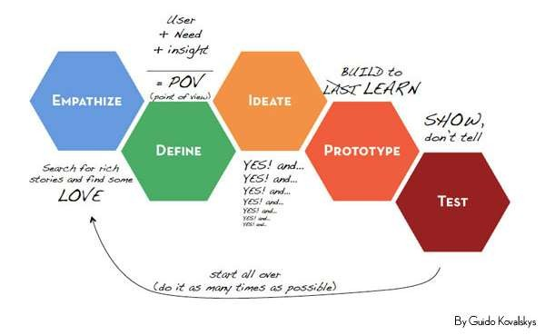
Design Thinking is not a linear process
It's flexible and fluid moving back and forth and around and in on itself
Notes:
The classic flow of Design Thinking is to:
Empathise (search for rich stories and find some love)
Define (user need and insights – their POV)
Ideate (ideas, ideas, ideas)
Prototype (build to learn)
Test (show, don’t tell)
Start all over and iterate the flow as much as possible

Slide 6
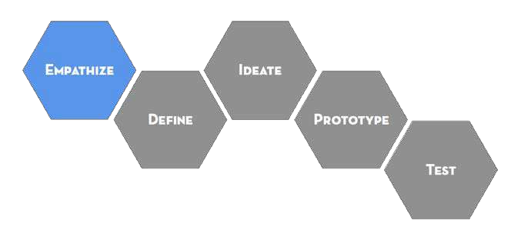
Empathy is the foundation of a human-centered
design process:
Observe
Engage
Immerse
Uncover needs that people have which they
may or may not be aware of
Guide innovation efforts
Identify the right users to design for
Discover the emotions that guide behaviors

Slide 7
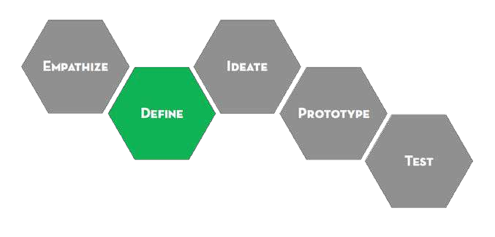
The define mode is when you unpack and synthesize your empathy findings into compelling needs and insights, and scope a specific and meaningful challenge.
It’s critical to the design process because it explicitly expresses the problem you are striving to address through your efforts.
Often, in order to be truly generative, you must first reframe the challenge based on new insights you have gained through your design work.

Slide 8
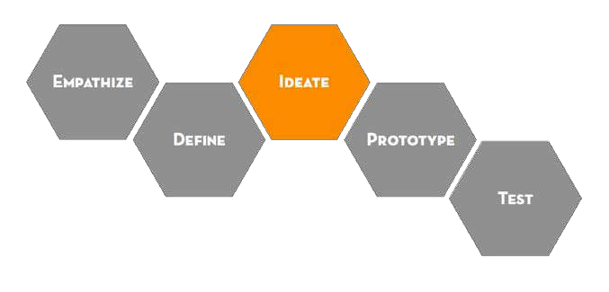
Ideate is the mode of your design process in which you aim to generate radical design alternatives. Mentally it represents a process of “going wide” in terms of concepts and outcomes
- it is a mode of “flaring” rather than “focus”.
Step beyond obvious solutions
Harness the collective perspectives
Uncover unexpected areas of exploration
Create fluency (volume) and flexibility (variety) in your innovation options
Get the obvious solutions out of your heads

Slide 9
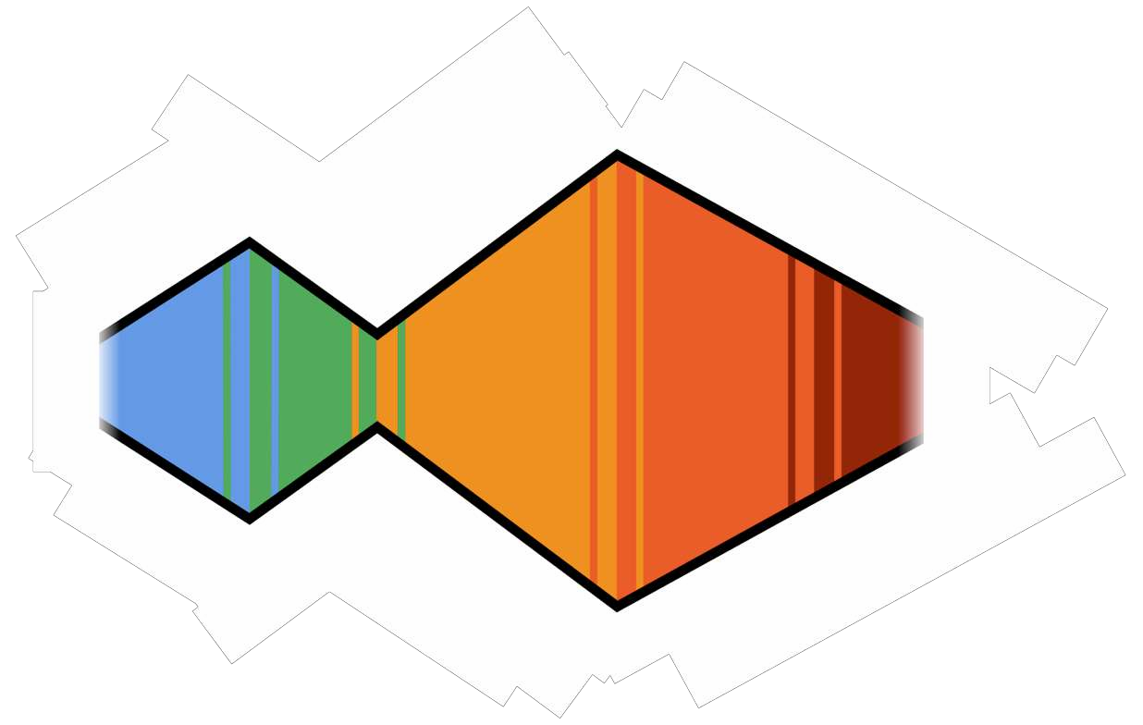
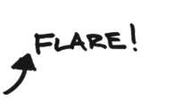
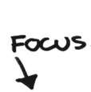

Slide 10
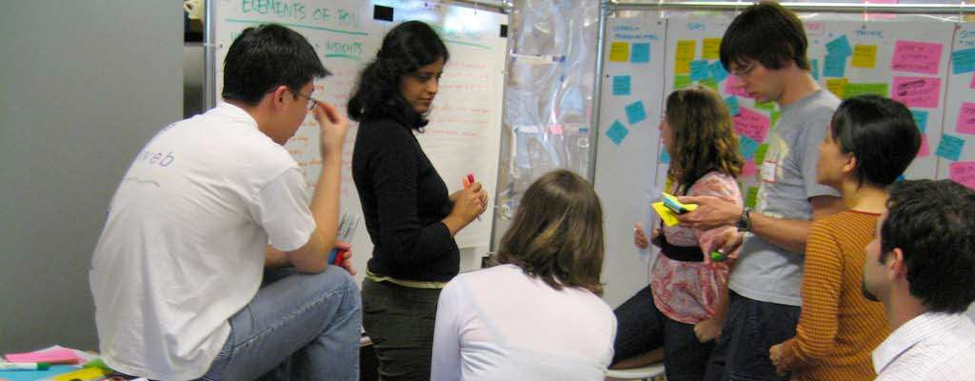

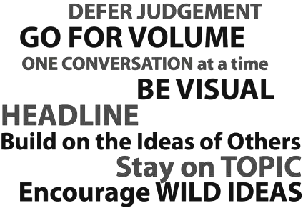

Slide 11
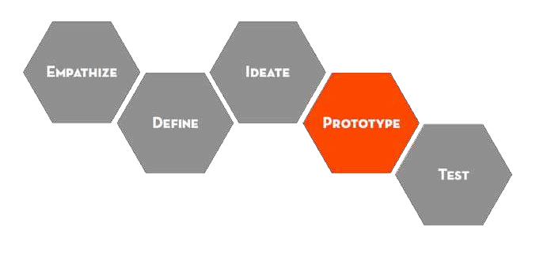
Prototyping is getting ideas and explorations out of your head and into the physical world.
A prototype can be anything that takes a physical form - be it a wall of post-it notes, a role-playing activity, a space, an object, an interface, or even a storyboard.
Learn.
Solve disagreements.
Start a conversation.
Fail quickly and cheaply.
Manage the solution-building process.

Slide 12
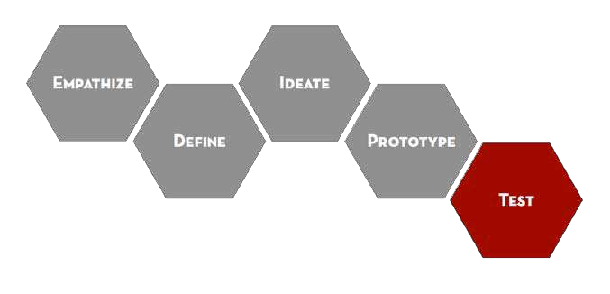
Testing is the chance to get feedback on your solutions, refine solutions to make them better, and continue to learn about your users.
Prototype as if you know you’re right, but test as if you know you’re wrong.
To refine your prototypes and solutions.
To learn more about your user.
To test and refine your POV.

Slide 13


















Notes:
Back to the beginning – Start again. Iterate as much as time allows.

Slide 14
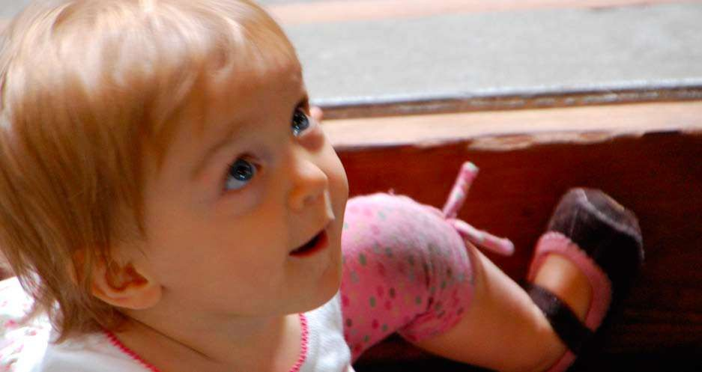
Assume a Beginner’s Mindset
Don’t judge. (observe, engage, don’t influence) Question everything.
Be truly curious. wonder, curiosity
Find patterns. Listen. Really.
Notes:
Ideas and techniques to help the flow
Now we’ve got you thinking design process, here are some ideas and techniques you can use in the flow to make it more effective:
Don’t judge, just observe, engage, and don’t influence. Question everything. Be truly curious. Find patterns. Listen. Really listen.

Slide 15
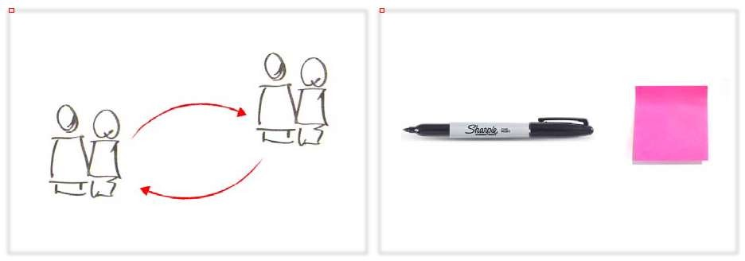
Story Share-and-Capture
Use post-it notes and a white board. Storytelling is key to getting everyone up to speed. Listen and probe for more information. Look for the nuance and the meaning. Start synthesising. Capture every single, interesting detail.
Notes:
Use post-it notes and a white board. Storytelling is key to getting everyone up to speed. Listen and probe for more information. Look for the nuance and the meaning. Start synthesising. Capture every single, interesting detail.

Slide 16
What? | How? | Why?
Set-up: Divide a sheet into three sections: What?, How?, and Why?
Start with concrete observations (What):
What is the person you’re observing doing
Notice and write down
Try to be objective and don’t make assumptions in this first part.
Move to understanding (How):
How are they doing what they are doing?
Does it require effort?
Do they appear rushed? Use descriptive phrases packed with adjectives.
Step out on a limb of interpretation (Why):
Why are they doing what they’re doing?
What are the motivations and emotions.
Understand the meaning and assumptions of the situation.

Slide 17
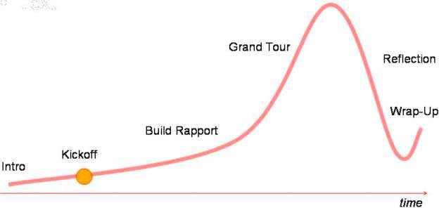
Interview for Empathy
Ask why. Encourage stories.
Look for inconsistencies.
Pay attention to nonverbal cues. Don’t be afraid of silence.
Don’t suggest answers to your questions. Ask questions neutrally.
Don’t ask binary questions.
Make sure you’re prepared to capture.

Slide 18
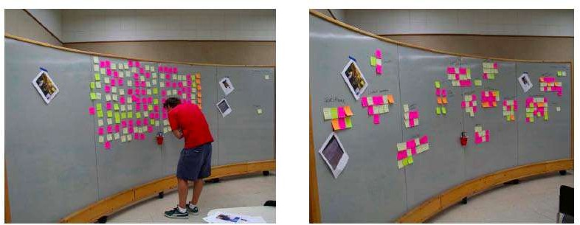
Saturate and Group

Slide 19
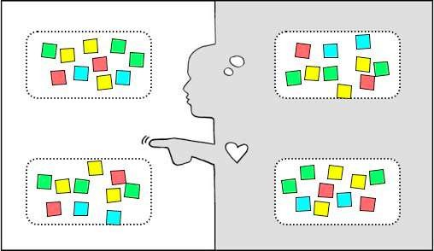
Empathy Map
SAY: What are some quotes and defining words your user said? DO: What actions and behaviors did you notice?
THINK: What might your user be thinking? What does this tell you about his or her beliefs?
FEEL: What emotions might your subject be feeling?

Slide 20
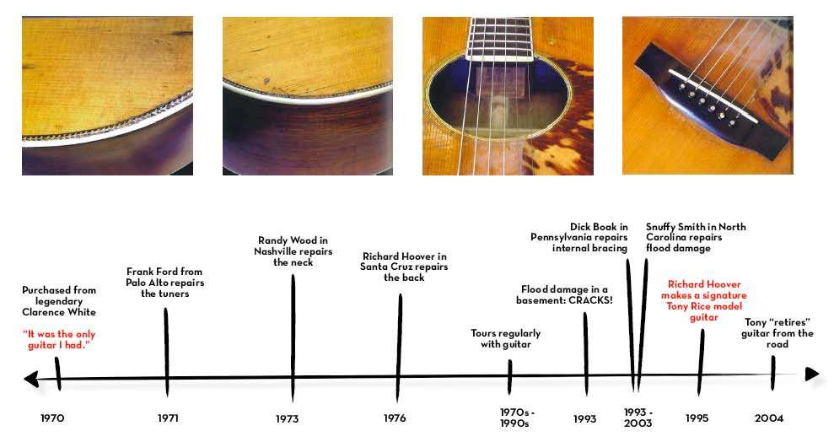
Journey Map

Slide 21
THE MODIFIED WEED PULLER
Aida MOTAMER
NAVJOT SINGH
TO
DR. ROBERT FLEISIG

Slide 22
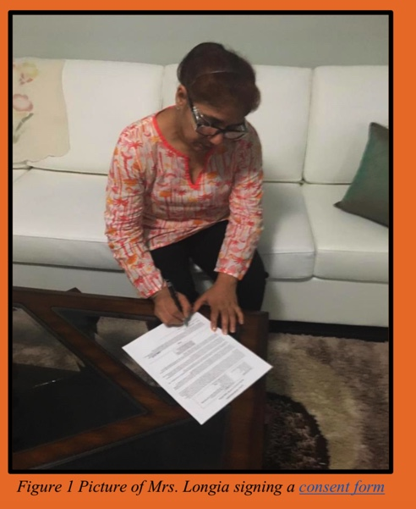
The Client
The daily chores in cooking and gardening have become a challenge because of her short height.
Notes:
Mrs. Paramjit Longia is a 55 years old lady who lives in Brantford with her family. She has two daughters and her husband is a truck driver. She works as a supervisor in a warehouse nearby her house. She was recommended to us by one of our friends as we were looking for a person facing challenges to execute routine chores due to physical limitations. She is a petite lady with 4’9” height. Due to her short height, she is facing a number of problems which a normal person would never think of as a problem. She likes to cook for her family and she spends most of her time in her backyard garden. The daily chores in cooking and gardening have become a challenge because of her short height. Our main focus was to identify some of those main challenges and find solutions accordingly.

Slide 23
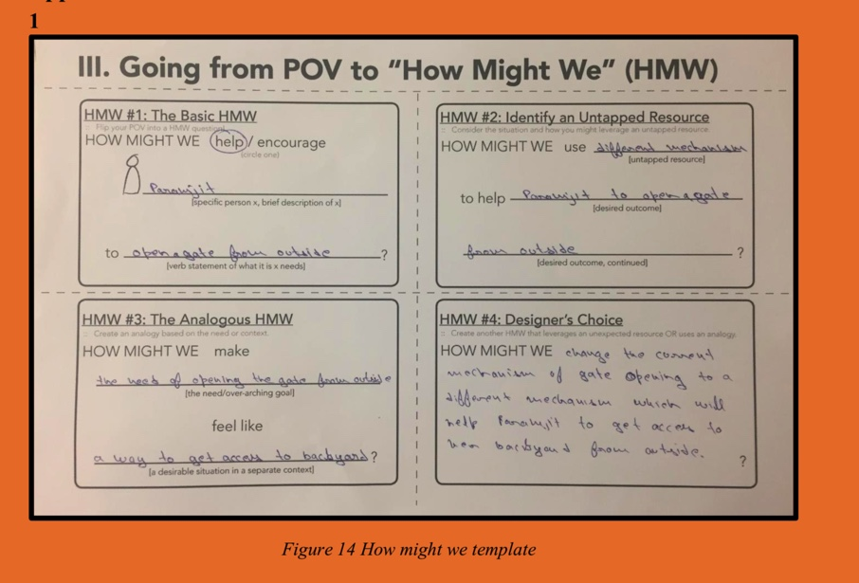
Empathy phase: First Interview
The first positive point for us was to perceive that the solution would be related to gardening and cooking.
Notes:
The first positive point for us was to perceive that the solution would be related to gardening and cooking.
he told us a number of incidents when she almost tripped trying to place or pick stuff from the top shelves. She tried to indicate several problems where she thought an engineer would be helpful. After talking for some time, we visited her backyard garden. She had a lot of plants and vegetables in her garden. The first problem that we saw was with her backyard door. Since she was short and because of this, she couldn’t reach the top of the door to facilitate the locking mechanism. She told us that it happened to her several times that she got locked out because she couldn’t operate the lock from the outside. It was a potential point for us to work on. The potential problem of the backyard door was declined.
This could’ve been constrained our design approaches. The next step was to find the meaning of her liking. We realized that only keeping herself busy wasn’t a valid reason to do something with that much of dedication. So, we set our new goal to know the real reason of her interest towards gardening and cooking.

Slide 24
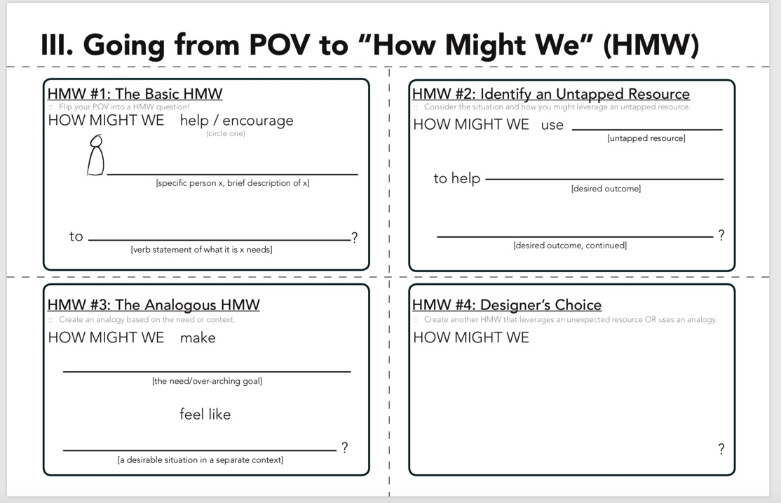
Different mechanism
Open a gate from outside
Client to open a gate from out side
The need of opening the gate from out side
Change the common mechanism of gate opening to
a different mechanism that make easy to get
access to the backyard
A normal person usually does
Notes:
Tapped recource: A resource that is rich in valuable/enjoyable infomation but is also not acknowledged or noticed as much as it should.

Slide 25
Empathy Phase: Second Interview
Another Potential problem : working with Weed Puller
She showed us different vegetables she had in her backyard. When she was showing us around, she had an eye on a weed and she tried to pull that weed with the help of a weed puller. The ground was dry and hard. So, this made it hard for her to penetrate it. She wet the ground and then easily penetrated it. We didn’t see much challenge ourselves to operate the weed puller on the dry ground. This was her physical structure which made it hard for her to use the weed puller.
Notes:
She showed us different vegetables she had in her backyard. When she was showing us around, she had an eye on a weed and she tried to pull that weed with the help of a weed puller. The ground was dry and hard. So, this made it hard for her to penetrate it. She wet the ground and then easily penetrated it. We didn’t see much challenge ourselves to operate the weed puller on the dry ground. This was her physical structure which made it hard for her to use the weed puller.

Slide 26
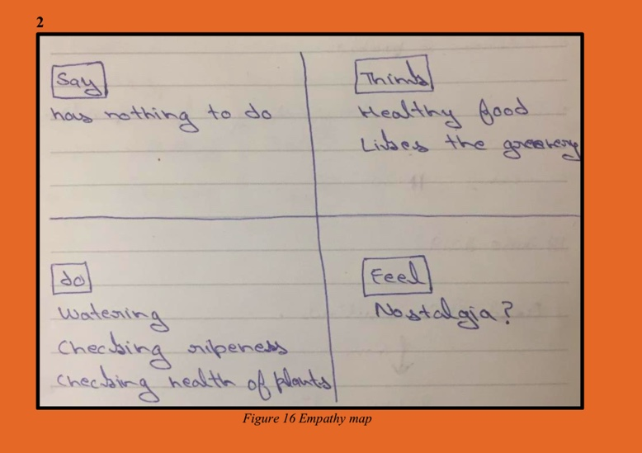
Empathy Map: Second Interview
What does she say, do, think and feel?
Notes:
What does she say, do, think and feel? This time we decided to focus mainly on gardening because all the problems we saw in her kitchen could be solved by ordering a product from Amazon or buying it from a local market. [3]* Working on the gardening helped us to converge our ways but there was a problem. We didn’t decide what she felt about the gardening and we assumed that it could be nostalgia. But we needed to make sure that our assumptions were right.

Slide 27
Empathy map: Third interview
It was clear from the last interview that those plants were a part of her life.
Our main focus was now shifted towards gardening only. We spent significant time on various ways which would help her to
ENJOY
gardening even more.
Notes:
She shared something very emotional with us this time. She told us that she had a younger brother who died one year ago due to cancer. Her brother had a number of indoor plants and he loved doing gardening. When he was having his treatment, she took care of his indoor plants because he kept insisting that these plants were very important to him. He had his treatment for two years and during this treatment she was taking care of these plants. After fighting for two years, he passed away and she moved all those plants to her house. She feels her brother is alive when she sees those plants. We had a sense that these plants were very important to her.

Slide 28
her doughter
her to feel better when doing gardening
To enjoy gardening more
The working with weed puller
Make a mechanism to remove weeds which is feasible for a short person to use
Every normal person does
Notes:
Tapped recource: A resource that is rich in valuable/enjoyable infomation but is also not acknowledged or noticed as much as it should.

Slide 29
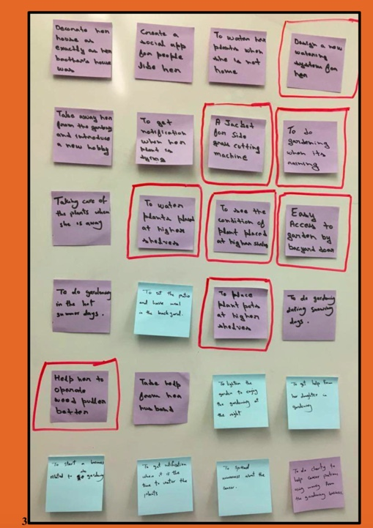
Define: Ideas on sticky notes
Notes:
we came up with 24 ideas to make gardening more enjoyable for her. But at this time when we tried to contact her, we came to know that she was away. She was visiting her home back in India. Due to this situation we got stuck in the moment. Then we decided to continue with the information that we already gathered. Our professor, Dr. Fleisig acted as our stakeholder as well as our guide at that moment. Based on our 24 ideas, we needed to select one or two ideas from them. We categorized our ideas in to two categories.
Need of a device
No need of a device
The reason of categorizing the ideas in to these categories was to make it easy for us to decide on which category we would want to work. [5]* We chose to work on the first category since we needed to create a prototype of the solution. It would be easy to create a prototype of the solution where a physical device is required. The other category would need a project management plan. So, it was more beneficial to choose one where we would practise design thinking approach better. We marked borders of the eight ideas with a red colour where a device was required as shown in Appendix A. Among these ideas, [6]* the weed puller idea was selected. Because a weed puller is kind of a device which is used by almost everyone having a backyard and our client had a problem to use it properly and she wasn’t aware that this was something that could be solved.

Slide 30
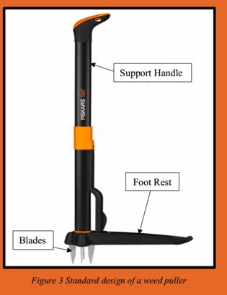
Ideation
The problem that we observed with our client was mainly with the balancing.
A weed puller is a device which is used to pull weed out of the ground manually. Figure 3 shows the standard design of a weed puller. It has a foot rest area where a person will place his foot and press in the downward direction. The blades will help to penetrate the ground and grab the weed and then pull it out. The problem that we observed with our client was mainly with the balancing. She doesn’t have proper balance and that is why she can’t put much force on the foot rest area. Also, the handle is straight and hard to guide.

Slide 31
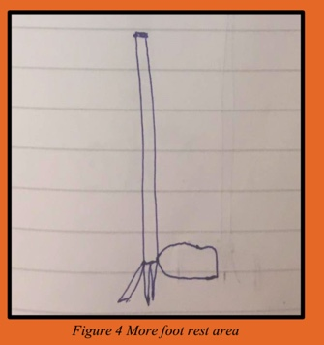
Idea1
The first sketch that we made took in to an account the main problem of less area on the foot rest. The idea was to increase the surface area of the foot rest so it would be easy for our client to stand on it. The inherited foot rest area is very less can trip a person if he has balancing issues.

Slide 32
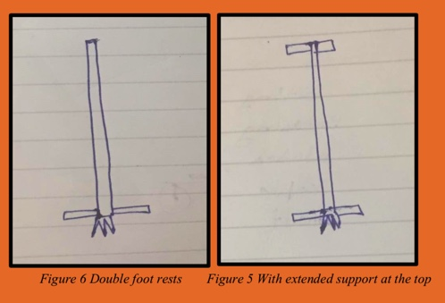
Idea 2
In these sketches, the foot area was extended. The two sides were used to make proper balance. These two sides can be used to stand on them and put pressure to penetrate the ground. The next improvement was done by adding hand actuator at the top of the handle to make the gripping easier.

Slide 33
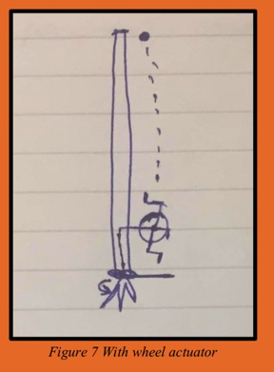
Idea3
In this sketch, a rotating wheel is installed on the side of the weed puller. This wheel will be used to make a hole in the ground. This motion will make it easier to penetrate the ground and this wheel is flexible to move across the handle and in this manner the position can be modified according to the height of an operator.

Slide 34
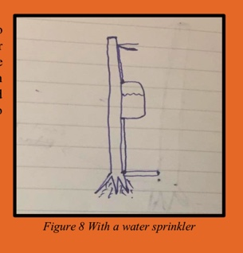
Idea4
When our client used water to damp the ground to make it softer, it gave us an idea to mount a water sprinkling system on it. The sketch shows the position of a water tank and an actuator. An operator can sprinkle some water on the ground first and then use the standard weed puller to penetrate the ground

Slide 35
FeedBack :We were asked that why did we use blades only?
Sharpness not Blades
The appeal of this question was strong and we realized that we were unintentionally setting a paradigm that only blades can penetrate the ground. So, after that, we again started from the very beginning and found out that we needed something sharp to penetrate the ground. The real property that we needed was sharpness and not the blades particularly.
Notes:
The next step was to seek the different ways to remove weed from the ground. [7]* This decision diverged the whole process and now we were working not only on the weed puller but on the different ways to remove the weed. We brainstormed on the possible solutions with some basic concepts as shown in Appendix A. We categorized it in to four types based on the process behaviour.

Slide 36

Ideas based on Feedback and divergence of solution
Penetrate the ground and take the weed out – The idea is to penetrate the ground first and then take the weed out.
2.Cut the weed from the top – In this category, the weed wouldn’t be taken out of the ground but it would be cut from the top.
3. Destroy the weed by chemical products – A chemical will be used to destroy the weed. This process will take some time and may damage the soil and environment.
Cut the source of sunlight.
Covering by sheets
Covering by snow
By plastic bags
Use cemented floorings

Slide 37
Second Feedback
we decided to work again on the basic design of the weed puller. This time, we were trying to modify the existing design according to the need of our client.
After showing these sketches to our stakeholder, we got feedback that some of these ideas were too crazy to work with. For example, the use of a flamethrower can be used to destroy the weed. But it won’t be a prudent decision to ask a 55 years old lady to use it. Some of those ideas were too impractical and hard to make.

Slide 38
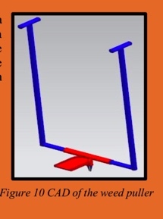
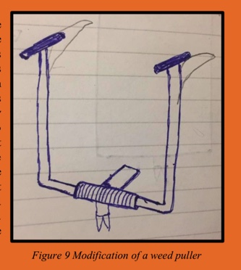
Prototyping of Solution

Slide 39
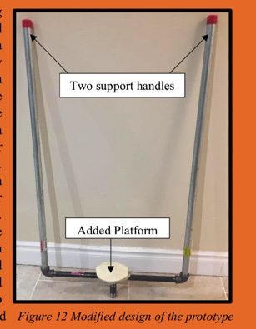
Initial Prototype

Slide 40
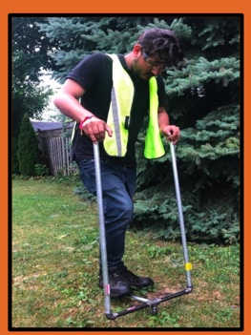
Prototype Testing

Slide 41
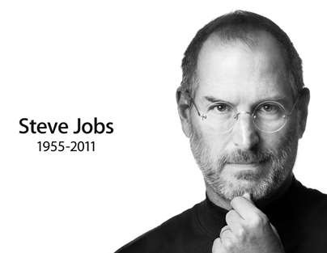
“Most people make the mistake of thinking design is what it looks like. People think it’s this veneer - that the designers are handed this box and
told, ‘Make it look good!’ That’s not what we think design is. It’s not just what it looks like and feels like.
Design is how it works.”
innovation | digital transformation | value creation | (r)evolution

