Slide 1
Characteristics of the most dominant dinosaurs
Stephanie LaRue
Aug. 12, 2021

Slide 2
Data Source: Compiled data from the archives of the Natural History Museum of the UK, provided by kaggle
Dataset contains information such as their type, diet, length, regions they lived, species, time period they lived, and names.

Slide 3
Problem we’re trying to solve:
What were some of the characteristics of the most dominant type of dinosaur(s)?

Slide 4
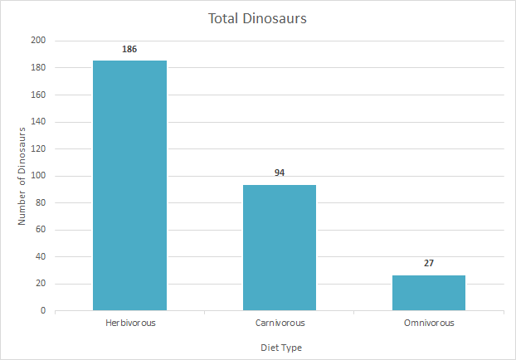
Characteristic #1: Diet
Herbivores consisted of more than half of the total dinosaurs

Slide 5
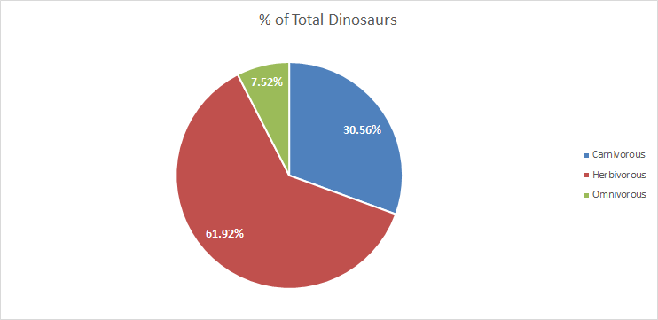
Characteristic: Diet
% of dinosaurs with specific diets

Slide 6
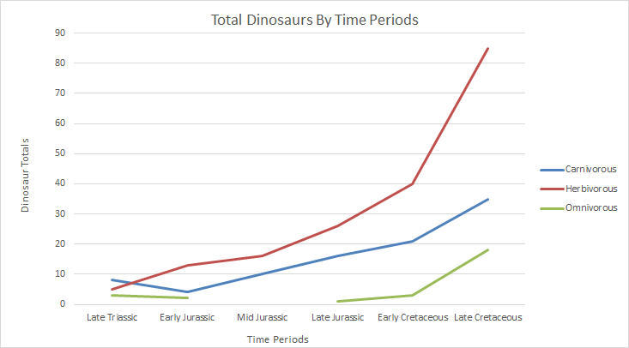
Total Dinosaurs and their specific diets within a given period in time
Carnivorous dinosaurs had a gradual increase in numbers
Omnivorous dinosaurs had sporadic numbers
Herbivorous dinosaurs had a gradual increase in numbers before a sudden increase around the early cretaceous period

Slide 7
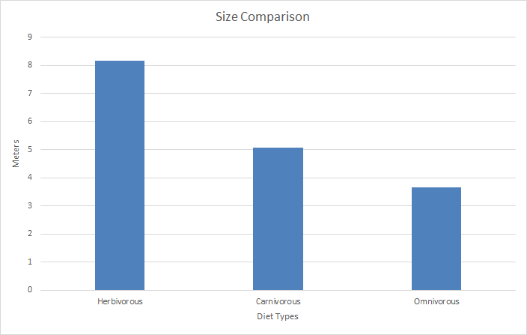
Characteristic #2: Size
Carnivores and omnivores were closer in size
Herbivores were over twice the size of omnivores

Slide 8
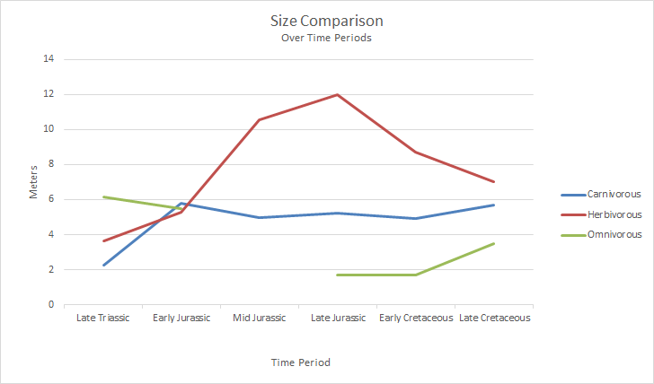
Size comparisons based on the time period and diet types of dinosaurs
Omnivores appears to show an average increase in size
Herbivores show a downward trend in their average size
Carnivores remained mostly constant in their sizes

Slide 9
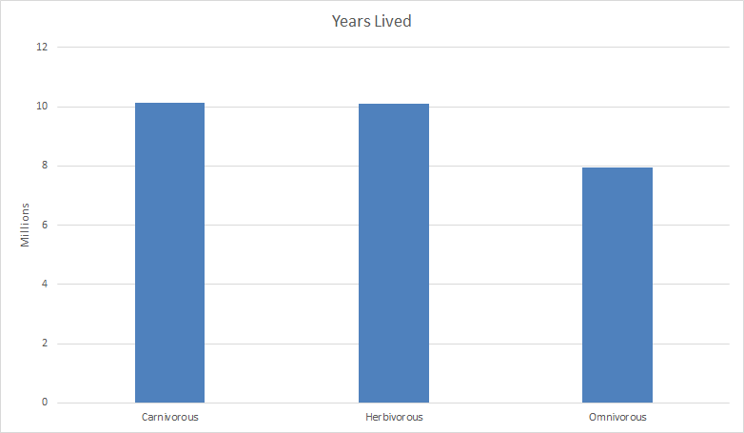
Average years each type of dinosaur existed based on its diet

Slide 10
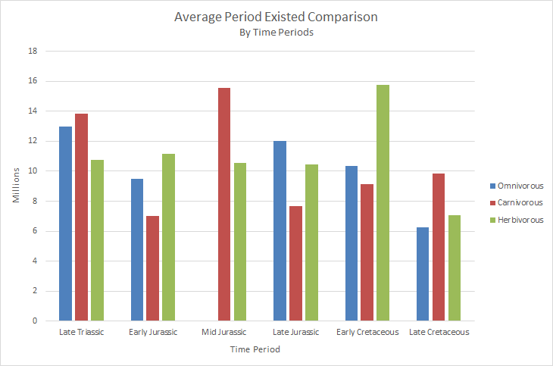
Sizes varied over each period, however herbivores existed for longer periods on average

Slide 11
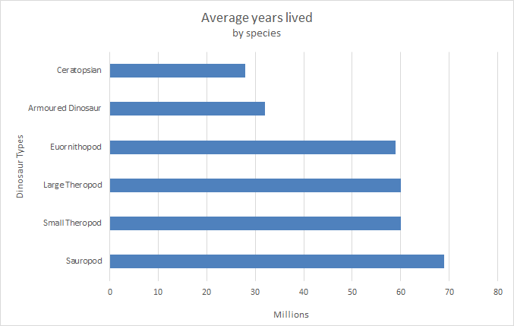
Characteristic #3: Type
Sauropods averaged a longer existence
Followed by theropods and ornithopods

Slide 12
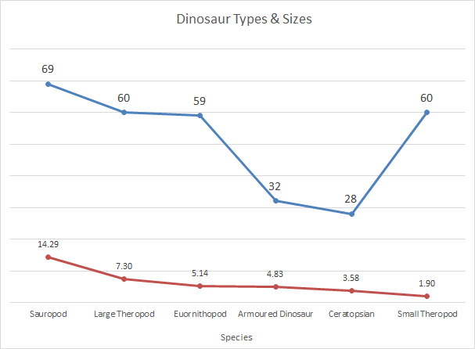
# of types
Size (meters)

Slide 13
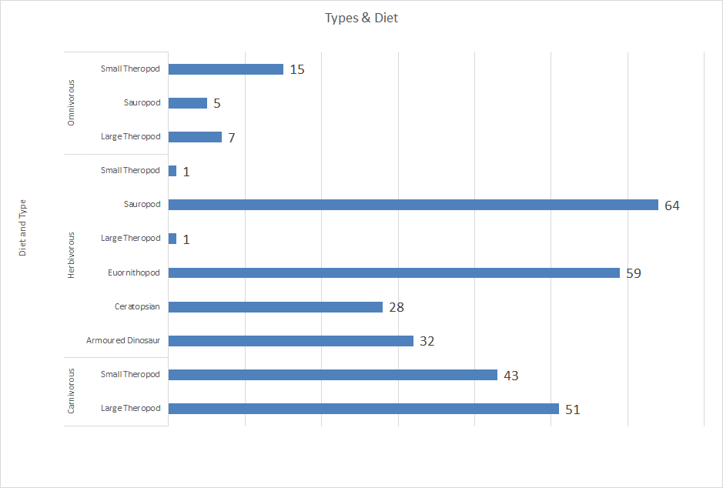
Herbivorous sauropods make up the largest share of dinosaurs

Slide 14
Findings
Larger dinosaurs with an herbivorous diet tended to exist for longer periods of time
There were larger numbers of the different types of herbivorous dinosaurs
Carnivorous dinosaurs, though lacking in size and species types, averaged an existence close to that of the much larger herbivores

Slide 15
Issues or concerns
Information on the breeding habits and details of types of habitats and environments the different dinosaurs lived would have provided a clearer picture of how the dinosaurs coexisted.
Without regional environment data it’s difficult to say if certain regions had an impact on the dinosaur’s survival

Slide 16
Conclusion
Herbivorous sauropods dominated the time of the dinosaurs.
Their large size and larger population/species numbers probably contributed to their overall survival and dominance.
“Sauropods had very long necks, long tails, small heads, and four thick, pillar-like legs. They are notable for the enormous sizes attained by some species, and the group includes the largest animals to have ever lived on land.”

